Slide 1
Gas Leakage Detection System using IoT
UVCE
Smart Safety Solution for Industries and Homes
Team : Phoenix
Members : Pooja M Patil
Gagana T
Vardan

Slide 2
Gas Leakage: A Potential Threat
Gas leakage can lead to fires, explosions, and health hazards.
Traditional detection methods may not provide real-time alerts.
Need for a smart and reliable solution.

Slide 3
Gas Leakage Detection System using IoT
Uses sensors to detect gas leakage.
Leverages IoT technology for real-time alerts and monitoring.
Provides fast and reliable notifications to users.

Slide 4
System Components
ESP8266 NodeMCU (IoT-enabled microcontroller).
MQ-2 or MQ-5 Gas Sensor (for detecting gases).
Buzzer (for audio alert).
LED (for visual alert).
Power Supply (Battery or USB).
Wi-Fi Network (for IoT connectivity).

Slide 5
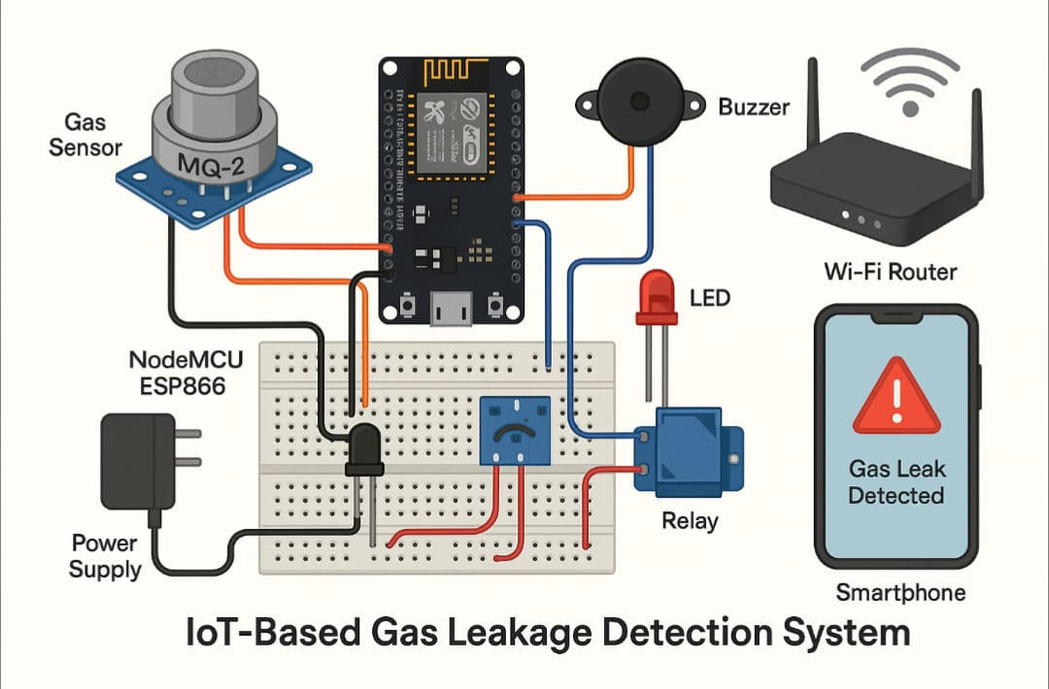
Circuit Diagram

Slide 6
How it Works
Gas sensor constantly monitors the environment.
When gas leakage is detected, the sensor outputs a signal to the ESP8266 controller.
ESP8266 sends alerts to users via buzzer, LED, and IoT platform.

Slide 7
Applications
Home kitchens and gas stoves.
Industrial gas storage and supply units.
Hotels, restaurants, and laboratories.
Public transport and vehicle garages.

Slide 8
Benefits
Real-time alerts and monitoring.
Fast and reliable notifications.
Easy scalability.
Enhanced safety and preventive monitoring.

Slide 9
Conclusion
The Gas Leakage Detection System using IoT provides a smart and reliable solution for detecting gas leakage and alerting users in real-time.
With its easy scalability and real-time alerts, it is a valuable tool for industries and homes.

Slide 10
Future Scope
Integration with other smart devices.
Advanced analytics and machine learning.
Expansion to other industries and applications.

