Slide 1
INHERITANCE
By: Ashish Verma

Slide 2

Contents
What is Inheritance?
Concept of Derived and Base class
Types of Inheritance

Slide 3
What is Inheritance?
It is the capability of one class to inherit properties from another class.
The technique of building new classes from the existing classes is called inheritance.

Slide 4
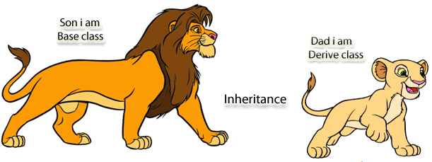
Base and Derived Class
Derived class is the class that inherit properties
from base class(es).
It is also called Sub Class.
It inherits all the properties of the base class and can add additional features to the derived class.
Base class is the class
whose properties are inherited by
another class.
It is also called
Super Class.

Slide 5
Types of Inheritance
1. SINGLE INHERITANCE
2. MULTIPLE INHERITANCE
3. HIERARCHICAL INHERITANCE
4. MULTILEVEL INHERITANCE
5. HYBRID INHERITANCE

Slide 6
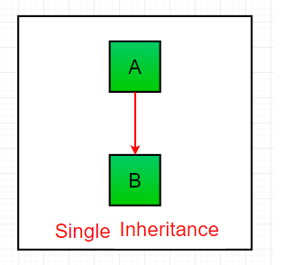
1. SINGLE INHERITANCE
In Single Inheritance, subclasses inherit the features of one superclass.
In image below, the class A serves as a base class for the derived class B.

Slide 7
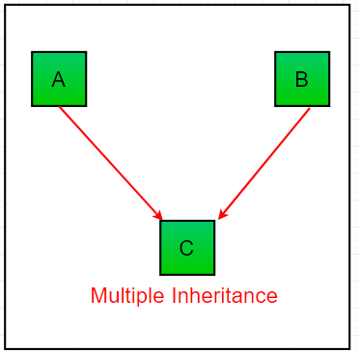
2. MULTIPLE INHERITANCE
In Multiple inheritance ,one class can have more than one superclass and inherit features from all parent classes.
Please note that Java does not support multiple inheritance with classes.
In java, we can achieve multiple inheritance only through Interfaces. In image below, Class C is derived from interface A and B.

Slide 8
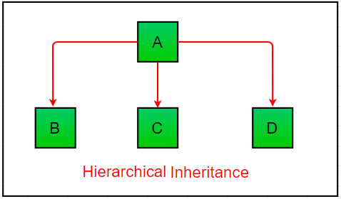
3. HIERARCHICAL INHERITANCE
In Hierarchical Inheritance, one class serves as a superclass (base class) for more than one sub class.
In below image, the class A serves as a base class for the derived class B,C and D.

Slide 9
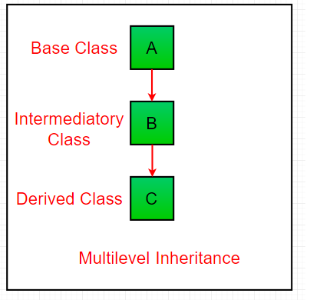
4. MULTILEVEL INHERITANCE
In Multilevel Inheritance, a derived class will be inheriting a base class and as well as the derived class also act as the base class to other class.
In below image, the class A serves as a base class for the derived class B, which in turn serves as a base class for the derived class C.
In Java, a class cannot directly access the grandparent’s members.

Slide 10
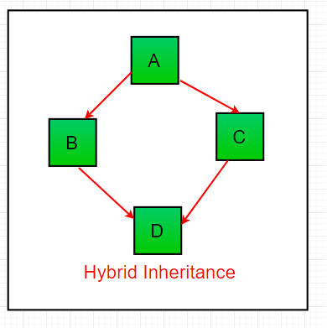
5. HYBRID INHERITANCE
It is a mix of two or more of the above types of inheritance. Since java doesn’t support multiple inheritance with classes, the hybrid inheritance is also not possible with classes.
In java, we can achieve hybrid inheritance only through Interfaces.

Slide 11

Lets Recall..
Inheritance is the capability of one class to inherit properties from another class.
Types of Inheritance
Single Inheritance
Multiple Inheritance
Multilevel Inheritance
Hierarchal Inheritance
Hybrid Inheritance

