Slide 1
A Simulator of Human Emergency Mobility following Disasters: Knowledge Transfer from Big Disaster Data
Authors : Xuan Songy, Quanshi Zhangy, Yoshihide Sekimotoy,
Ryosuke Shibasakiy,Nicholas Jing Yuanz and Xing Xiez
Presented By : Pooja Shekhar (23)

Slide 2
Objective
Aims to understand what basic laws govern human mobility following disasters.
Develop a simulation model to predict human emergency mobility.
Dataset Used
GPS records of approximately 1.6 million anonymized users throughout Japan from 1 August 2010 to 31 July 2013
Disaster information data(earthquake and tsunami) - occurrence time, earthquake magnitude, damage level (1-7)
Disaster reporting data – Government declarations and mainstream media reports

Slide 3
Model Development and Learning
Activity = < act₁; act₂…….act_{n} >
Set of an individual’s activity after the disaster)
act_{i} = L₁ -> L₂ -> ::: -> L_{m}
Denotes a series of m location transfer with the disaster information
L =<uid; time; label; latitude; longtitude; distance; intensity;
damage; reporting >
Each location l is a tuple where uid is the id of the person, label specifies the important places the person visits, distance depicts e distance from earthquake center etc.
Goal : To learn a general model from Activity.

Slide 4
Hidden Markov Model
Given a set of disaster information Z = <z₁; z₂; …..z_{N}>.
Such that intensity of earthquake, damage level, news reporting, current time, travel distance, travel time
A series of states S = <s₁; s₂; …. s_{M}>.
Models human activities and mobility following disasters as the random transition through a series of states , such as home location,
working location, social relationship.
Paper uses hidden Markov model (HMM) to model dependencies between these states.

Slide 5
Mobility Simulation
Two stages for the simulation process :
based on the training HMM behavior model, randomly generates location transition through its important places.
given the location transition sequences, use the transportation network or pre-trained urban mobility graph to plan the traveling routes.
Note :-
For the small earthquakes, we can directly use the transportation network (e.g. road network data and metro network) of cities to plan people’s traveling routes.
But for the large-scale earthquakes, the public transportation systems are usually unavailable. Hence, we use the pre-trained urban mobility graph to plan the traveling routes.

Slide 6
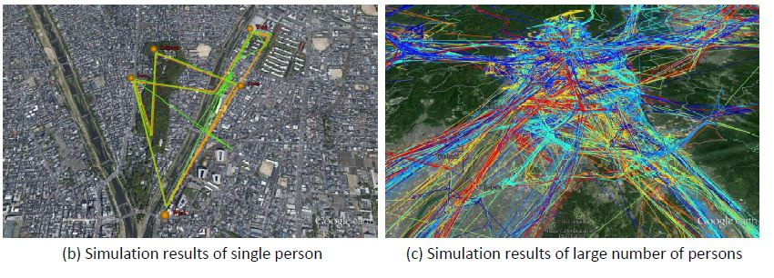
Simulation Results
To simulate human emergency mobility following disasters,
users need firstly to select the important places in the map,
and then input the disaster information (e.g. occurrence time,
earthquake intensity at this region, damage level and etc.)
Simulator can automatically simulate possible movements of this person.

Slide 7
Performance Evaluation
Evaluation metrics
Model’s most likely simulated trajectory (trajectory with the highest probability) with the actual demonstrated trajectory
in the testing set
The second shows what percentage of the testing trajectories match at least 90% (distance) with the model’s simulated one.
The final metric measures the average log probability of mobility in the training set under the given model.

