Slide 1

Capstone Project-Unleashing Insights From Football Data
REPRESENTER-POOJA SINDHU

Slide 2

INTRODUCTION-FOOTBALL DATA ANALYSIS
FOCUS AREAS- -Performance analysis -Player profile and market value -Team comparison -Attendance and stadium analysis -Referee analysis -Substitution patterns -Event analysis -Competition analysis -Player attributes and demographics -Contract management
CONCLUSION AND RECOMMENDATIONS- -Key findings. -Business objective. -Decision making. -Story telling. -Conclusion.
NOTE-For every focus areas ,created two questions with visuals.
TOOLS AND TECHNIQUES – -MS EXCEL: Analyzing data of all five excel files. -MYSQL: Importing all fives files and connecting to python. -PYTHON: Cleaning,treating,and implemented focus areas. -TABLEAU: Performing visuals and dashboards. -MS WORD: Story-telling,key points and objectives. -FIGMA: Templates.

Slide 3
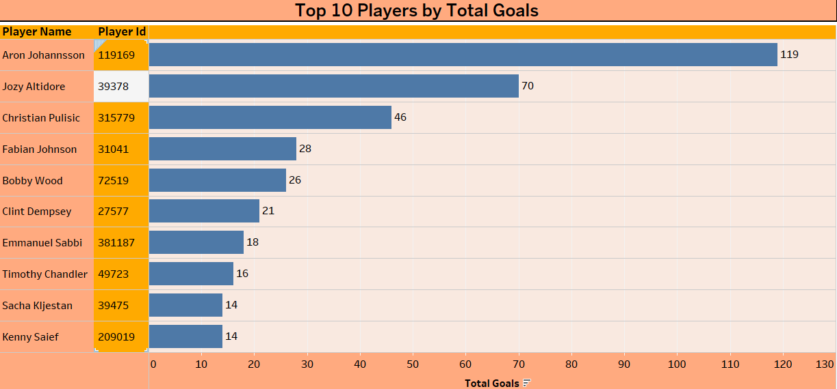
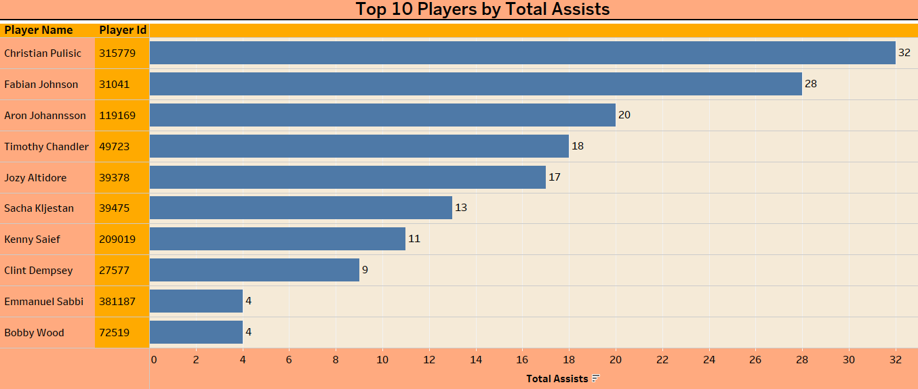
(TABLEAU-FOCUS AREAS) Performance Analysis
For Performance analysis there are two set of questions and these are- TOP 10 PLAYERS BY TOTAL GOALS -Aron Johannsson leads the pack with 119 goals! This table highlights the top 10 goal scorers, showcasing the most lethal finishers across all seasons. TOP 10 PLAYERS BY TOTAL ASSISTS -Christian Pulisic tops the assist chart with 32 assists! This table highlights the league’s top 10 assist providers, showcasing the players who create the most scoring opportunities.

Slide 4
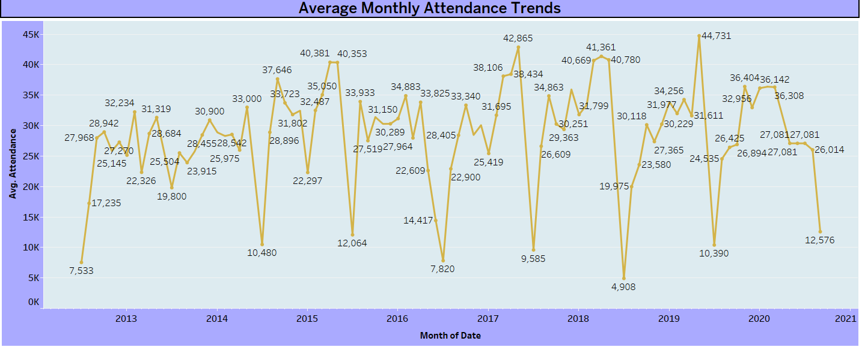
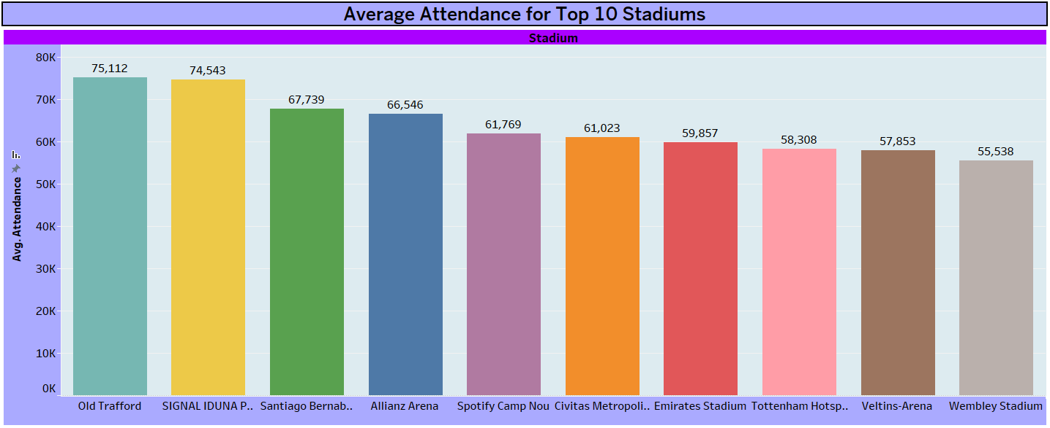
Attendance and stadium analysis
For Attendance and stadium analysis there are two set of questions and these are- AVERAGE MONTHLY ATTENDANCE TRENDS -The highest average attendance was in May 2019 at 44,731, while the lowest was in July 2018 at 4,908. AVERAGE ATTENDANCE FOR TOP 10 STADIUMS -Old Trafford leads with the highest average attendance of 75,112 among top 10 stadiums.

Slide 5
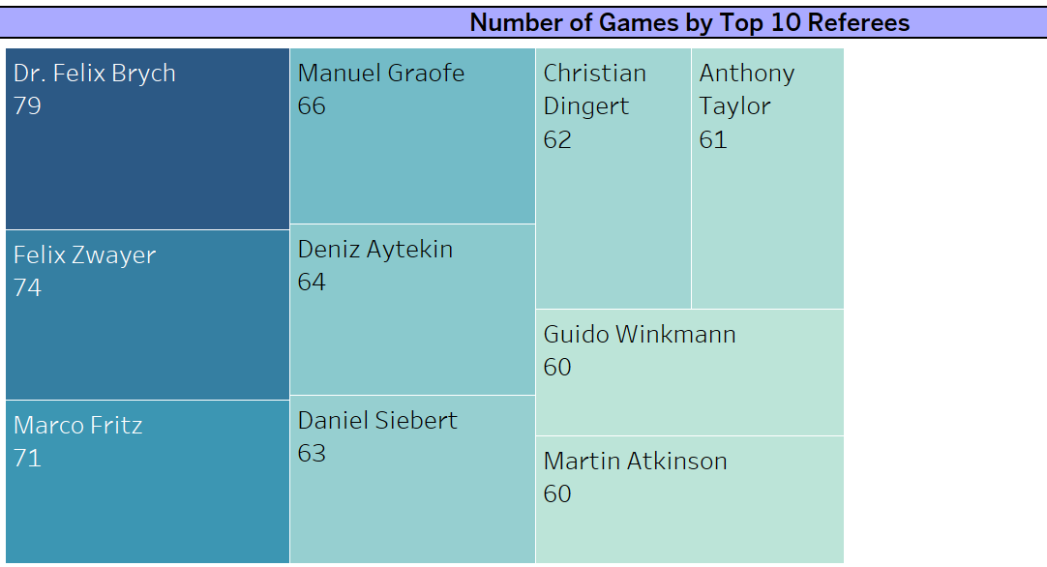
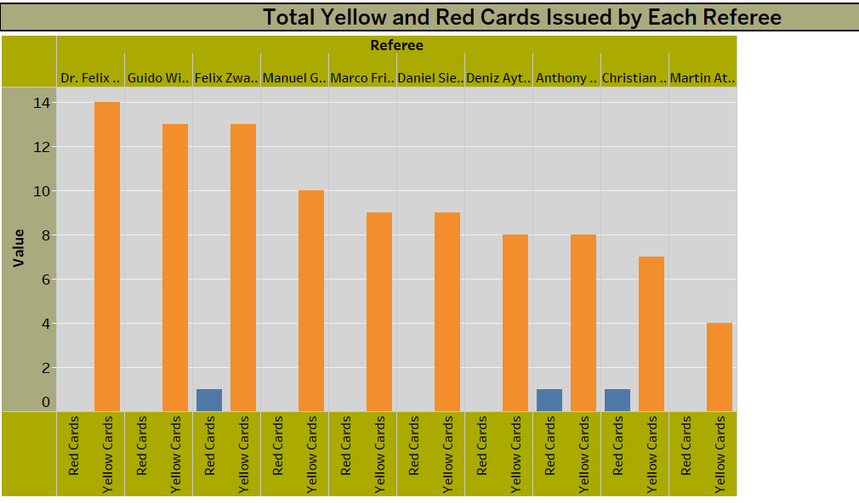
Referee analysis
For Referee analysis there are two set of questions and these are- NUMBER OF GAMES BY TOP 10 REFEREE -From the top 10 referees ,Dr. Felix Brych is the top referee with 79 games, followed by Manuel Graefe with 66 . TOTAL YELLOW AND RED CARDS ISSUED BY EACH REFEREE -Dr. Felix Brych issued the most cards ( 14 yellow cards ) among the top 10 referees listed.
Only 3 have issued red cards from the top 10 referees listed that are Felix Zwayer , Anthony Taylor and Christian Dingert.

Slide 6
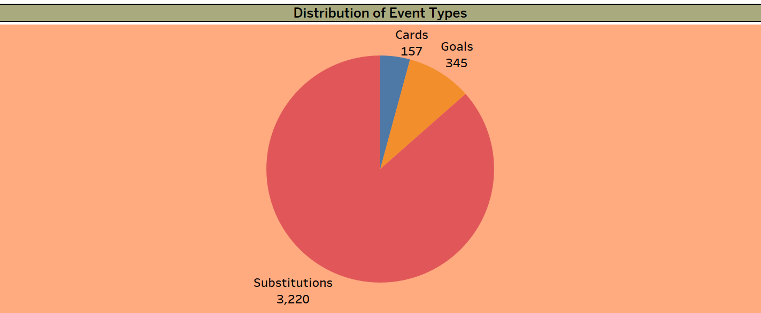
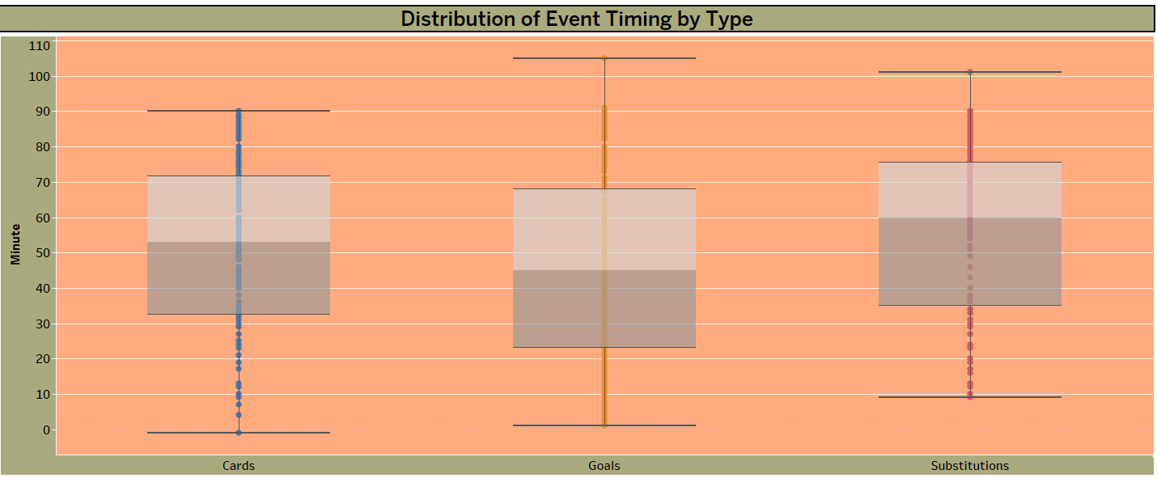
Event analysis
For Event analysis there are two set of questions and these are- DISTRIBUTION OF EVENT TYPES -The data has more spread of substitutions compared to Cards and Goals across all seasons. DISTRIBUTION OF EVENT TIMING BY TYPE -Distribution of event timings in a soccer match, with Cards and Substitutions generally occurring throughout the match and Goals showing a more spread-out distribution. Notably, outliers indicate some events happening beyond the typical match duration.

Slide 7
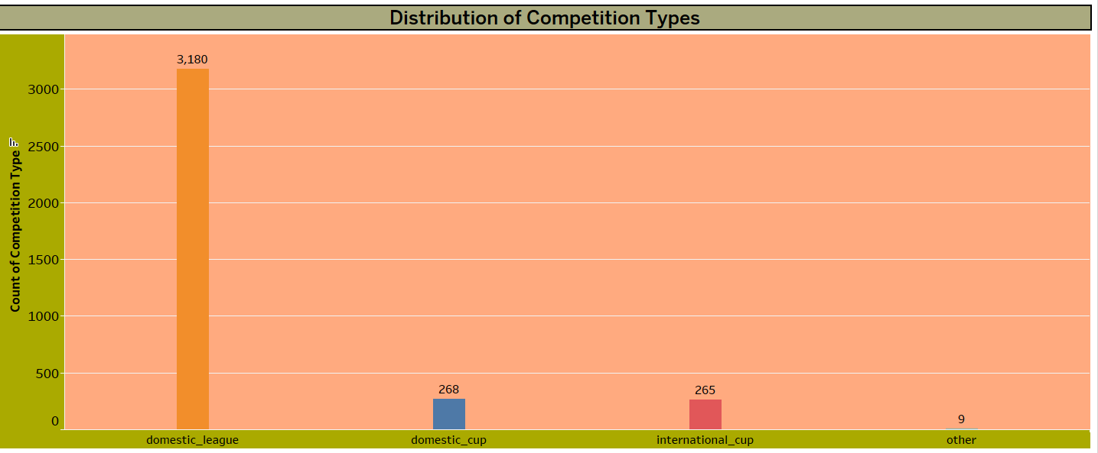
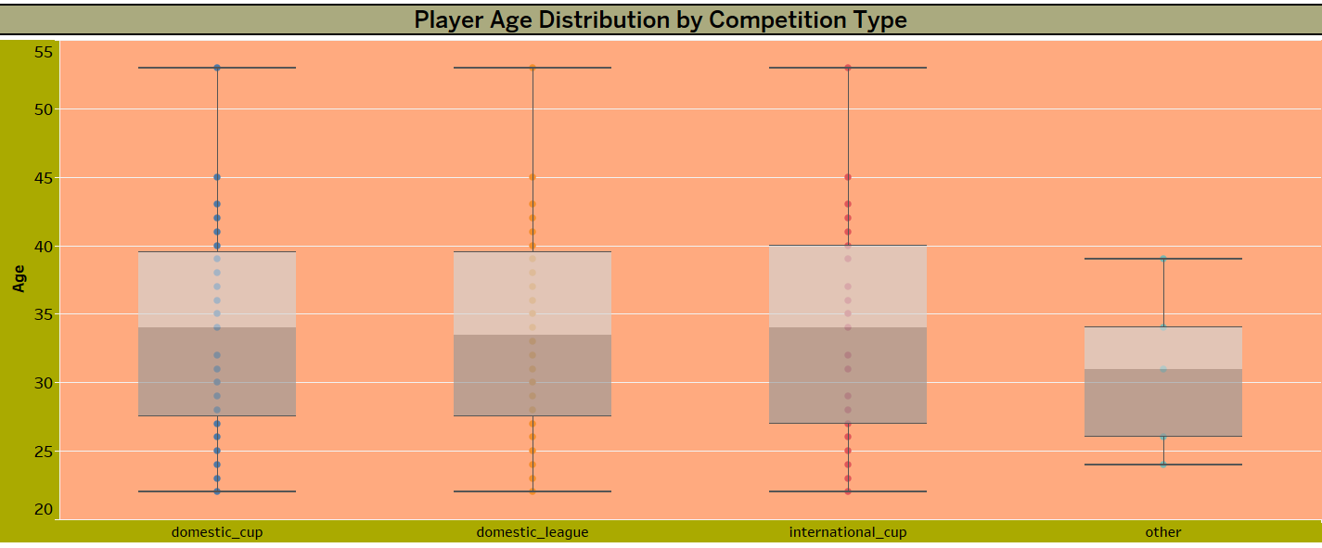
COMPETITION ANALYSIS
For Competition analysis there are two set of questions and these are- DISTRIBUTION OF COMPETITION TYPES - Distribution of competition types, with domestic_league being the most common at 3,180 occurrences, followed by domestic_cup at 268 occurrences, international_cup at 265 occurrences, and other at 9 occurrences. PLAYERS AGE DISTRIBUTION BY COMPETITION TYPE - The age ranges are similar across domestic cup, domestic league, and international cup competitions, with medians around 30-35 years. The other category has a narrower age range with a lower median compared to the other types.

Slide 8
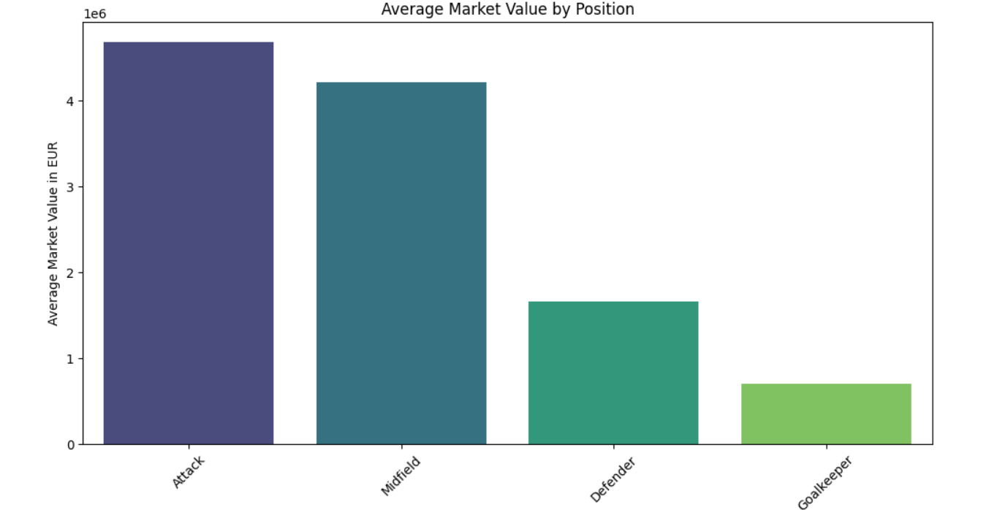
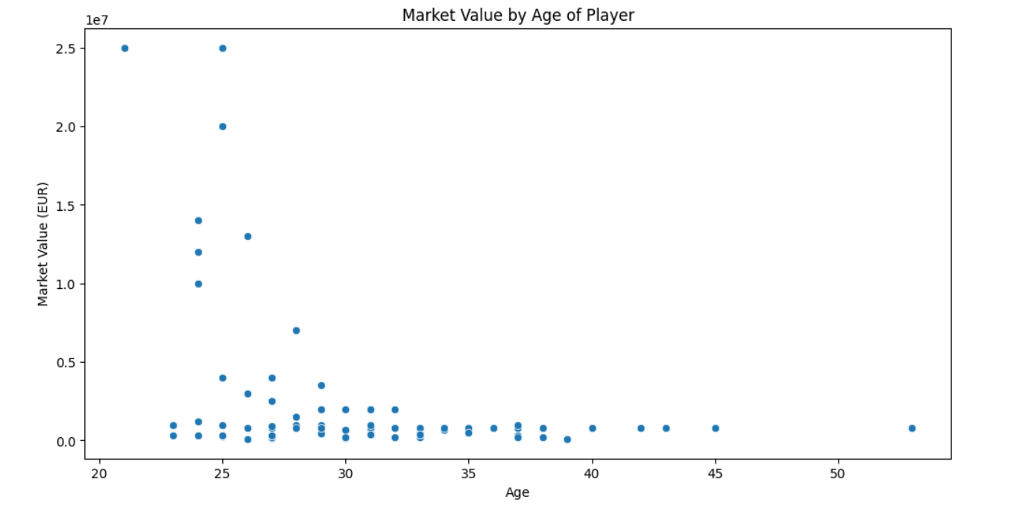
(PYTHON-FOCUS AREAS) Player profile and market value
For Player profile and market value there are two set of questions and these are- MARKET VALUE DISTRIBUTED BY POSITION -Attackers and Midfielders have high average market values (4,681,063 and 4,203,906, respectively) with significant variability, while Defenders and Goalkeepers have lower averages (1,653,631 and 699,043, respectively), with less extreme ranges. MARKET VALUE OVER TIME -The chart shows a clear downward trend in market value as player age increases. The peak market value is around 2.5 million for players in their early 20s, and it steadily declines to near zero for players in their late 40s.

Slide 9
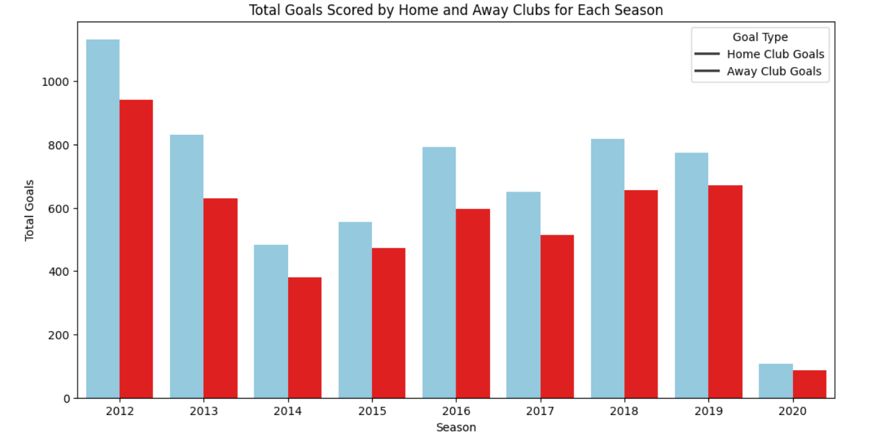
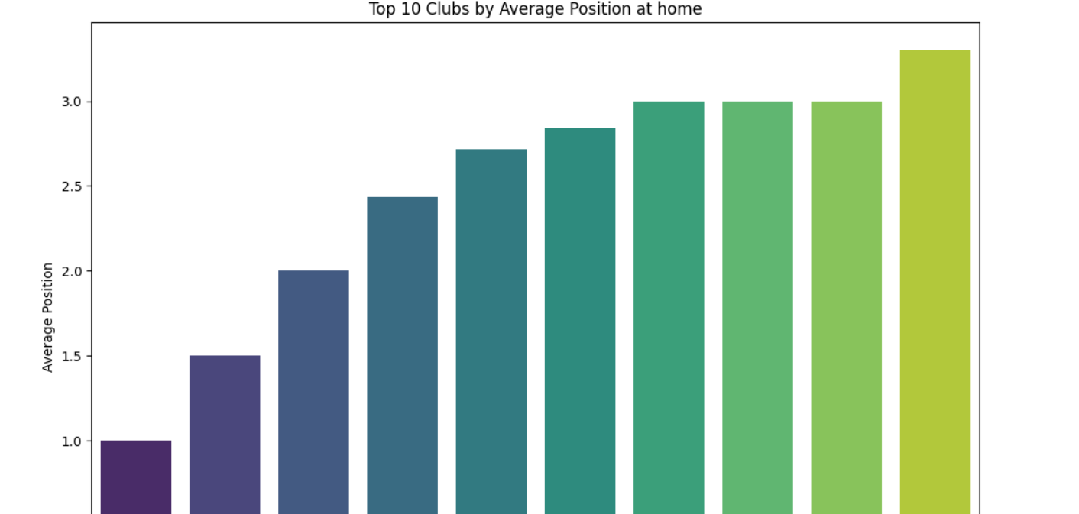
Team Comparison
For Team comparison ,there are two set of questions and these are- Home vs. Away Team Goals - Home clubs generally scored more goals than away clubs across seasons, with total ranging from 107 to 1132 goals for home clubs and 87 to 941 goals for away clubs, showing a significant drop in 2020. Average home club Position - Top 10 - Clubs with lower average positions, like Vejle Boldklub and Fatih Karagümrük Istanbul FC, performed exceptionally well at home, while clubs with higher average positions, like Club Brugge, performed less effectively.

Slide 10
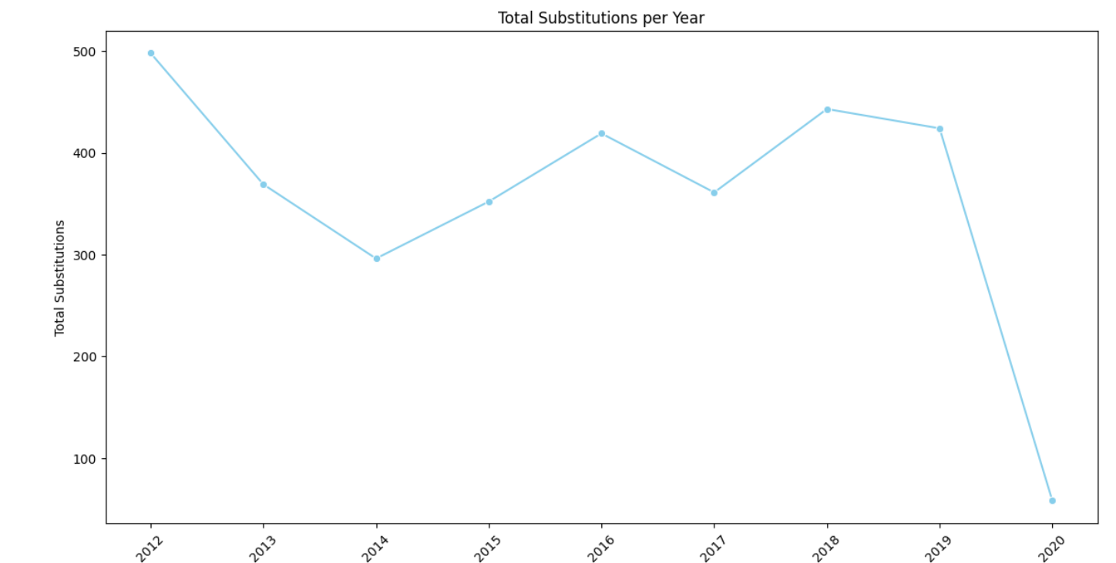
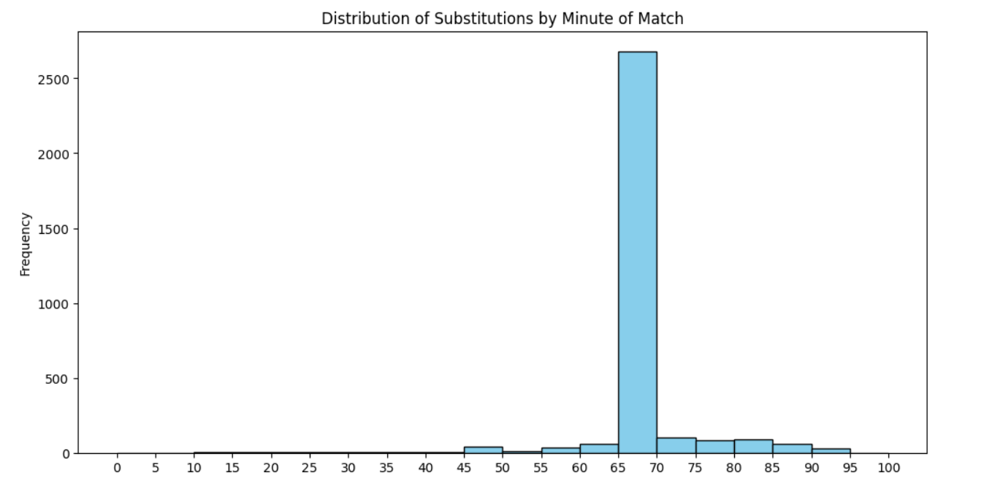
Substitution Patterns
For Substitution patterns there are two set of questions and these are- Substitution Trends Analysis by season -Total substitutions peaked in 2012 with 498 and generally ranged between 296 and 443 in subsequent years, but dropped dramatically to 58 in 2020, likely due to disruptions caused by the pandemic. Timing of Substitutions - The number of substitutions generally increases from the start of the match, peaks around the 60th minute, and then declines towards the end of the game.

Slide 11
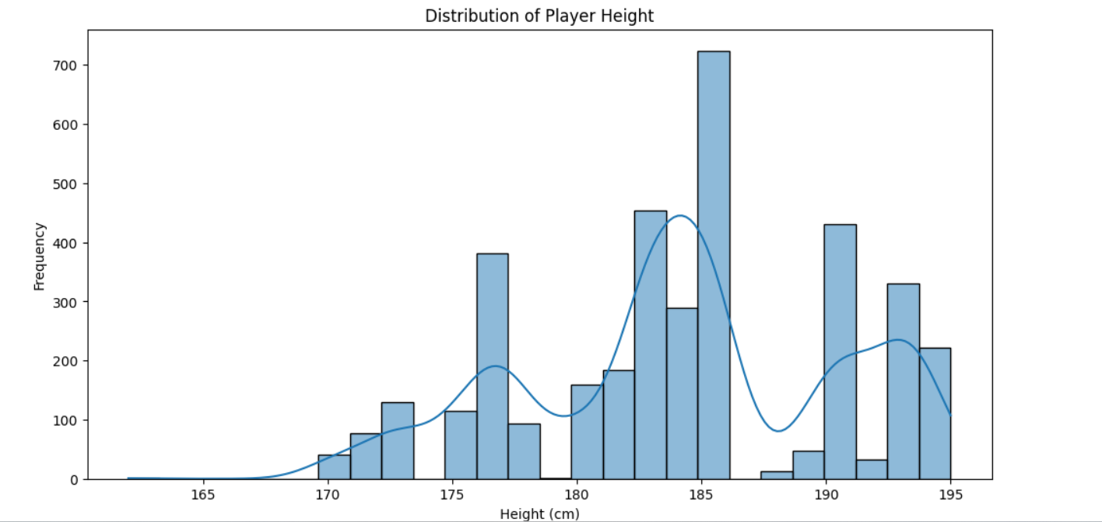
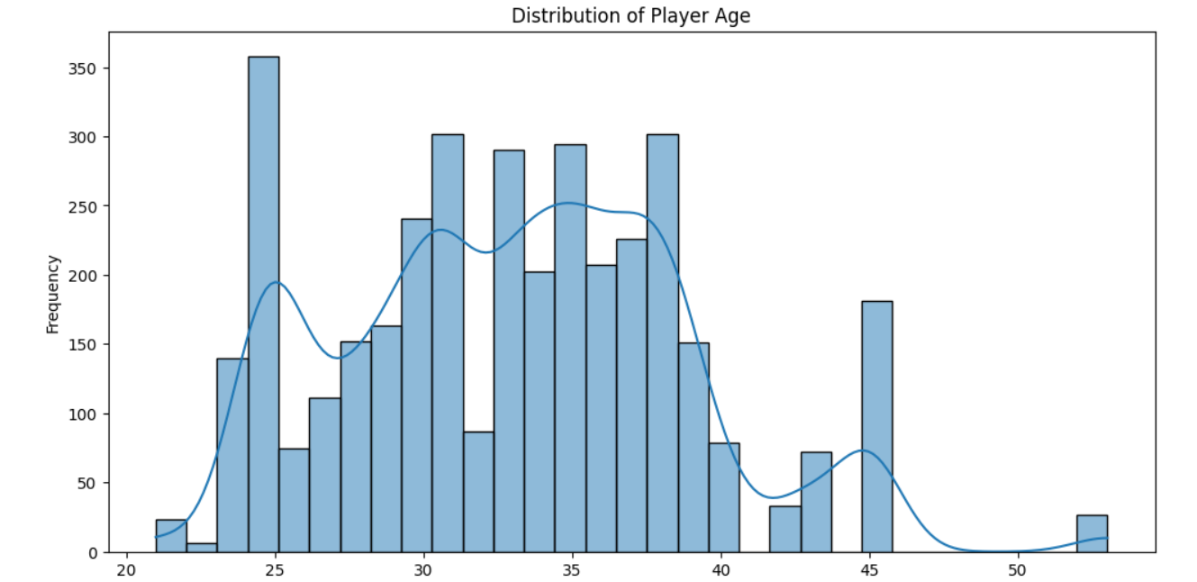
Player Attributes and Demographics
For player attributes and demographics there are two set of questions and these are- Player Height Distribution -The average height of players is 184.19 cm, with most players falling between 180 cm and 190 cm. Heights range from a minimum of 162 cm to a maximum of 195 cm, with a standard deviation of 6.27 cm indicating moderate variability. Player Age Distribution -The average age of players is 33.14 years, with most players between 29 and 37 years old. Ages range from 21 to 53 years, with a standard deviation of 5.83 years indicating moderate variability in player ages.

Slide 12
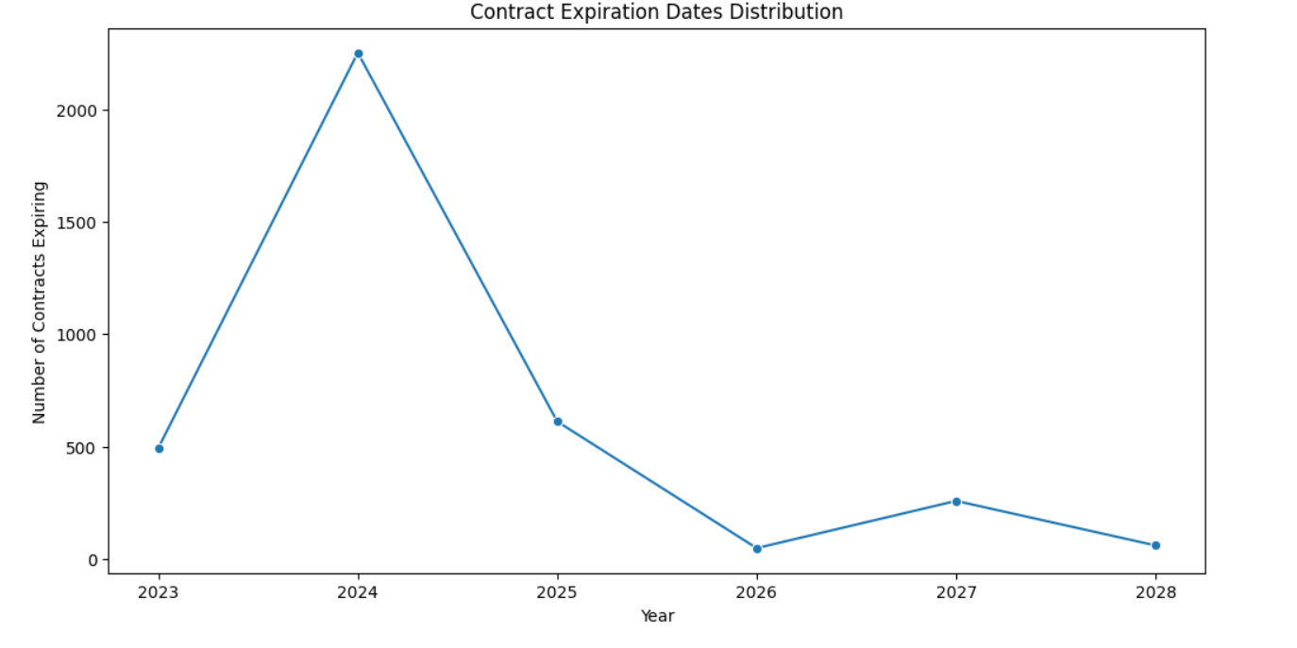
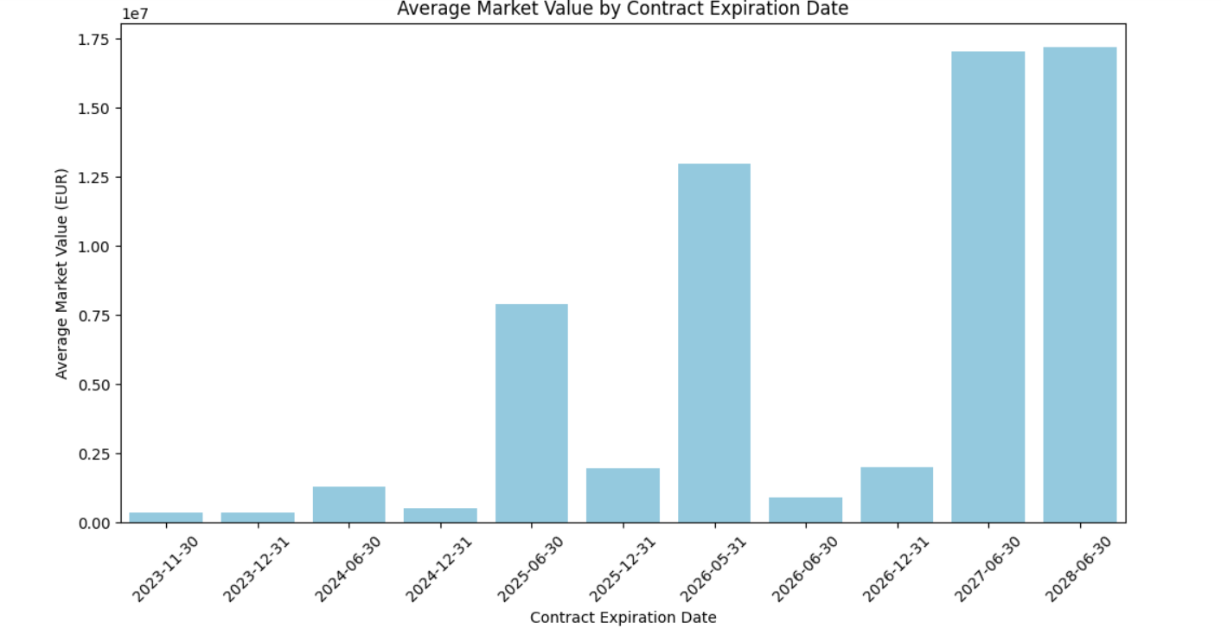
Contract Management
For Contract management there are two set of questions and these are- Contract Expiration Dates Distribution -The plot shows a peak in contract expirations in 2024 with 2,251 contracts, and notably fewer expirations in other years, particularly in 2026. Market Value by Contract Expiration Date
-A general trend of increasing average market values leading up to 2027 and 2028 is seen, with significant spikes in 2025 and 2026. This indicates higher market values for contracts expiring in the later years, particularly in 2027 and 2028.

Slide 13
Business Objective: Maximizing Club Performance, Fan Engagement, and Financial Success through Data-Driven Strategies
1. Performance Optimization: Objective: Enhance team performance by leveraging detailed player statistics and match data.
Actions:
Player Recruitment & Development: Identify and recruit top goal scorers like Aron Johannsson and assist providers like Christian Pulisic to strengthen the team's offensive capabilities.
Home Game Strategies: Analyze home performance metrics, particularly for clubs like Vejle Boldklub and Fatih Karagümrük Istanbul FC, to develop strategies that capitalize on home advantages. 2. Fan Engagement & Attendance Maximization: Objective: Increase match attendance and improve fan engagement by understanding attendance trends and fan preferences.
Actions:
Stadium Experience Enhancement: Utilize attendance data to create targeted marketing campaigns and promotions, especially during historically low attendance periods like July 2018.
Event Planning: Focus on high-attendance events, particularly at top stadiums like Old Trafford, to maximize fan turnout and engagement. 3. Market Value & Contract Management: Objective: Optimize player market value and contract management to increase revenue and retain top talent.
Actions:
Market Trends Analysis: Monitor the decline in player market value with age to make informed decisions on contract renewals and transfers.
Contract Negotiation: Focus on high-value years (e.g., 2027, 2028) for better contract negotiations and financial planning. 4. Officiating Quality & Match Integrity: Objective: Improve officiating quality to maintain match integrity and fairness.
Actions:
Referee Performance Review: Analyze top referees like Dr. Felix Brych and Manuel Graefe to ensure consistent and fair officiating in matches.
Training & Standards: Develop training programs for referees based on performance data to maintain high officiating standards. 5. Competitive Analysis & Strategy Development: Objective: Strengthen competitive positioning by analyzing trends in player performance, substitution patterns, and competition types.
Actions:
Tactical Adjustments: Use data on event timings (e.g., substitutions, goals) to refine in-game strategies and improve match outcomes.
Competition Focus: Prioritize domestic leagues and cups, where the highest occurrences are noted, to maximize competitive success. 6. Financial Forecasting & Budget Planning: Objective: Enhance financial forecasting and budget planning using player market values, contract expiration data, and market trends.
Actions:
Budget Allocation: Allocate resources effectively by anticipating market conditions and planning for key contract expiration years.
Revenue Maximization: Focus on maximizing the value of contracts expiring in high-value years through strategic financial planning.

Slide 14
SUMMARY
In recent soccer seasons, the game’s dynamics have been shaped by standout performances and intriguing trends. Aron Johannsson’s 119 goals make him the league’s most lethal striker, while Christian Pulisic, with 32 assists, has proven to be a key playmaker. Stadium attendance tells its own story—Old Trafford leads with an impressive average of 75,112 fans, while May 2019 saw the highest overall turnout at 44,731. On the field, referee Dr. Felix Brych has been the busiest, overseeing 79 matches, indicating his significant role in maintaining the game’s flow.
Interestingly, match events like goals and substitutions are spread throughout the game, with goals more evenly distributed and substitutions peaking around the 60th minute. Player demographics reveal consistent age ranges across different competitions, with the prime of most players centered around their early 30s. However, the pandemic’s impact is undeniable, with 2020 witnessing a sharp decline in goals and substitutions, highlighting the disruption it caused. Despite this, the market value of players remains a focal point, particularly with younger players in their early 20s commanding higher prices, although a downward trend begins as they age.
Looking ahead, contract expirations peak in 2024, with rising market values anticipated through 2027 and 2028, signaling potential lucrative opportunities for clubs. This data paints a vivid picture of the evolving landscape of soccer, offering valuable insights for future strategies.

Slide 15
KEY -FINDINGS
Here are the key findings from the output data:
1.Top Goal Scorer: Aron Johannsson is the leading goal scorer with 119 goals across all seasons.
2.Top Assist Provider: Christian Pulisic leads the assist chart with 32 assists, highlighting his playmaking ability.
3.Highest Attendance: The highest average attendance was recorded in May 2019, with 44,731 spectators.
4.Lowest Attendance: The lowest average attendance occurred in July 2018, with only 4,908 spectators.
5.Top Stadium by Attendance: Old Trafford has the highest average attendance among the top 10 stadiums, with 75,112 spectators.
6.Top Referee: Dr. Felix Brych officiated the most games (79) among the top 10 referees, followed by Manuel Graefe with 66 games.
7.Event Timing Distribution: Cards and substitutions generally occur throughout the match, while goals are more evenly distributed, with some events occurring beyond typical match duration.
8.Player Age Ranges: The age ranges are similar across domestic cup, domestic league, and international cup competitions, with medians around 30-35 years.
9.Competition Types Distribution: Domestic leagues are the most common competition type, followed by domestic cups and international cups.
10.Player Market Values: Attackers and midfielders have the highest average market values, with significant variability, while defenders and goalkeepers have lower averages.
11.Market Value and Age: Player market value tends to peak in the early 20s and declines steadily with age.
12.Home vs. Away Goals: Home clubs generally scored more goals than away clubs, with a significant drop in goals scored in 2020.
13.Club Performance at Home: Clubs with lower average positions, such as Vejle Boldklub and Fatih Karagümrük Istanbul FC, performed exceptionally well at home.
14.Substitutions Trend: Substitutions peaked in 2012, with a sharp decline in 2020, likely due to the pandemic.
15.Substitution Timing: The number of substitutions typically increases from the start of the match, peaks around the 60th minute, and declines towards the end.
16.Player Height Distribution: The average height of players is 184.19 cm, with most players falling between 180 cm and 190 cm.
17.Player Age Distribution: The average age of players is 33.14 years, with most players between 29 and 37 years old.
18.Contract Expirations: A peak in contract expirations is expected in 2024, with rising market values anticipated through 2027 and 2028.

Slide 16
DECISION-MAKING APPROACHES FOR FUTURE
To make future decisions based on the data, follow these steps: 1.Focus on High-Impact Players:
-Invest in Goal Scorers and Assist Providers: Target or retain top players like Aron Johannsson and Christian Pulisic, or similar high performers, to boost team effectiveness and competitive edge.
2.Optimize Fan Engagement:
-Leverage Attendance Insights: Schedule matches and promote events during periods similar to high-attendance months (e.g., May 2019) to maximize stadium turnout.
-Enhance Venue Appeal: Invest in upgrades for high-attendance stadiums like Old Trafford to improve fan experience and increase revenue.
3.Strategic Referee Utilization:
-Deploy Experienced Referees: Assign high-experienced referees like Dr. Felix Brych to critical matches to ensure high officiating standards and game fairness.
4.Adjust Tactical Strategies:
-Utilize Event Timing Data: Adapt game strategies based on when goals, cards, and substitutions typically occur. For example, plan for more tactical substitutions around the 60th minute.
5.Manage Player Roster Effectively:
-Age and Performance Management: Balance the roster with a mix of younger and experienced players, focusing on younger talent for higher market values and long-term development.
-Height and Positioning: Recruit players with optimal height and skills based on positional needs and average player metrics.
6.Financial and Contract Planning:
-Prepare for Contract Expirations: Plan for peak contract expirations in 2024 and strategize for upcoming contract negotiations and renewals.
-Leverage Market Value Trends: Align financial strategies with projected market value trends, particularly for contracts expiring in 2027 and 2028.
7.Mitigate Future Disruptions:
-Develop Contingency Plans: Create flexible strategies to handle potential disruptions similar to the pandemic’s impact, including adjusting substitution rules and match schedules. By implementing these data-driven strategies, we can make informed decisions that enhance team performance, optimize fan engagement, and ensure effective financial and operational planning for the future. THANKYOU

