Slide 1


Customer Churn Prediction & Retention Strategies
Customer Churn Analysis: Prediction & Retention
By Pooja Tyagi

Slide 2

Background
Professional experience of 2 years in Industry
Masters graduate in Artificial intelligence at CIT (2018-19)
Bachelors graduate in Computer Science and Engineering at Dr. APJ Abdul Kalam Technical University (2013-17)
Customer Churn Analysis: Prediction & Retention (Master’s Dissertation)

Slide 3

Why this topic?
In the competitive world of telecommunication carriers, customer retention is key
Acquiring new customers can cost up to 25 times more than retaining existing customers.
80% of the company profit may come from just 20% of existing customers.
Churn rates are often used to indicate the strength of a company’s customer service division and its overall growth prospects. Lower churn rates suggest a company is, or will be, in a better or stronger competitive state.
This project deals with churn analysis to strategise retention policies to reduce churn rates.

Slide 4
Aim & Objectives
AIM:
To explore Predictive Technology to forecast Telco customers who are likely to churn, targeting them and, creating policies to retain them. Logistic Regression, Random Forests and XGBoost are three important techniques that are applied.
OBJECTIVES:
Business Challenge: This initial phase of Project focuses on understanding the requirements from a business perspective, and then converting this knowledge into a Predictive modelling problem definition
Performing deep research and experiments to find best fit ML algorithm for this specific problem. Gaining more insights into the customer forecast model.
Creating Retention Policies to strategise their marketing initiatives to improve revenue.

Slide 5

Research & Findings
[1]. S. Daskalaki, et al., Data Mining for Decision Support on Customer Insolvency in Telecommunications Business. European Journal of Operational Research. 145, 239-255 (2003).
Observations, the study had the objective to build decision support system to handle customer insolvency for large telecommunication company. The main point is to predict churner customers by using Decision Trees and Neural Networks.
[2]. H. Ren, Y. Zheng, Y. Wu, Clustering Analysis of Telecommunication Customers. The Journal of China Universities of Post and Telecommunications. 16(2), 114-116 (2009).
In their study Ren, Zheng and Wu, presented a Clustering method based on Genetic algorithm for telecommunication customer subdivision.
[3]. María Óskarsdóttira,∗, Cristián Bravob. and Wouter Verbeke, “Social Network Analytics for Churn Prediction in Telco: Model Building, Evaluation and Network Architecture”
This study shows different strategies for constructing a relational learner by applying them to a total of eight distinct call-detail record datasets, originating from telecommunication organisations across the world. They have statistically evaluated the effect of relational classifiers and collective inference methods on the predictive power of relational learners.

Slide 6
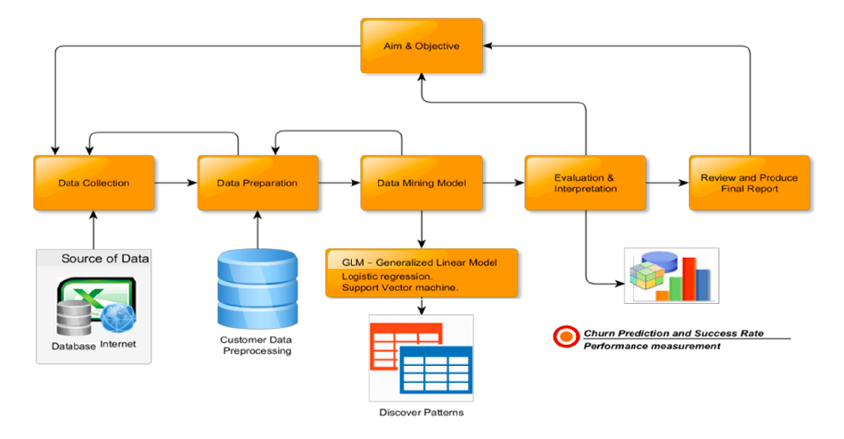
Methodology

Slide 7
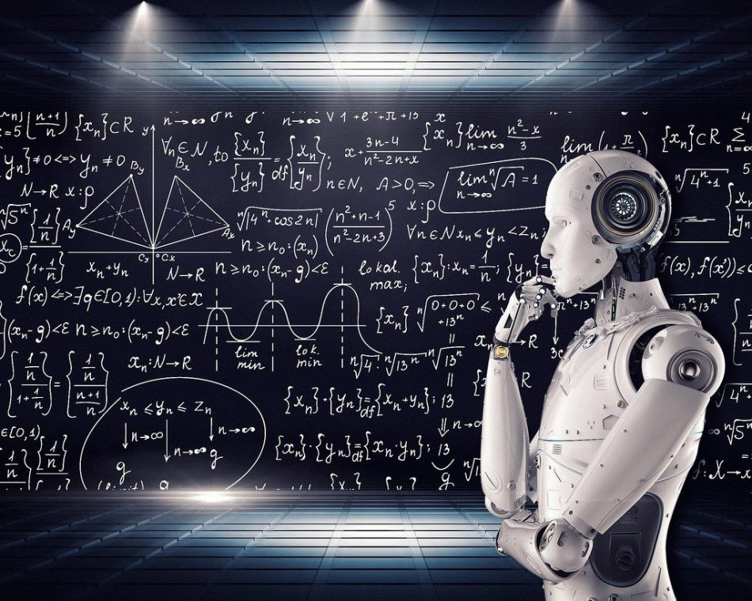
Technology used..
Python 3
Jupiter Notebook (IDE)
Machine Learning Models (Classification)
Python libraries
Numpy - To perform Linear Algebra
Pandas
Seaborn
Matplotlib
Sklearn - Linear_model(Logistic Regression),
Sklearn - Ensemble (RandomForestClassifier)
Xgboost
Sklearn - Metrics ( roc_auc_curve, classification report, confusion matrix)

Slide 8

Data Preparation
1.
Replaced N/A values with Mean value
CHALLENGES
“Telco Dataset “ Published by IBM
Rows: 7043 (No. Of customers)
Columns: 21 (Features)
2.
1. Missing Values
Used Standard Deviations (multiples of sigma)
2. Outliers
3.
Normalization using Z- score
3. Different Scales
4. Categorical variables
4.
Label Encoder or One - Hot Encoder

Slide 9

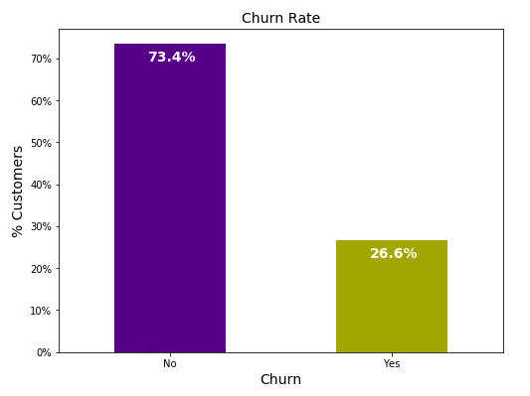
Finding Patterns.. (Exploratory Data Analysis)
Performed Univariate and Multi-variate analysis, before we calculated churn rate which is important for an organization to know:
CHURN RATE
It is the % of users who stop using services within a given period.
It is calculated using formula,
Customers at the start of the month= X
Customers at the end of month = Y
Churn Rate in % = (X-Y) /X

Slide 10
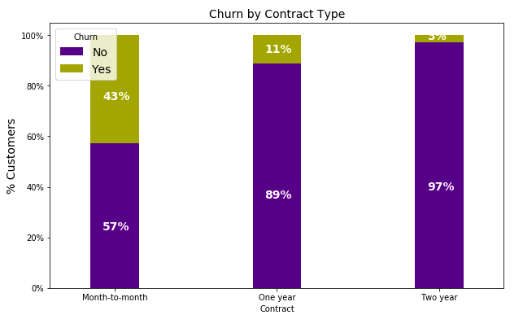
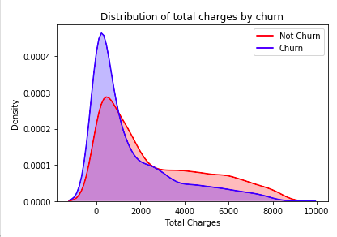
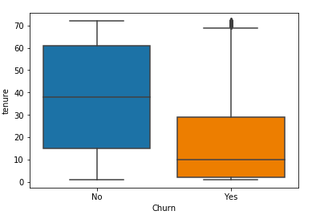
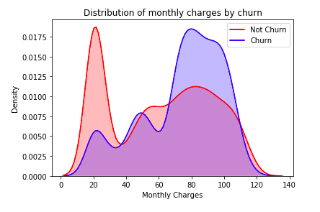
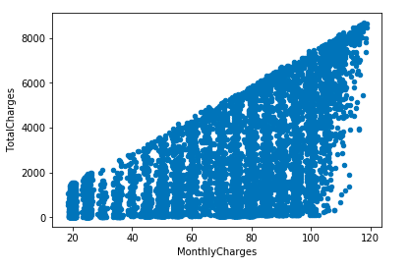
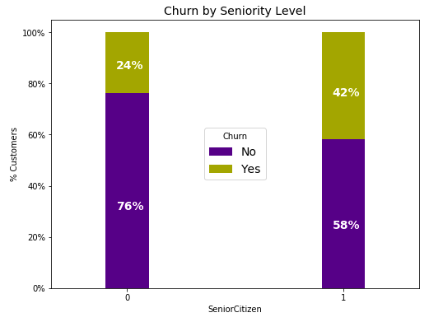
Continue..

Slide 11

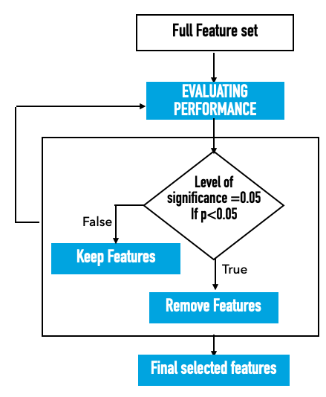
Data Modeling
2.
Performed Backward Elimination Techniques
CHALLENGES
1. Imbalanced Data
Imbalanced Data
2. Feature Selection
1.
Synthesized Minority class (SMOTE)

Slide 12
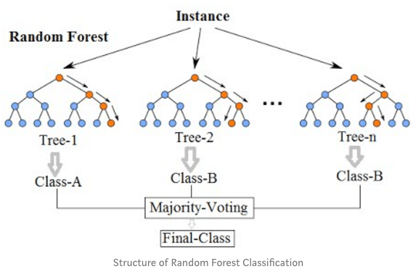
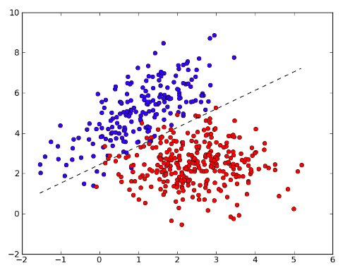
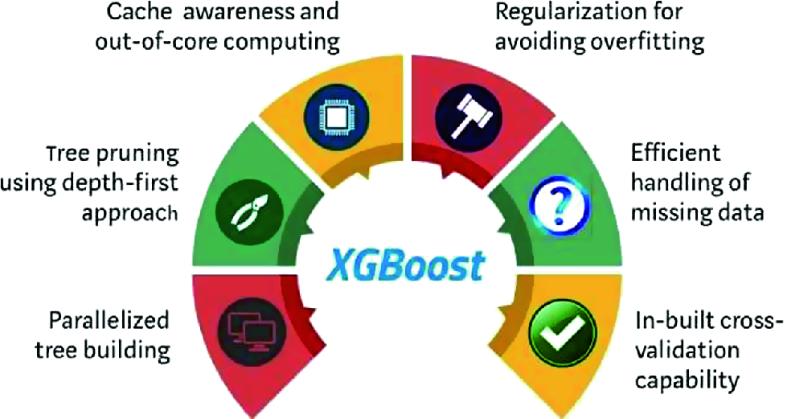
Continue..
Various model are developed and trained before selecting the best one.
1. Logistic Regression
2. Random Forests
3. Extreme Gradient Boost

Slide 13

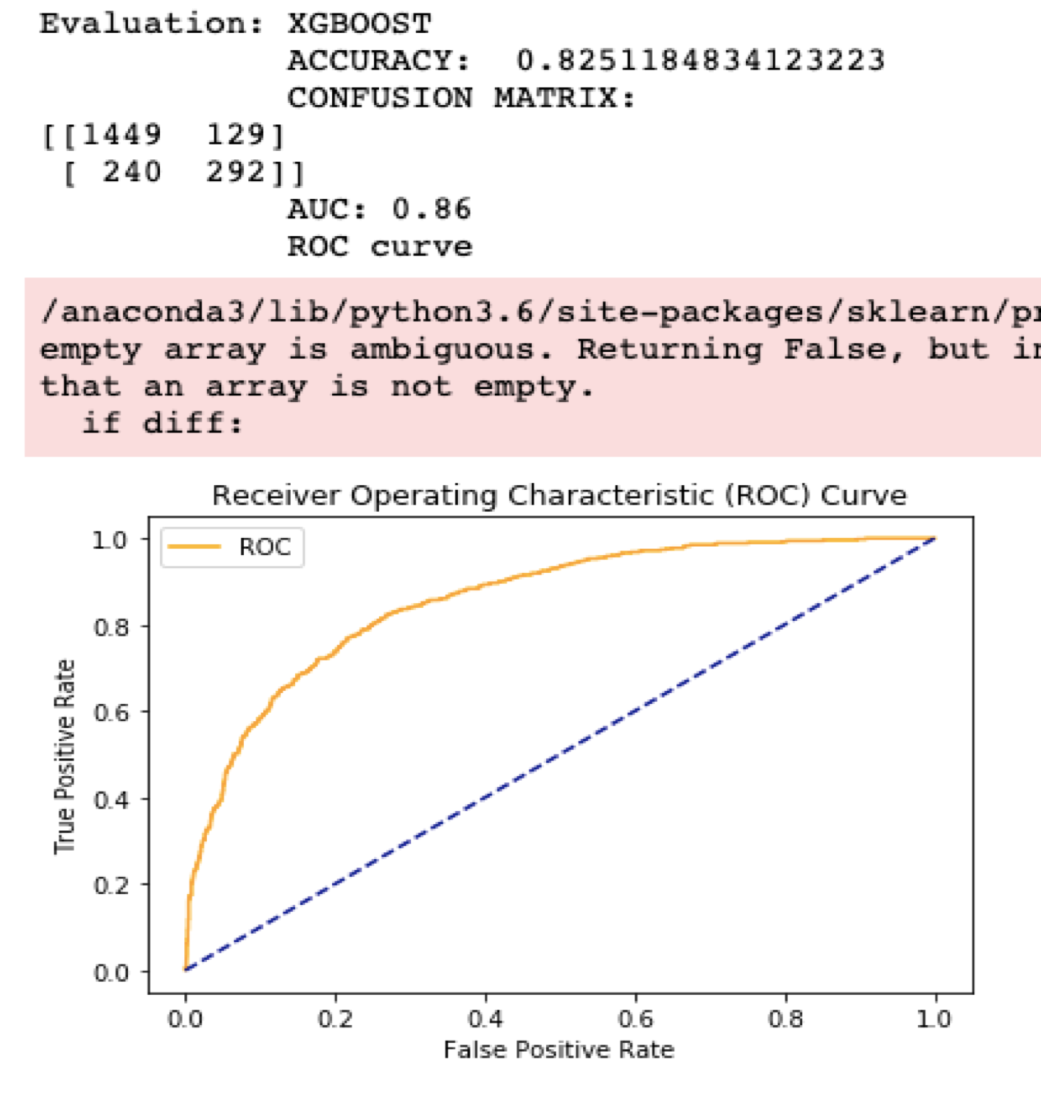

Model Evaluation
Model Evaluation metrics are required to
quantify model performance.
XGBoost Model
Evaluation metrics
1. Classification Accuracy
2. Confusion matrix
2. Confusion Matrix
3. Area Under Curve (AUC)

Slide 14
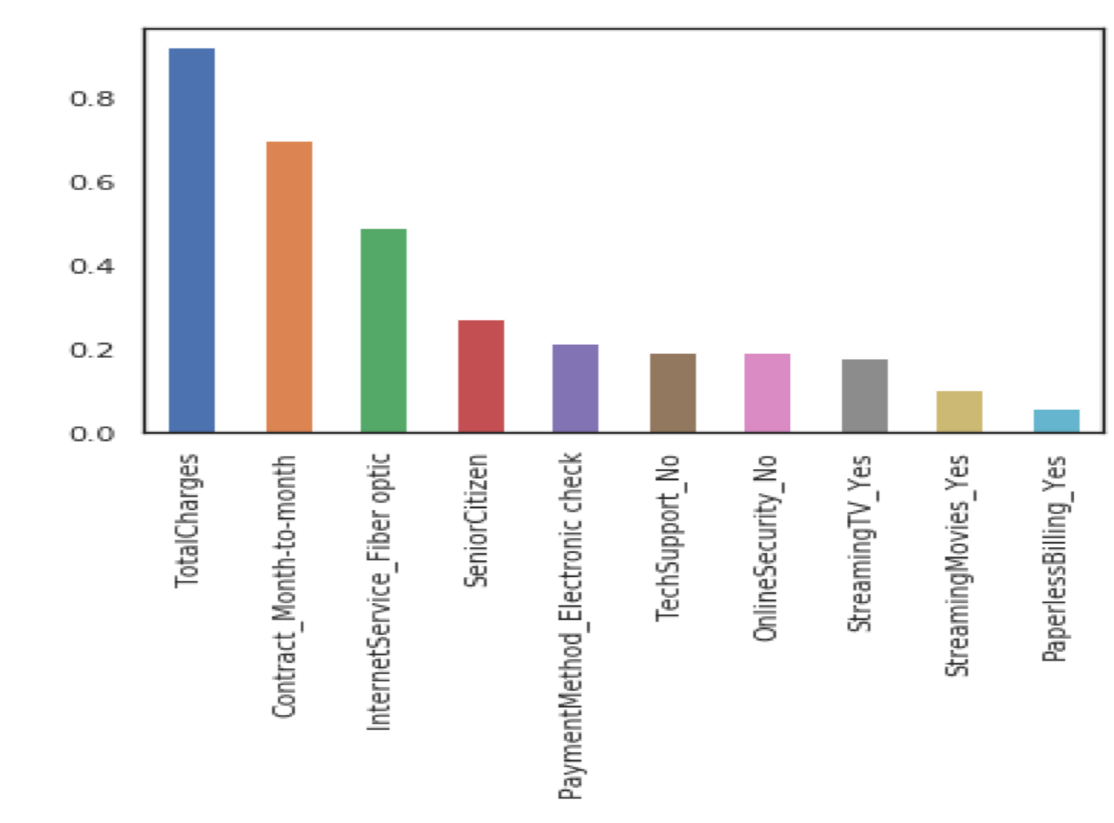

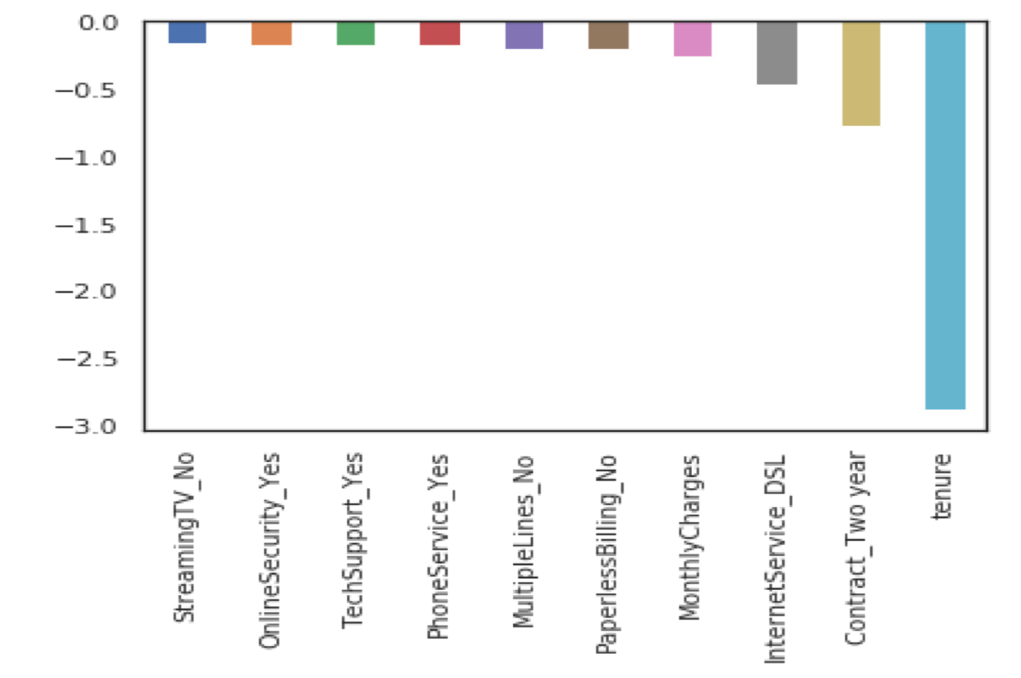
Observations & Retention Policies
The graph shows the positive and negative correlation of all the variables (after feature selection) with churn (target variable) of the group of customers that are likely to churn.
Two_year contract reduces chances of churn
Two_year contract along with tenure has the most negative relation with churn
DSL Internet service is negatively correlated
Total_charges, monthly contracts, fibre optics can lead to higher churn
Monthly contracts,TotalCharges and tenure are the most important predictor variables to predict churn
Policies guidelines

Slide 15

Future Scope..
Dataset: Including features that portrays customer usage details such as, calling minutes (nationally/ internationally), Data usage, text usage etc. will help in building more efficient model.
Implementing Artificial Neural Networks will improve the prediction. Using hybrid neural network models to predict churn.
In conclusion, Experimenting more with Deep Neural Networks on a large dataset will be an efficient way to predict churn.

Slide 16
Project Code..
Implementation Instructions
Working Environment: The below file is best fit for Jupyter Notebook IDE
The project includes:
Readme file – readme.txt
Python code file – code.ipynb
Presentation – Presentation.ppt
Link : https://github.com/PoojaTyagi-AI/Masters_Project.git

