Slide 1

Computer Networks(cs3530) Project-2024
Team Member:- GROUP 8
BOLLA NEHASREE - CS22BTECH11012
NETHI KEERTHANA - CS22BTECH11043
MANE POOJA VINOD - CS22BTECH11035
NALAVOLU CHETANA - CS22BTECH11042
TUMARADA PADMAJA - CS22BTECH11059
SURBHI - CS22BTECH11057

Slide 2
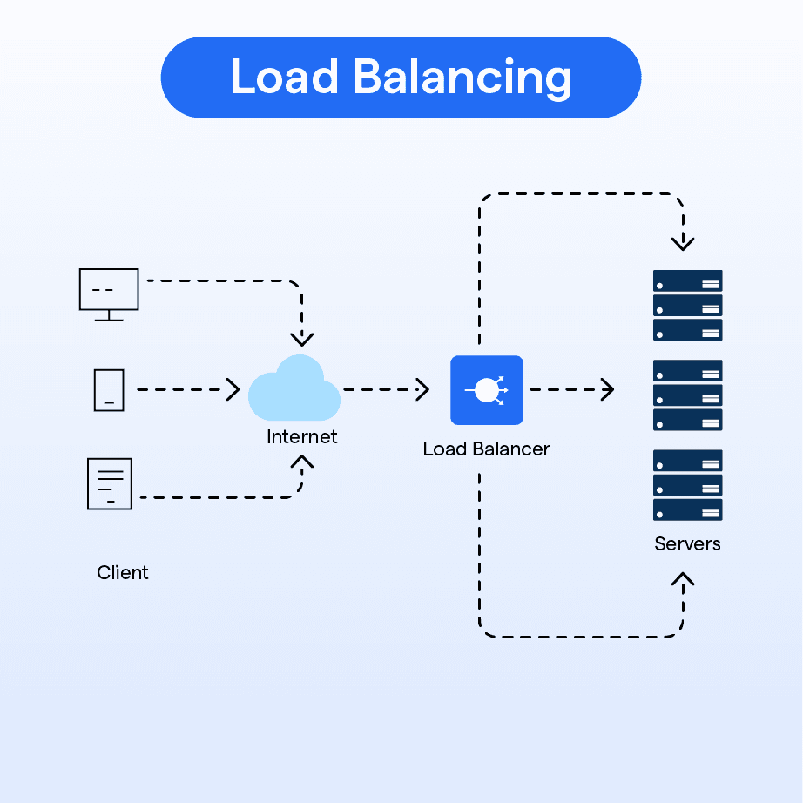
Problem Statement:-
Efficient Load Balancing Mechanism in software defined Networks
Objective:
Implement a response time-based load balancing strategy using an OpenFlow switch and evaluate its performance compared to RR and Random Strategies.

Slide 3
Background
Load balancing is a critical component of Software Defined Networks (SDNs) to ensure efficient resource utilization, improved application performance, and fault tolerance. Traditional load balancing algorithms like Round Robin and Random allocation fail to adapt to varying server response times, leading to potential inefficiencies.
A response-time-based load balancing algorithm considers the real-time performance of servers to dynamically distribute client requests, ensuring reduced latency and improved throughput. This approach can significantly enhance application performance, especially in scenarios where server response times vary widely. So we have used least response time strategy for this. The objective of this project is to implement and evaluate a response-time-based load balancing mechanism and compare its effectiveness with Round Robin and Random strategies in terms of:
Throughput:amount of data transferred from one location to another in given amount of time.
Latency: Measures the delay experienced by a data packet as it travels from one point to other in a network.

Slide 4
Commands to run the code
To get mininet we have to write : sudo mn --custom topology.py --topo loadbalancer --controller=default --ipbase=10.0.0.0/24 In mininet:
xterm server1
xterm server2
xterm server3
xterm lb
xterm client
In Server1 : python3.6 backend_server1.py
In server2: python3.6 backend_server2.py
In server3: python3.6 backend_server3.py
In lb: python3.6 load_balancer.py
In client: python3.6 client.py

Slide 5
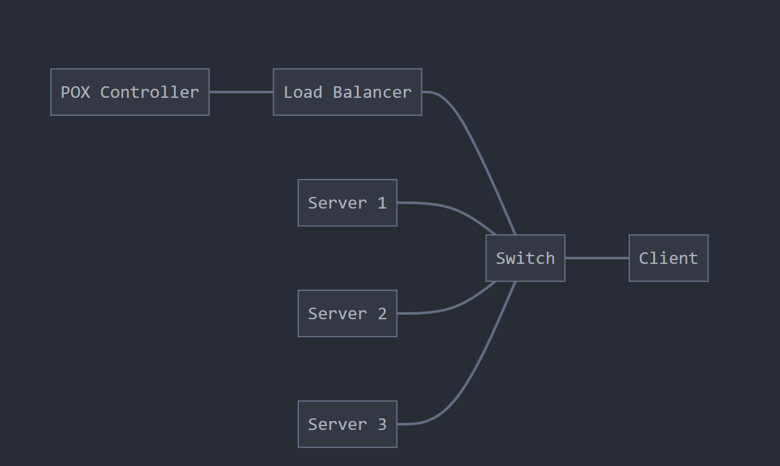
System Block-diagram

Slide 6
Pseudocode
1. Initialize backend servers with their IP addresses and ports.
2. Define a function to measure server response time:
- Find the average response time of the previous requests and use this as current response time metric
- Record the time taken to receive a response and update the metrics
3. On receiving a client request:
- Measure the response time of all servers.
- Select the server with the least response time.
- Forward the client request to the selected server.
- This client is added to the corresponding server’s queue
- Record metrics (response time, latency, throughput).
4. Return the server's response to the client.

Slide 7
Load Balancing Flow-Chart
Start
|
Receive Client Request
|
Measure Server Response Times
|
Choose Server with Least Response Time
|
Forward Request to Selected Server
|
Return Response to Client
|
Log Metrics
|
End

Slide 8
Implementation
load_balancer.py: Implements load balancing algorithms (Response Time, Round Robin, Random).
backend_server1/2/3.py: Simulates backend servers, each with varying response times to evaluate algorithm performance.
topology.py: Defines the SDN topology using Mininet.
client.py: send requests to the load balancer.
Implementation Details:
Response-Time-Based Load Balancer:
Uses the time module to measure server response times.
Dynamically selects the server with the minimum queue length.
Round Robin and Random Algorithms:
Round Robin cycles through servers in a fixed order.
Random selects a server at random.

Slide 9
Evaluation
Performance Metrics:
Throughput:amount of data transferred from one location to another in given amount of time.
Latency: Measures the delay experienced by a data packet as it travels from one point to other in a network.
Experimental Setup:
Simulated using Mininet with three backend servers and one client.
Simulated a load balancer for efficiently dividing the load on to servers using multiple algorithms.
Results and Analysis:
Response Time Algorithm:
Achieved the best throughput and lowest latency.
Effectively distributed requests to minimize server overload.
Round Robin:
Performed reasonably well but struggled under uneven server loads.
Latency increased for overloaded servers.
Random:
Exhibited inconsistent performance due to non-adaptive server selection.
Higher latency and lower throughput compared to the other algorithms.

Slide 10
Evaluation Strategies Assuming each request size is 1024 bytes
Load-Balancing Strategy | Throughput | Latency
Round Robin | 2300 KiloBytes/s | 0.0005 sec
Random | 2700 KiloBytes/s | 0.0006 sec
Least Response Time | 5100 KiloBytes/s | 0.0004 sec

Slide 11
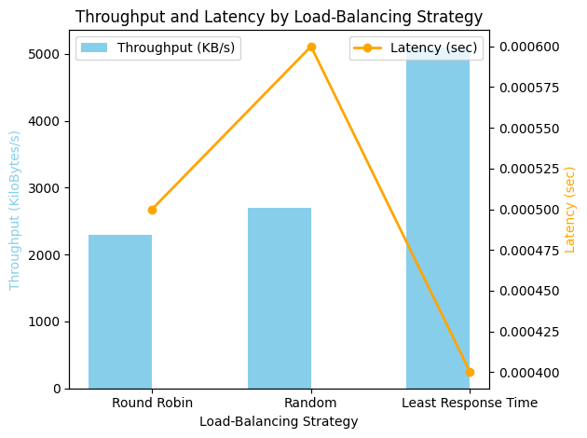
Throughput VS Latency Graph

Slide 12
Conclusion
Our project demonstrates that response-time-based load balancing provides significant performance improvements over traditional algorithms like Round Robin and Random. By dynamically adapting to server performance, the system ensures:
Lower latency.
Higher throughput.
Efficient utilization of server resources.

Slide 13
References
Efficient Load Balancing Mechanism in SDN

Slide 14
Thank You

