Slide 1
Russian troll tweets
Classification of tweets

Slide 2
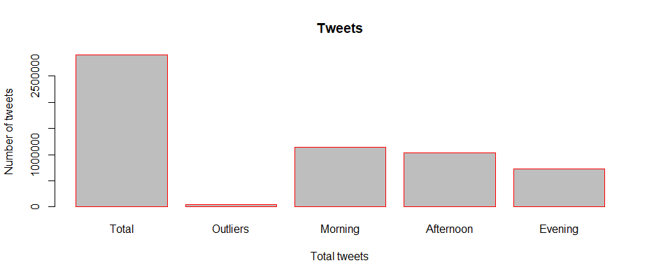
Short introduction
Troll tweets from 2014 till 2018.
Classification is based on the year and time.
Note: Morning- 0-11:59am; Afternoon- 12pm-17:59; Evening- 18-23:59

Slide 3
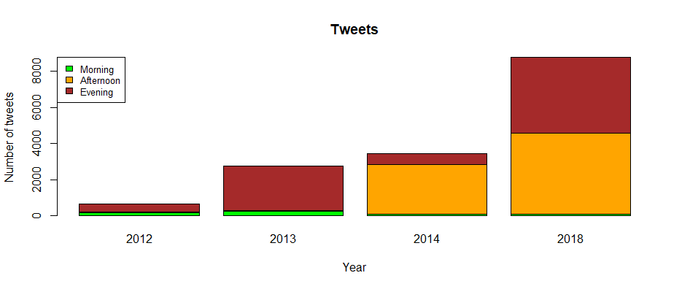
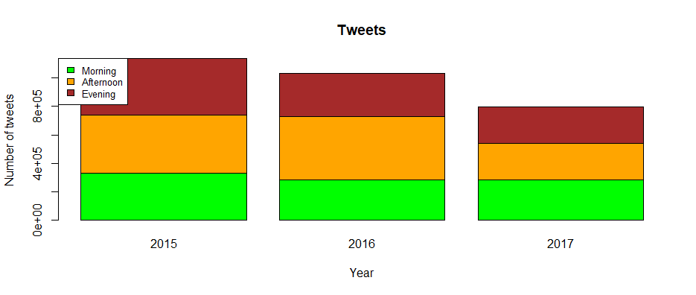
Results

Slide 4
Conclusion
Initial tweets were in the evening and afternoon.
People mostly tweeted in the morning and inactive in the evening.
Tweets started from year 2012 and reached the peak in year 2015 and gradually reduced.

