Slide 1










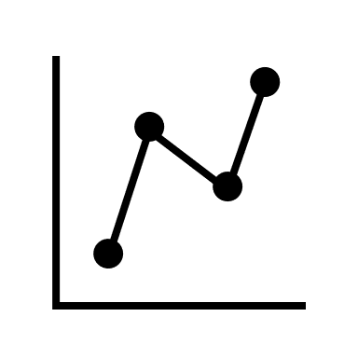











Introduction
2023
Requirement Gathering
Pooja Dash
Carbon emission assessment
2023
Renewable Energy
MSc Business Analytics
Visualization
Analysis
Forecast &
Strategy
Sr.
Retail Transport Consumer Behavior
2022
3+ years
Jr.
IT Infrastructure
University of Mumbai
Business Process diagrams
2018
Cross functional collab.
IT Business Analyst
Bachelor of Engineering
Team lead
MSc Business Analytics
National Hackathon
Won Technical Paper Presentations

Slide 2
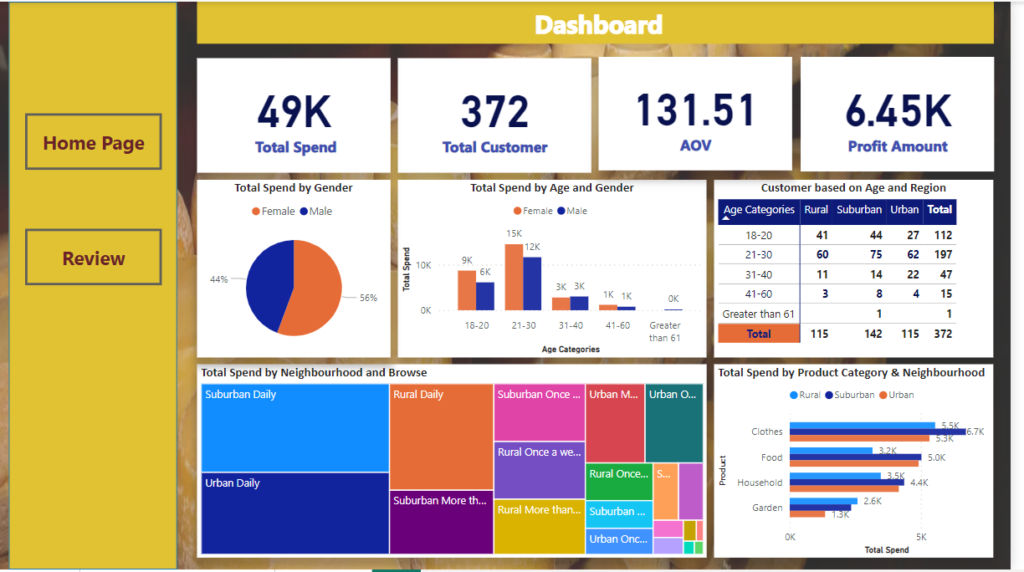
Case Study: Power BI Dashboard

Slide 3
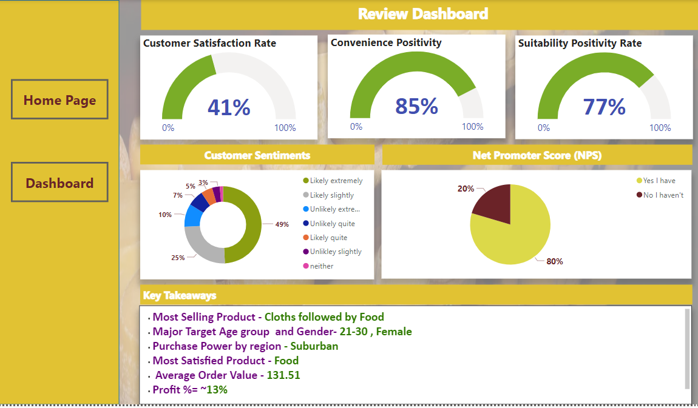
Case Study: Power BI Dashboard

Slide 4



Strategies and recommendations
Improve Clothing Satisfaction
Quality
Market Basket Analysis
Gather feedback directly or using surveys
Variety
Customer Service
Cross-selling
Inventory
management
Advertising Campaigns
Targeted Cloth Marketing
Tailor to Demographics
Local Influencers
Diversity offerings
Taste and preferences
Introduce new styles, brands, sizes
Expanding the products
Notes:
Improve Clothing Satisfaction: Since clothing is the most selling category but has a low satisfaction rate, focus on improving the quality, variety, and customer service in the clothing section. Conduct surveys or gather feedback directly from customers to understand their pain points and preferences.
Targeted Marketing: Recognizing that customers buying clothes primarily come from semi-urban or rural areas, tailor your marketing efforts to resonate with this demographic. Consider using local influencers or running targeted advertising campaigns in relevant areas.
Diversify Product Offerings: While clothes are the top-selling category, consider expanding your product offerings within the clothing section to cater to different tastes and preferences. Introduce new styles, sizes, and brands that appeal to a wider range of customers.
Identifying Cross-Selling Opportunities: market basket analysis can uncover patterns and relationships between items that are frequently purchased together.
By understanding these associations, the store can optimize product placement and suggest complementary items to customers, leading to increased sales and customer satisfaction. Improving Inventory Management: market basket analysis can provide insights into which items are frequently purchased together and their demand patterns. This information can help the store better manage inventory levels, reduce stockouts, and minimize overstocking, leading to improved operational efficiency and cost savings. By recommending relevant products or offering bundle deals based on past purchases, the store can enhance customer satisfaction and loyalty.

Slide 5

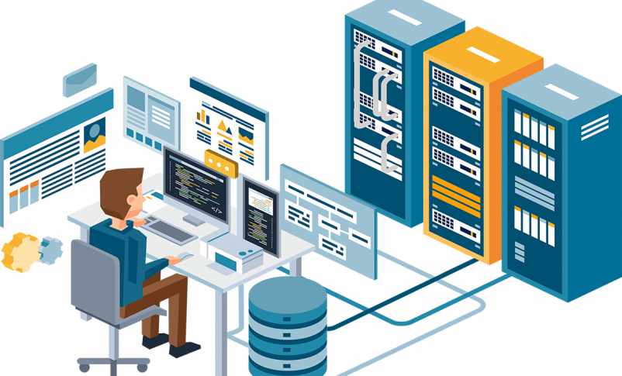






Achieving Objectives
Technical
Data mining, visualization and process improvement
IT Infrastructure
Interpersonal
Strong Communication Skills
Global teams
ITIL certified
Team player and leader
Ability to look at the big picture
Efficiency improvement
using automation
Improve Sustainability in operations

Slide 6
Thank You!

