Slide 1
Employee Data Analysis using Excel
STUDENT NAME: Pooja Devi G
REGISTER NO: 312210454
DEPARTMENT: B. Com (General) (II Shift)
COLLEGE: GSS Jain College for Women, Vepery.

Slide 2
PROJECT TITLE
Employee Performance Analysis using Excel

Slide 3


AGENDA
Problem Statement
Project Overview
End Users
Our Solution and Proposition
Dataset Description
Modelling Approach
Results and Discussion
Conclusion
3/21/2024 Annual Review

Slide 4

PROBLEM STATEMENT
The organization seeks to analyze employee performance to identify key factors influencing productivity, efficiency, and overall contributions to business goals. Currently, performance data is dispersed across multiple sources, making it challenging to assess individual and team effectiveness. The lack of a standardized approach hinders the ability to reward high performers and address areas needing improvement. Additionally, understanding the correlation between employee engagement and performance remains unclear. A robust, data-driven analysis is required to make informed decisions that foster employee growth and optimize organizational outcomes.

Slide 5

PROJECT OVERVIEW
The project aims to analyze employee performance through data-driven metrics to enhance productivity and organizational growth. By leveraging key performance indicators (KPIs) such as task completion rates, efficiency, and peer feedback, we will identify top performers and areas for improvement. Advanced analytical tools and machine learning models will be utilized to detect patterns and predict future performance trends. The findings will support strategic decisions in talent management, training, and resource allocation. Ultimately, the project will foster a culture of continuous improvement and accountability within the organization.

Slide 6

WHO ARE THE END USERS?
Human Resources (HR) Department: They use the insights to manage talent,
drive recruitment, promotions, and develop training programs.
Managers and Team Leaders: To monitor team productivity, recognize high performers,
and address areas needing improvement.
Executives and Senior Leadership: For strategic decision-making, workforce planning,
and aligning employee performance with business goals.
Employees: To receive feedback, understand their own performance, and identify growth
opportunities.
Learning and Development Teams: To tailor training programs based on identified
skill gaps and performance trends.

Slide 7

OUR SOLUTION AND ITS VALUE PROPOSITION
Condintional Formating. Missing
Filter.Remove
Formula.Performance
Pivot.Summary
Graph.Data Visulaztion

Slide 8
Dataset Description
Employee-Kaggle
26-features
9-features
Empid-num
Name-Text
Emp type
Performacce level
Gender – Male-Female
Employee rating - num

Slide 9

THE "WOW" IN OUR SOLUTION
Performance Level = =ifs(Z8>=5,"VERY HIGH",Z8>=4,"HIGH",Z8>=3,"MED",TRUE,"LOW")
Moving Trend
Values in graph for Business Units
3/21/2024 Annual Review
9

Slide 10
MODELLING
Data Collection
1. Employee Basic Details
2. Business Unit
3. Employee Status
Feature Collection
1. Employee Rate
Data Cleaning
1. Active Employees
Performance Level
Very High
High
Medium
Low
10

Slide 11
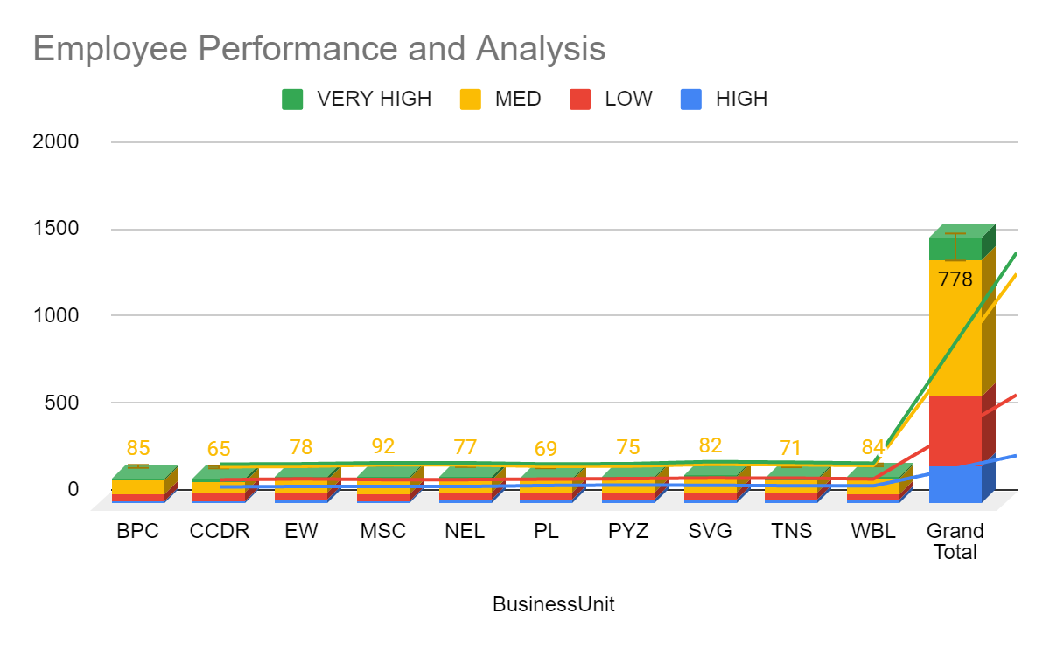
RESULTS
11

Slide 12
conclusion
1. Summary of Findings:
Briefly restate the main points or patterns observed in the performance data, such as overall strengths, weaknesses, and trends.
Mention significant performance metrics and how they align with the organization’s goals.
2. Performance Insights:
Highlight the factors influencing performance, such as skill gaps, engagement levels, or resource limitations.
If applicable, note any discrepancies between high and low performers.
3. Recommendations:
Suggest actionable steps to enhance performance, such as training, mentorship, realignment of roles, or improved resources.
Recommend ways to maintain high performance in top-performing employees.
4. Next Steps:
Propose a plan for continuous monitoring and feedback, emphasizing the importance of regular performance reviews.
Encourage fostering a culture of continuous improvement and professional growth.

