Slide 1

SUBJECT : KNOWLEDGE MANAGEMENT
COURSE CODE : UE15CS344
TOPIC : DESIGNING A KNOWLEDGE MANAGEMENT PORTAL FOR CSE DEPARTMENT
NAMES
Bhaarat Chetty
USN's
01FB15ECS065
Brindavana Sachidanand
01FB15ECS072
Chaitra M V
01FB15ECS073
D J Pooja
01FB15ECS083
Devika Mishra
01FB15ECS093

Slide 2
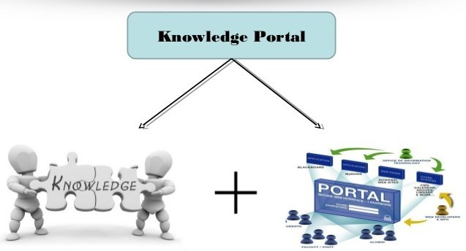
WHAT IS KNOWLEDGE PORTAL ?
What is Knowledge ?
What is Portal ?
What is Knowledge Portal ?

Slide 3
TYPES OF PORTAL :
> Personal Portals
> Government Web Portals
> Cultural Portals
> Corporate Portals
> Functional Portals
> Stock Portals
> Tender's Portals

Slide 4
Difference between a Portal and a Website
Websites are for driving traffic, whereas web portals are for limiting traffic to a specific group of users. Most web portals require a user to log in, which allows the site to deliver more specific content and services based on who that user is.
Website :
●
Location on the internet publically accessible with a unique URL (web address).
No login is required and anyone can see the content.
●
Portal :
●
A private location on the internet, accessible with a unique URL (web address) and unique username and password.
●
Personal login is required and only portal members can see the content.

Slide 5
OUTLINE OF KM PORTAL
KNOWLEDGE CAPTURE
DATABASE MODULE
UI
RULES,
DEFINITIONS ETC
KNOWLEDGE
DATABASE
DISSEMINATION
UI
EXTERNAL USERS
ANALYTICS OR REPORTS

Slide 6
VARIOUS COMPONENTS OF KM PORTAL
USER INTERFACE(UI) : User Interface is the means by which the user and a computer system interact
EXTERNAL USERS: Users here include Students ,Teachers ,Parents, Management and Researchers
KNOWLEDGE CAPTURE: This implies capturing data. It can be achieved by entering data through keyboard or uploading from a document or fetching it from other sources.
KNOWLEDGE DISSEMINATION: Knowledge
dissemination, also known as the sharing and transferring of knowledge represent the exchange of information,expertise or knowledge between members within the firm. In other words,knowledge sharing represents the convenience of accessing knowledge among the users.
DATABASE MODULE: Database Module verifies with the rules and definitions. Once verified, puts into the database

Slide 7
ANALYTICS/RECORDS: Every organization creates records,whether in paper, film, electronic record, or some other format.
Records management helps an organization to make sure it is creating and maintaining an adequate documentary record of its functions,policies,decisions,procedures,and essential transactions
DATABASE: Database is a structure which is used to provide quick and easy access to all of the information necessary to run an organization.
TESTING: This involves testing the components
of Knowledge Management System .It starts with UI and proceeds with Knowledge
Capture , Rules and finally the database
RULES AND DEFINITIONS: Certain
specifications on the data like taking care of any inconsistency present

Slide 8
KNOWLEDGE MANAGEMENT PORTAL FOR CSE DEPARTMENT - PESU
STUDENTS
PARENTS
TEACHERS
MANAGEMENT
RESEARCHERS
The various programs offered by the department are designed to create globally competent man power for the
^{DEPT HEAD:DR SHYLAJA SS}Information and Communication
ESTABLISHED:1972
Technology industry(ICG)
LOCATION:B-BLOCK
PROGRAMS
PHONE NO:555-111-2345
-B. Tech
-M .Tech with specializations in
EMAIL:pes_cse@pes.edu
Cloud Computing, Web
Technologies,Software
Engineering,Big Data & IOT
-Integrated B .Tech – M . Tech
PESSAT 2018 : REGISTER NOW!!!!!!!

Slide 9



PORTAL FOR STUDENTS
LOGIN
DEPT HEAD:DR SHYLAJA SS ESTABLISHED:1972 LOCATION:B-BLOCK
PHONE NO:555-111-2345
EMAIL:pes_cse@pes.edu
COURSES OFFERED
PLACEMENT DETAILS
ANNOUNCEMENTS
CLUBS AND ACTIVITIES

Slide 10



COURSES OFFERED
The programs of the department are designed to create globally competent manpower for the
information and communication technology (ICT)
industry.The students will build specialist Knowledge in the field of applied computer sciences with the flexibility to follow their interest through the choice of varied optional modules, courses and electives.
PROGRAMS
-B. Tech
-M. Tech with specializations in Cloud Computing, Web Technologies,Software Engineering,Big Data & IoT, Cyber Security
-Integrated B. Tech – M. Tech Program

Slide 11









CLUBS AND ACTIVITIES

Slide 12



ANNOUNCEMENTS
SAMARPANA-RUN WITH THE JAWANS ON 25TH MARCH

Slide 13
PLACEMENTS
Over the years, the placement office has ensured that all the eligible candidates got placed in companies with very good credentials. These include MNCs and Indian companies which are well established and startups. Some of these are product companies and the others are in the “Services” space. We now have a fairly strong alumni network working across technologies
and domains and many of them have started feeding in some of the knowledge they have gained to the current crop of students. We also have more and more companies wanting to come and hire from our college because of the proven track record of our alumni.
PLACEMENT STATISTICS (2017):
 | TIER-I
SL NO | Company | No of Students
1 | SAP Labs | 6
2 | Sprinklr | 2
3 | Reverie Lan | 4
4 | Amadeus Se | 3
5 | Tesco | 3
6 | Myntra Des | 2
7 | Salt Side | 2
8 | Code Nation | 1
9 | Edgeverve | 1
10 | Infinera

Slide 14
 | TIER-II
SL NO 1 | Company ACI WORLD | No of Students 2
2 | AIG Analyti | 5
3 | AIG CoE | 1
4 | BRIDGEi2i | 3
5 | Cloud lendi | 3
6 | Danske IT | 2
7 | Globollogic | 1
8 | Indegene L | 1
9 | Manhattan | 4
10 | Oracle | 4
 | TIER-III
SL NO | Company | No of Students
1 | Accenture | 15
2 | Infosys | 8
3 | Capgemini | 2
4 | Genpact | 3
5 | Onmobile | 7
6 | Volvo | 5
7 | NTT Data | 5
8 | eLitmus | 1
9 | Tata Elxsi | 2
10 | Neudesic | 2

Slide 15
Login page which appears on clicking the Login tab on Students homepage
USERNAME
PASSWORD
Forgot password?
SUBMIT
SAMARPANA-RUN WITH THE JAWANS ON 25TH MARCH

Slide 16
Login page which appears on clicking the SUBMIT tab
Welcome NAME
NAME:ABCD
Email:abc@gmail.com Contact no:998879569
Photo of the student.
ATTENDANCE
ACADEMIC PERFORMANCE
ACHIEVEMENTS
SIGN OUT
SAMARPANA-RUN WITH THE JAWANS ON 25TH MARCH

Slide 17
Page which appears on clicking the Attendace tab
Courses Total number Number of of classes classes conducted attended
Compiler Design
Unix System Programming
Machine Learning
Elective - 3
Elective - 4
Compiler Design Laboratory
Unix System Programming Laboratory
Machine Learning Laboratory

Slide 18
Page which appears on clicking the Academic Performance tab
Courses | ISA – 1 Marks | ISA – 2 Marks | ESA Marks
Compiler Design
Unix System Programming
Machine Learning
Elective - 3
Elective - 4
Compiler Design Laboratory
Unix System Programming Laboratory
Machine Learning Laboratory

Slide 19
ACHIEVEMENTS
Page which appears on clicking Achievements tab
●
●
Secured 3rd Place in Google Hackathon Secured 2nd Place in 10K Marathon Run
●
●
●
●
●
●
●
●
●
●
●
●
●
●
●
●
●
SAMARPANA-RUN WITH THE JAWANS ON 25TH MARCH

Slide 20
STUDENT DATABASE
SRN
NAME SEMESTER
CGPA BATCH ADMISSION EMAIL ADDR
CONTACT NO
VARCHAR
CHAR VARCHAR
NUMERIC INTEGER CHAR VARCHAR NUMERIC
SRN
STUDENT ACHIEVEMENTS
VARCHAR
VARCHAR

Slide 21






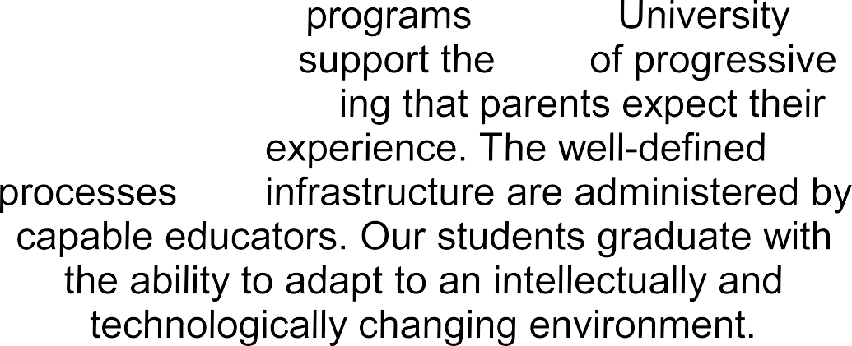











LOGIN
LOGIN
Web page that appears on clicking the Parents tab
IMPORTANT INFORMATION FOR PARENTS
CAMPUS LIFE
ACCOMODATION
HEALTH
SAFETY
SCHOLARSHIPS
ADVERTISEMENTS

Slide 22

Page that appears on clicking CAMPUS LIFE tab on Parents page
PES University campus life is about balancing personal and academic goals. The opportunities to be part of sports, cultural and socially useful activities and activities that are as much fun as learning shape the personality of our students.
ADVERTISEMENTS

Slide 23
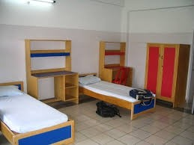
Page that appears on clicking ACCOMODATION tab on Parents page
The excellent residential facilities have been carefully planned according to international standards. Our hostels on the campus offer well- ventilated, comfortable rooms with round the clock security. The University has a tradition of a student community working together to take up meaningful initiatives. In the process they make friends and realize the importance of team play.
ADVERTISEMENTS

Slide 24

Page that appears on clicking HEALTH tab on Parents page
The increasing demands of academics has brought into focus the work-life balance. The association with Excelcare medical center enables students to get timely medical advice and counselling on health and personality related issues.
ADVERTISEMENTS

Slide 25

Page that appears on clicking SCOLARSHIPS tab on Parents page
Outstanding performers right from entrance exam stage, are identified by their achievements in curricular and co-curricular activities. The University assists students in exploring options of financial aid.
ADVERTISEMENTS

Slide 26

Page that appears on clicking SAFETY tab on Parents page
The University infrastructure meets the stringent standards of safety laid down by the regulatory authority. The on campus activities and entry and exit of visitors are actively monitored. The quality of food and essential supplies are subject to periodic checks. Easily accessible contact points are provisioned for informing the authorities in case of any risks.
ADVERTISEMENTS

Slide 27
Login page which appears on clicking the Login tab on Parents homepage
USERNAME
PASSWORD
Forgot password?
SUBMIT

Slide 28




Login page which appears on clicking the SUBMIT tab
Welcome name
Student's Name: ABCD Student's Email: abcd@xmail.com
Student's Contact Number: 9611862581
Parent's Name: WXYZ Parent's Email: wxyz@xmail.com
Parent's Contact number: 9999000088
Attendance
Academic Performance
Photo of the student.
Extra-Curricular Achievements
Announcements
SIGN OUT
Advertisement

Slide 29
Page which appears on clicking the Attendace tab
Courses Total number Number of of classes classes conducted attended
Compiler Design
Unix System Programming
Machine Learning
Elective - 3
Elective - 4
Compiler Design Laboratory
Unix System Programming Laboratory
Machine Learning Laboratory

Slide 30
Page which appears on clicking the Academic Performance tab
Courses | ISA – 1 Marks | ISA – 2 Marks | ESA Marks
Compiler Design
Unix System Programming
Machine Learning
Elective - 3
Elective - 4
Compiler Design Laboratory
Unix System Programming Laboratory
Machine Learning Laboratory

Slide 31
Page which appears on clicking the Extra - Curricular Achievements tab
STUDENT'S EXTRA – CURRICULAR ACHIEVEMENTS
●
●
Secured 3rd Place in Google Hackathon Secured 2nd Place in 10K Marathon Run
●
●
●
●
●
●
●
●
●
●
●
●
●
●
●
●
●
ADVERTISEMENTS

Slide 32
Page which appears on clicking the Announcements tab
ANNOUNCEMENTS
●
●
●
Parent – Teacher's Meeting is scheduled on 1st April 2018 Prakalpa (A Science Exhibition) is scheduled on ........
Epsilon (A Science Fest) is scheduled on .........
●
●
●
●
●
●
●
●
●
●
●
●
●
●
●
●
ADVERTISEMENTS

Slide 33
PARENTS DATABASE
SRN
STUDENT NAME PARENT NAME CGPA
BATCH
ADMISSION
STUDENT EMAIL ADDR
STUDENT CONTACT NO
PARENT EMAIL ADDR
PARENT CONTACT NO
VARCHAR
VARCHAR VARCHAR NUMERIC
CHAR VARCHAR
NUMERIC VARCHAR NUMERIC
INTEGER

Slide 34
LOGIN
LOGIN
Web page that appears on clicking the teachers/Faculty tab
UG Teachers
PG Teachers
Name
Designation
Name
Designation
Dr. Shylaja SS
Professor and Chairperson
Prof. Nitin V Pujari
Professor & Chairperson

Slide 35





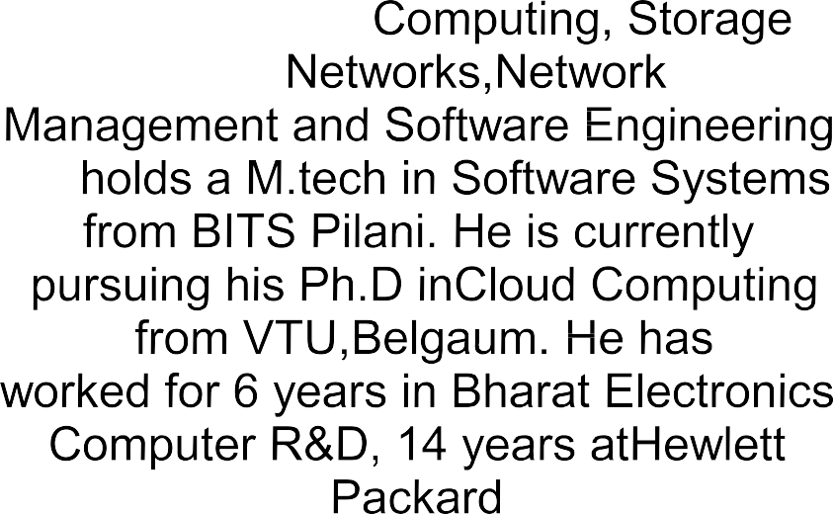












When name of some professor is clicked on (without /with login - Other than yours).
Name: ABCD Email: abcd@xmail.com
Contact number: 9999000088
DOJ: 26.03.2010
Experience: 14 years
Currently teaching: subject S And special topic P
Profile
Publications & Research
Responsibilities
Photo of the faculty.
Advertisement

Slide 36
On clicking the Publication and research tab on faculty page.
Name: ABCD
Profile
Publications & Research
Responsibilities
Photo of the
faculty.
●
●
●
●
●
●
Excellent and consistent publication record, with 35+ international papers in
peer reviewed conferences and journals with 85 citations , h-index of 6 and
i10-index of 2.
Received a Travel Grant of Rs.25,000 from VTU towards paper presentation in an International conference conducted in Kathmandu, Nepal.
Received a Travel Grant of Rs.50,000 from PESIT towards paper presentation
in an International conference conducted in Xiamen, China.
Guided several academic and research projects, many of them leading to research publications.
Email: abcd@xmail.com
Contact number: 9999000088
DOJ: 26.03.2010
Experience: 14 years
Currently teaching: subject S And special topic P
CURRENT RESEARCH
Isolated Handwritten Kannada Character recognition
Document Analysis of Handwritten Documents
Microarray gene Analysis for Cancer Detection
Fingerprint Recognition
Nature Inspired Computing
Medical Imaging

Slide 37















Name: ABCD
Profile
Publications & Research
Responsibilities
Photo of the
faculty.
Email: abcd@xmail.com
Contact number: 9999000088
DOJ: 26.03.2010
Experience: 14 years
Currently teaching: subject S And special topic P
Advertisement

Slide 38
Login page which appears on clicking the Login tab on teachers homepage
USERNAME
PASSWORD
Forgot password?

Slide 39


















Welcome name
Name: ABCD Email: abcd@xmail.com
Contact number: 9999000088
DOJ: 26.03.2010
Experience: 14 years
Currently teaching: subject S And special topic P
EDIT PROFILE ^{P}
UBLICATION
SIGN OUT
Photo of the faculty.
& RESEARCH
Advertisement

Slide 40
Photo of the
faculty.
Welcome: ABCD Member ID: 1PF1008
EDIT PROFILE ^{P}
UBLICATION
SIGN OUT
& RESEARCH
Edit / Add research work: On clicking edit a dialog box with all The present data appears and can be edited.
Add Your work here...
Edit/ Add Publications: (Please do provide link for the same if possible)
Add Your work here...
Add awards/ achievements:
Add Your achievements here...
SAVE

Slide 41
On clicking the Publication and research tab on faculty page.
Name: ABCD Email: abcd@xmail.com
Contact number: 9999000088
DOJ: 26.03.2010
Experience: 14 years
Currently teaching: subject S And special topic P
●
●
●
●
●
●
Excellent and consistent publication record, with 35+ international papers in
peer reviewed conferences and journals with 85 citations , h-index of 6 and
i10-index of 2.
Received a Travel Grant of Rs.25,000 from VTU towards paper presentation in an International conference conducted in Kathmandu, Nepal.
Received a Travel Grant of Rs.50,000 from PESIT towards paper presentation
in an International conference conducted in Xiamen, China.
Guided several academic and research projects, many of them leading to research publications.
Photo of the faculty.
CURRENT RESEARCH
Isolated Handwritten Kannada Character recognition
Document Analysis of Handwritten Documents
Microarray gene Analysis for Cancer Detection
Fingerprint Recognition
Nature Inspired Computing
Medical Imaging

Slide 42
Database for Faculty:
Member_id | Varchar
Name | Varchar
Email | Varchar
Contact | Numeric
Dob | Date
Designation | Varchar
Responsibilities | Varchar
CTC | Numeric
DOJ | Date
Experience | Numeric
Database for research, publication and Responsibilities : (Member_id,Research work and publication make composite key)
Member_id | Varchar
Publication | Varchar
Research | Varchar

Slide 43
Page that appears on clicking Management tab on home page(For outsiders)
INFORMATION FOR :
> Chancellor
> Pro Chancellor
> Vice Chancellor
> Principal
> Hostel Manager
> Librarian
>
ADVERTISEMENT

Slide 44
Web page that appears on clicking information about each officer
CHANCELLOR
Image of Chancellor
Dr. M. R. Doreswamy, Chancellor, PES University
In 1972, PES was founded in Bangalore with just over 40 students. Today, we have more than 18,000 students spread across four different campuses in Karnataka
It is our unwavering commitment to the highest quality education that has sped us along on this journey.
I would also like to thank the generations of parents who have entrusted us with the care and education of their
children. It is their faith and belief in the PES values – Perseverance, Excellence and Service.
I believe that education has the most critical role to play in the progress of a nation. We realize that our students represent the future of our society and we take our responsibility seriously. We ensure that the rock-solid foundation we help them build here – both, in terms of
skills and values – will stand them in good stead no matter which career they choose. Along with the requisite academic and related skills, we try and instill empathy for the less fortunate in our students and a concern for the environment around them.

Slide 45
Login page that appears on clicking the Management Login tab on Management page.
USERNAME
PASSWORD
Forgot password ?
SUBMIT

Slide 46
Welcome to Management Portal !
Name : XYZ Email-id : abc Contact_no : 123 Position : pqr
DASHBORAD
Photo
FEE/ACCOUNT
EXAMINATION MGMT
HOSTEL MGMT
PLACEMENTS
FEEDBACK

Slide 47
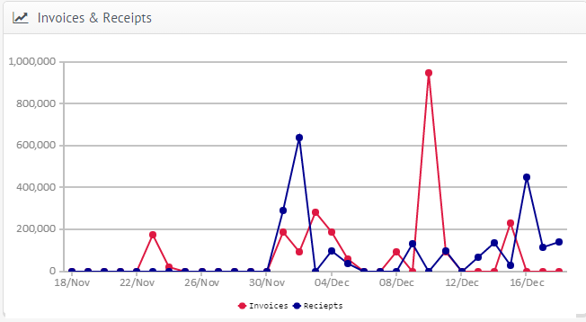
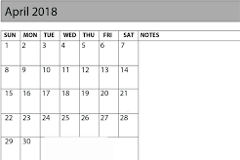
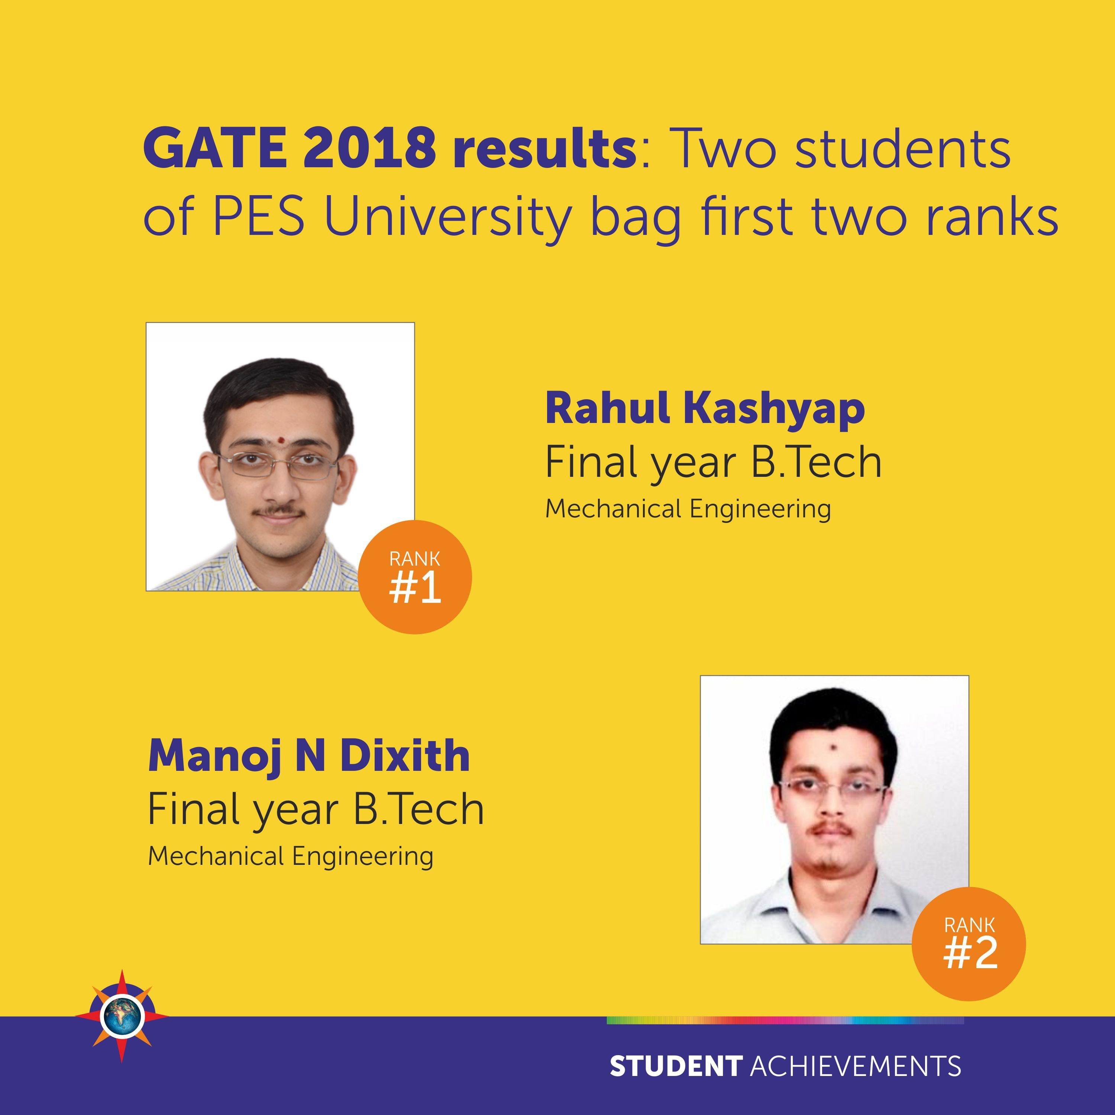
DASHBOARD
Programmes-Max.Enrolled Students |  |  | Programmes-Max | .Revenue
Workshops | 200 |  | Bridging courses | 150000
Bridging courses | 250 |  | Hosting Exams | 900000
Local short courses | 100 |  | Tech Fests | 100000
Tech talks | 50
Circulars and Notices
Message Board
104 Active Cohorts in the Campus
Science Fest Award Distribution
1500 Enrolled Students

Slide 48
Page that appears on clicking Fee/Account Management
tab on Management tab
Manage Fee
Invoices
Scholarship
Invoic e_No
Name
Amt
Status
SrnNo
Name
Amt of conce ssion
Categ ory
1458 Zyx
75000 Paid
045
Zyx
7500
Mrd
Manage Accounts
Payment |  |  |  | Credit Notes
Trn No | Name | Amt | Date | Trn_No | Loan | Status
014 | Abc | 54000 | 05-04 | 014 | 80000 | Not paid
AACSB ACCREDITED

Slide 49
Webpage that appears on clicking Examination Management tab on the Management Portal
Date | Sub | Time | Room Allotmnt (Usn ) | Teacher allotmnt | Subitu- te
14/05 | DBMS | 1:30- 5:30 | B-106: B-401 | Xyz | Abc
16/05 | KM | 1:30- | B-201: | Abc | Xyz
 |  | 5:30 | B-501
ADVERTISEMENTS

Slide 50
Webpage that appears on clicking Hostel Management tab on the Management Portal
GIRLS HOSTEL
UNIT ROOM NO_OF S_AVAI _STUD LABLE ENTS |  |  | FEES | WARD STAFF EN AVAILA NAME ^{BLE}
UNIT1 | 30 | 90 | 85000 | Xyz | 12
BOYS HOSTEL
BLOCK | ROOM S_AVAI LABLE | NO_OF STUDE NTS | FEES | WARD EN NAME | STAF F AVAIL ABLE
BLK_A | 40 | 100 | 90000 | ZSW | 21
ADVERTISEMENTS

Slide 51
Page that appears on clicking Placements tab on Management tab
PLACEMENT STATISTICS (2017):
TIER-I
SL NO Company No of Students SAP Labs 6 Sprinklr 2 Reverie Lan 4 Amadeus Se 3 Tesco 3 Myntra Des 2 Salt Side 2 Code Nation 1 Edgeverve 1 Infinera 5

Slide 52
 | TIER-II
SL NO 1 | Company ACI WORLD | No of Students 2
2 | AIG Analyti | 5
3 | AIG CoE | 1
4 | BRIDGEi2i | 3
5 | Cloud lendi | 3
6 | Danske IT | 2
7 | Globollogic | 1
8 | Indegene L | 1
9 | Manhattan | 4
10 | Oracle | 4
 | TIER-III
SL NO | Company | No of Students
1 | Accenture | 15
2 | Infosys | 8
3 | Capgemini | 2
4 | Genpact | 3
5 | Onmobile | 7
6 | Volvo | 5
7 | NTT Data | 5
8 | eLitmus | 1
9 | Tata Elxsi | 2
10 | Neudesic | 2

Slide 53
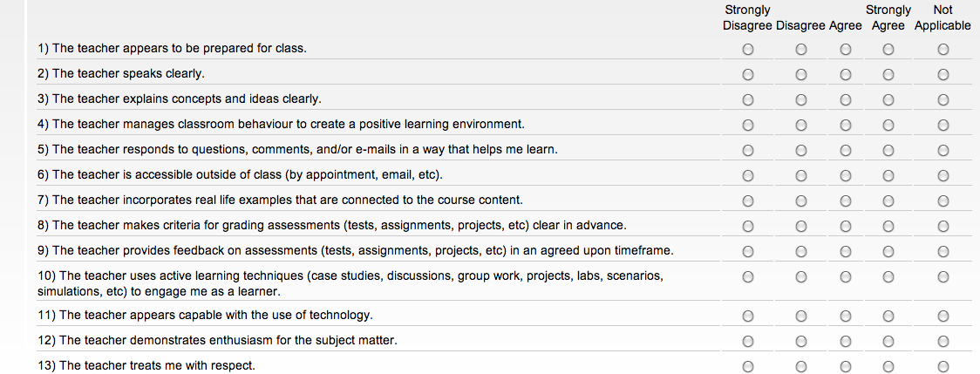
Page that appear on clicking Feedback tab
on Management tab
FACULTY NAME : XYZ
ANY OTHER COMMENTS :

Slide 54
MANAGEMENT DATABASE
INVOICE NUMBER
INTEGER
STUDENT NAME
CHAR
AMOUNT
NUMERIC
STATUS
VARCHAR
SRN
VARCHAR
DATE
DATE
REMARKS
VARCHAR
FACULTY NAME
CHAR
Database for Examination and Hostel
Management
DATE
SUBJECT FEE
DATE VARCHAR
INTEGER
WARDEN_NAME CHAR
ROOMS_AVAILABLE INTEGER

Slide 55


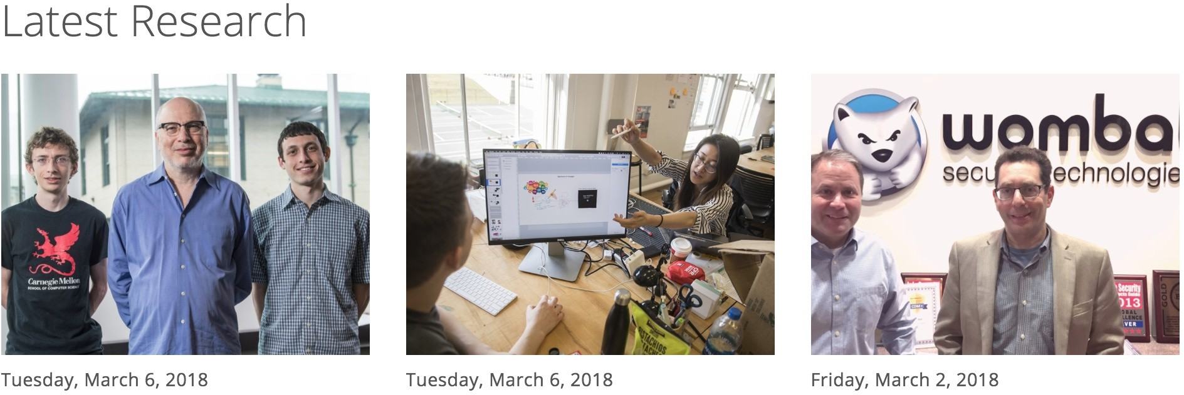
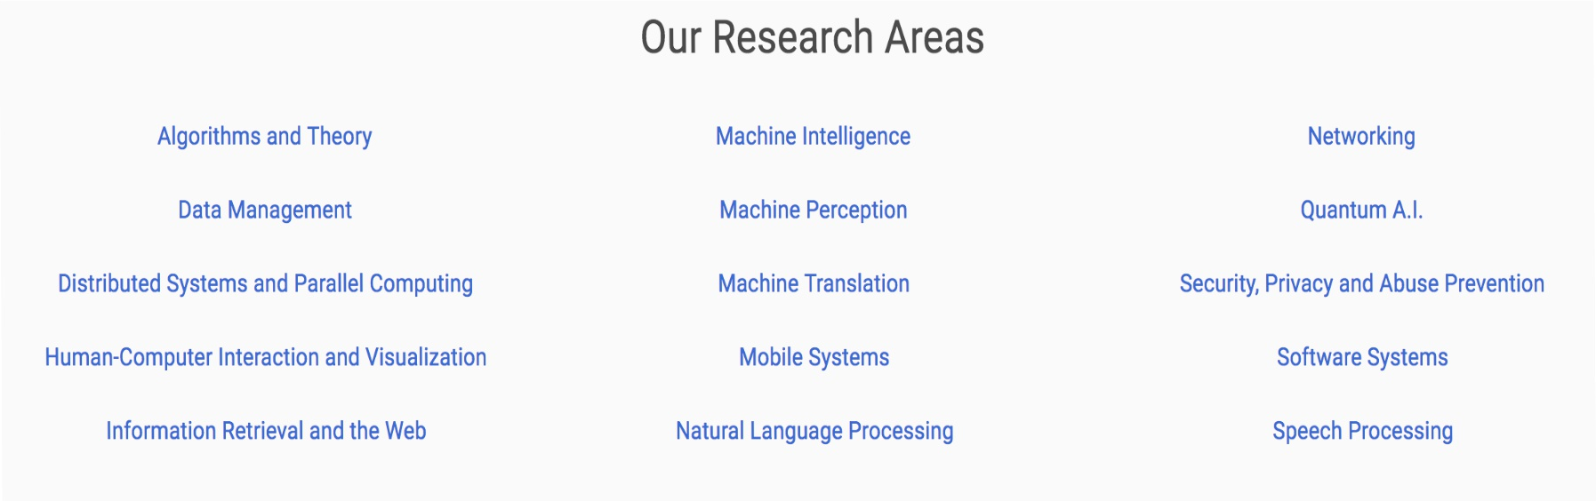
RESEARCH AT PES
RESEARCH CENTERS
CONTACT
Get In Touch

Slide 56

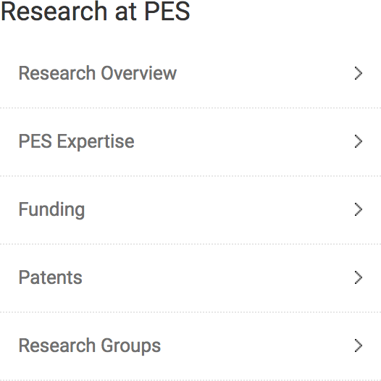

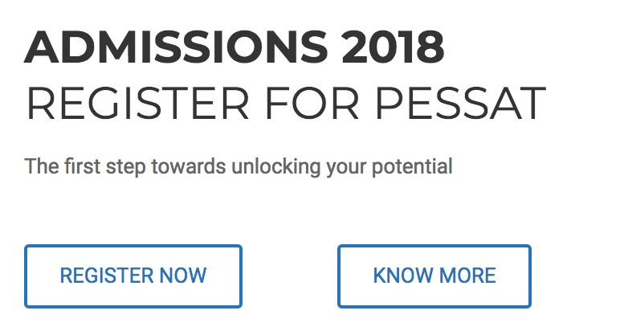
Web page that appears on clicking the RESEARCH AT PES
●
Resources
PES University ensures that the best in faculty work in well equipped laboratories. Each domain is guided by a domain head with exceptional academic credentials and a passion for research and development activities. The domain head leads a research team comprising of members drawn from the faculty who work closely with the students.
●
Projects
Research enriches all aspects of teaching and learning. The list of projects demonstrates the deep domain knowledge of the faculty and competence of the students. Premier organizations have relied on PES University’s talent for active assistance.
●
Accomplishments
The various research domains at PES University have successfully initiated projects independently and in collaboration with other research institutes. The funding organizations include government concerns and industries.

Slide 57

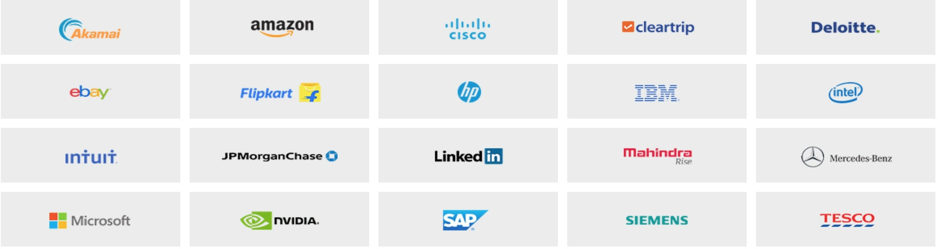
Premier organizations have relied on PES University's talent for active assistance. The guidance provided by the experienced faculty and the well equipped laboratories have ensured successful completion of projects that meet the expectations of the funding organization.
The university has provided funding for many of the promising projects in collaboration with :
●
National Institute of Design Naval Research Board (NRB)
Center for Development of Advanced Computing (CDAC) Indian Space Research Organization (ISRO)
DRDO
●
●
●
●

Slide 58
Adaptive multimodal communication assist system
Patent publication number: United States Patent 8,793,118 (application #13/330,712) Published on: 29th July, 2014 (Filed on 20th December, 2011)
Research Domain: Center for Pattern Recognition
The invention is a system that permits visually and/ or hearing impaired persons to communicate with each other and with people who have normal sight and hearing. It accepts input in one of the multiple modes: audio (speech), video (gestures) or text and relays the output in any one or more of the three modes. If the input and output modes are different, the system processes the input to convert it from one format to another using gesture, speech or text recognition systems (as applicable) that are based on machine learning algorithms. The system permits the user to define their own constructs and dictionaries, thus its use extends beyond standard Indian and International languages.
Further, it adapts to the userâ€™s proficiency level, adjusting the input and output rates to the speed at which the user processes the input/ output. Since a novice user may become proficient with time, the system is designed to continuously adapt to the changing proficiency of the user.
Gesture Based Tangible User Interface for Resource Management
Patent application number 2378/CHE/2014, Patent Filed on 12-05-2014 Research Domain: Networks and Security
This project aims at providing the end users with an innovative way to share resources across cross platform devices using internet as a medium of transfer and gesture based user interface. The main objective is to provide convenience to users to transfer contents by using one simple gesture rather than using additional hardware devices, emails or other such approaches. The project intends to build an application on different platforms which can share documents, media files and links over the internet using hand gestures. The main aim is to provide easy interface for user through gestures to share previously mentioned resources. Thus enables user to share resources without any external hardwares like pen drives and hard disks. Also usage of emails, chat features or other social sites can be avoided to share links and files.

Slide 59
Web page that appears on clicking the RESEARCH CENTERS
Research Centers are more in the nature of a team of students with common interests, a shared lab and an entity that provided opportunities of experiencing the best practices, understanding the latest developments and knowing the current tools and techniques.
Research Centers expose the students to the tools and techniques applied in the core areas and closely related areas. The centers provide mentoring for enthusiastic students to work on research projects in specific areas and help them develop their own approach to problem solving. The centers work on projects independently and in collaboration with other institutions.
●
Ordell Ugo
Center for Cloud Computing & Big Data
Knowledge Analytics & Ontological Engineering (KANOE) Center for Pattern Recognition
Center for Networks And Security PESU-Huawei Innovation lab
Center for Data Sciences and Applied Machine Learning (CDSAML)
●
●
●
●
●
●
Computer Science
The students of the university are sought after by the IT companies. The diverse applications driven by principles of computer science has resulted in domains of: Mobile Systems Engineering, Networks and Security, Cloud Computing & Big Data, Intelligent Social Systems, Knowledge Analytics & Ontological Engineering.

Slide 60

Ordell Ugo, the beginning vision, gives students a chance to participate in the process of developing ideas into research concepts and workable products. Starting from a single room with a small group of students it has grown into a hub of ideas where a large number of students work on innovative projects. Ordell Ugo is the first encounter with the world of research for students.
Research Projects
●
iNoah. An initiative to evangelize Cloud technology.
●
Ogbon. A framework for Interactive and synchronized multilingual multimedia creation, modification and rendering.
●
SNAIDE. Integrated development environment for social network analysis
●
Crowd Scripting. The project attempts to provide an efficient framework that supports CrowdScripting. It identifies students who are most suitable for providing content for a given context.
OBJECTIVES
●
To provide common infrastructure, research environment and technical guidance for students and academicians.
To work with the Industry in terms of current technological problems and challenges and come up with solutions which can make an impact quickly in the technological directions.
Projects:
●
●
Hewlett Packard – Early identification of escalations
Project: ELogic – optimization of BlastX
Janagraaha – Analytics of citizenship participation in smart cities IBM – Cloud Security
●
●
●

Slide 61

KANOE
KAnOE – the Centre for Knowledge Analytics and Ontological Engineering – is a research centre funded primarily by the World Bank through the Government of India – Ministry of Human Resources Development. With a focus on the unique area of combining analytics with ontological engineering, KAnOE aims to make a defining contribution to the field of knowledge management through knowledge analytics and ontological engineering.
PROJECTS
●
Automatically translating very large semantic datasets to Indian languages such as Kannada.
●
Building a browser for Linked Open Datasets.
Ontological engineering of mechanical mechanisms and heat exchangers.
●
The Center for Pattern Recognition is involved in research projects in the ubiquitous areas of signal processing and pattern recognition. It focuses on designing mathematical and engineering tools to solve computational problems in biomedicine, biometric recognition, optical character recognition and text analytics, video processing and various applications of data mining.
PROJECTS
Automated diagnosis of the retinopathy of prematurity in collaboration with Dr. Anand Vinekar and his team at Narayana Nethralaya
Automated (re-)scheduling of surgeries in a multispecialty hospital in collaboration with Mr. Sunil Kumar C. N. and his team at Narayana Hrudayala
Efficient annotation and retrieval of video clips
Strategies to improve the mining of natural language text

Slide 62

●
To help students, faculty remain up to date with current trends in network and security.
To develop technologies for new products that addresses the real world challenges. The document indicates the focus of the research activities at the Network and Security domain in PES University and profiles the research team, technologies, projects and accomplishments.
To encourage collaborative research through working on projects that require expertise in multiple disciplines (such as Cloud computing, Wireless networking, Telecommunications, Data center technologies).
●
●
RECENT ACCOMPLISHMENTS
●
Project: HSTS: A remedy of web based MITM attacks?
Project: Privacy protection of personal data in public clouds Paper: Zygote: A framework for prototyping Smart Devices, IEEE ADCom 2015, Chennai, India
●
The PESU-Huawei Innovation Lab provides required training and guidance to the students, and enable them to innovate or challenge the status quo of current by undertaking the following:
●
Artificial Intelligence and Deep Learning in NLP , computer vision and chatbot.
Augmented reality and virtual reality solutions with smartphones/digital devices.
Projects
Hand Set Testing Automation with Robotic Arm Cloud based OS for Mobile Phones
Adaptive Learning
●
●
●
●

Slide 63
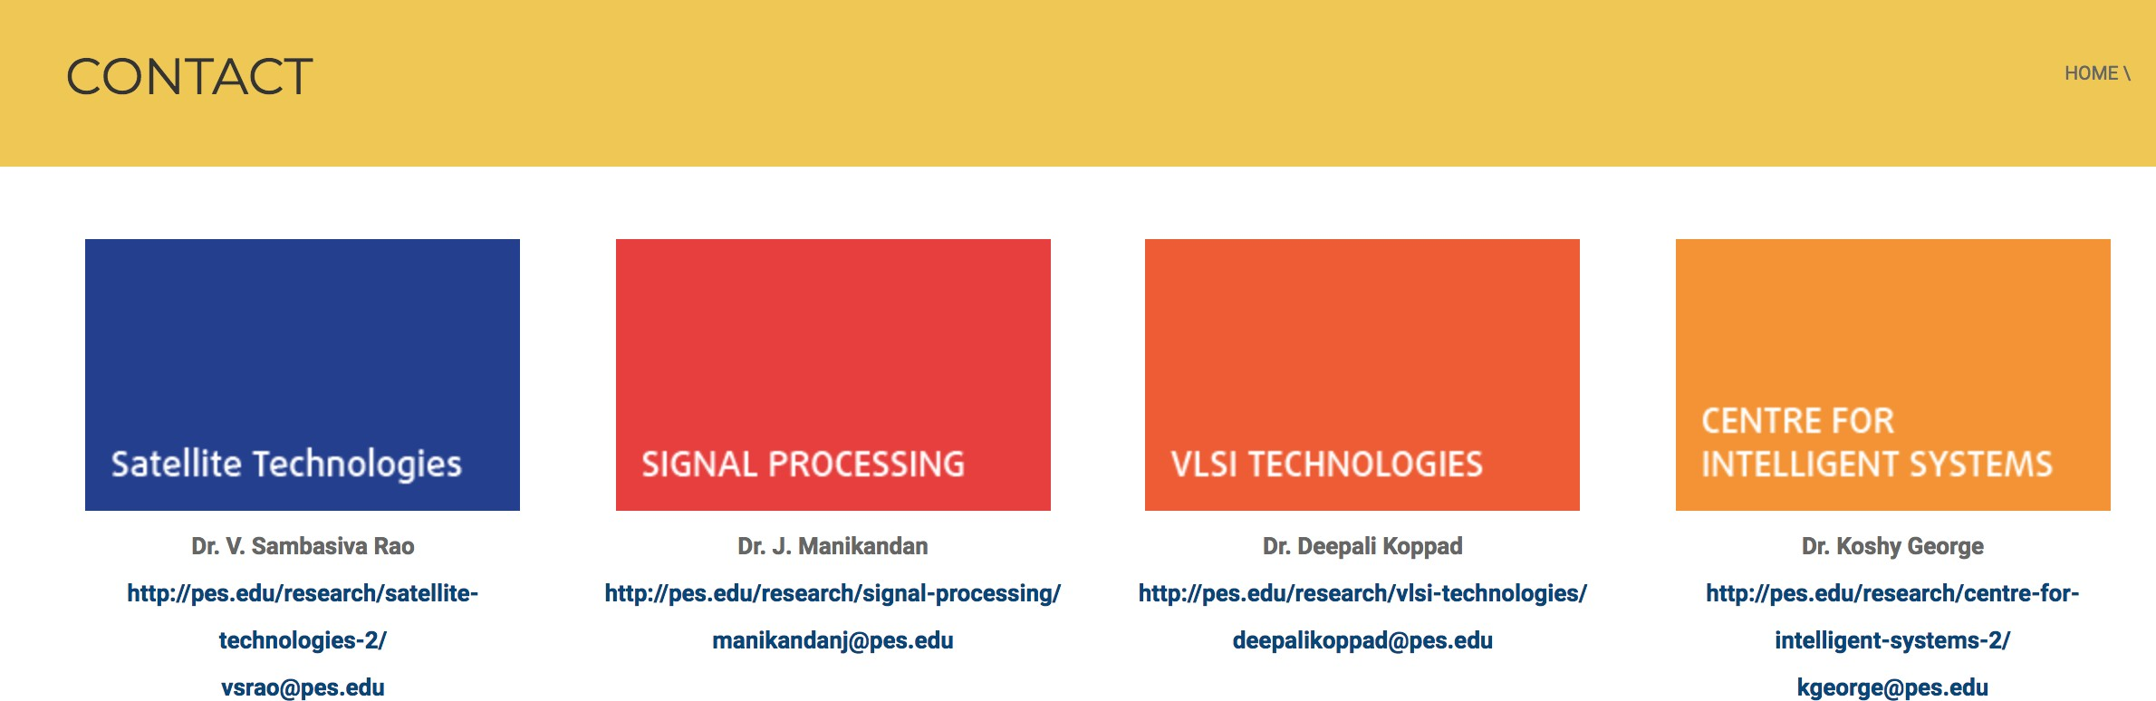


Web page that appears on clicking the CONTACTS Tab

Slide 64
DATABASE
RESEARCH PAPERS AND JOURNALS
TITLE VARCHAR
AUTHOR NAME(s) VARCHAR PUBLISHER NAME VARCHAR
CONFERENCE NAME
JOURNAL NAME
VOLUME
VARCHAR
VARCHAR
NUMERIC
ISSUE
NUMERIC
h-Index
NUMERIC
i10-Index NUMERIC
AUTHOR EMAIL ID(s) VARCHAR
AUTHOR CONTACT NO(s)
PUBLISHER EMAIL ID
NUMERIC
VARCHAR

Slide 65


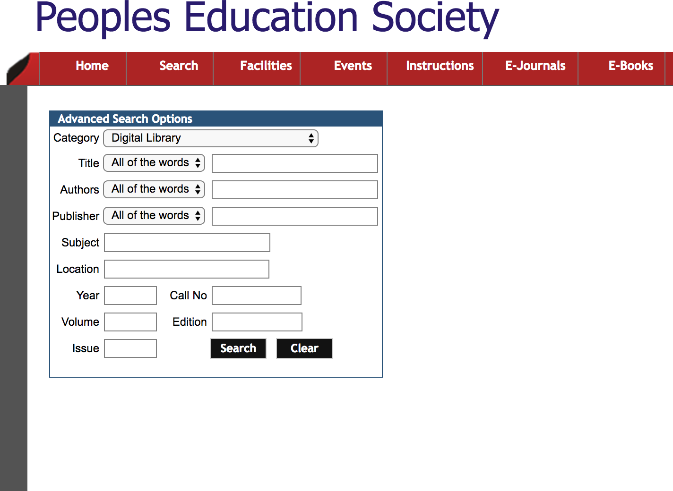
DISTINCTIVE FEATURES OF PES RESEARCH PORTAL

Slide 66
INTERFACING BETWEEN UI AND DATABASE
Frontend : HTML, CSS, JavaScript Backend : mySQL
Tools used for linking : XAMPP and PHP
Advantage of Using mySQL over others
●
mySQL is fast
Reliable
Robust
●
Open source database
●
Administration and Security are effective
●
MySQL is suited for websites/portals and smaller companies that don't require massive storage.

Slide 67
CONCLUSION
The domain-specific portal helps the user gain knowledge about the University, CSE Department in particular. Knowledge of Students, Teachers, Industrial Projects(Research), Management and Parents is gained. This data helps user in gaining information about the quality of work done in the campus. The knowledge dissemination is between the database and the UI. Different portals for different users, improve the portal functionality.

Slide 68
Bibliography
> https://www.slideshare.net/bitttttsdas/knowledge-portal-46679222
> https://www.slideshare.net/akhilesh_551/college-management-project
> https://www.bayt.com/en/specialties/q/166665/what-are-the-types-of-portals/
> http://eduscol.in/Staff-portal.html
> http://www.ifnoss.com/edu/college-university-software/director-login.aspx#
> http://eduscol.in/Store-Inventory_Management_System.html
> https://www.slideshare.net/pinalpatel13/ex033

Slide 69
ANY SUGGESTION ?
SHARE YOUR KNOWLEDGE.
IT'S A WAY TO ACHIEVE IMMORTALITY.
... DALAI LAMA
THANK YOU !

