Slide 1
GITHUB
How people build software?
POOJA D.S.
1MS15MCA33

Slide 2
OUTLINE
Definition of GitHub
Types
About GitHub
Why we use GitHub
Advantages
Disadvantages
Conclusion

Slide 3
What is Github?
Github is a web based Git repository hosting service. It offers all of the distributed version control and source code management(SCM) functionality of Git as well as adding its own features.

Slide 4
GitHub provides two types of plans:
Free Plans
Paid Plans
Free plans for open-source projects and paid plans offering unlimited private repositories. Both plans have the exact same features.
They can have limited number of public repositories, with unlimited collaborators. Paid accounts can create unlimited private repositories.

Slide 5
ABOUT GITHUB?
Github founded on February 8,2008.
Founders are Tom Preston-werner and Chiris Wanstrath
Headquaters located at California,U.S.
Current CEO : Chiris Wanstrath.
Slogan : “BUILD SOFTWARE BETTER, TOGETHER.”,”WHERE SOFTWARE IS BUILT”.
Companies adopted github technology are : google, adobe, twitter,yahoo,linkedin,facebook,dropbox for repository purpose.

Slide 6
WHY USE GITHUB?
Github is like facebook for programmers. Everyone’s on there. You can look at what they’re working on and easily peruse their code and make suggestions or changes.
As github is an Open source, all of the code is easily inspected, as is its entire history.
Github lowers the barriers to collaboration. It’s easy to offer suggested changes to others code through github. You don’t have to set up a git server. It’s surprisingly easy to get things set up.

Slide 7
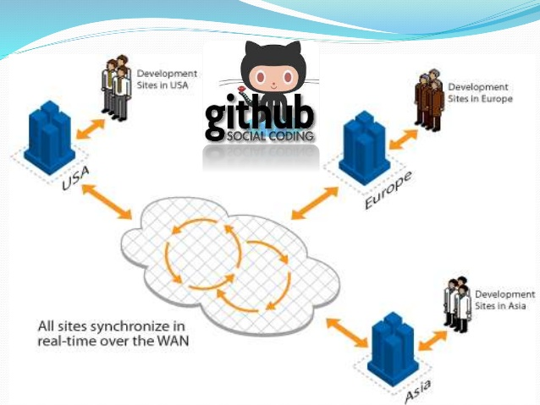

Slide 8
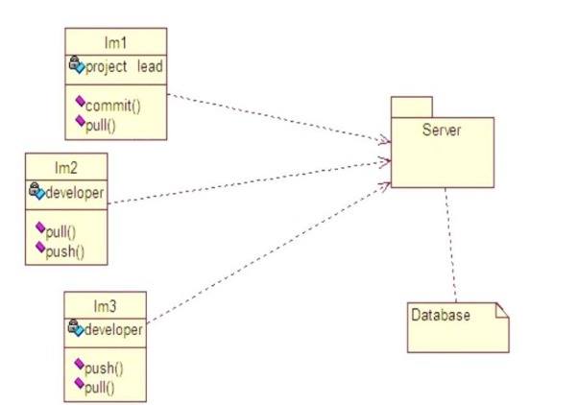

Slide 9
ADVANTAGES :
Self-explaining, straight forward solutions, less overhead code. Thus the code is easy to maintain.
General and flexible solutions. Once designed interfaces remain quite stable.
Well structured solutions, reusable and self-containing modules. Focuses on customer’s need.
Code is kept up-to-date and improved continuously. Stable,well proven,uniform and well-structured software.

Slide 10
DISADVANTAGES :
Simplicity needs time. Design only focused on current requirements, nothing foresighted.
Flexibility and generality results in higher complexity.
Predefined rules (eg : architectural constraints) are sometimes ignored in order to get something working.
There is risk of losing contact state of technologies or methodology.

Slide 11
CONCLUSION:
Millions of developers use github projects , support their businesses on open source.

Slide 12
