Slide 1
PANIMALAR ENGINEERING COLLEGE B.E. COMPUTER SCIENCE ENGINEERING
POOJALAKSHMI .P (211422104339) PRAISY MIRACLINE .O (211422104343) CHATBOT:BOOSTING ENGLISH COMMUNICATION 21CS1503 SOCIALLY RELEVANT MINI PROJECT

Slide 2
ABSTRACT
This project focuses on the development of a specialized chatbot aimed at enhancing English communication skills among primary school students. The chatbot is designed with the unique needs of primary school students in mind, incorporating age-appropriate language and content. It leverages natural language processing (NLP) and artificial intelligence (AI) to facilitate dynamic interactions, offering real-time feedback and personalized learning experiences. To ensure the effectiveness of the chatbot, several pedagogical principles are applied. The design emphasizes simplicity and clarity in communication . The integration of technology in education has revolutionized the learning experience, particularly for young learners. By providing a personalized and engaging platform for language practice, the chatbot has the potential to support the development of foundational English communication skills in young learners.

Slide 3
EXISTING SYSTEM
Existing chatbots for primary student’s English communication focus on interactive learning, adaptive feedback, and engaging content. They offer features like conversational practice, vocabulary building, and grammar exercises through gamified elements and storytelling. Various platforms use AI to tailor lessons and provide real-time feedback, while some other tools like offer instant explanations and practice. These systems are designed to align with educational standards and cater to diverse learning styles, though challenges include ensuring content accuracy and maintaining student interactive and engagement. Overall, these chatbots enhance language learning by making and personalized . But these tools are online tools and most often user needs to pay money to access them.

Slide 4
PROPOSED SYSTEM
The proposed system introduces an innovative offline chatbot designed to enhance English communication skills for primary school students . The chatbot utilizes pre-trained language models tailored to educational content, allowing students to practice vocabulary, grammar, a through engaging dialogues and interactive exercises. One unique aspect of this offline chatbot is its integration with localized content . By incorporating culturally relevant scenarios and examples, the chatbot ensures that students are not only improving their English but also connecting with real-life situations. This approach combines cutting-edge technology with practical accessibility, making effective English language learning achievable for students in resource-limited environments.

Slide 5
ARCHITECTURE DIAGRAM
USER
INTERFACE
USER INPUT MESSAGE
NLP ENGINE
LOCAL
STORAGE
RESPONSE
RESPONSE GENERATOR
ENTITY EXTRACTOR
INTENT
CLASSIFIER

Slide 6
MODULES
1.Greeting and Introduction Module
This module starts simple conversations to help students practice greetings and introductions. Chatbot greets the student with phrases like "Hello! How are you?" and asks for their name.
2.User Profile & Personalization Module
This module creates a customized learning experience for each student. It Create user profiles with names, age, and grade level. Track progress over time (words learned, conversation skills). Adapt conversation difficulty based on student's performance.

Slide 7
3.Basic Conversation Module
This module teach fundamental conversational phrases. Simulate everyday scenarios like meeting new people, asking simple questions, or answering questions. Offer choices for the student to respond or input free-text answers.
4.Vocabulary Learning Module
This module Introduces new words to students in an easy and fun way. Expand students vocabulary through interactive learning. Daily words with contextual sentences. Vocabulary categorized by topics (animals, colors, food, school).
5.Grammar & Sentence Construction Module
This module teaches sentence structure and improve grammar. Correct and explain grammar mistakes in real time.

Slide 8
HARDWARE AND SOFTWARE REQUIREMENTS
HARDWARE REQUIREMENTS
1.PROCESSOR: INTEL CORE i5/i7 OR AMD Ryzen 5/7 (QUAD-CORE OR HIGHER) A STRONG PROCESSOR WILL ENSURE SMOOTH EXECUTION OF DEVELOPMENT TOOLS, NLP LIBRARIES, AND AI MODELS.
2.RAM: 4GB OR MORE (8GB RECOMMENDED FOR SMOOTHER PERFORMANCE)
3.OPERATING SYSTEM: WINDOWS, MAC OS OR LINUX
4.NETWORK: NOT REQUIRED OF STABLE INTERNET CONNECTION FOR DOWNLOADING DEPENDENCIES, LIBRARIES AND TRAINING DATASETS.

Slide 9
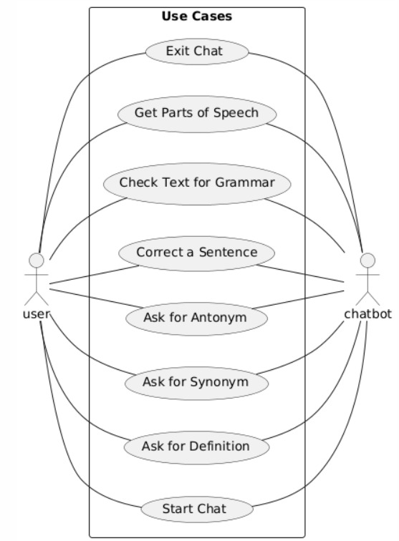
UML DIAGRAMS
USE CASE DIAGRAM

Slide 10
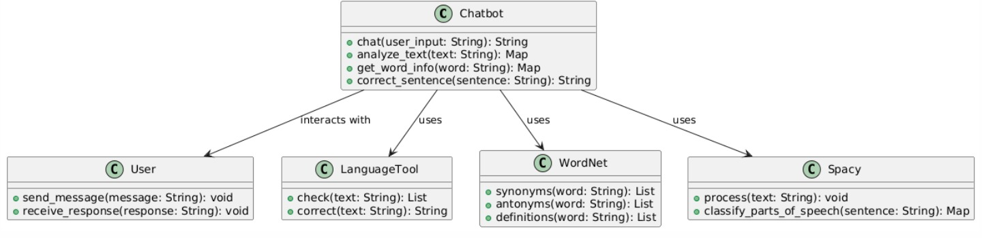
CLASS DIAGRAM

Slide 11
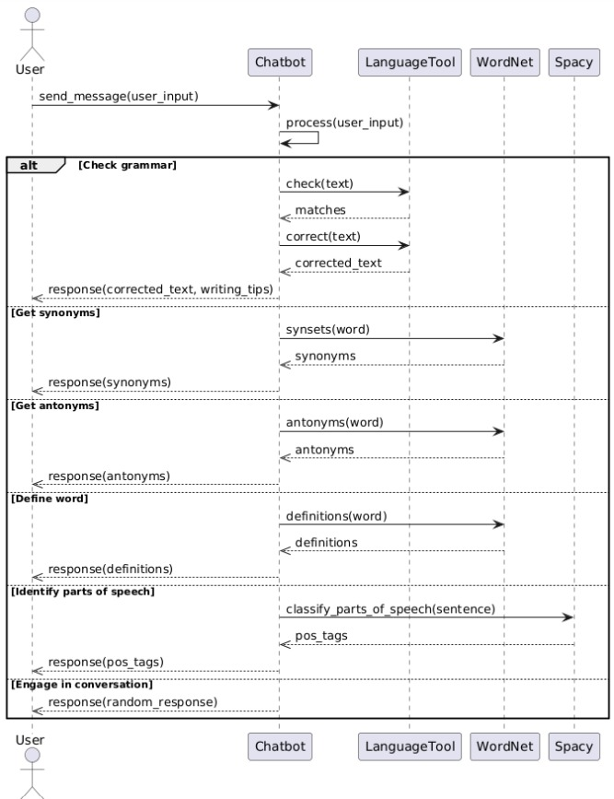
SEQUENCE DIAGRAM

Slide 12
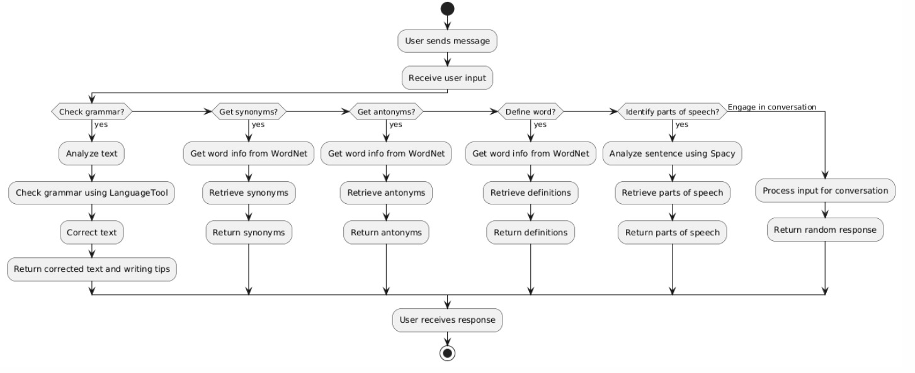
ACTIVITY DIAGRAM

Slide 13
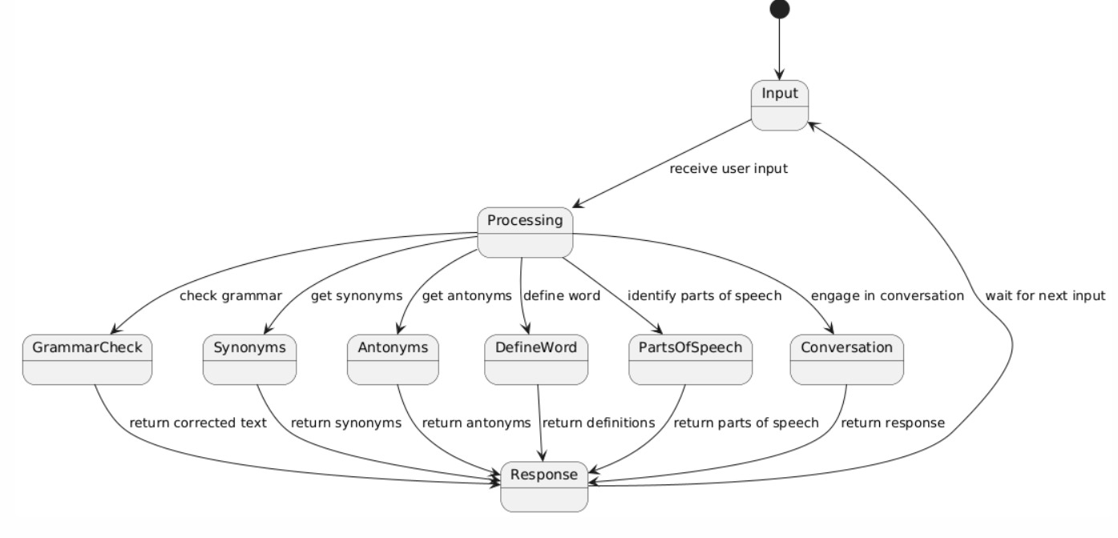
STATE DIAGRAM

Slide 14
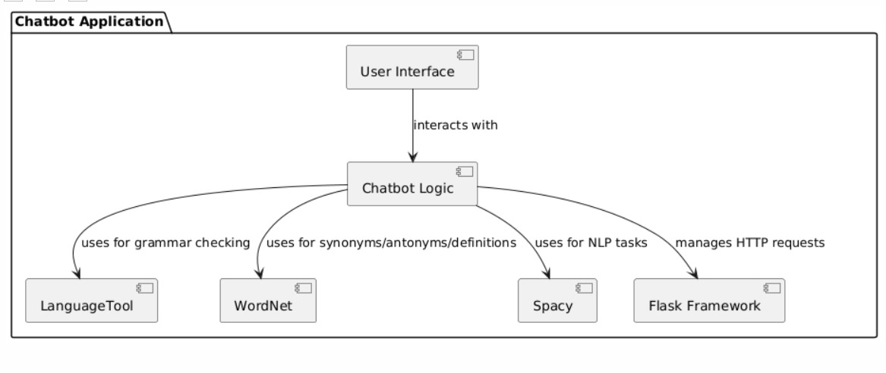
COMPONENT DIAGRAM

Slide 15
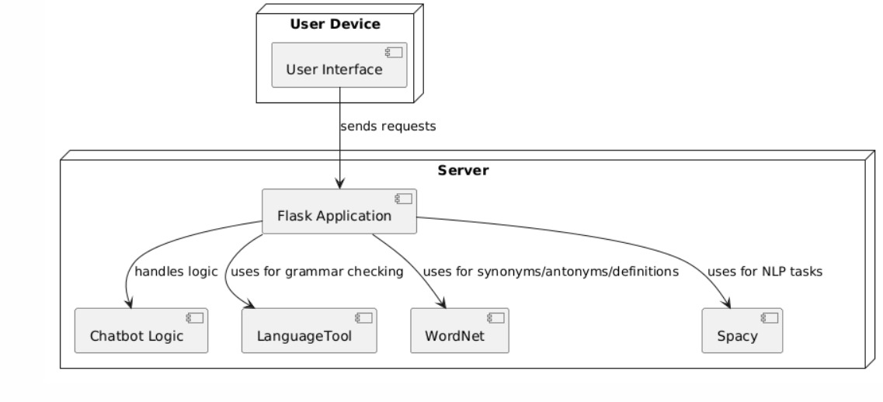
DEPLOYMENT DIAGRAM

Slide 16
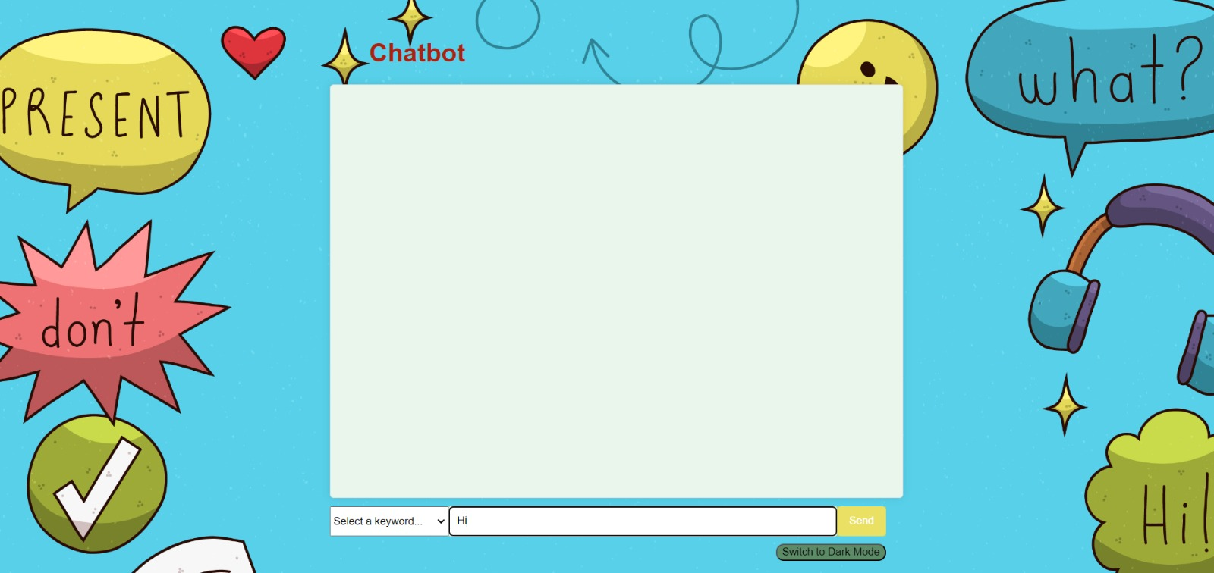
SCREEN SHOTS

Slide 17
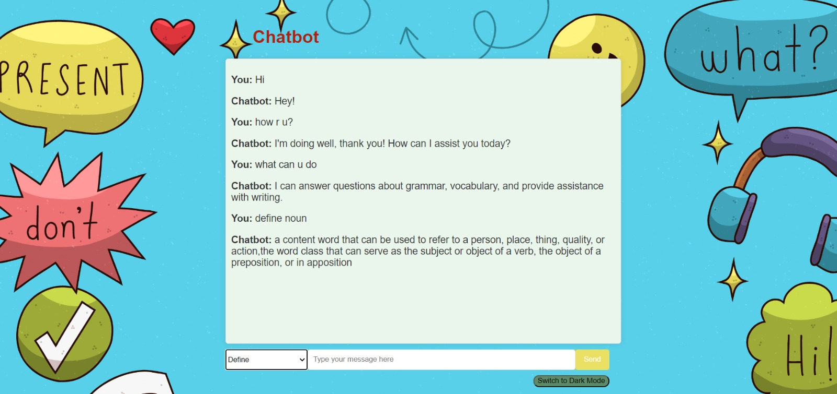
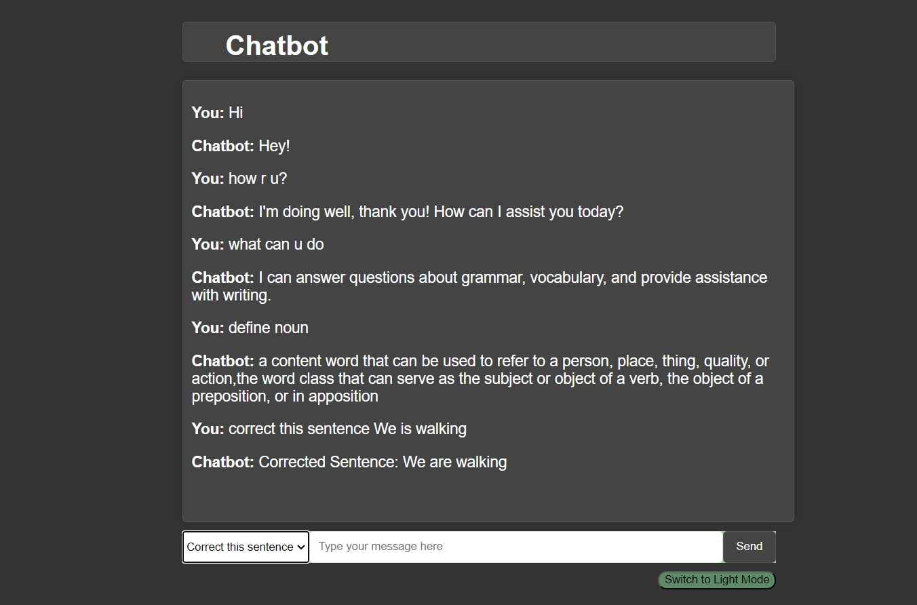
USER INPUT
OUTPUT

Slide 18
CONCLUSION
In conclusion, this project successfully addresses the development of an English communication chatbot for primary school students represents a significant step toward integrating technology into language education. By leveraging Natural Language Processing(NLP) and AI, the chatbot can deliver personalized, interactive, and learning experiences that are essential for young learners. This project provides a platform where students can practice vocabulary, grammar, and conversational skills in an engaging and supportive environment. Through carefully designed modules like basic conversation practice, vocabulary building, the chatbot caters to the unique educational needs of primary school students. The use of real-time feedback and AI-driven personalization ensures that each student receives a tailored learning experience that adapts to their pace and skill level. By integrating this chatbot into the educational system, schools can enhance students foundational communication skills, fostering greater confidence in using English in everyday scenarios. This project demonstrates the potential of AI-powered educational tools to revolutionize learning, making it more accessible, fun, and effective for young students.

