Slide 1
SQL_Project_Music_Store_Analysis
By Pooja vekal

Slide 2

Objective
Analyze sales and customer data from a music store database to gain actionable business insights.
The project aims to answer specific business questions that can help improve decision-making, optimize marketing strategies, and enhance customer satisfaction

Slide 3

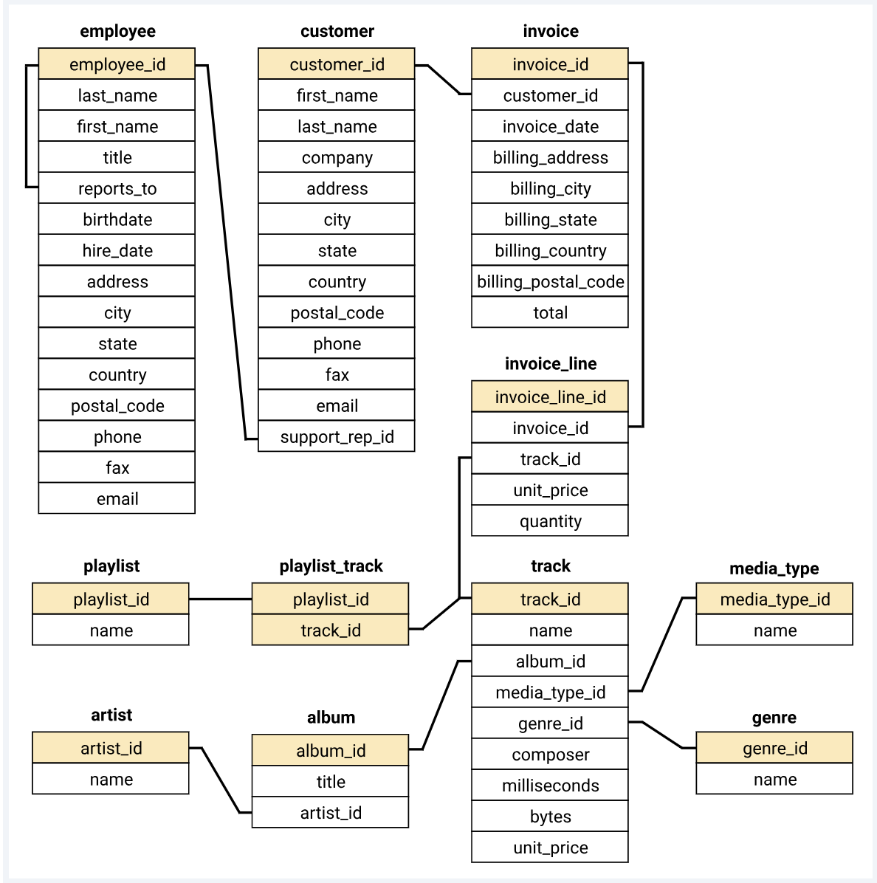
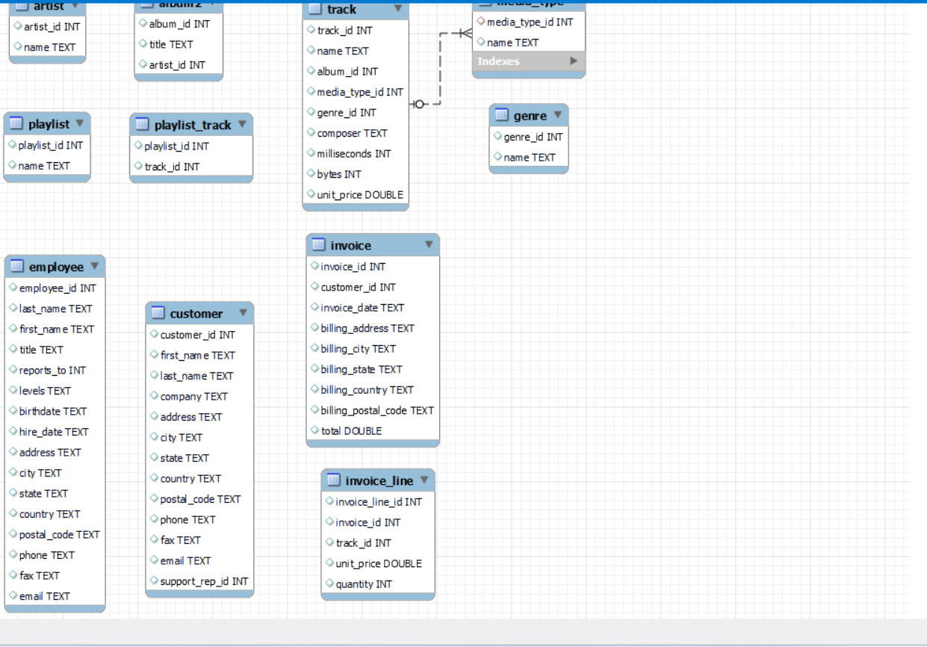
Schema- Music Store Database

Slide 4

Business Questions
Which countries have the most Invoices?
What are top 3 values of total invoice?
Which city has the best customers? We would like to throw a promotional Music Festival in the city we made the most money.
Write query to return the email, first name, last name, & Genre of all Rock Music listeners
Who is the senior most employee based on job title?

Slide 5
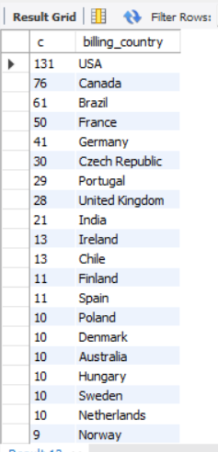
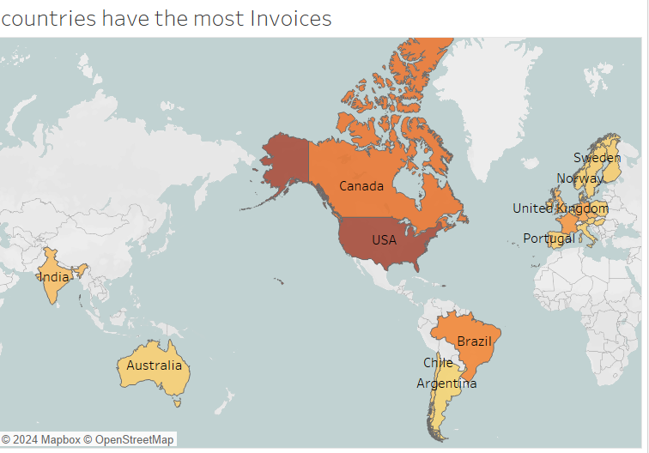
Which countries have the most Invoices?

Slide 6
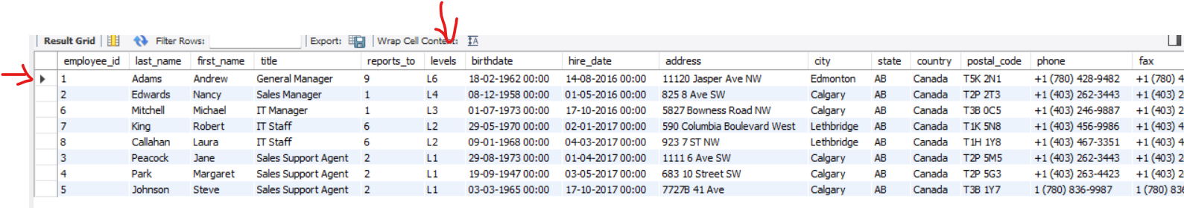
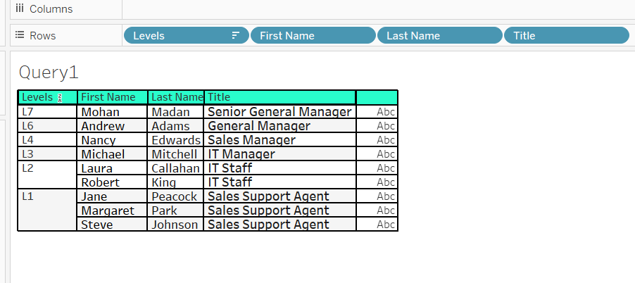
WHo is the senior most employee based on job title?

Slide 7

Who is the best customer? The customer who has spent the most money will be declared the best customer

Slide 8
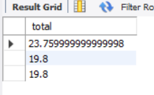
What are top 3 values of total invoice?

Slide 9

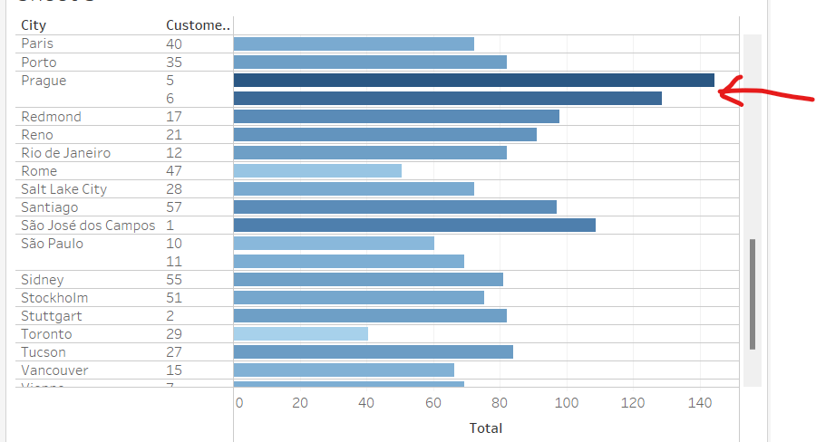
Which city has the best customers? We would like to throw a promotional Music Festival in the city we made the most money?

Slide 10
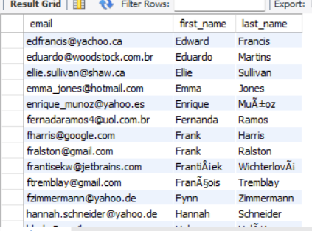
Write query to return the email, first name, last name, & Genre of all Rock Music listeners.

Slide 11
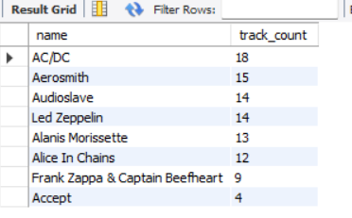
Write a query that returns the Artist name and total track count of the top 10 rock bands

Slide 12
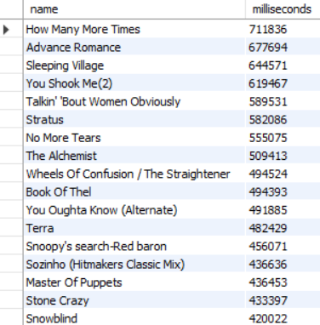
Return all the track names that have a song length longer than the average song length.

Slide 13

Find how much amount spent by each customer on artists? Write a query to return customer name, artist name and total spent?

Slide 14

Insight
🎷understanding the hierarchy and decision-making authority within the company.
🎷understanding geographical markets where the music store is most active. This can guide targeted marketing strategies and regional promotional efforts.
🎷largest transactions, which can be used to analyze purchasing behaviour and identify high-value customers.
🎷Identifying the city with the highest total invoice amounts indicates where the store’s most profitable customers are located. promotional events, such as a Music Festival, in cities with the best customers.
🎷best customer by total spending helps in recognizing and rewarding loyal customers.

Slide 15


