Slide 1


IBM-HR-employee-Attrition-Prediction
By pooja vekal

Slide 2
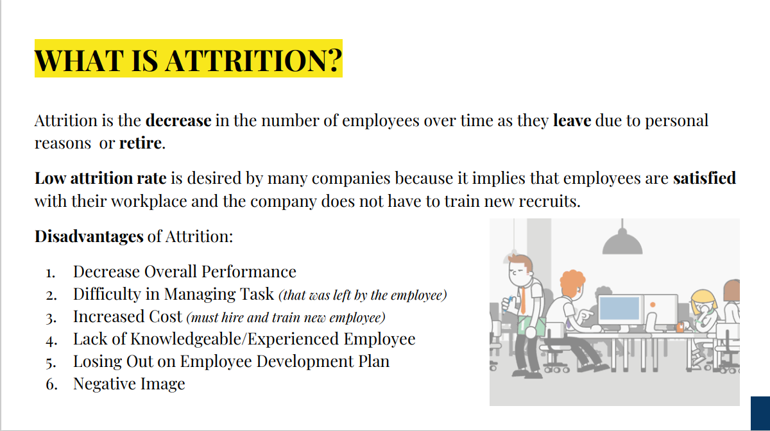

Slide 3



Contents of The Project
Data Exporatory and analysis
Feature engineering
Model training and performance evaluations
Feature importance analysis

Slide 4

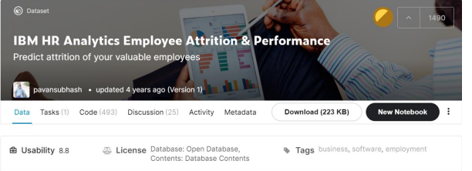
Source
Kaggle Dataset
Contains 35 columns and 1470 records
No missing values

Slide 5
OBJECTIVE AND SCOPE OF THE STUDY
The objective of this project is to predict the attrition rate for each employee, to find out who's more likely to leave the organization.
It will help organizations to find ways to prevent attrition or to plan in advance the hiring of new candidate.
Attrition proves to be a costly and time consuming problem for the organization and it also leads to loss of productivity.
The scope of the project extends to companies in all industries.

Slide 6
The Dataset consists of 1470 observations of 15 variables which are described below:
Attrition: Whether the attrition happened (Y es = 1 ) or not (No = 0) This is our independent variable which we are trying to score.
Business Travel :relates to travel frequency of the employee
Satisfaction_level : relates to environment satisfaction level of the employee (1-Low, 2-Med 3-High, 4-Very high)
Age,Gender , Marital Status,Monthly Income
JobInvolvement:relates to job involvement level of the employee (1-Low, 2-Medium, 3-Hig Very high)
JobSatisfaction : relates to job satisfaction level of the employee (1-Low, 2-Medium, 3-High Very high)
NumCompanies Worked : how many companies has the employee worked upon
Over Time - whether the employee works overtime (Yes / No)
Training Times Last Year :number of trainings received by the employee
last yearYearsInCurrentRole :number of years in current role
Years SinceLast Promotion :number of years since last promotion
Years With CurrManager: number of years with current manager

Slide 7
ANALYTICS APPROACH
Check for missing values in the data, and if any, will process the data accordingly.
Understand how the features are related with our target variable – attrition
Convert target variable into numeric form
Apply feature selection and feature engineering to make it model ready
Apply various algorithms to check which one is the most suitable
Draw out recommendations based on our analysis.

Slide 8
Model building
The process of modeling means training a machine learning algorithm to predict the labels from the features, tuning it for the business need, and validating it on holdout data,
Models used for employee attrition:
Logistic Regression
Random Forest
Support vector machine
XG Boost

Slide 9
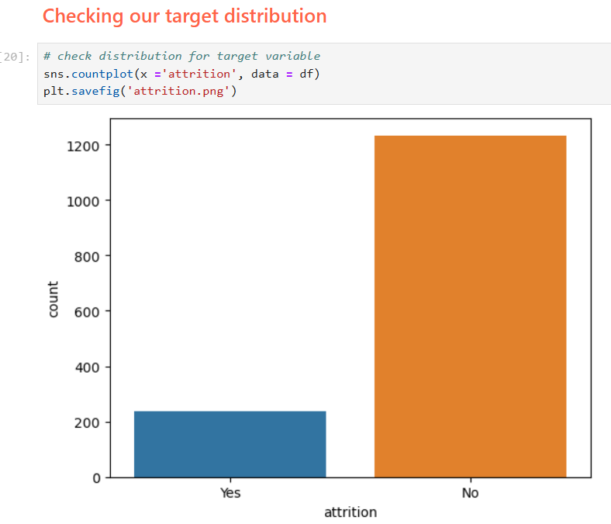
EDA
This dataset is imbalanced

Slide 10
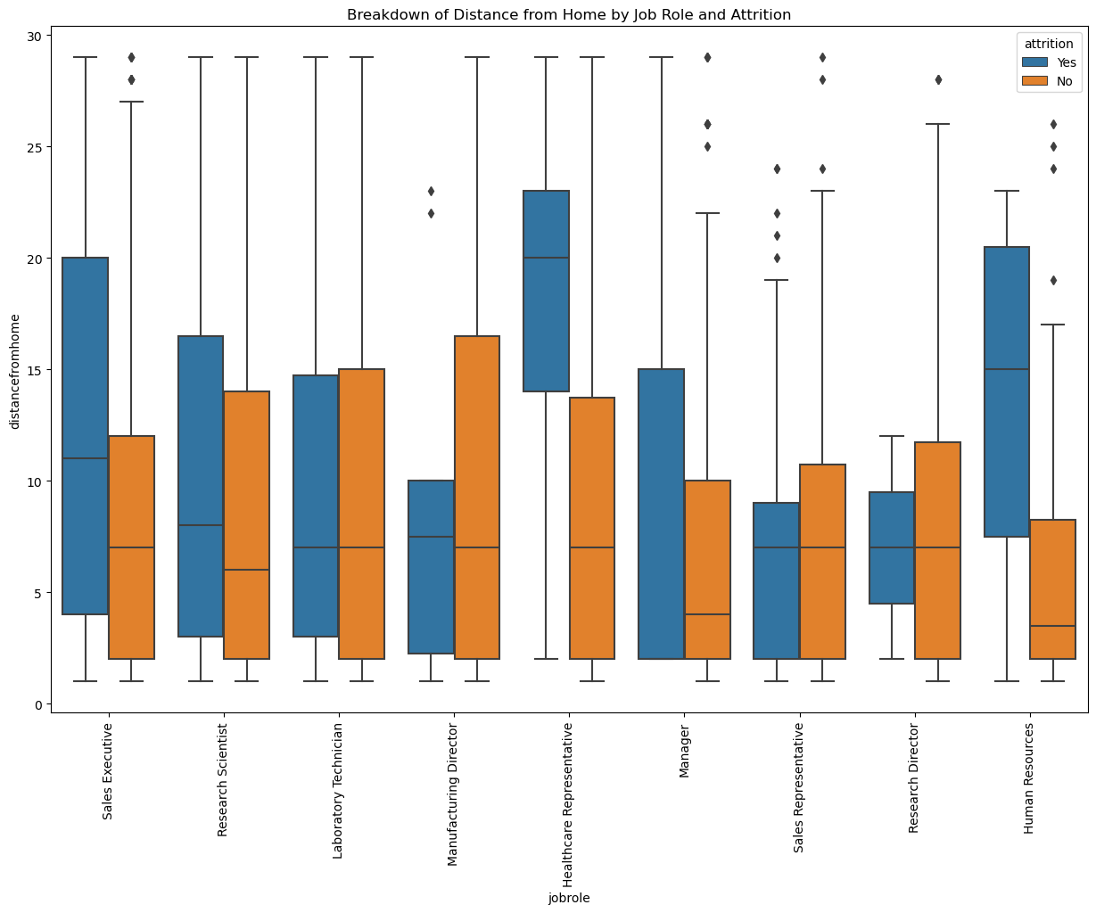
Breakdown of distance from home by job role and attrition

Slide 11
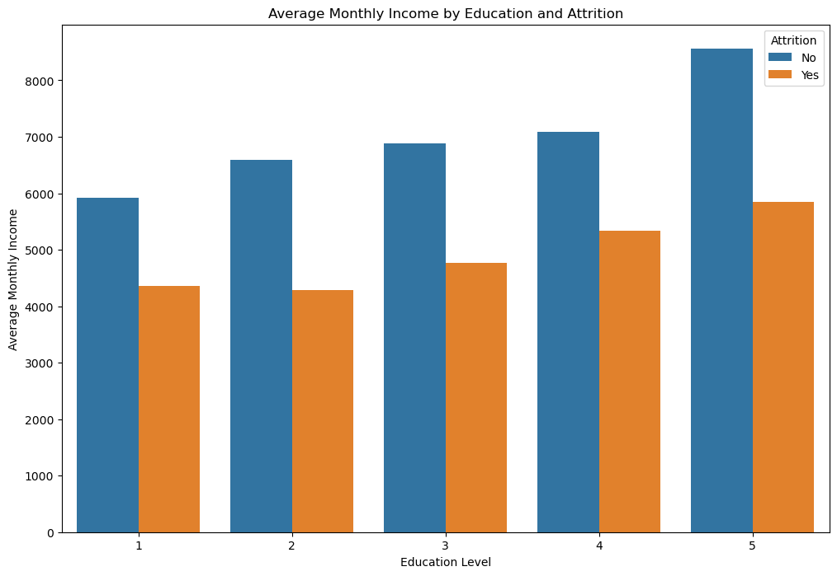
Compare average monthly income by education and attrition
In case of 5 :Identifying Key Education Levels: If certain education levels have a high average income and also high attrition, this could indicate that these employees might be leaving for better pay elsewhere.

Slide 12
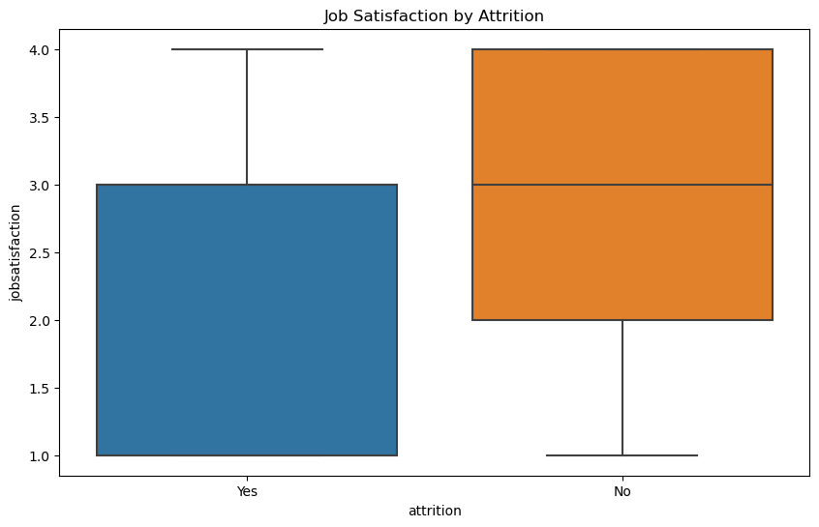
Job satisfaction by attrition
As we could see the distribution of our target variable is imbalanced for the binary variable yes and no.
Lower job satisfaction might correlate with higher attrition.

Slide 13
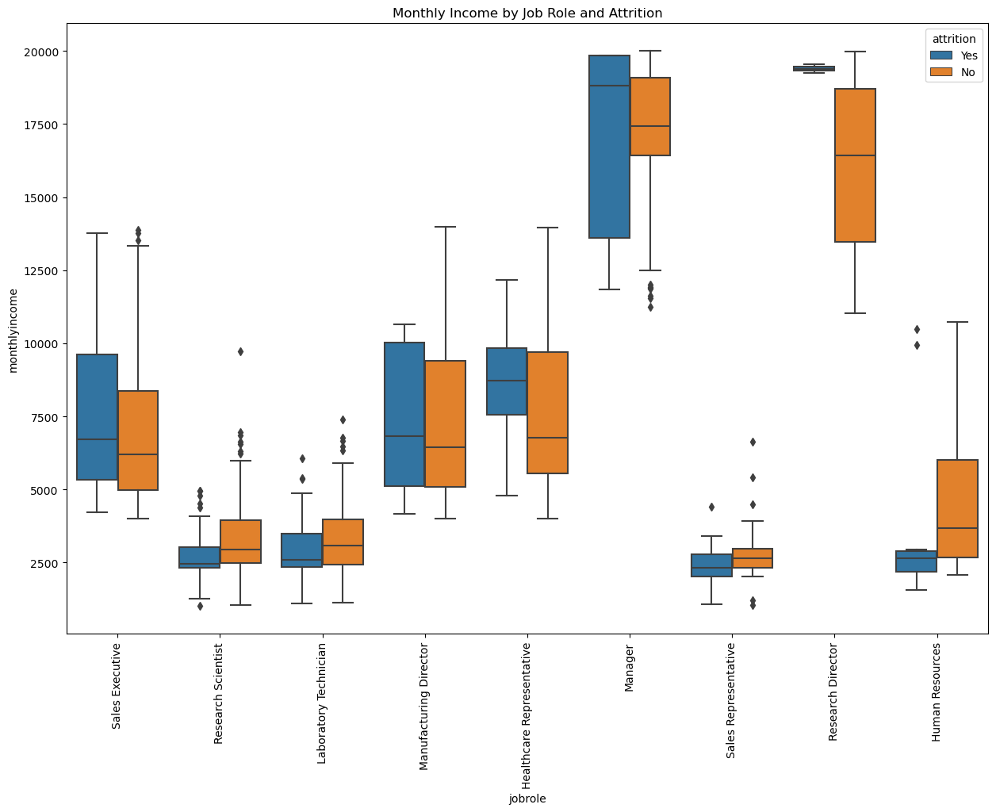
Monthly income by job role and attrition

Slide 14
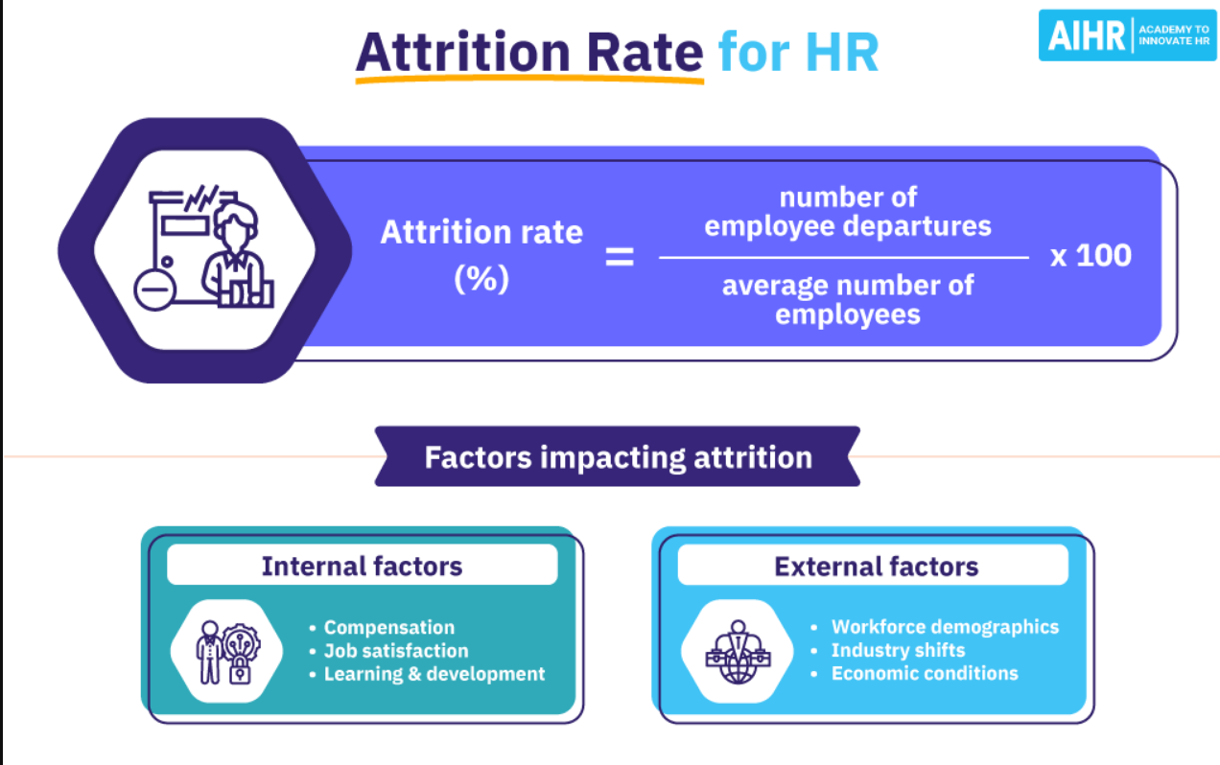

Slide 15
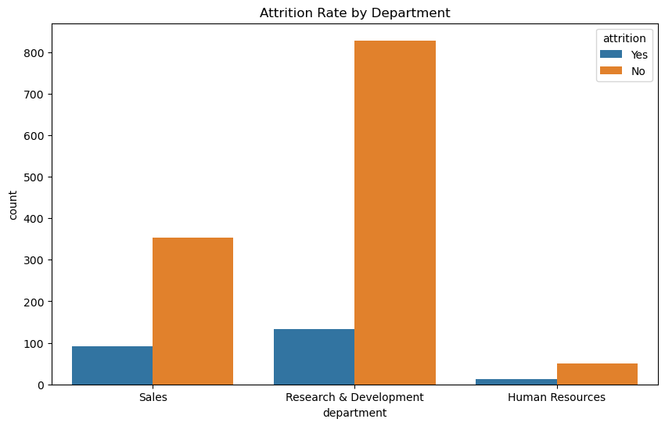
Attrition rate by department

Slide 16

The Column 'EmployeeCount’ is all 1s which indicate every observation is linked with 1 employee only, thanks for this info and we will drop it. Column 'StandardHours' is all 80s which means everyone in this dataset works as a fulltime employee and we could definitely drop it as well. Column 'Over18' is another interesting column which tells us every employee in this dataset is over 18 and we will drop it as well.

Slide 17
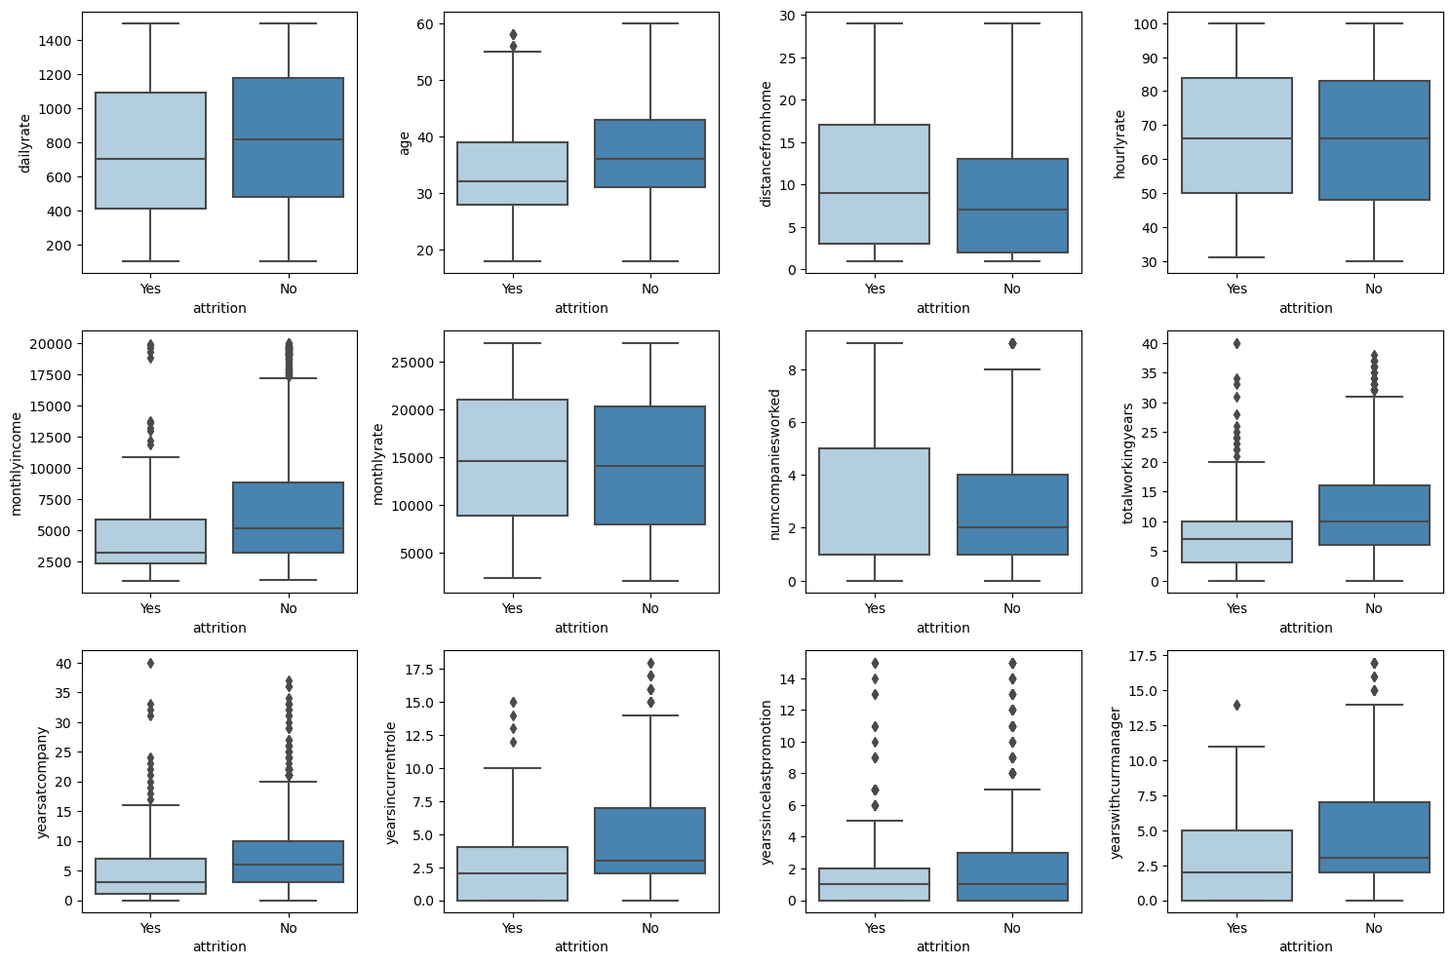
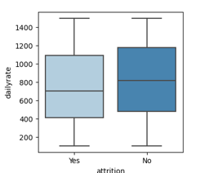
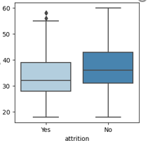
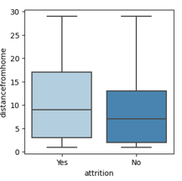
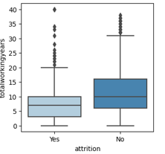
Checking Distributions

Slide 18
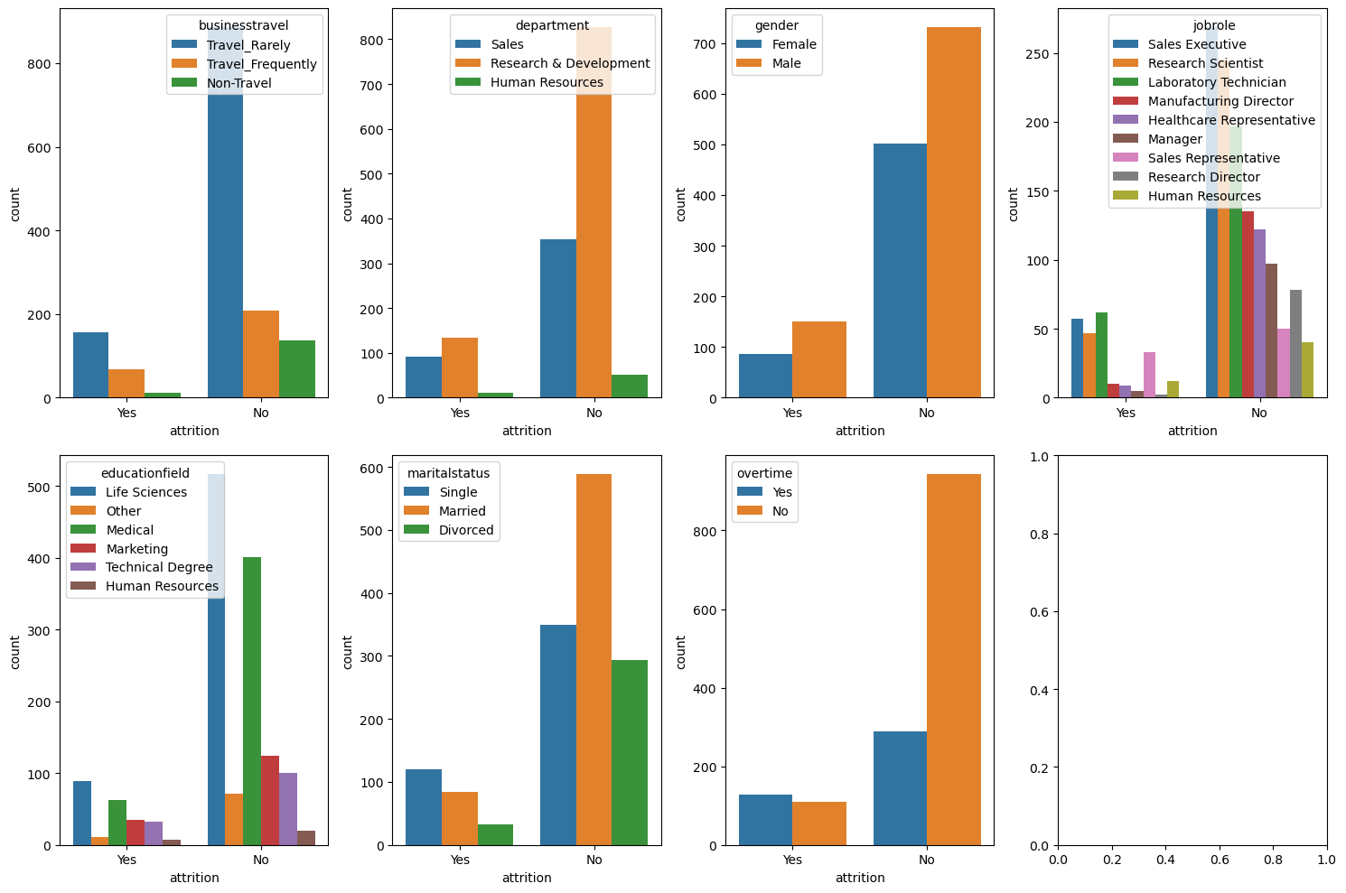
Distribution of Non Numerical Features

Slide 19
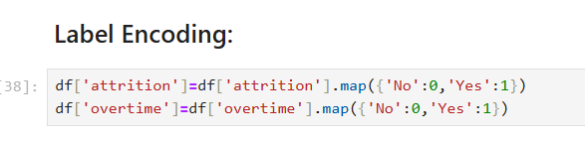
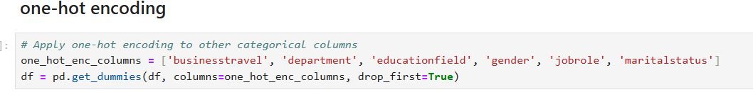
Feature engineering

Slide 20
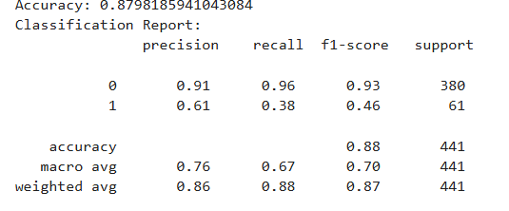
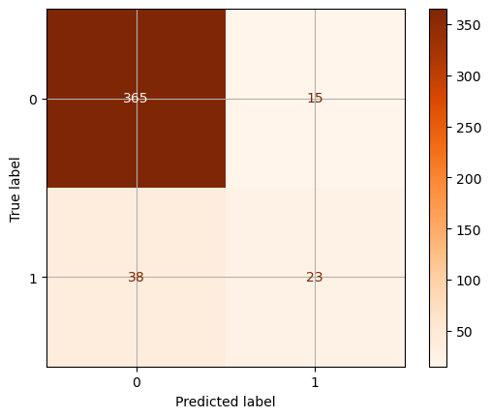
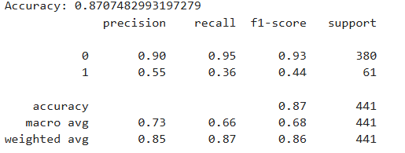
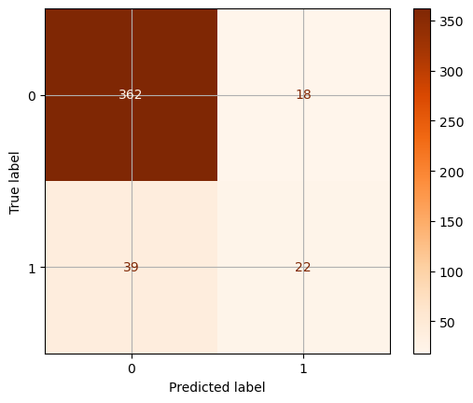
Model training and performance evaluation
LogisticRegression
LinearSVC

Slide 21
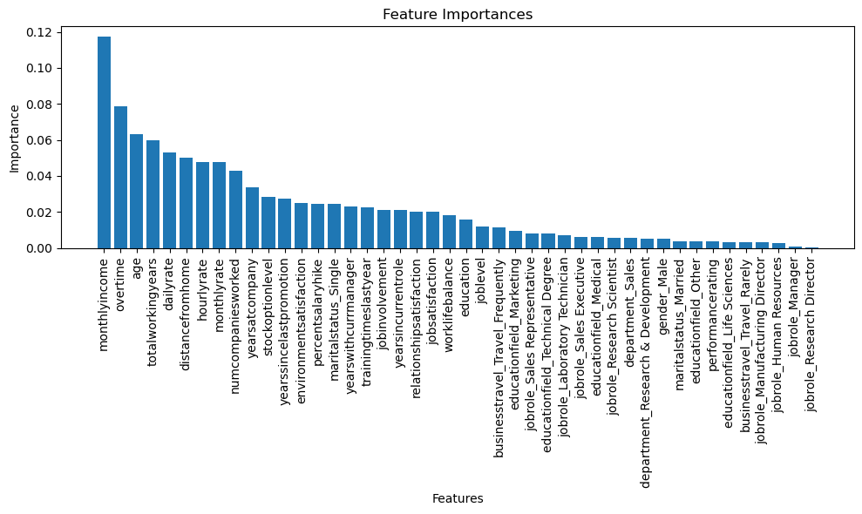
Feature Importances :
This is the most important analysis that gained from random forest .The feature importance reveals how important each feature is and how it will affect the performance of the model.

Slide 22
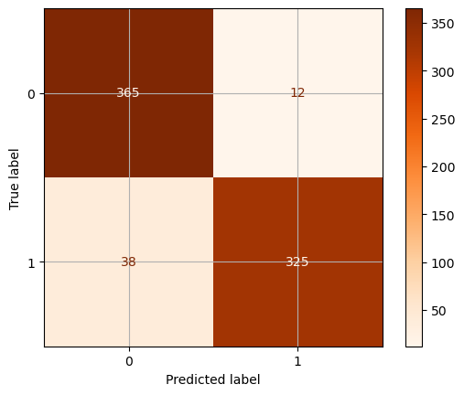
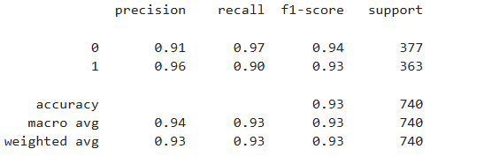
Oversampling with SMOTE
RandomForest

Slide 23
RECOMMENDATIONS
Transportation should be provided to employees living in the same area, or else transportation allowance should be provided.
Plan and allocate projects in such a way to avoid the use of overtime.
Employees who hit their two-year anniversary should be identified as potentially having a higher-risk of leaving.
Gather information on industry benchmarks to determine if the company is providing competitive wages.

Slide 24
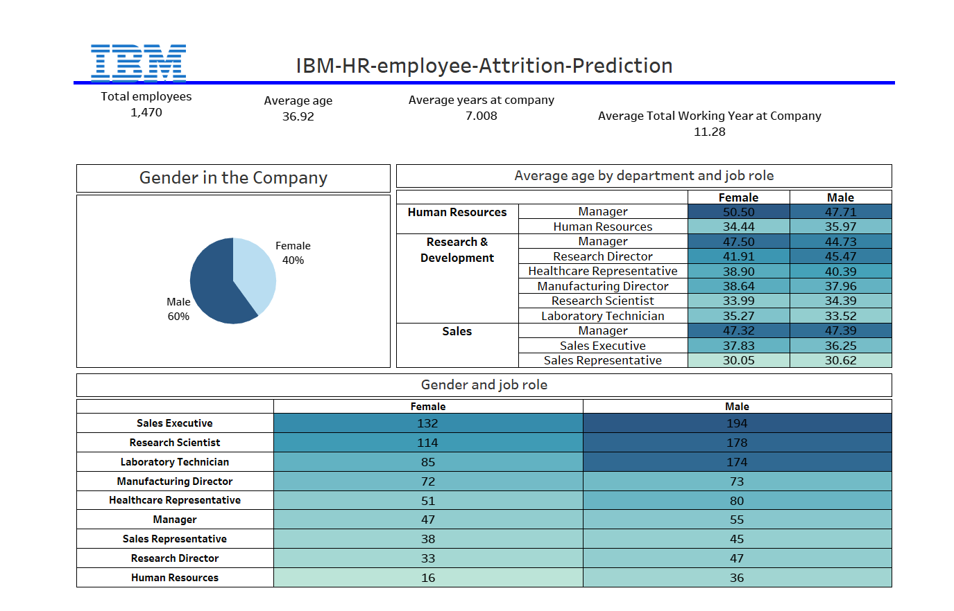

Vielen Dank
jemand@example.com

Slide 25
Thank you!

