Slide 1


G H PATEL COLLEGE OF ENGINEERING & TECHNOLOGY
(THE CHARUTAR VIDYA MANDAL (CVM) UNIVERSITY) | DEPARTMENT OF INFORMATION TECHNOLOGY
SEM 6 | CSE(IoT)| A.Y. 2025-26 EVEN TERM | MINI PROJECT (202040601) | FINAL PRESENTATION
Stock Market
Forecasting App
Stock Trend Prediction Using SARIMAX Time-Series Model
Guided By Prof. Ritesh Upadhyay
Presented By Poojan Patel (12302110501080) Shrey Patel (12302110501081)
23 March 2026

Slide 2
Outline
G H Patel College of Engineering & Technology
What we will cover in this presentation
Department of Information Technology
01
Project Overview & Problem Statement
08
Admin Backend (Hidden Feature)
02
Objectives & Scope
09
Data Analysis: ADF Test & Decomposition
03
Literature Survey
10
SARIMA Model & Forecasting
04
System Architecture
11
UI Walkthrough & Screenshots
05
Technology Stack
12
System Testing & Results
06
Application Flow & Methodology
13
Challenges & Solutions
07
Key Code Modules Explained
14
Future Work & Conclusion
Stock Market Forecasting App | SEM 6 Mini Project | A.Y. 2025-26
2 / 19

Slide 3
Project Overview
G H Patel College of Engineering & Technology
What is this application?
Department of Information Technology
Stock Market Forecasting App is a web-based platform that allows anyone to retrieve historical stock data, analyze trends, and forecast future prices — with zero programming knowledge required.
📊
💱
🔬
📈
🔒
Real-Time Data
Auto Currency
Time-Series Analysis
SARIMA Forecast
Admin Backend
Retrieves OHLCV historical stock data from Yahoo Finance using yfinance API for any globally listed stock.
Detects and displays the correct trading currency (₹, $, €, £, ¥) automatically for any stock.
Runs ADF stationarity test and seasonal decomposition (trend, seasonal, residuals) with interactive charts.
Fits SARIMAX (2,1,2) (2,1,2,12) model and generates price forecast for user-defined number of days.
Hidden panel at /?admin=1 for admins (Poojan & Shrey) to monitor all user searches and model summaries.
Stock Market Forecasting App | SEM 6 Mini Project | A.Y. 2025-26
3 / 19

Slide 4
The Core Problem & Our Solution
G H Patel College of Engineering & Technology
Why does this app need to exist?
Department of Information Technology
⚡ The Problem
✅ Our Solution
Financial data is available but scattered — no single tool combines data retrieval, analysis, and forecasting
Most stock apps display USD prices for all stocks regardless of actual trading currency
SARIMA models are powerful but inaccessible to non-programmers
No separation between casual users and technical administrators
Python tools expose raw error tracebacks when inputs are invalid — terrible UX
No way for developers to know how their tool is being used in the wild
One-stop web app: enter ticker + dates → get full analysis & forecast instantly
Auto-detects currency via Yahoo Finance metadata (₹ for NSE, $ for NYSE, € for XETRA, etc.)
SARIMA model runs in the background — user sees only clean charts and results
Public app has zero login; admin backend hidden at /?admin=1 URL
Friendly amber/red info boxes replace all raw Python error tracebacks
Silent JSON logging records every search for admin review and CSV export
Stock Market Forecasting App | SEM 6 Mini Project | A.Y. 2025-26
4 / 19

Slide 5
Objectives & Scope
G H Patel College of Engineering & Technology
What this project aims to achieve
Department of Information Technology
Primary Objectives
Scope
Develop a fully functional web-based stock forecasting app using Python + Streamlit
Integrate yfinance API for automated OHLCV data retrieval from Yahoo Finance
Implement SARIMAX time-series forecasting model (order 2,1,2 seasonal 12)
Create interactive Plotly visualizations accessible to non-technical users
Build a hidden admin backend to monitor all user activity
In Scope ✔
Any stock listed on Yahoo Finance (NSE, BSE, NYSE, NASDAQ, LSE, etc.)
Date range: Jan 2000 to today, forecast up to 365 days
14 currency symbols auto-detected
Two roles: public user & admin
Secondary Objectives
Out of Scope ✗
Auto-detect trading currency for any global stock (14 currencies supported)
ADF stationarity test with clear pass/fail visual result
Seasonal decomposition into trend, seasonal, residual components
Robust input validation with friendly error messages — no raw tracebacks
Real-time intraday tick-by-tick streaming
Fundamental analysis (earnings, balance sheet)
Deep learning models (LSTM, Transformer)
Cloud deployment & mobile interface
Stock Market Forecasting App | SEM 6 Mini Project | A.Y. 2025-26
5 / 19

Slide 6
Existing Methods & Why We Chose SARIMAX
G H Patel College of Engineering & Technology
Literature survey summary
Department of Information Technology
Statistical
Models
Machine
Learning
Why SARIMAX?
ARIMA — models trend + autocorrelation
SARIMA — adds seasonal components ✓ Used here
GARCH — models volatility clustering
Exponential Smoothing — simple baseline
Financial data has natural trend + seasonal components.
SARIMAX handles both without extra preprocessing.
Stats models provides a production-ready implementation.
Fewer hyperparameters than deep learning.
Model summary (AIC, BIC, p-values) is interpretable by admins.
Works well on moderate datasets (6–24 months).
Random Forest / Gradient Boosting
Support Vector Machines (SVM)
LSTM — captures long-term dependencies
Transformer — attention-based forecasting
Stock Market Forecasting App | SEM 6 Mini Project | A.Y. 2025-26
6 / 19

Slide 7
System Architecture
G H Patel College of Engineering & Technology
Three-tier architecture overview
Department of Information Technology
PRESENTATION LAYER
PROCESSING LAYER
DATA LAYER
Streamlit web framework
Custom CSS styling
Plotly interactive charts
URL-based routing (?admin=1)
Input validation module
Currency detection (yfinance.info)
ADF stationarity test
Seasonal decomposition
SARIMAX model fitting
Silent JSON logging
Yahoo Finance API (yfinance)
OHLCV historical data
Ticker metadata (currency)
search_log.json (admin log)
User Input → Validation → Yahoo Finance API → Processing (ADF + Decompose + SARIMA) → Silent Log → Plotly Charts → User
Stock Market Forecasting App | SEM 6 Mini Project | A.Y. 2025-26
7 / 19

Slide 8
Technology Stack
G H Patel College of Engineering & Technology
Tools and libraries used
Department of Information Technology
Python 3.11
Streamlit
yfinance
pandas
Core Language
Web Framework
Data Source
Data Processing
Primary development language. Handles all logic, API calls, data processing, and logging.
Renders the entire web interface in the browser. Handles inputs, charts, session state, and URL routing.
Downloads OHLCV historical data and ticker metadata (including currency) from Yahoo Finance API.
DataFrame operations: column flattening, date handling, table display, and data slicing.
statsmodels
Plotly
JSON / OS
Statistical Models
Visualisation
Storage
Provides ADF test (adfuller), seasonal_decompose, and SARIMAX — the core analytical engine.
Renders interactive line charts for price history, decomposition components, and forecast overlay.
Built-in Python modules for reading/writing the search_log.json admin log file.
Stock Market Forecasting App | SEM 6 Mini Project | A.Y. 2025-26
8 / 19

Slide 9
Application Flow — 6 Steps
G H Patel College of Engineering & Technology
Public user journey from input to forecast
Department of Information Technology
1
User Input
2
Data Fetch
3
KPI + Charts
Enter: Ticker symbol, Start date, End date, Forecast days. All fields required. Date validation ensures start < end.
yf.download() pulls OHLCV data. yf.Ticker().info fetches currency. MultiIndex columns are flattened automatically.
5 metric cards displayed (price, return, high, low, avg) with correct currency symbol. Interactive Plotly chart for all columns.
4
ADF + Decompose
5
SARIMA Forecast
6
Results Display
ADF stationarity test run. If data ≥ 24 points, seasonal_decompose splits series into trend, seasonal, and residual components.
SARIMAX(2,1,2)(2,1,2,12) fitted with disp=False. Forecast generated from len(df) to len(df)+forecast_days. Search silently logged.
Combined chart: historical (blue) + forecast (dotted green). Forecast table + last 20 historical rows shown side by side.
Stock Market Forecasting App | SEM 6 Mini Project | A.Y. 2025-26
9 / 19

Slide 10
Key Code Modules — Explained
G H Patel College of Engineering & Technology
The most important lines of code and what they do
Department of Information Technology
df = yf.download(ticker, start=start_date, end=end_date)
info = yf.Ticker(ticker).info
currency_code = info.get('currency', 'USD')
Downloads historical OHLCV stock data from Yahoo Finance for the user-selected ticker and date range.
Fetches ticker metadata to identify the trading currency. Returns 'INR' for NSE stocks, 'USD' for NYSE, etc.
adf_pval = adfuller(df[col])[1]
if adf_pval < 0.05: # stationary
decomp = seasonal_decompose(
df[col], model='additive', period=12)
ADF test — p-value below 0.05 means the series is stationary. Required for SARIMA. d=1 handles non-stationarity anyway.
Splits series into Trend + Seasonal + Residual. Needs 24+ data points (2 full cycles of period=12).
sarima = SARIMAX(df[col],
order=(2,1,2),
seasonal_order=(2,1,2,12)).fit(disp=False)
future = sarima.get_prediction(
start=len(df), end=len(df)+forecast_days)
Fits SARIMA model. p=2 past values, d=1 differencing, q=2 error terms. Seasonal period 12. disp=False hides logs.
Generates forecast values beyond the last known data point for the user-specified number of days ahead.
Stock Market Forecasting App | SEM 6 Mini Project | A.Y. 2025-26
10 / 19

Slide 11
SARIMA Model — Deep Dive
G H Patel College of Engineering & Technology
How the forecasting engine works
Department of Information Technology
SARIMAX(df[col], order=(2, 1, 2), seasonal_order=(2, 1, 2, 12)).fit(disp=False)
p = 2
d = 1
q = 2
P=Q=2,D=1,S=12
Autoregressive
Integrated
Moving Average
Seasonal
Uses the last 2 price observations as predictors. Captures short-term momentum and persistence.
First-order differencing applied once. Transforms non-stationary price series into stationary returns.
Uses the last 2 forecast errors as inputs. Corrects for recent prediction mistakes.
Same AR, I, MA structure applied at the seasonal level. Period 12 = recurring 12-day cycle.
Forecast Generation:
future = sarima.get_prediction(start=len(df), end=len(df)+forecast_days) → predicted_mean gives point estimates → Index set to date_range(start=end_date, periods=N, freq='D')
Stock Market Forecasting App | SEM 6 Mini Project | A.Y. 2025-26
11 / 19

Slide 12
Admin Backend
G H Patel College of Engineering & Technology
The hidden monitoring system
Department of Information Technology
🔒 How It's Hidden
📊 What Admins Can See
The admin panel is NOT linked anywhere in the public app. Access URL: localhost:8501/?admin=1 This works by reading the URL query parameter: params = st.query_params if params.get('admin','') == '1': admin_login() Regular users at localhost:8501 never see it.
Total Searches
Count of all forecasts ever run
Unique Tickers
Which stocks people are searching
Per-Search Detail
Ticker, date range, column used
ARIMA Parameters
p, d, q values for each run
Full Model Summary
AIC, BIC, coefficients, p-values
CSV Export
Download entire log as spreadsheet
Stock Market Forecasting App | SEM 6 Mini Project | A.Y. 2025-26
12 / 19

Slide 13
User Interface — Input Panel & KPI Metrics
G H Patel College of Engineering & Technology
The first thing users see
Department of Information Technology
StockCast
Market Forecasting Platform · Powered by SARIMA · Data from Yahoo Finance
📊 Enter Details
Start Date
End Date
Ticker Symbol
Forecast Days
2026-01-01
2026-03-20
AAPL
30
Current Price
Total Return
Period High
Period Low
Average
$189.30 (USD)
+23.4%
$198.23
$164.08
$181.56
Navbar at top shows app name and tagline — no login prompt for public users
Input panel: 4 fields in a single horizontal row — all visible without scrolling. Date fields use native date picker. No hardcoded defaults.
5 KPI metric cards auto-update when a ticker is entered. Currency symbol (₹, $, €) detected automatically from Yahoo Finance metadata.
If any field is empty, a blue info strip guides the user. If dates are invalid, a red error message appears — no raw traceback ever shown.
Stock Market Forecasting App | SEM 6 Mini Project | A.Y. 2025-26
13 / 19

Slide 14
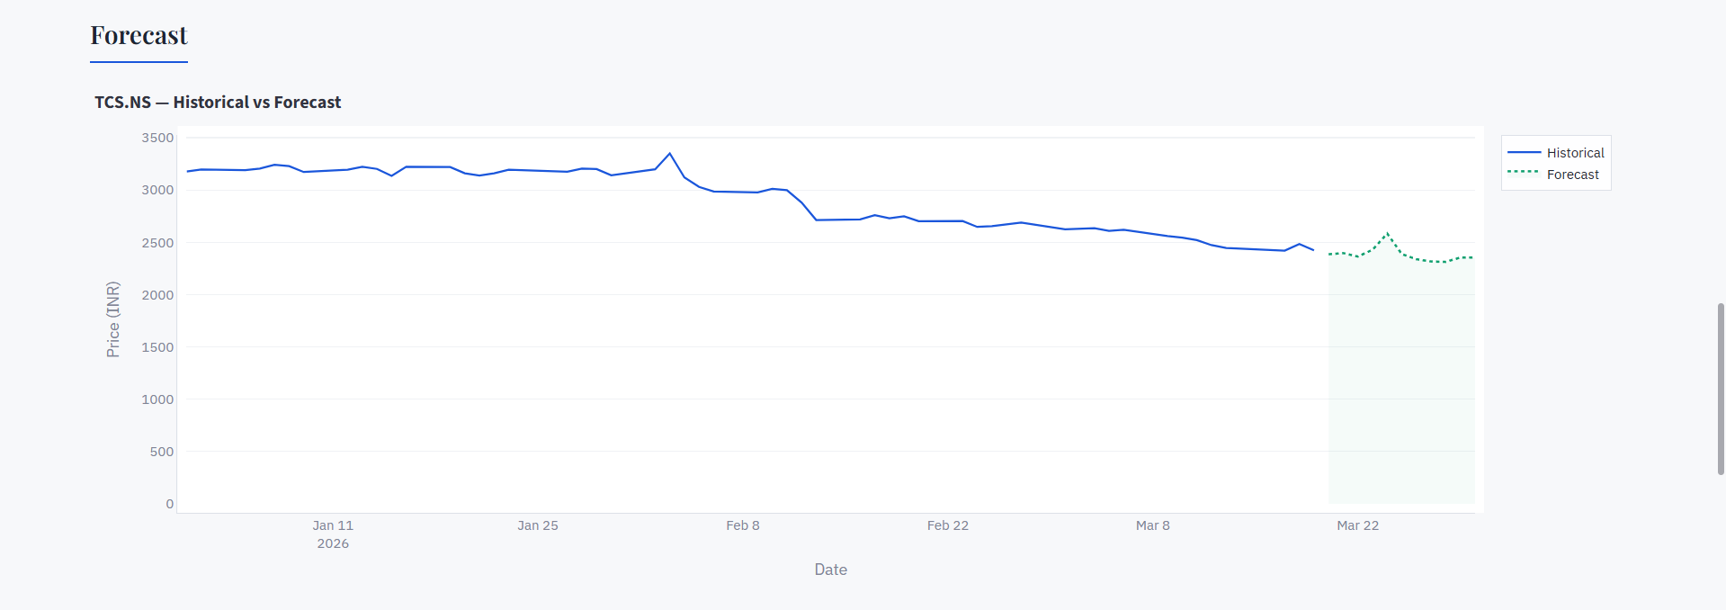
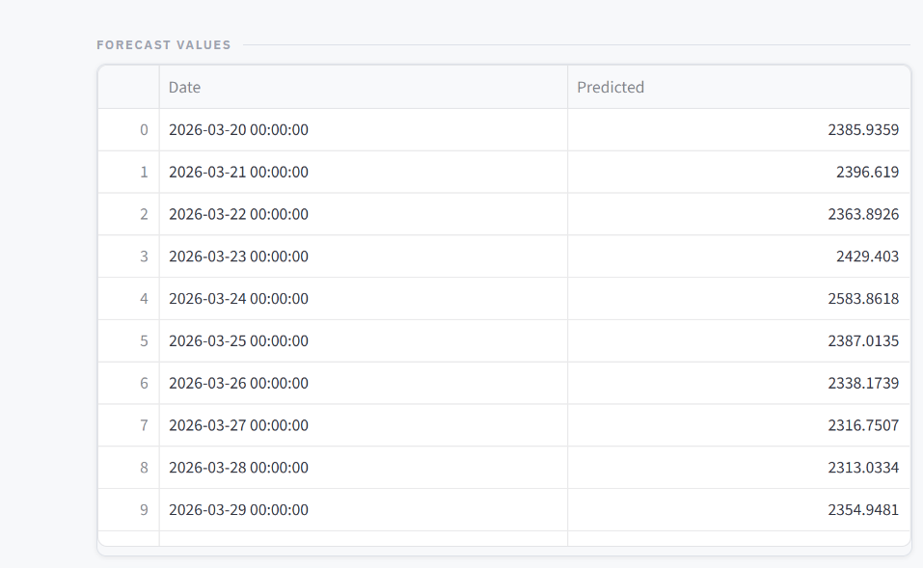
User Interface — Forecast Results
G H Patel College of Engineering & Technology
The final output: historical vs predicted prices
Department of Information Technology
FORECAST VALUES
RECENT HISTORICAL (LAST 20 DAYS)
FORECAST VALUES
Stock Market Forecasting App | SEM 6 Mini Project | A.Y. 2025-26
14 / 19

Slide 15
System Testing & Results
G H Patel College of Engineering & Technology
All 16 test cases — all passed
Department of Information Technology
TC ID | Test Case | Input | Expected | Status
TC-01 | Valid Indian NSE stock | RELIANCE.NS, 2024-01-01 to 2025-01-01 | ₹ symbol, all features | PASS
TC-02 | Valid US NYSE stock | AAPL, same range | $ symbol, forecast | PASS
TC-03 | Valid European stock | SAP.DE (Germany) | € symbol displayed | PASS
TC-04 | Invalid ticker | XYZABC999 | Friendly error message | PASS
TC-05 | Start > End date | Start: 2025-06, End: 2024-01 | Error shown, no crash | PASS
TC-06 | 3-day date range | Any ticker, 3 days only | Amber warning: need 24+ points | PASS
TC-07 | 5-year range | AAPL, 2020-2025 | All features work | PASS
TC-08 | Admin login - correct | poojan / poojan123 | Dashboard displayed | PASS
TC-09 | Admin login - wrong | poojan / wrongpass | Error: Wrong credentials | PASS
TC-10 | Public at /?admin=1 | No credentials | Login page, no bypass | PASS
TC-11 | Currency: INR | TCS.NS or INFY.NS | ₹ in all KPI cards | PASS
TC-12 | Forecast = 1 day | Any stock, days=1 | 1-row forecast table | PASS
TC-13 | Forecast = 365 days | Any stock, days=365 | 365-row forecast table | PASS
TC-14 | CSV download | Admin, after searches | CSV downloaded | PASS
TC-15 | SARIMA convergence fail | Very noisy short data | Friendly error, no crash | PASS
TC-16 | Empty ticker field | Submit with no ticker | Info strip guidance | PASS
Stock Market Forecasting App | SEM 6 Mini Project | A.Y. 2025-26
15 / 19

Slide 16
Challenges Faced & Solutions
G H Patel College of Engineering & Technology
Problems encountered during development
Department of Information Technology
⚡ yfinance MultiIndex Columns
⚡ Streamlit Sidebar Hidden
yfinance returns multi-level column headers (e.g., ('Close', 'AAPL')) for some tickers, causing KeyError crashes.
Sidebar toggle arrow was invisible on some screen sizes/browsers, making inputs unreachable for users.
FIX
Added a check: if isinstance(df.columns, pd.MultiIndex): df.columns = [' '.join(col).strip()]. Flattens to 'Close AAPL'.
FIX
Moved all inputs to the main page in a styled card. Sidebar hidden via CSS. All fields visible without any toggle.
⚡ ADF/SARIMA on Short Data
⚡ Currency Always Shows USD
seasonal_decompose and SARIMAX crashed with raw ValueError when less than 24 data points were provided.
Initial version hardcoded ₹ symbol. Users of US/European stocks saw wrong currency symbol.
FIX
Added MIN_POINTS = 24 check before calling both functions. Shows amber info box with guidance instead of crash.
FIX
Implemented get_currency() using yf.Ticker(ticker).info to fetch real currency code and map to symbol dynamically.
⚡ SARIMA Convergence Failure
⚡ Admin Panel Discovery
For certain stocks with extreme volatility, SARIMAX().fit() raised ConvergenceWarning or LinAlgError.
Needed admin access without creating a separate file or page that would be discoverable in source code.
FIX
Wrapped fitting in try-except block. On failure, shows user-friendly red error box: 'Try 3 to 6 months of data'.
Used st.query_params to read ?admin=1 URL parameter. Single-file routing — no extra files, no visible link.
FIX
Stock Market Forecasting App | SEM 6 Mini Project | A.Y. 2025-26
16 / 19

Slide 17
Future Enhancements
G H Patel College of Engineering & Technology
What comes next?
Department of Information Technology
01
Auto-ARIMA
02
LSTM Model
03
Confidence Intervals
04
Technical Indicators
Use pmdarima's auto_arima() to automatically find optimal p, d, q values for each stock instead of fixed (2,1,2) defaults.
Add Long Short-Term Memory neural network as an alternative forecasting model. Show comparison: SARIMA vs LSTM accuracy.
Display 95% prediction interval bands around the SARIMA forecast to communicate uncertainty to users.
Add RSI, MACD, Bollinger Bands, Moving Averages as analysis tabs alongside the time-series forecast.
05
Cloud Deployment
06
PDF Report Export
07
Multi-Stock Compare
08
Database Backend
Deploy on Streamlit Community Cloud so anyone can access the app without local installation.
Let users download a PDF summary of their analysis including all charts, forecast table, and model summary.
Allow entry of multiple tickers to compare historical performance and SARIMA forecasts on the same chart.
Replace JSON log file with SQLite/PostgreSQL for scalable admin log storage and richer querying.
Stock Market Forecasting App | SEM 6 Mini Project | A.Y. 2025-26
17 / 19

Slide 18
Conclusion
G H Patel College of Engineering & Technology
What we built and what we learned
Department of Information Technology
This project successfully delivered a complete, production-quality Stock Market Forecasting App — from data retrieval through SARIMA modeling to interactive visualization — accessible to users with no programming background.
✅
End-to-end pipeline: yfinance → cleaning → ADF test → decomposition → SARIMA → Plotly charts
✅
Automatic currency detection for 14 currencies — ₹ INR for NSE, $ USD for NYSE, € EUR for XETRA
✅
Hidden admin backend at /?admin=1 — search logs, model summaries, CSV export — invisible to public users
✅
Robust error handling — all failures show friendly messages, zero raw Python tracebacks exposed
✅
16/16 test cases passed — functional, currency, validation, admin, and edge cases all verified
✅
Single-file app (~280 lines Python + CSS) with URL routing — no database, no extra files needed
Stock Market Forecasting App | SEM 6 Mini Project | A.Y. 2025-26
24 / 25
Key Learning: SARIMA modeling · yfinance API integration · URL-based routing · Role-based access without a database · Friendly UX design

Slide 19
G H PATEL COLLEGE OF ENGINEERING & TECHNOLOGY
Department of Information Technology | Mini Project (202040601) | A.Y. 2025-26
Thank You
Poojan Patel (12302110501080) & Shrey Patel (12302110501081) SEM 6 | B.Tech CSE(IoT) | G.H. Patel College of Engineering & Technology
Guided By: Prof. Ritesh Upadhyay | Department of Information Technology

