Slide 1
Sinarja Marketing
Backend Development
E-LEARNING platform
PRESENTED BY:
Poojan Pradhan
PRESENTED TO:
Raj Kumar Bogati
Date:2079-01-13

Slide 2
OVERVIEW
Introduction
Objectives
Scope and Applications
Methodology
Development Model
Entity Relationship Diagram
5. Epilogue
Tasks Completed
Tasks To Be Completed
To be continued…

Slide 3
INTRODUCTION
Backend for E-learning platform similar to Programmiz
Dynamic Fields and Relationships between sections such as Tutorial, References and Examples
Python and Django Rest Framework has been used for the system
To be continued…

Slide 4
OBJECTIVE
To create an entire working backend platform for e-learning application.

Slide 5
SCOPE AND APPLICATIONS
Used for learning different programming languages
Strong Medium for understanding and working on real time projects on professional world
Easy access to free and pro courses
Easy and secure access to other normal applications

Slide 6
METHODOLOGY
Development Model
Agile Development Model
First phase includes the preliminary planning
Second phase of the model includes requirements analysis
Third phase includes design and development of the software based on the defined requirements
To be continued…

Slide 7
Fourth phase is the building/coding phase
Fifth phase is the testing phase which includes testing, internal and external training and documentation development to be worked into the requirements for the next iteration

Slide 8
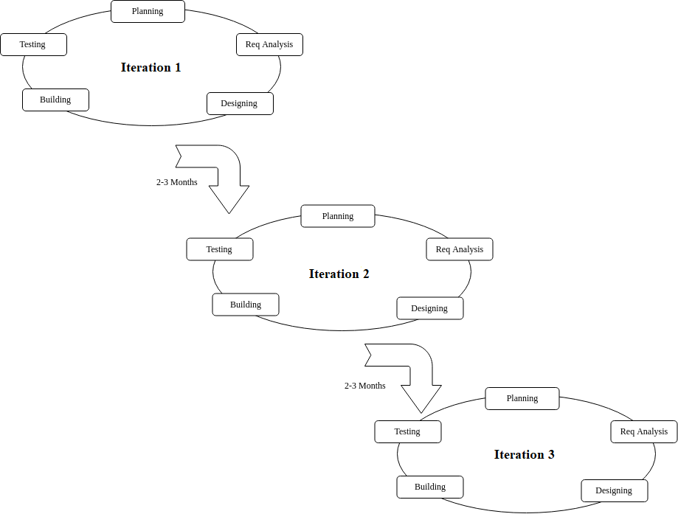
Block Diagram of Agile Development Model

Slide 9
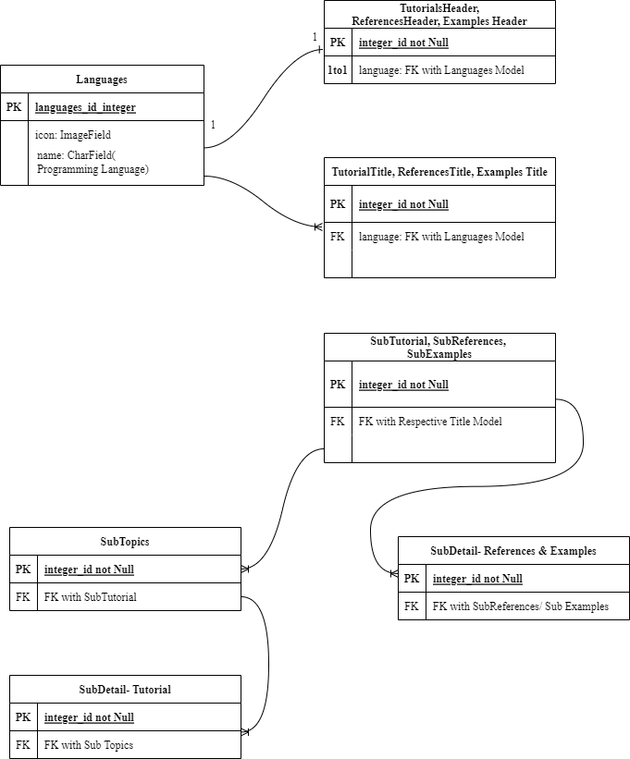
ENTITY RELATIONSHIP DIAGRAM

Slide 10
EPILOGUE
Tasks Completed
Successful Rest APIs for Home Page, Tutorials, References & Examples Section
Tasks To Be Completed
Pro functionality and paid courses, user Authentication and billing features
Microservices for PRO Feature

Slide 11
THANK YOU! ☺

