Slide 1

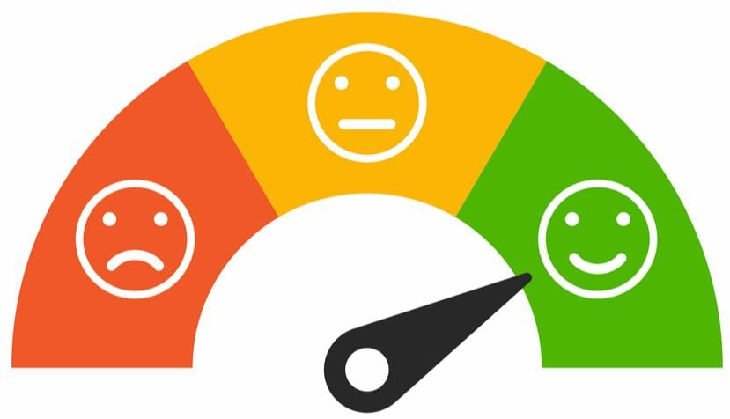
Coimbatore Institute of Engineering and Technology
SENTIMENT ANALYSIS
Presented by
BATCH:09
Keerthanadevi R 20BCS023
Poojana A 20BCS037
Saranya N 20BCS049
Theola Lois Keren R 20BCS055
Under the guidance of,
Ms.S.Kanchana, M.E.,
Assistance Professor,
Department of Computer Science and Engineering
Department of Computer Science and Engineering(CSE)

Slide 2
Content
Introduction
Abstract
Objective
Domain, Tools and Technology used
Literature review
Analysis of Existing system
Proposed system and advantages, features
Modules
Architecture
Methodology
Working
Results and discussion
Applications of the project
Conclusion and Future work
References
Twitter Sentiment Analysis
2

Slide 3
INTRODUCTION
Sentiment Analysis is a rapidly growing field in the area of Natural Language Processing (NLP) that aims to extract insights from textual data by analyzing the sentiments, emotions, and attitudes expressed in the text.
Therefore, developing a Sentiment Analysis classifier will have the ability to automatically classify sentiments as positive, negative, or neutral
We get to explore the effectiveness of different machine learning algorithms and techniques for sentiment classification
Twitter Sentiment Analysis
3

Slide 4
ABSTRACT
Twitter - major source of information and communication for millions of people around the world.
Sentiment Analysis has become an important task for understanding public opinion and attitudes towards various topics.
Analyzing the public sentiment is important for many applications such as firms trying to find out the response of their products in the market, predicting political elections and predicting socioeconomic phenomena like stock exchange.
The aim of this project is to develop a functional classifier for accurate and automatic sentiment classification of an unknown tweet stream.
Twitter Sentiment Analysis
4

Slide 5
OBJECTIVE
To develop a tool which is called an “Emotion recognizer” which determines the emotional tone behind a series of words with no attachment to a specific target.
To learn, develop and create an automated technique that extracts meaningful customer information related to their attitudes, emotions, and opinions.
To compare different algorithms for solving a specific problem, evaluate their accuracies, and identify the best approach for achieving optimal results.
Twitter Sentiment Analysis
5

Slide 6
DOMAIN, TOOLS, LANGUAGE & TECHNOLOGY
DOMAIN
Machine Learning
Data Science
TECHNOLOGY
Machine Learning’s Natural Language Processing(NLP) classification algorithms are used.
Logistic Regression
SVM
Naïve Bayes
Random Forest
XGBoost
TOOLS USED LANGUAGE
Jupyter Notebook, Google Collab Python
VS Code
Kaggle(for obtaining datasets)
Twitter Sentiment Analysis
6

Slide 7
LITERATURE REVIEW
1. "Twitter Sentiment Analysis: A Survey" by Santhosh Kumar and G. Sahoo (2019)
Observation: Deep learning techniques have shown promising results in recent years and that the availability of annotated datasets has contributed to the development of more accurate sentiment analysis models.
2. "A Survey of Sentiment Analysis Techniques on Twitter Data" by Supriya Kulkarni, Abhijit Mishra, and Shubham Kulkarni (2018)
Observation: While rule-based and lexicon-based methods are easy to implement, they lack accuracy, and machine learning-based methods have shown better results.
3. "A Comprehensive Survey of Twitter Sentiment Analysis Techniques" by Radhika Kapur and Vasudha Bhatnagar (2016)
Observation: Machine learning-based approaches have shown better accuracy and that deep learning techniques are promising for future research.
Twitter Sentiment Analysis
7

Slide 8
LITERATURE REVIEW
4. "A Survey on Sentiment Analysis Challenges" by Aqsa Ahmed and Aisha Abdul Basit (2020)
Observation: The lack of annotated datasets and the difficulty of identifying sarcasm and irony are significant challenges in sentiment analysis.
5. "A Comprehensive Survey on Sentiment Analysis in Social Media" by Arash Mohammadi and Mohsen Kahani (2022)
Observation: Deep learning techniques have shown better results in recent years, and that domain adaptation techniques are crucial for improving sentiment analysis performance on social media data.
6. "A Survey on Twitter Sentiment Analysis Using Machine Learning and Deep Learning Techniques" by Subashri Chandrasekaran and Hui Zhang (2021)
Observation: Deep learning techniques have shown better results in recent years and that transfer learning approaches, such as fine-tuning pre-trained language models, have shown promising results in sentiment analysis of Twitter data.
Twitter Sentiment Analysis
8

Slide 9
ANALYSIS OF EXISTING SYSTEM
Existing Methodologies
Rule-based approaches
Machine learning-based approaches
Hybrid approaches
Observation
Rule-based - Easy to implement but not very accurate
Machine learning based - Require a labeled dataset and may not be effective if the training data is not representative of the target population
Hybrid approaches - Effective at combining the strengths of both rule-based and machine learning-based approaches but may require more resources to implement.
Twitter Sentiment Analysis
9

Slide 10
PROPOSED SYSTEM
The proposed system aims to develop a sentiment analysis model for Twitter data using machine learning techniques (Supervised learning approach ) to identify the emotions in the data.
Machine learning algorithms like Logistic Regression, SVM, Naïve Bayes, Random Forest, XGBoost are used for implementation and comparative analysis.
ADVANTAGES: ML & NLP techniques together provide improved accuracy, adaptability, scalability, computational insights, flexibility, and automation in predicting results in a variety of contexts.
Twitter Sentiment Analysis
10

Slide 11
MODULES
1. Data Collection
3. Pre – processing the dataset
2. Importing Python Libraries
4. Exploratory Data Analysis
Twitter Sentiment Analysis
11

Slide 12
MODULES
5. Feature Generation
7. Classification
9. Visualizing the results through bar charts and graphs
6. Model Training and Testing
8. Performance Evaluation
Twitter Sentiment Analysis
12

Slide 13
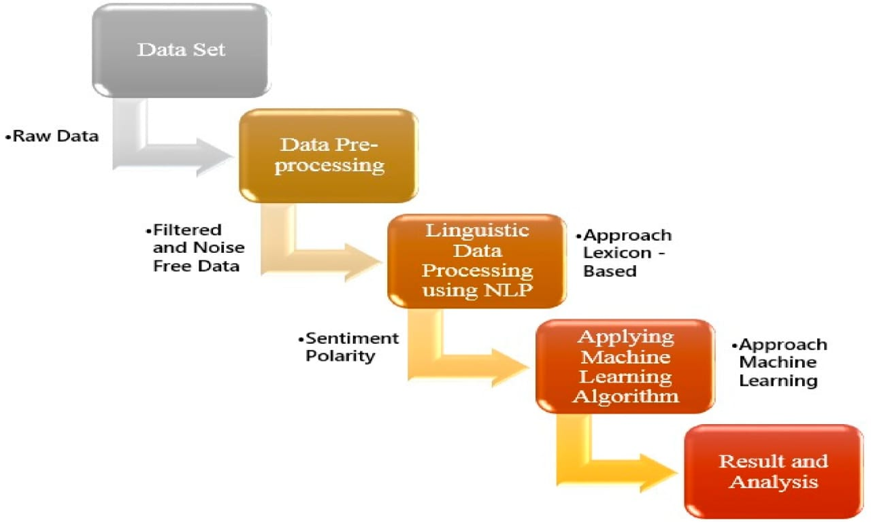
ARCHITECTURE
Figure 1 An architecture of the system
Twitter Sentiment Analysis
13

Slide 14
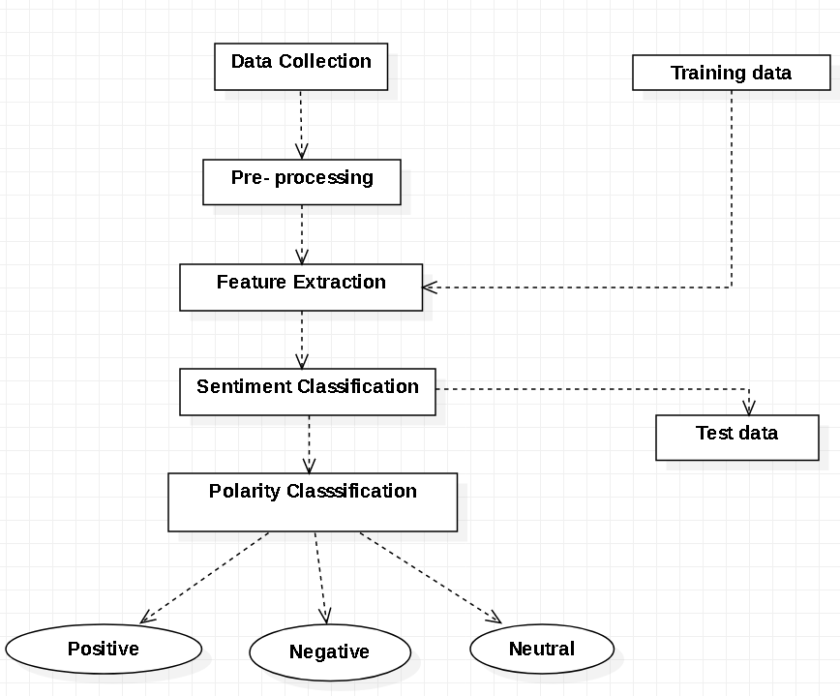
ARCHITECTURE
Figure 2 An UML architecture of the system
Twitter Sentiment Analysis
13

Slide 15
METHODOLOGY AND WORKING
Supervised Learning algorithms of ML – 2 types:
Classification
Regression
Classification models that are chosen for implementation:
Logistic Regression
SVM
Naïve Bayes
Random Forest
XGBoost
Involves 2 phases :
Model Training
Model Testing
Twitter Sentiment Analysis
15

Slide 16
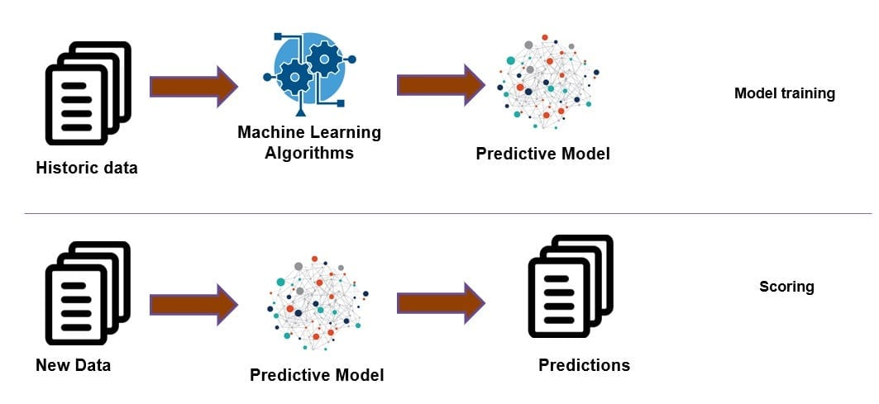
METHODOLOGY AND WORKING
Step 1: Install and Import Libraries
Step 2: Getting labeled data of tweets from Twitter
Step 3: Tokenizing and cleaning the data
Step 4: Removing stop words
Step 5: Preprocessing the data Figure 3 A general working model
Step 6: Feature extraction ---Training & Test data
Step 7: Training the model using supervised algorithms
Step 8: Classifying using ML
Step 9: Output with predicted sentiment labels
Step 10: Calculating the accuracy of the classifier which analyzes the sentiment
Twitter Sentiment Analysis
16

Slide 17
METHODOLOGY AND WORKING
1. DATA COLLECTION
A dataset obtained from Kaggle https://www.kaggle.com/datasets/jp797498e/twitter-entity-sentiment-analysis in CSV format
2. PREPROCESSING
Removing punctuations like, removing stop words, tokenization, stemming, lemmatization
3. IMPORTING PYTHON LIBRARIES
NLTK, Scikit-learn, Pandas, NumPy, Keras, Matplotlib, Seaborn etc.,
4. FEATURE EXTRACTION
Bag-Of-Words: Each document is represented as a vector of word frequencies, where each element of the vector corresponds to a particular word in the vocabulary. The value of each element represents the frequency of that word in the document
Twitter Sentiment Analysis
17

Slide 18
METHODOLOGY AND WORKING
5. IMPLEMENTATION OF MACHINE LEARNING ALGORITHMS
fit(), predict(), transform(), score(), plot() – methods used while implementing
6. MODEL TRAINING AND TESTING
train_test_split() - for splitting into training and test data set
TfidfVectorizer() - to transform the training and testing data into numerical feature vectors
7. MODEL EVALUATION
Performance of the system is measured through metrics - Precision, Recall, F1 score, and Accuracy
8. VISUALIZATION
Word clouds, Heatmaps, and Scatter plots and Bar graphs are used for visualization purposes.
Twitter Sentiment Analysis
18

Slide 19
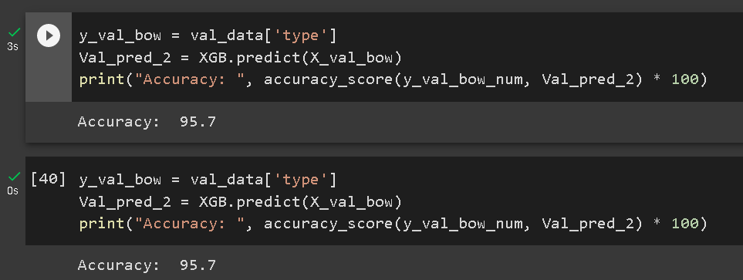
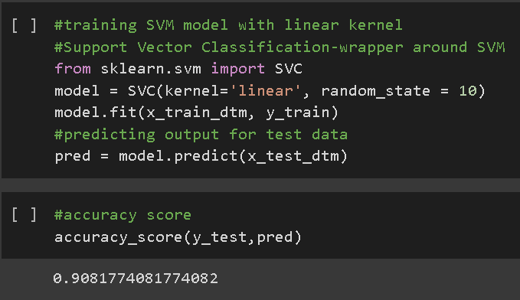
RESULTS AND DISCUSSION
Figure 5 Accuracy of SVM
Figure 4 Accuracy of Logistic regression
Twitter Sentiment Analysis
19

Slide 20
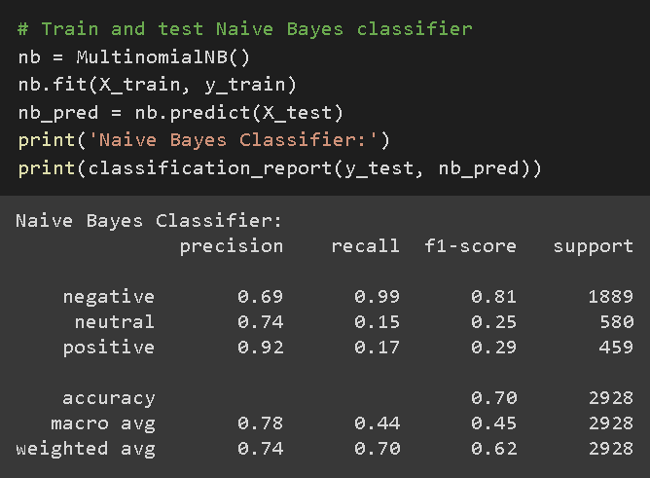
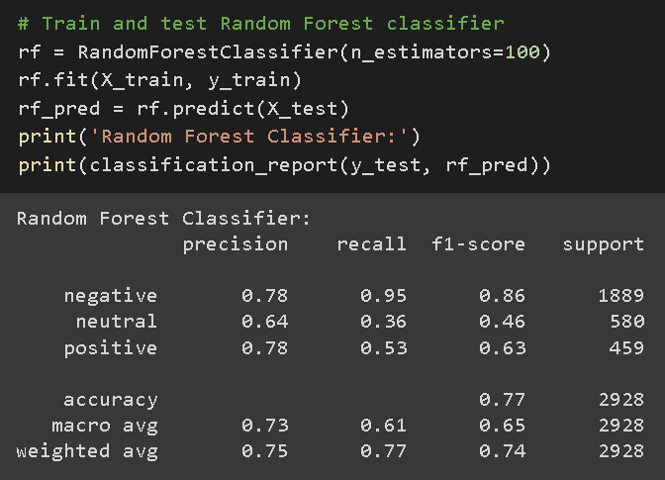
RESULTS AND DISCUSSION
Figure 7 Accuracy of Random Forest
Figure 6 Accuracy of Naïve Bayes
Twitter Sentiment Analysis
20

Slide 21
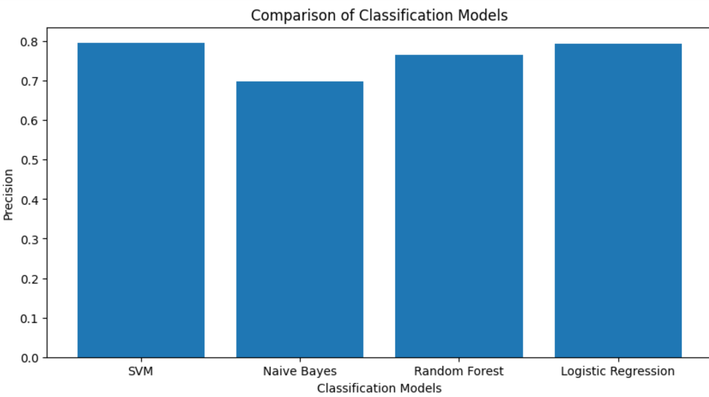
RESULTS AND DISCUSSION
ALGORITHM | ACCURACY
1. Logistic Regression | 95.7
2. SVM | 0.9081
3. Naïve Bayes | 0.78
4. Random Forest | 0.73
Table 1 Comparison of Accuracies
Figure 8 Comparison of Classification models
Twitter Sentiment Analysis
21

Slide 22
RESULTS AND DISCUSSION
The experimental results showed that Logistic Regression has the highest accuracy rate. The confusion matrix and classification report showed that all algorithms performed well in predicting positive tweets.
However, in some cases, mis-predictions in classification is observable. This could be due to the fact that negative tweets are more diverse and complex than positive tweets, making them harder to predict.
Further analysis could be done to improve the accuracy of negative tweet prediction. Additionally, the project could be expanded to include sentiment analysis on other social media platforms such as Facebook and Instagram
Twitter Sentiment Analysis
22

Slide 23
APPLICATIONS
Brand monitoring
Customer feedback analysis
Market research
Political analysis
Social media analysis
Customer service
Fraud detection
Twitter Sentiment Analysis
23

Slide 24
CONCLUSION & FUTURE WORK
Thus a Classifier model is developed that will “Unlock the power of sentiment analysis and gain valuable insights into what your customers really think”.
Sentiment analysis can be extended further by digging deeper, far past the surface of the number of likes, comments and shares, and aim to reach, and truly understand, the significance of social media interactions and what they tell us about the consumers and their opinions behind the screen.
FUTURE WORK – to improve Performance
Experiment with different word embeddings - Word2Vec or GloVe
Implement a deep learning model - Convolutional Neural Network (CNN) or a Recurrent Neural Network (RNN)
Use ensemble methods to combine the predictions of multiple models and improve the accuracy and expand the scope by implementing it in other social media platforms, such as Facebook or Instagram
Twitter Sentiment Analysis
24

Slide 25
REFERENCES
1. Po-Wei Liang, Bi-Ru Dai (2013) “Opinion Mining on Social MediaData"- IEEE 14th International Conference on Mobile Data Management,Milan,
2. O. Almatrafi, S. Parack and B. Chavan (2015) “Application of location-based sentiment analysis using Twitter for identifying trends towards Indian general elections 2014”. Proc. The 9th International Conference on Ubiquitous Information Management and Communication
3. A. L. Thakur, A. K. Singh, and R. Kumar (2020) "A Review of Deep Learning Models for Sentiment Analysis"
4. D. D. Dung, N. T. Nguyen, and D. T. Hoang (2018) "A Survey on Sentiment Analysis Techniques for Social Media Analytics"
5. Yu, B (2015) “An evaluation of text classification methods for literary study. Literary and Linguistic Computing”
Twitter Sentiment Analysis
25

