Slide 1


Uber Transportation Data Analysis
Insights & Recommendations for Driver Allocation & Customer Experience
Notes:
1

Slide 2
Problem Statement
Uber's transportation network requires data-driven optimization to improve driver allocation efficiency, reduce customer wait times, and enhance overall service quality. This analysis examines real-world trip patterns to uncover actionable insights for operational excellence.
Understanding Demand
Optimizing Supply
Improving Experience
When and where customers request rides
Strategic driver positioning and scheduling
Reduced wait times and better service coverage
Notes:
2

Slide 3
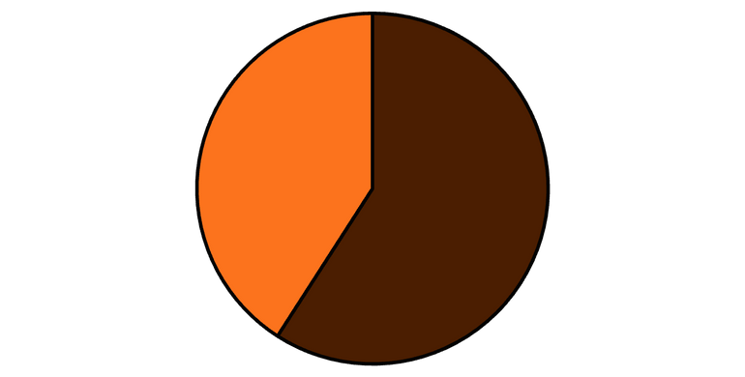
Dataset Overview
New York City Uber Pickups
  1,100+ trips analyzed across multiple categories
  Attributes: timestamps, trip category, distance, purpose, locations
  Preprocessing: null values handled, duplicates removed, timestamps standardized
  Quality: Clean, validated dataset ready for analysis
Business
Personal
Notes:
3

Slide 4
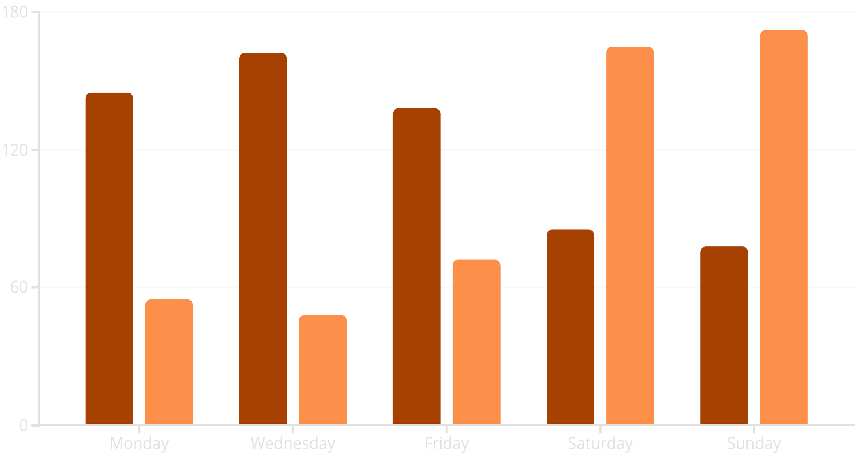


One of the insight: Weekday vs Weekend Patterns
Business trips dominate weekday demand while personal trips peak on weekends, indicating distinct usage patterns driven by commuting versus leisure activities.
Business Trips
Personal Trips
📈 Confidence: 93%
🎯 Fleet Adjustment
💰 Promotional Opportunity
Scale business drivers for weekdays, increase personal trip coverage weekends
Weekend discounts drive personal trip growth and expand revenue streams
Notes:
5

Slide 5



Expected Impact & Metrics
Projected outcomes from implementing the strategic recommendations, measured through key performance indicators critical to Uber's operational success.
25%
18%
22%
Reduced Wait Time
Revenue Growth
Driver Efficiency
Peak hour customer wait times expected to decrease through optimized driver deployment
Projected increase in total trip volume from weekend promotions and improved service reliability
Improved earnings per driver through better matching and reduced idle time via predictive scheduling
Notes:
9

Slide 6
Conclusion
This data-driven analysis reveals clear patterns in Uber's transportation demand, enabling strategic optimization of driver allocation, geographic coverage, and customer incentive programs. By implementing these recommendations, Uber can enhance operational efficiency, reduce wait times, and drive sustainable revenue growth through evidence-based decision-making.
Data Confidence
Quick Wins
Long-term Value
90-95% across all insights
Immediate implementation within weeks
Scalable, predictive framework for ongoing optimization
Notes:
10

