Slide 1

How to Use the Binomial Distribution in Python?
Submitted by:
Pooja Patil
HYD-7230

Slide 2
What is Binomial Distribution?
Formula
P(X=k) = _{n}C_{k} * p^{k} * (1-p)^{n-k}
n: number of trials
k: number of successes
p: probability of success on a given trial

Slide 3
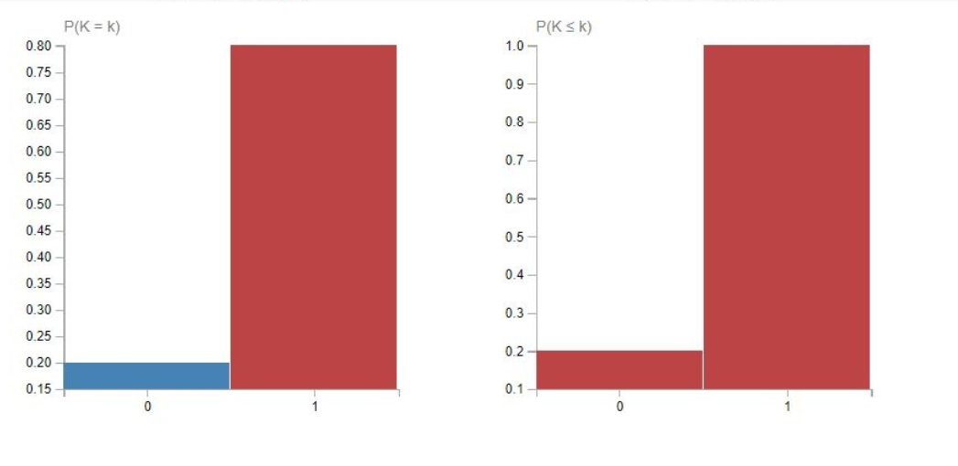
Calculating Probabilities Using a Binomial Distribution

Slide 4
Example:
Nathan makes 60% of his free-throw attempts. If he shoots 12 free throws, what is the probability that he makes exactly 10?
Here
k=10 ,n=12 , p=0.6

Slide 5
Example:
Marty flips a fair coin 5 times. What is the probability that the coin lands on heads 2 times or fewer?
Here
k=2 ,n=5 , p=0.5

Slide 6


