Slide 1

VARDHAMAN COLLEGE OF ENGINEERING, HYDERABAD
Autonomous institute affiliated to JNTUH
DEPARTMENT OF CSE(AI&ML)
Mini Project (A8041)
Title: TalkGenie: Intent and Sentiment–Aware Multilingual Chatbot
BATCH ID :22CSMPW-08
S. No | Roll. No | Student Name
1 | 22881A6620 | D S S SARANYA
2 | 23885A6603 | DARA ANIRUDH
3 | 23885A6604 | KOPPULA POOJA REDDY
4 | 23885A6606 | SHANIGARAM RAHUL
Supervisor
Mr. N S S S GIRISH KUMAR
Assistant Professor
Department of CSM

Slide 2
Outline
Abstract
Introduction
Existing System
Existing System Pros and Cons
Proposed Model
Specifications of the dataset
Proposed Model Results
Existing Model Vs Proposed Model
Sustainable Development Goals (SDGs)
Conclusion
Future Directions

Slide 3
Abstract
Input
Supports voice & text inputs in English
Integrated Technologies
Whisper, LLaMA3, Deep Translator, Text Blob, and gTTS combined
Output Modes
Delivers multilingual text and speech responses
Accessibility Focus
Designed for natural and inclusive communication

Slide 4
Introduction
Challenges
Voice assistants lack multilingual and emotional understanding
User Preferences
People want responses in their native languages
Our Goal
Build intelligent, accessible, and natural AI for everyone

Slide 5
Existing System
Core Approach
BERT-based encoder detects intent and fills slots
Probability-Aware Gate (PAG) links intent to slots dynamically
Adjusts predictions using intent probability scores
Limitations
Supports only text input.
Lacks speech interface
No multilingual capabilities

Slide 6
Existing System Pros and Cons
Pros | Cons
Advanced intent-slot modelling | No voice input support
Accurate text understanding | Limited to single language text
Improved intent-slot dependency | Doesn’t handle sentiment

Slide 7
Proposed Model
Voice and Text Input
Handles multiple languages with emotional and intent detection
Technology Integration
Combines Whisper, LLaMA3, translation, and text-to-speech modules
User Experience
Natural, emotion-sensitive, and localized responses

Slide 8
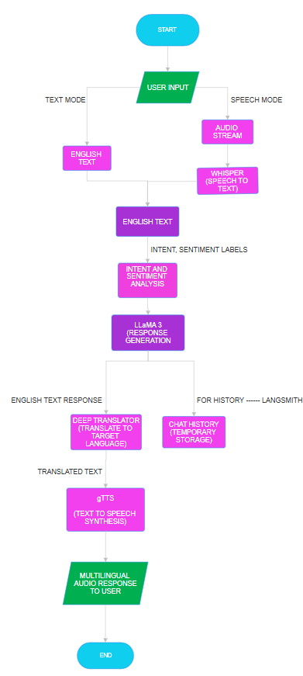
Proposed Model Flow Diagram

Slide 9
Specifications of data set
Dataset Size
80,000 User Interaction Instances
Data Details
User Sentence Input
Intent Labels (complaint, inquiry, request)
Sentiment Labels: (positive, neutral, negative)
Benefits
Enables context-aware, emotion-sensitive AI responses

Slide 10
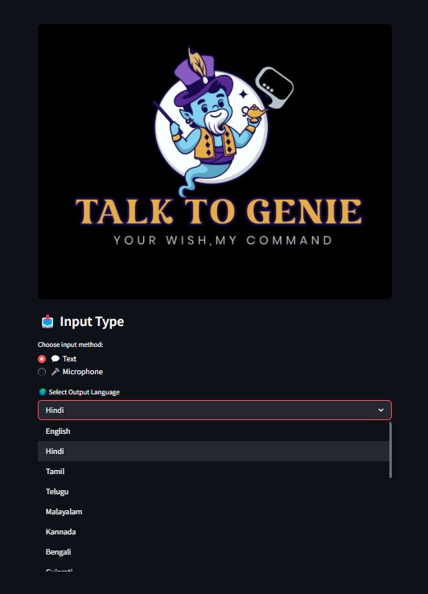
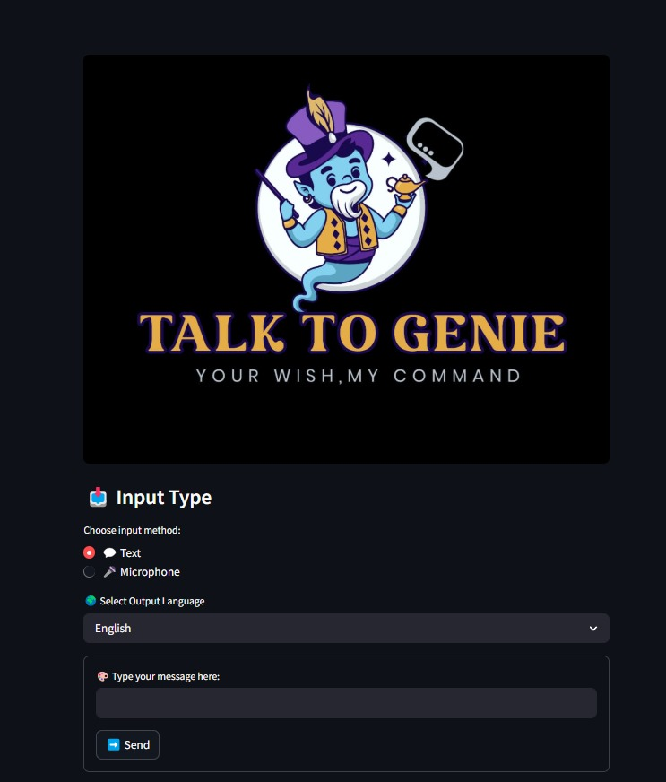
Proposed model results

Slide 11
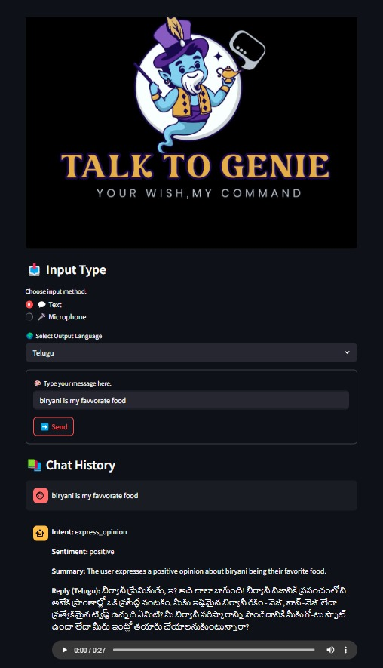
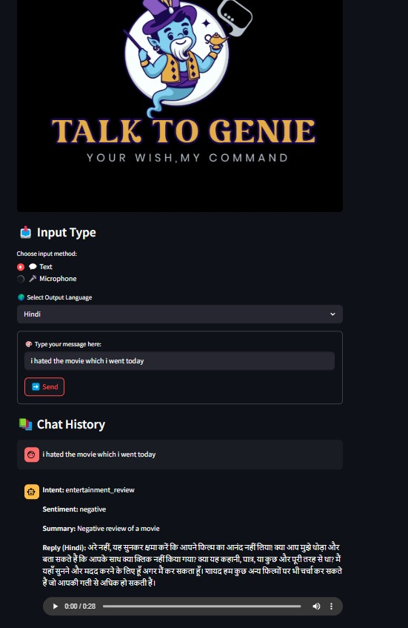
Proposed model results

Slide 12
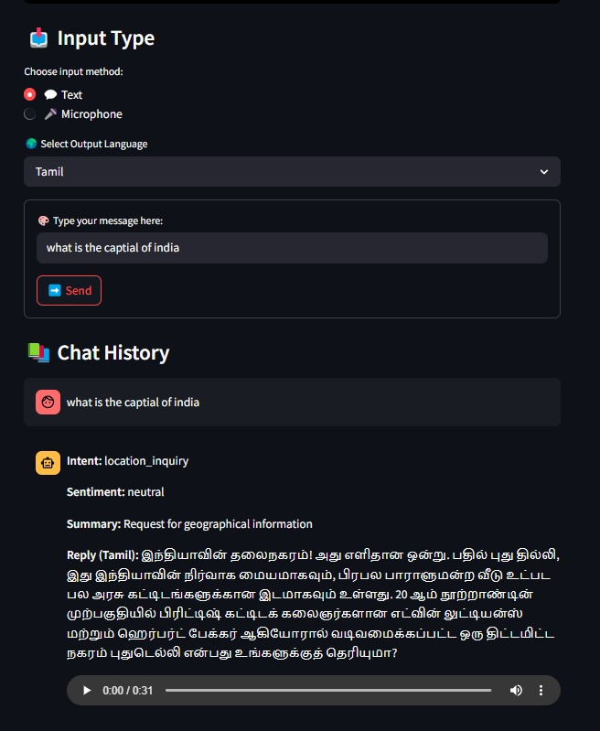
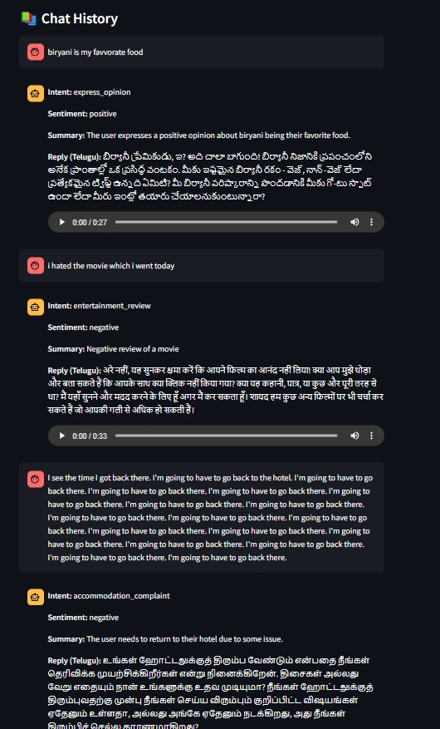
Proposed model results

Slide 13
Existing Model Vs Proposed Model
Aspect | Existing Model | Proposed Model
Input Type | Text only | Text and Speech
Language Support | English only | Multilingual (English, Telugu, Hindi, and Tamil)
Architecture | BERT + PAGM | Whisper + LLaMA3 + gTTS
Intent Detection | Yes | Yes (with higher accuracy)
Sentiment Analysis | No | Yes (Content-Aware)
Output Format | Text | Text + Multilingual Audio
Real-Time Interaction | Not Supported | Supported

Slide 14



Sustainable Development Goals (SDGs)
SDG 3: Good Health and Well-being
Enhances Healthcare Communication
Improved Patient Engagement
SDG 4: Quality Education
Accessible Education
Personalized Learning
SDG 9: Industry, Innovation, and Infrastructure
Blending AI with User-Friendly Design

Slide 15
Conclusion
Understands intent and sentiment in user input.
Supports multilingual Indian languages for wider reach.
Provides text and speech outputs for enhanced accessibility.
Helps make communication with AI more natural and inclusive elaborate a little and language simple

Slide 16
Future directions
Emotional Intelligence:
Detect stress, sarcasm, or excitement using voice analysis + ML
Conversation Memory:
Recall past chats for context-aware responses
Mobile App Integration:
Access TalkGenie anytime, anywhere
Offline Mode:
Use in low or no internet environments
Multilingual Input:
Direct queries in native languages
File & Image Analysis:
Process documents for summaries or recognize content using AI

Slide 17


