Slide 1

Asset Investment Analysis
By: Pooja Reddy Karnati

Slide 2
Objectives
SPARK FUNDS is an asset management company who want to make investments in other companies.
Their Investment criteria is:
The investment should be made to a Firm that is in English Speaking Country
Investment range is between 5 Million to 15 Million.
Objective is to suggest the best viable company suitable for SPARK FUNDS Investment criteria.

Slide 3
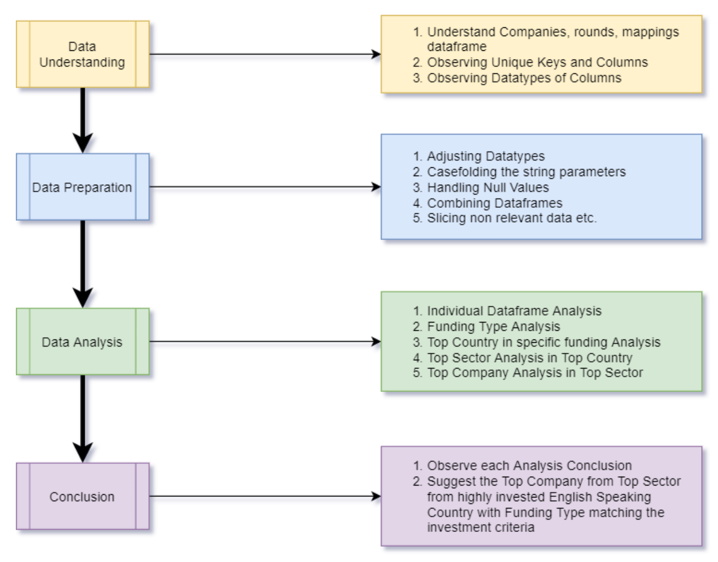
Problem Solving Methodology

Slide 4
Analysis – Best Investment Funding Type
Casefold Companies Unique Key and Round Funding Unique Key
Combine Both DataFrames to create Master DataFrame
Select the Data where investment type is “seed”, “venture”, “angel”, private equity”
Group by Investment Type on the selected dataframe and check the average and median investment value on each of these 4-investment type
Spark Funds criteria of Investment is 5M-15M.
Check the Investment type which fits in SPARK FUNDS criteria
We can find venture investment type fits the criteria of SPARK FUNDS and other types do not.
From this First Step, we arrived at a Conclusion that “Venture” type investment is suitable for SPARK FUNDS.

Slide 5
Analysis - Best Venture Investment Countries
As best Investment type is found out, we move on to select the entries belonging to venture type.
Our next goal is to find out the country where we have highest amount of venture type investments.
So, we group the data by Country and aggregate the investments by sum and count.
After observing the results, we can find USA,CHN,GBR,IND,CAN are in Top 5 countries where venture investment is most
But as SPARK FUNDS only considers investing in English speaking countries, USA, GBR, CAN are
Top 3 English Speaking Countries in in terms of highest venture investment.

Slide 6
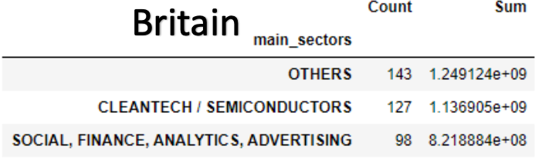
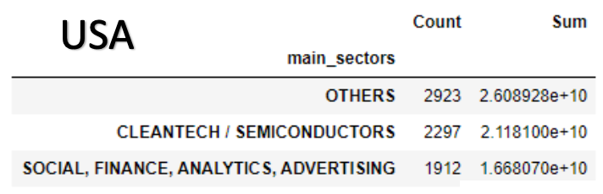
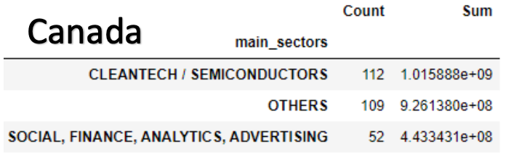
Analysis - Best Sector in Top Countries
After deciding the countries and investment type, let us find out the best sector to invest
Before moving to analysis, we have to create a derived column of main sectors from primary sectors using the SPARK FUNDS business logic
As main sectors column is created in master dataframe, we can group the data by main sectors and check the highest number of investments.
This analysis on all three countries to check the best sectors to invest in each country.

Slide 7
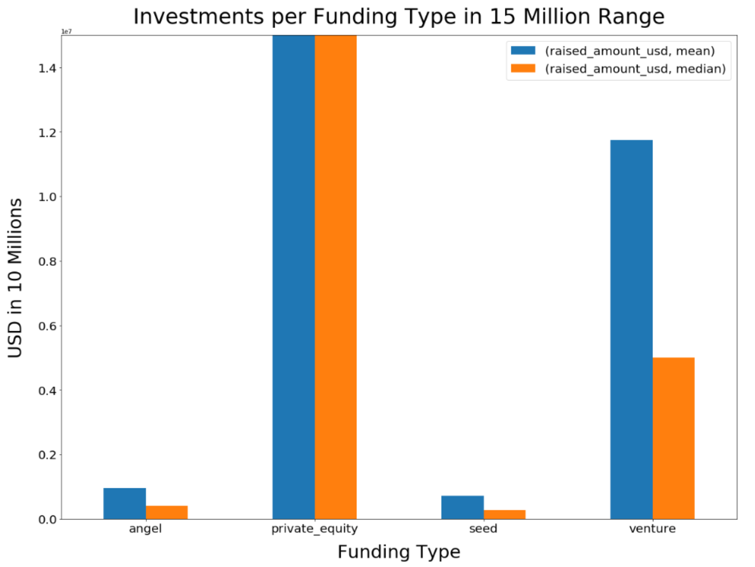
Suitable Funding Type = “Venture”
Angel < 5M
Seed < 5M
Private equity > 15M
5M < Venture < 15M

Slide 8
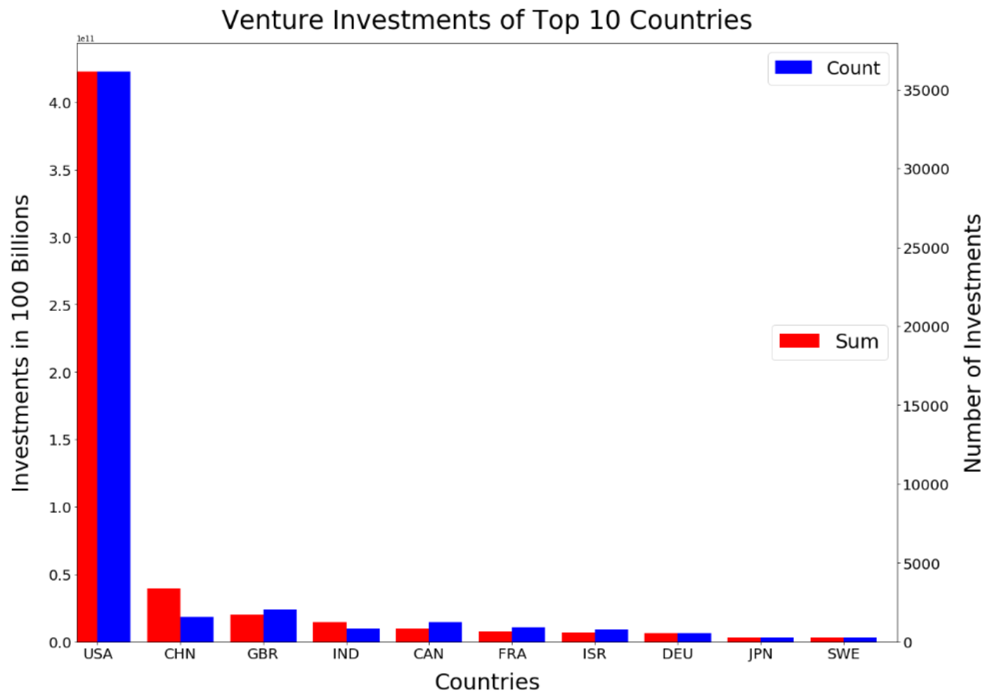
Best English Countries to Invest = USA, GBR, CAN
USA = United States
CHN = China
GBR = Great Britain
IND = India
CAN = Canada
FRA = France
ISR = Israel
DEU = Germany
JPN = Japan
SWE = Sweden

Slide 9
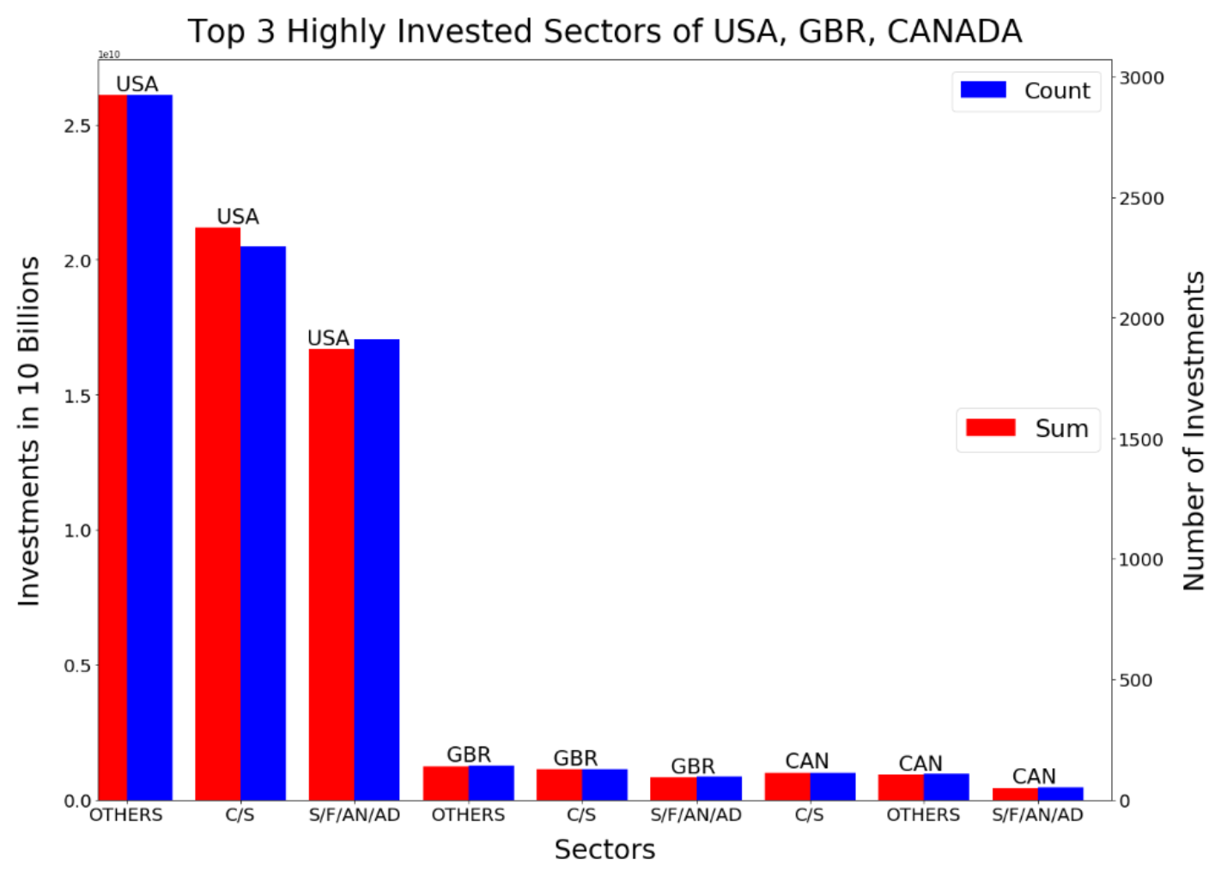
Best Main Sectors to Invest in USA, GBR, CANADA
“C/S” -> “CLEANTECH / SEMICONDUCTORS”
“S/F/AN/AD” -> “SOCIAL, FINANCE, ANALYTICS, ADVERTISING”

Slide 10
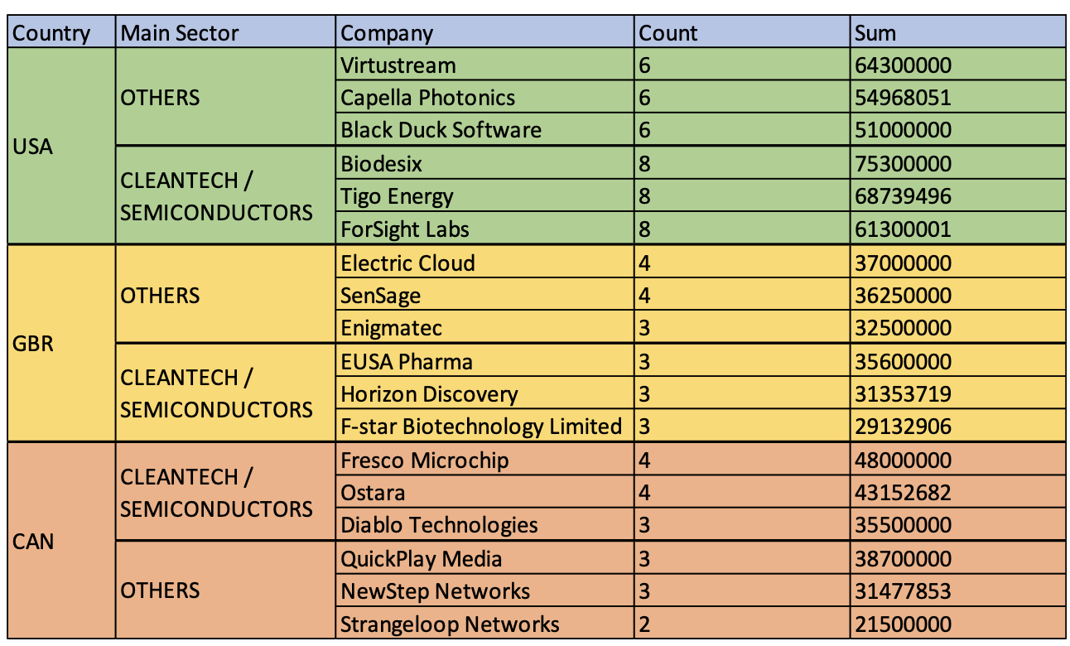
Conclusion
Investment Type:
VENTURE
Countries:
USA,
GBR,
CAN
Sectors:
OTHERS
CLEANTECH / SEMICONDUCTORS
SOCIAL, FINANCE, ANALYTICS, ADVERTISING
Companies Recommended:
REFER TO THE TABLE

