Slide 1
Digital Portfolio
STUDENT NAME: Pooja S
REGISTER NO AND NMID: 2428M0034, A850C5689BBFC3E827E4F58E357E02
0F DEPARTMENT: Bsc DATA SCIENCE
COLLEGE : Kumaraguru college of liberal arts and science, BHARATHIYAR UNIVERSITY

Slide 2
PROJECT TITLE
Digital portfolio using front-end web development (HTML & CSS)

Slide 3


AGENDA
Problem Statement
Project Overview
End Users
Tools and Technologies
Portfolio design and Layout
Features and Functionality
Results and Screenshots
Conclusion
Github Link
3/21/2024 Annual Review

Slide 4

PROBLEM STATEMENT
In today's competitive world, traditional resumes or paper/text- based portfolios fail to showcase an individual’s
skills and abilities full fledged. Aswell recruiters find it difficult to assess the practical abilities through static documents alone.
So here comes the need for a visually appealing, and easily accessible web pages/platforms where individuals will be able to present all their
achievements and activities and experiences in a professional way. This project “Digital Portfolio using Front- End Web Development (HTML & CSS)”,
provides a structured, user friendly and calm platform to highlight their personal and professional accomplishments

Slide 5

PROJECT OVERVIEW
OVERVIEWeloped as an interactive web design that is built using Front-End Web Development (HTML & CSS). It serves as a personal professional platform that allows an individual to showcase all their talents and accomplishments in a structured and engaging manner. The portfolio is designed in a user-friendly manner, that makes it suitable for academic and as well networking opportunities that allows to develop their career. By combining clean design with functional web elements, this portfolio goes beyond a traditional resume to provide a dynamic representation of my technical and creative journey.

Slide 6

WHO ARE THE END USERS?
The digital portfolio serves multiple categories of users. For students, it acts as a platform to present academic projects, internships, and extracurricular achievements. For fresh graduates and job seekers, it provides an opportunity to showcase technical skills and creativity to recruiters. Freelancers and professionals can use the portfolio to display their work and attract clients, while employers and recruiters benefit from gaining a clearer and more engaging view of a candidate’s abilities.

Slide 7

TOOLS AND TECHNIQUES
The portfolio was developed using HTML for content structuring, CSS for styling and layout design, and JavaScript for interactive features such as pop-up modals and smooth scrolling. The code was written and tested using Visual Studio Code. GitHub was used for version control and deployment, while Canva/Figma supported layout and design planning. These tools together ensured the project was functional, visually appealing, and deployable.

Slide 8
POTFOLIO DESIGN AND LAYOUT
The design consists of a clean and modern layout. A sticky navigation bar provides easy access to different sections such as About, Projects, and Contact. The About section contains a profile photo and a personal introduction. The Projects section displays mini-projects in a grid format with interactive pop-up modals for details. The Contact section includes a simple form to allow users to get in touch. Finally, the footer provides credits and social media links.
8

Slide 9
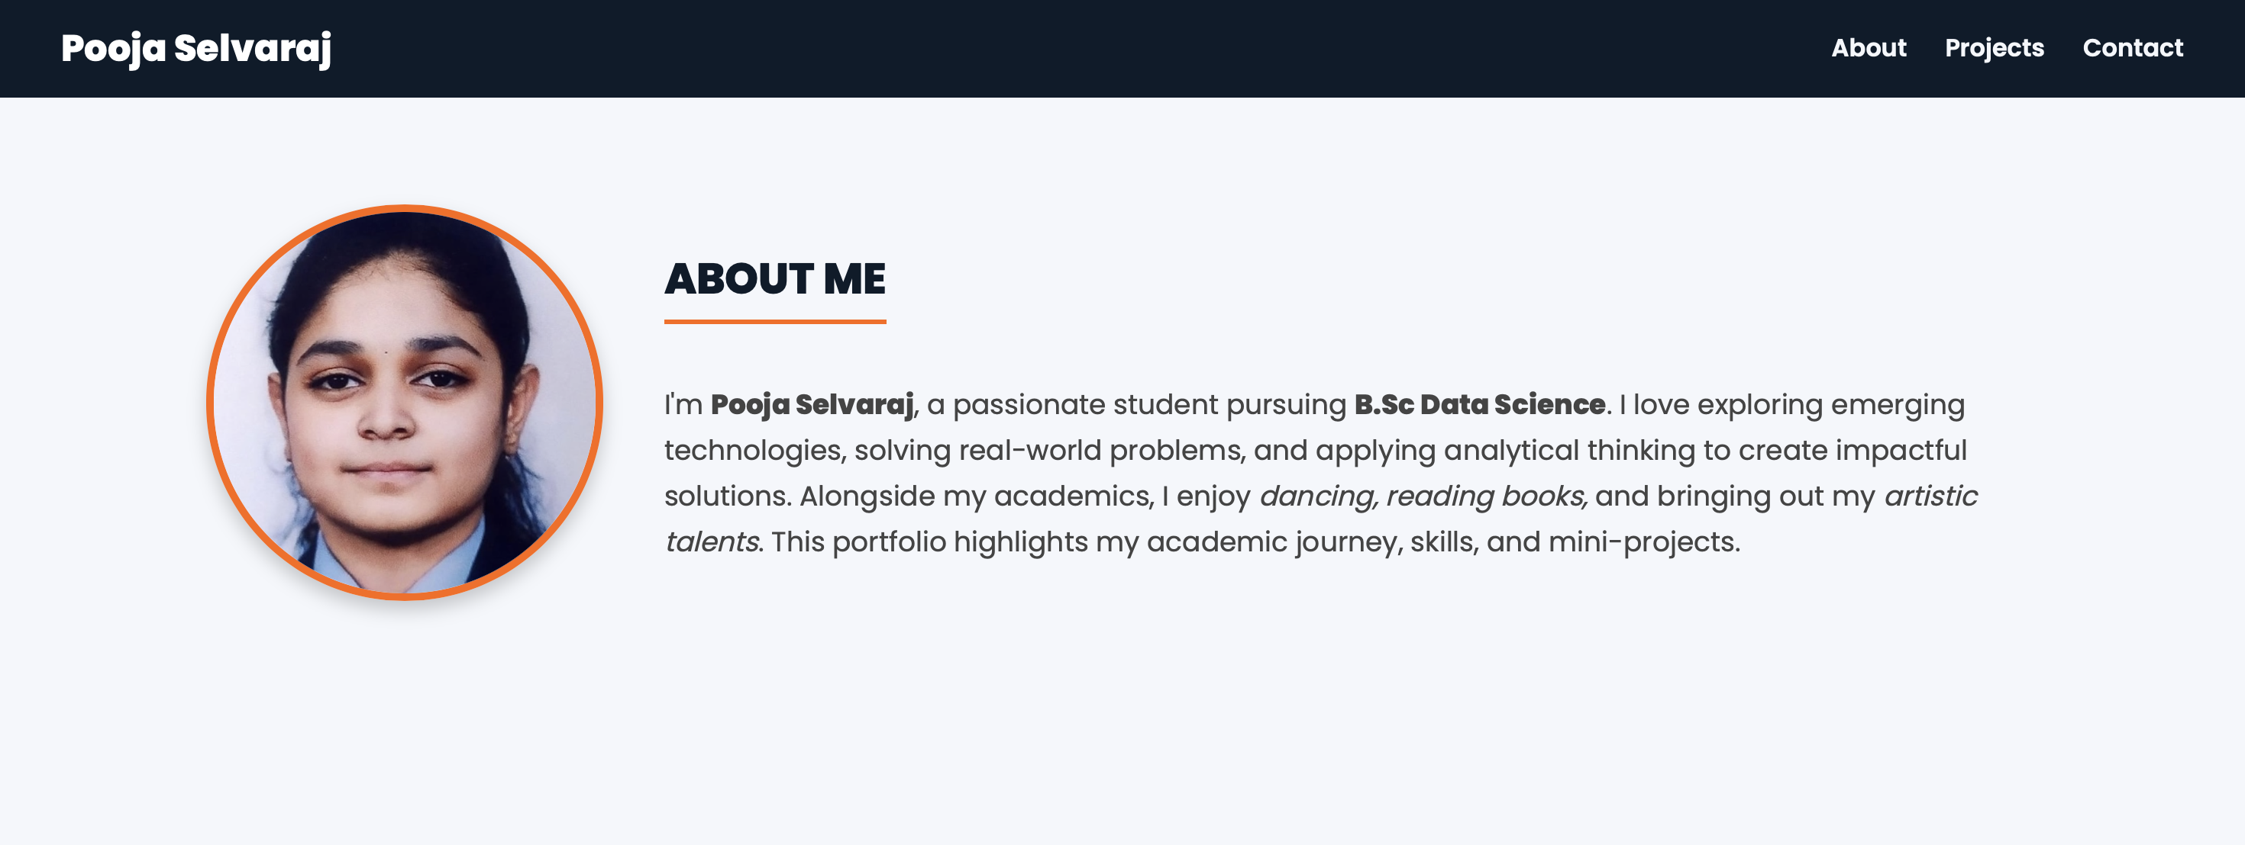
FEATURES AND FUNCTIONALITY
The portfolio includes responsive design, ensuring it works across devices such as desktops, tablets, and smartphones. Smooth scrolling and sticky navigation improve user experience. Project details are shown using modal pop-ups, making the interface clean yet informative. The contact form supports basic validation and user interaction. Modern fonts, theme colors, and hover effects add to the visual appeal, making the portfolio both professional and engaging.

Slide 10
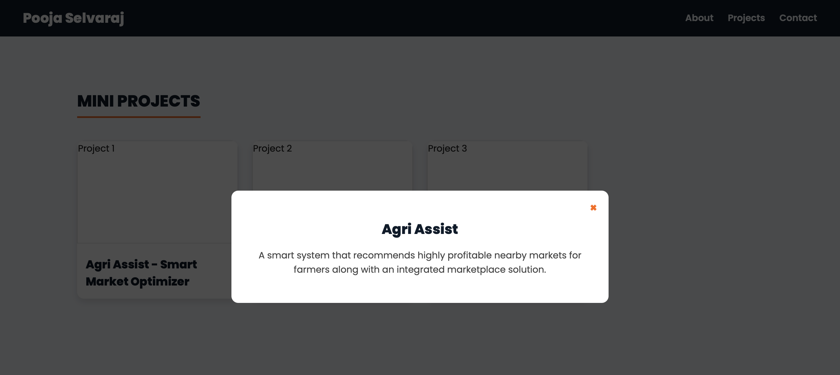
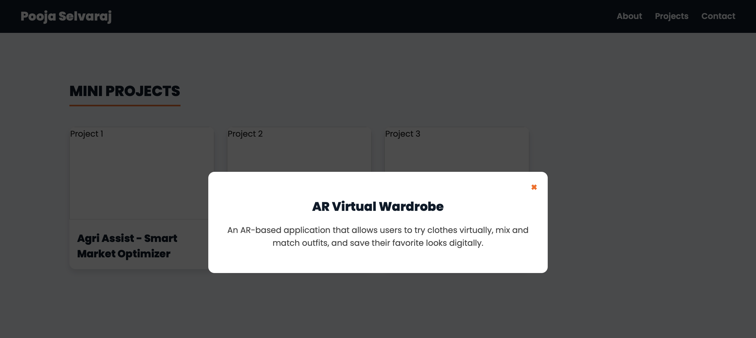
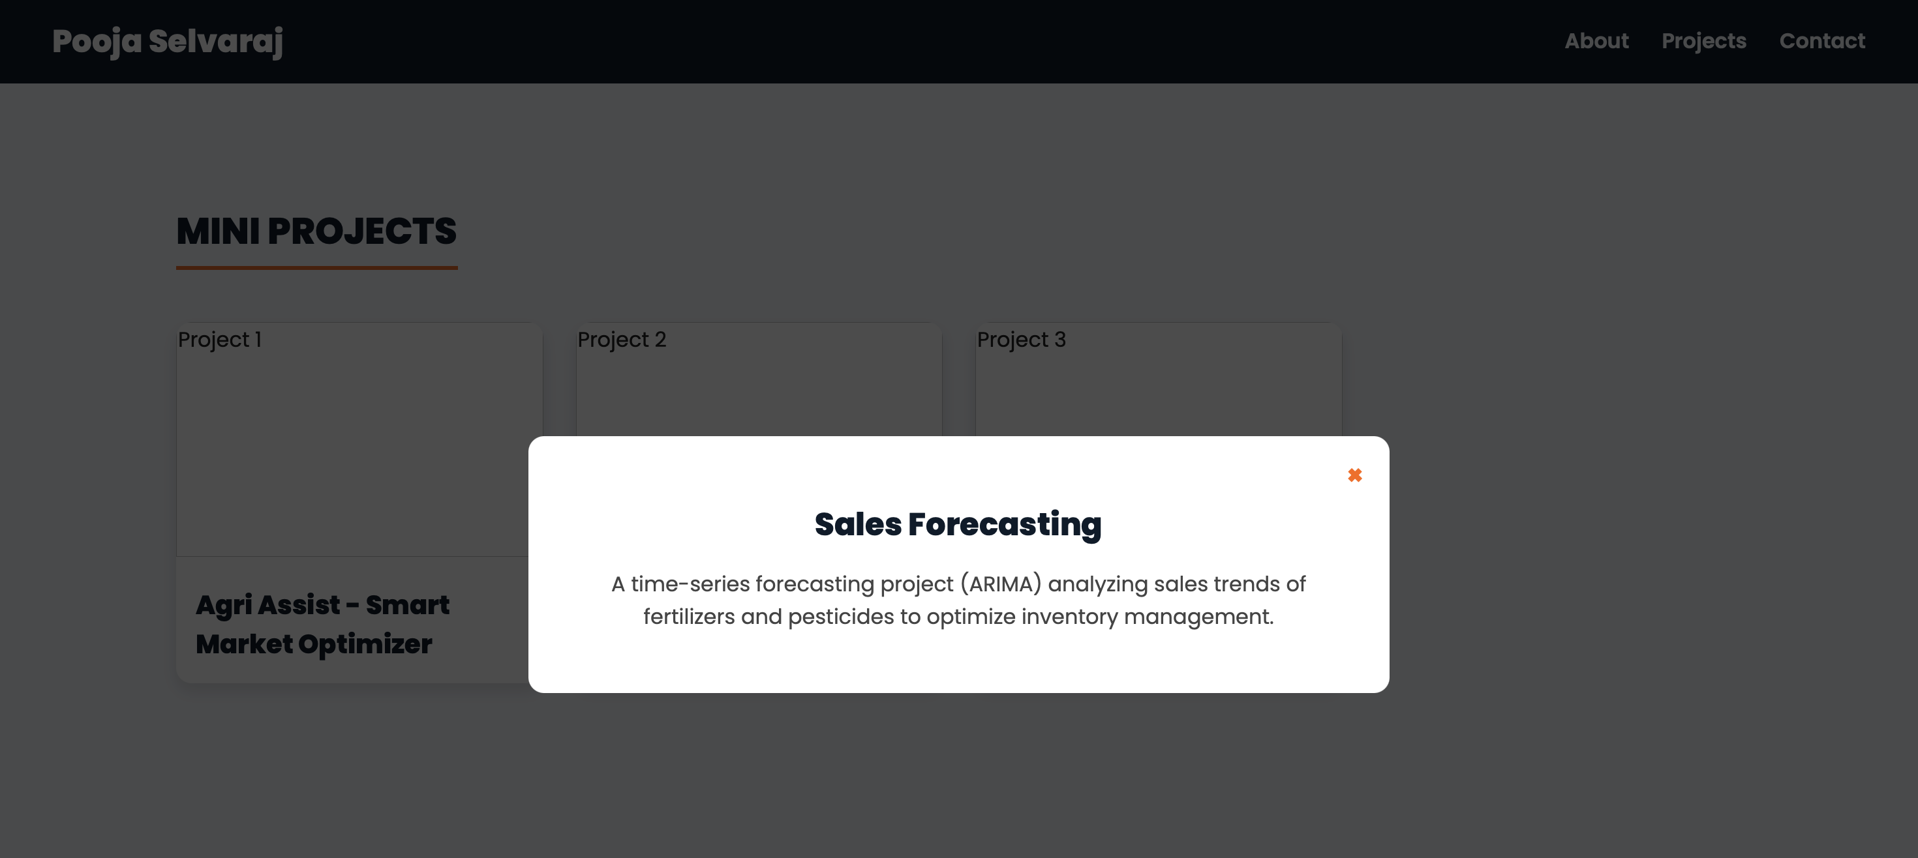
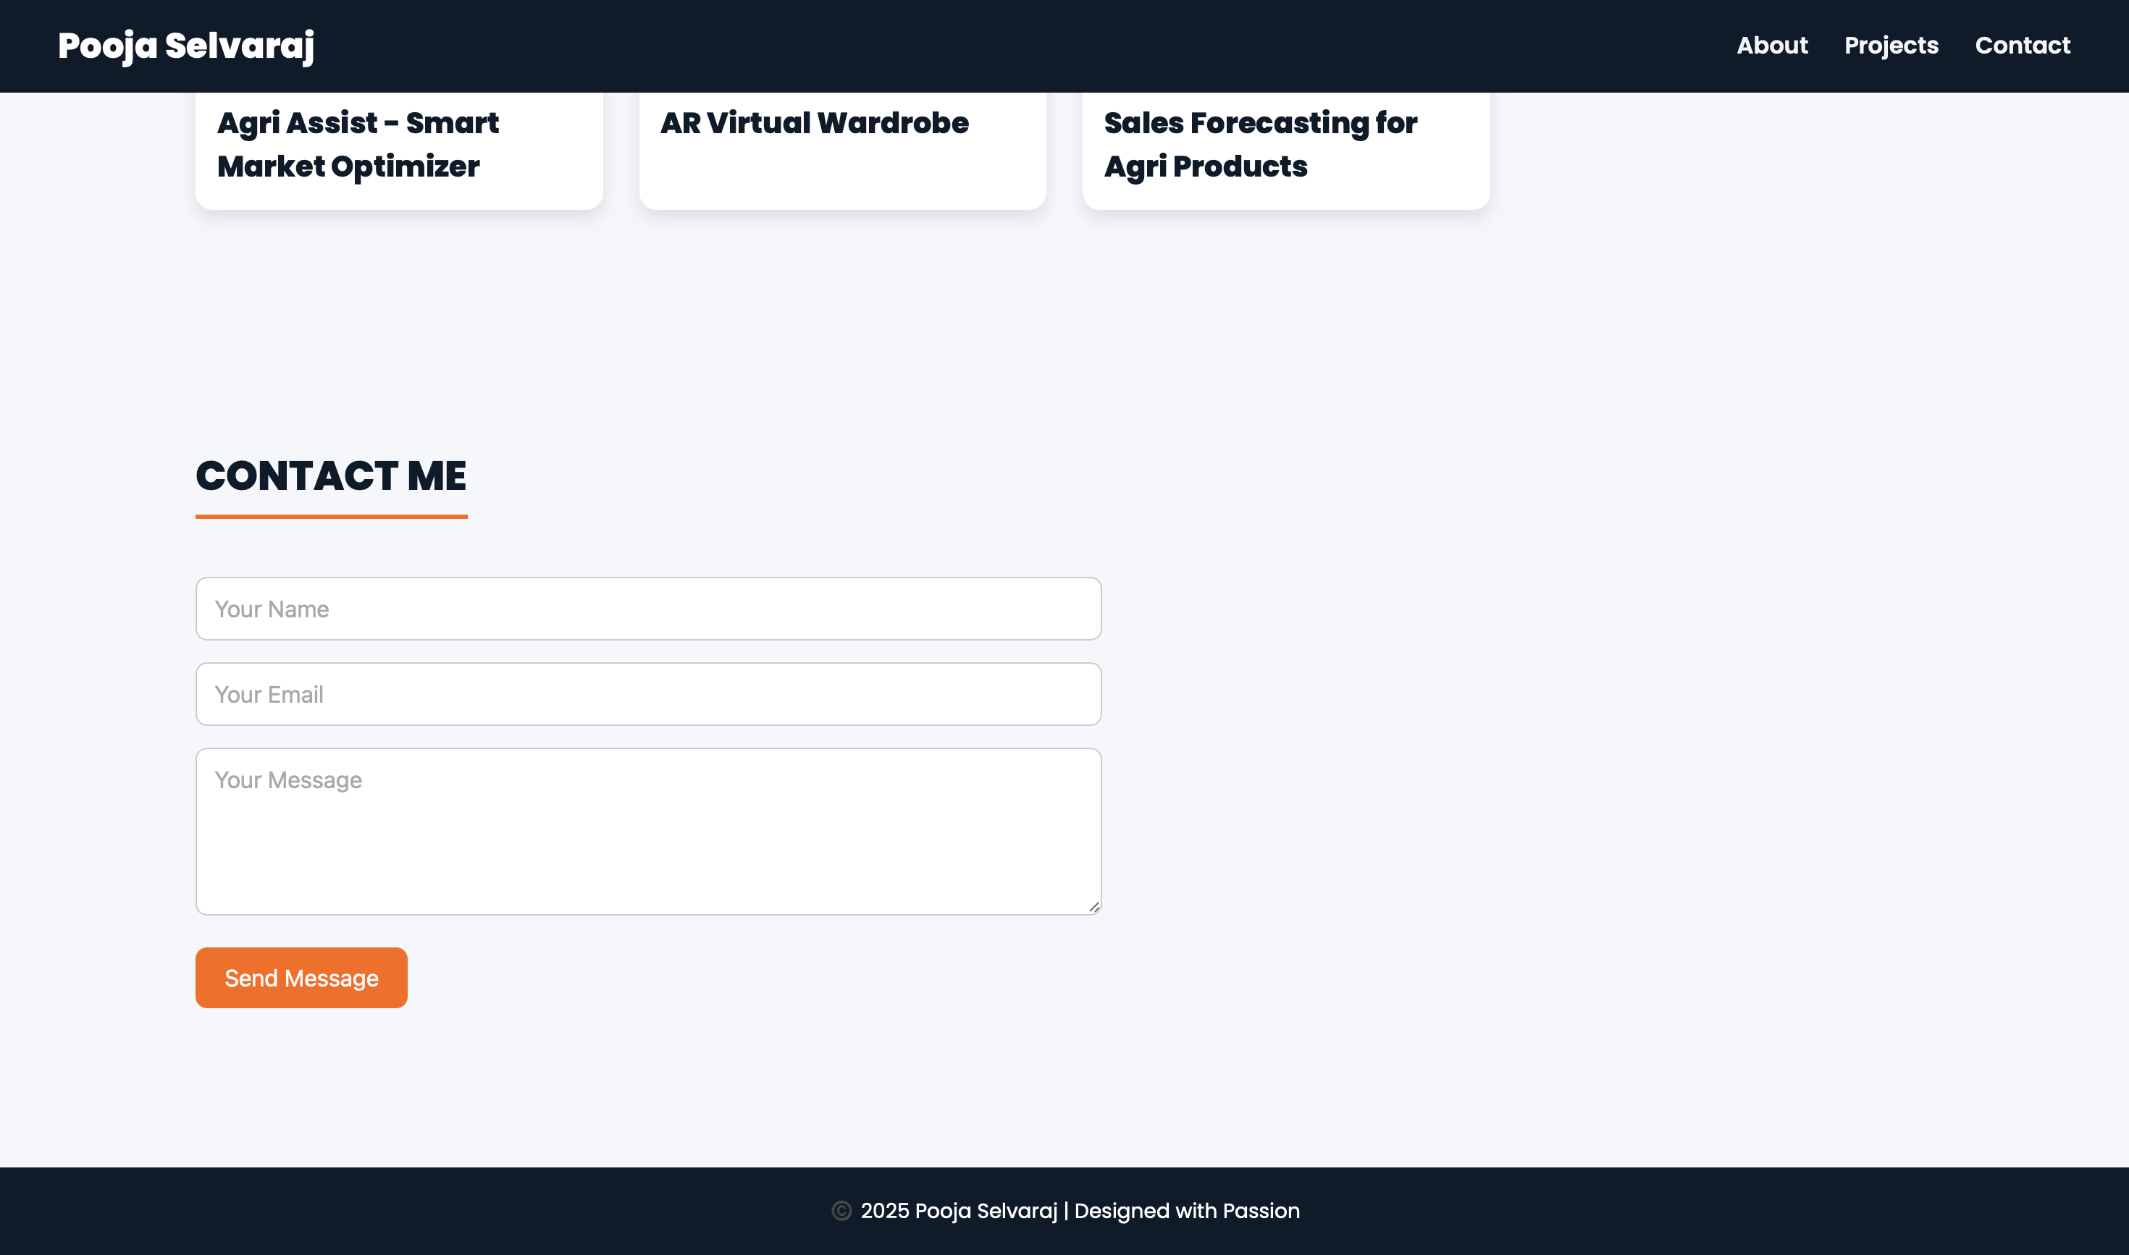
RESULTS AND SCREENSHOTS
3/21/2024 Annual Review
10

Slide 11
CONCLUSION
The digital portfolio project highlights the importance of having an online presence in today’s competitive world. It not only serves as a creative replacement for traditional resumes but also acts as a platform to demonstrate technical and design skills. The project strengthened my knowledge of front-end web development and design principles. In the future, the portfolio can be enhanced with backend integration for storing form responses and advanced frameworks like React for more dynamic features. Overall, this project reflects how simple web technologies can be used to make a strong professional impact.
11

