Slide 1
Project Title: Advanced Traffic Volume Estimation with Machine Learning Team Members: Team Leader : Mandava Poojaswini Team member :Anabothula Gayathri Team member :Darapaneni Murali Chandu Team member : Kalli Ram Gopal Reddy

Slide 2
Project Overview
Purpose:
Advanced Traffic Volume Estimation with Machine Learning aims to accurately predict traffic volume and flow using complex algorithms and data analysis. This enables informed decision-making for traffic management, infrastructure planning, and optimization of transportation systems. It helps reduce congestion, improve safety, and enhance overall traffic efficiency.
Features:
Data Integration
Predictive Modeling
Real-Time Analysis
Pattern Recognition
Accuracy Enhancement

Slide 3
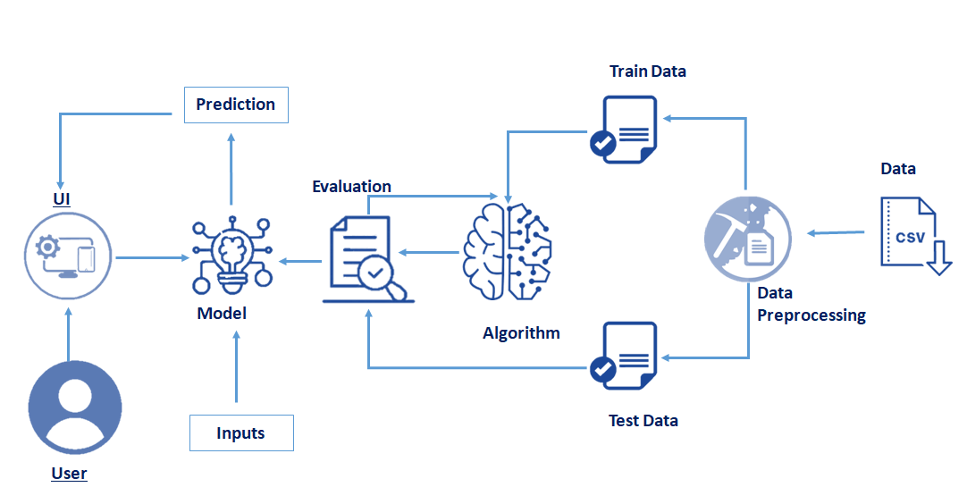
TrafficTelligence: Advanced Traffic Volume Estimation with Machine Learning
TrafficTelligence is an advanced system that uses machine learning algorithms to estimate and predict traffic volume with precision. By analyzing historical traffic data, weather patterns, events, and other relevant factors, TrafficTelligence provides accurate forecasts and insights to enhance traffic management, urban planning, and commuter experiences.
Scenario 1: Dynamic Traffic Management TrafficTelligence enables dynamic traffic management by providing real-time traffic volume estimations. Transportation authorities can use this information to implement adaptive traffic control systems, adjust signal timings, and optimize lane configurations to reduce congestion and improve traffic flow.
Scenario 2: Urban Development Planning City planners and urban developers can leverage TrafficTelligence predictions to plan new infrastructure projects effectively. By understanding future traffic volumes, they can design road networks, public transit systems, and commercial zones that are optimized for traffic efficiency and accessibility.
Scenario 3: Commuter Guidance and Navigation Individual commuters and navigation apps can benefit from TrafficTelligence's accurate traffic volume estimations..

Slide 4
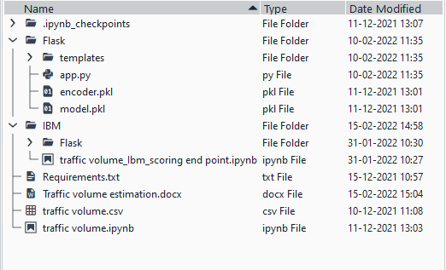
Project Structure
Flask files consist of template folder which has HTML pages, app.py file and .pkl files which are used for application building
IBM folder has flask files and scoring endpoint.ipynb- model training code file.
We need the model which is saved and the saved model in this content is Traffic volume. Pkl
Templates folder which contains index.HTML file, chance.HTML file, noChance.HTML file.
Scale.pkl for scaling, encoder.pkl file for encoding the categorical data, imputer.pkl file for filling out the missing values

Slide 5
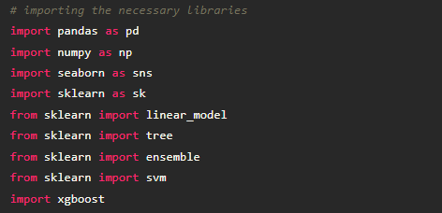

Import Necessary Libraries
It is important to import all the necessary libraries such as pandas, NumPy, matplotlib. Numpy- It is an open-source numerical Python library. It contains a multi-dimensional array and matrix data structures. It can be used to perform mathematical operations on arrays such as trigonometric, statistical, and algebraic routines.
Importing the Dataset
You might have your data in .csv files, .excel files
Let’s load a .csv data file into pandas
using read_csv() function.We will need to locate the directory of the CSV file at first (it’s more
efficient to keep the dataset in the same directory as your program).
If your dataset is in some other location, Then
Data=pd.read_csv(r”File_location/datasetname.csv”)

Slide 6
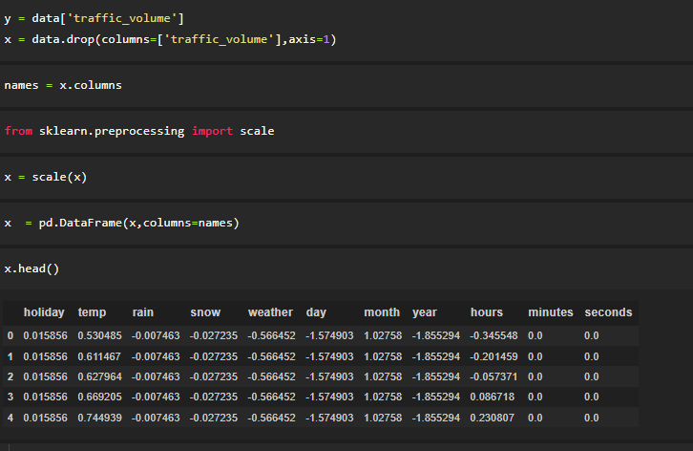
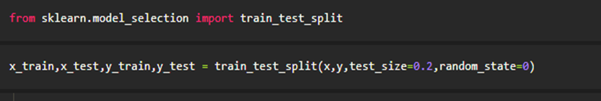
Feature Scaling
Splitting the data into Train and Test

Slide 7
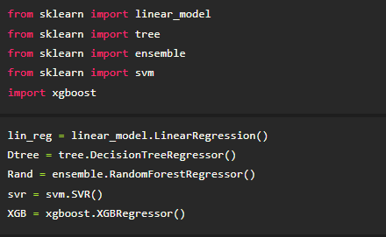
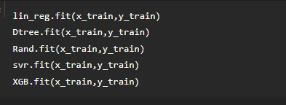
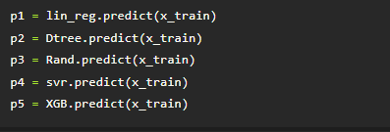
Training and Testing the Model
Once after splitting the data into train and test, the data should be fed to an algorithm to build a model.
There are several Machine learning algorithms to be used depending on the data you are going to process such as images, sound, text, and numerical values. The algorithms that you can choose according to the objective that you might have it may be Classification algorithms are Regression algorithms. 1. Linear Regression 2. Decision Tree Regressor 3.Random Forest Regressor 4.KNN 5.svm 5.xgboost

Slide 8
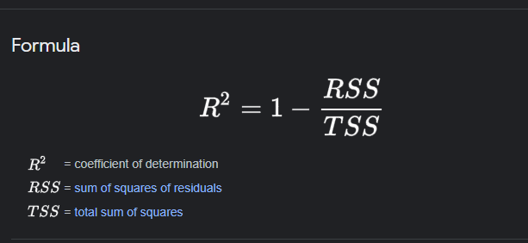
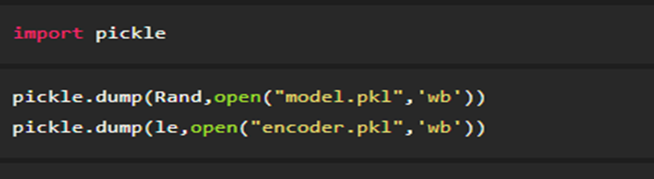
Pickle in Python is primarily used in serializing and deserializing a Python object structure. In other words, it's the process of converting a Python object into a byte stream to store it in a file/database, maintain program state across sessions or transport data over the network. wb indicates write method and rd indicates read method.

Slide 9
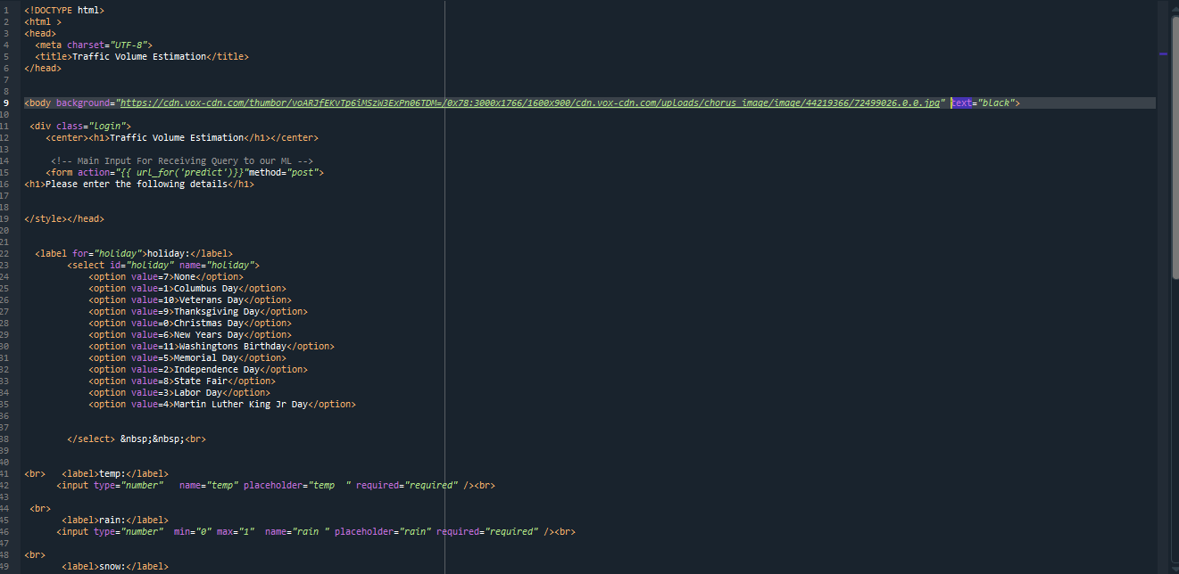
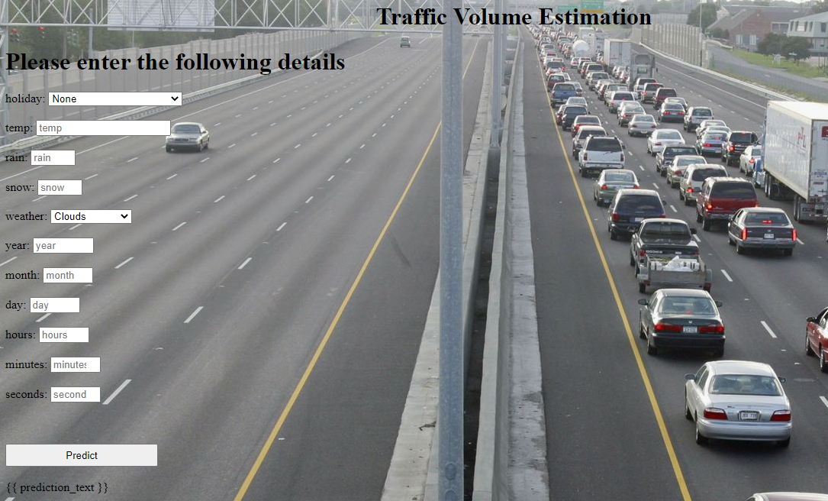
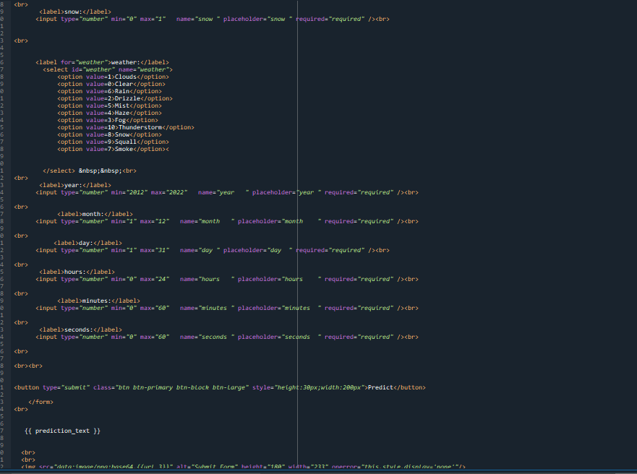
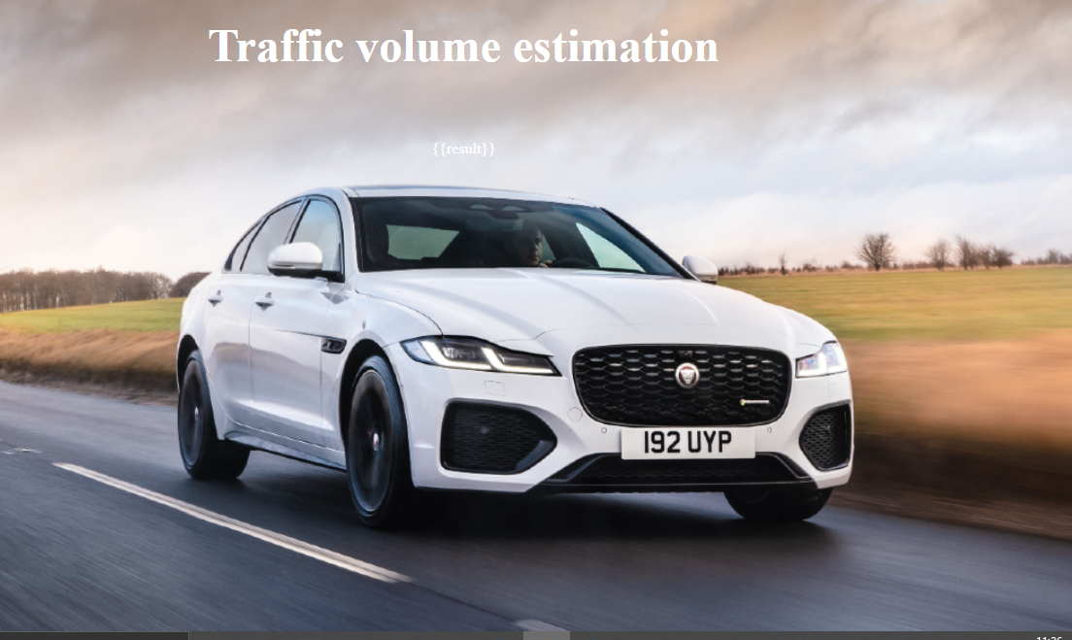
1.index.html - paste the image
2. The HTML page looks like this-
3. It will display all the input parameters and the prediction text will display the output value of the data given by the user.

Slide 10
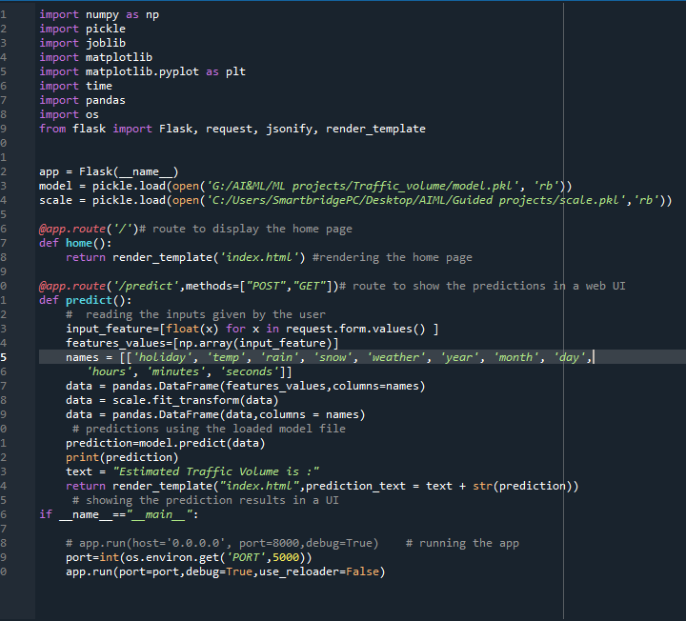
Python script

Slide 11
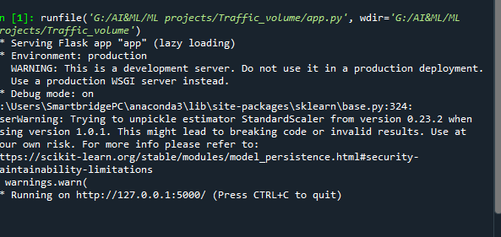
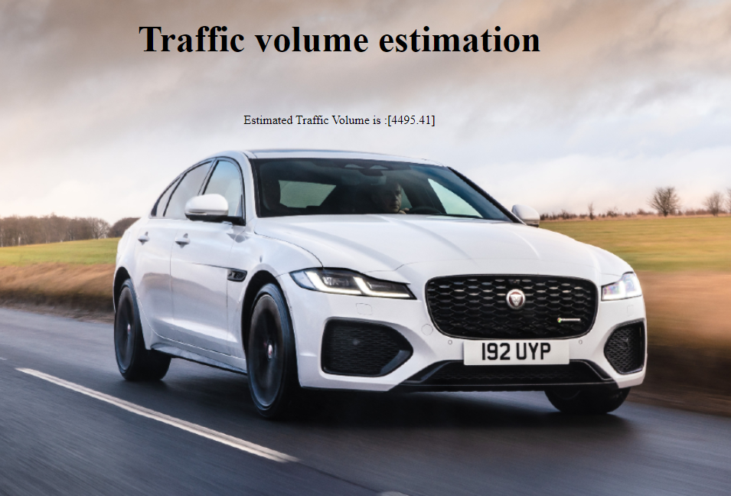
Output
Copy the HTTP link and paste it in google link tab, it will display the form page
Enter the values as per the form and click on predict button
It will redirect to the page based on prediction output
The output will be displayed in the prediction text as Estimated Traffic volume is in units.

Slide 12
Thank You

