Slide 1

BOOKING CANCELATION STATUS PREDICTION PROJECT
INDIAN INSTITUTE OF INFORMATION TECHNOLOGY DESIGN AND MANUFACTURING, KURNOOL
Samsung Innovation Campus (SIC)
by
G. Poojith sri sai
119me0018

Slide 2
Contents
Problem Statement
Dataset Details
Data Visualization
Procedure
Choosing best fit model
Conclusion

Slide 3
Problem statement
Cancelation status prediction for hotel bookings :
From the given data of hotel bookings of a particular hotel, we should able to find whether a resident will cancel the booking or not. Implementing a binary classifier with details of lead time, agent, customer type, etc will help us to predict the cancelation status.
Type: Binary Classification type

Slide 4
Dataset Details
Dataset that we use in this problem is “hotel_bookings”. In this dataset there are vast number of observations and features/variables. Size of the dataset is 1,19,390*32. These are of different datatypes. Variables are classified as follows.
object – hotel, arrival_date_month, meal,country, market_segment,distribution_channel, reserved_room_type,assigned_room_type , deposit_type, customer_type, reservation_status, reservation_status_date .
float – adr, agent, company, chidren
int - is_canceled, lead_time, arrival_date_year, babies, is_repeated_guest, previous_cancellations, previous_bookings_not_canceled, booking_changes, days_in_waiting_list, required_car_parking_spaces, total_of_special_requests

Slide 5
Data Visualization
By visualizing data we can explore data in more detailed way. Data can be visualized in various formats such as bar graphs, scatterplot, plotting, pie charts, histograms, boxplots, heatmaps.
In this project we visualize data using heatmaps, bar charts and scatterplots in order to get details of different variables.
Heatmaps are used to find the null values in the data set. In other words, to find columns which contains null values. From this graph we could able to remove the columns easily which have more null values. Heatmaps are also used for showing confusion matrices and correlation matrix.
Scatter plot helps to show the relation between 2 variables.
Bar charts are used to visualize the dependent variable with respect to categorial data in data frame.

Slide 6
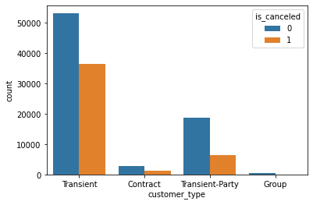
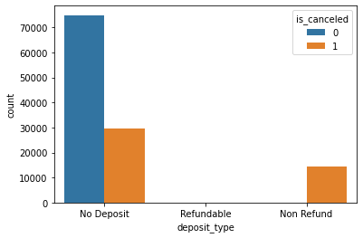
Data Visualization
figure1: Bar chart with customer_type on x-axis and
count of is_canceled on y-axis
figure2: Bar chart with deposit_type on x-axis and
count of is_canceled on y-axis

Slide 7
Data Visualization
figure1 represents bar chart between the independent variable customer type and target variable is_canceled. Inference from this graph is customer type of transient and transient party are more involved in canceling bookings comparative to the other customers.
figure2 represents bar chart between the independent variable deposit type and target variable is_canceled. Residents with deposit type no deposit and refund are canceling more than residents of deposit type refundable.

Slide 8
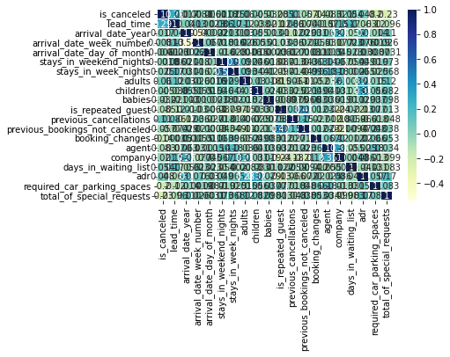
Data Visualization
Correlation Matrix:
figure3 represents heatmap of correlation matrix between different variables. Using this heatmap we could able to get information of relation between two variables.
We have positive correlation between
Lead_time and is_canceled
adr and adults
agent and company
is_repeated_guests and previous_bookings_not_canceled
figure3: correlation matrix

Slide 9
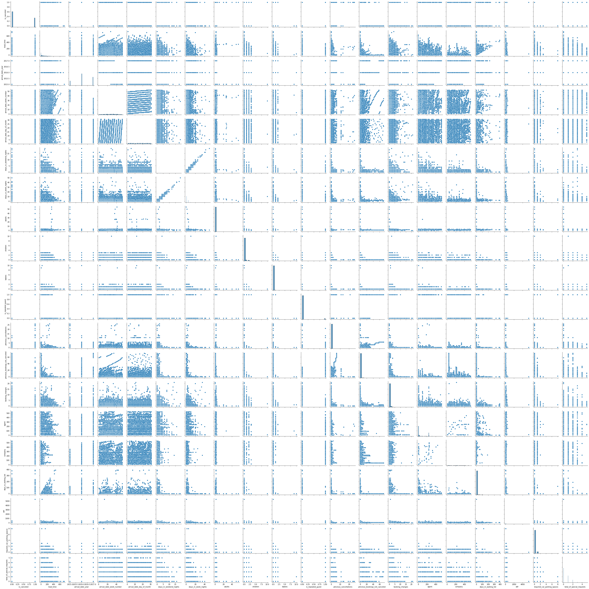
Data Visualization
Pair plot:
figure4 represents pair plot between all the numerical data type variables. This graph helps us to understand the relation of a variable with all the other variables.
figure4: pair plot of given data frame

Slide 10
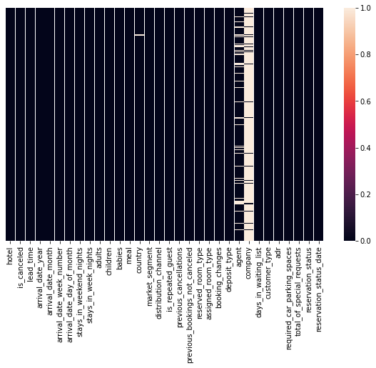
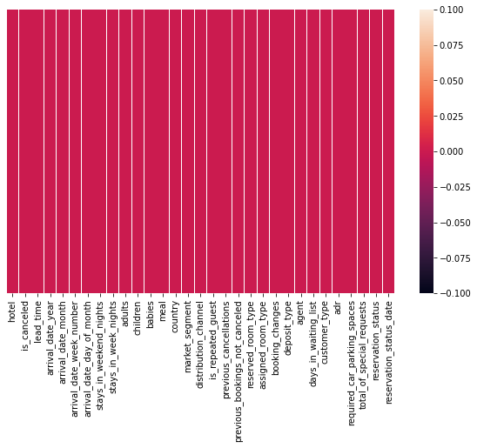
Data Visualization
figure5:heatmap showing white lines for null values.
figure6:heatmap after filling missing values

Slide 11
Data Visualization
figure5 is a heatmap created to find the missing values in the dataset. From the graph, we can analyze that there are more missing values in the company column. Next, column agent has more null values after company column. Comparatively there are less null values in column country. In column children there are very few null values which cannot be found in the graph and can be found using other commands.
figure6 represents heatmap after pre-processing the dataset which means after filling the null values with median and mode values.

Slide 12
Procedure
STEP 1: Importing Libraries
First step is to import all the required libraries and models such as pandas, numpy, matplotlib, seaborn, sklearn, train _test_split, LogesticRegression, SVC, confusion_matrix, accuracy_score, RandomForestClassifier, GradientBoostingClassifier, AdaBoostClassifier, DecisionTreeClassifier, GaussianNB, f1_score, LabelEncoder.
Ignoring warnings using warnings class.

Slide 13
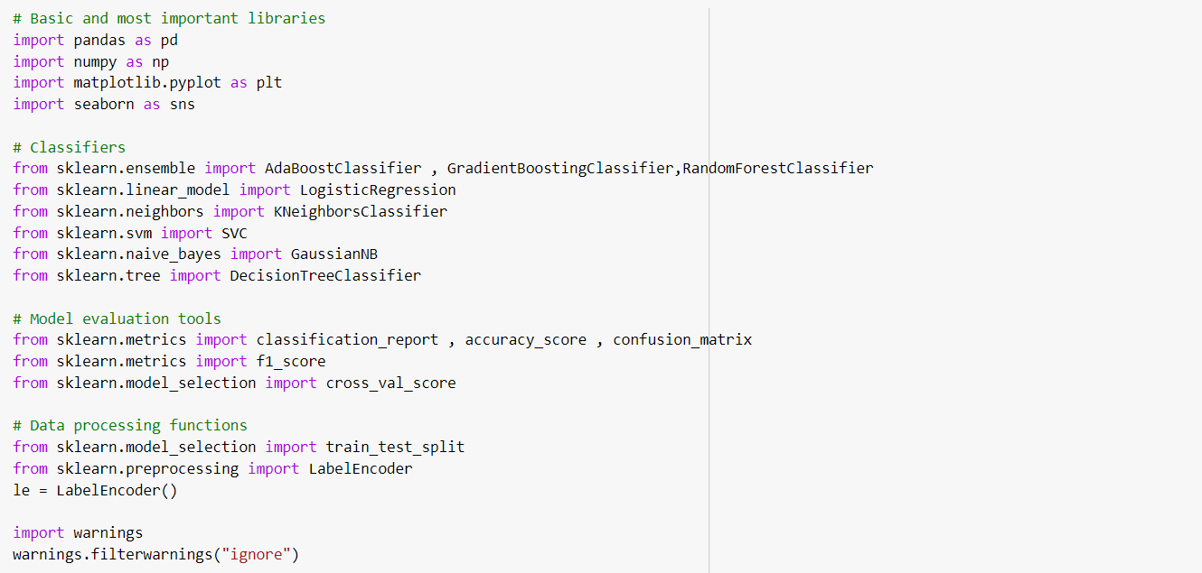
Procedure
figure7:importing libraries.

Slide 14
Procedure
STEP 2: Loading and Analyzing data
Loading dataset to a variable(data) in the form of dataframe using pd.read_CSV() command.
Analyze shape, datatypes and statistical information of the dataset using commands such as data.shape, data.dtypes, data.describe(), data.info().

Slide 15
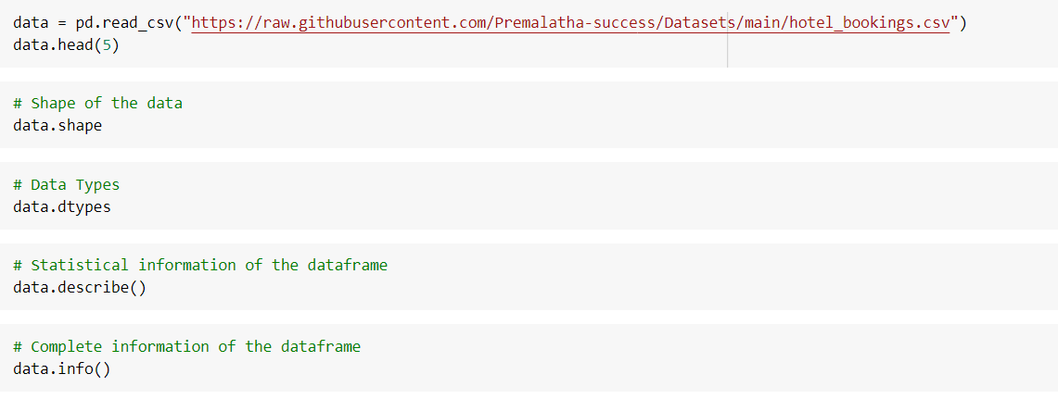
Procedure
figure8: Analyzing data

Slide 16
Procedure
STEP 3: Data Visualization
This is a major step while implementing a model as I have already mentioned in the previous slides.
In this we initially plot graph between categorial variables such as customer type, deposit type and target variable is_canceled.
After that we plot a heatmap graph for the correlation matrix of the given dataset to find the variables which are more related to each other. We use sns.heatmap(data.corr()) command for doing this.
Finally we draw a pair plot to find relation among all the numerical variables in the dataset.
These visualization steps are taken before the actual implementation in order to analyse the data in detail.

Slide 17
Procedure
STEP 4: Data Pre-processing
Now before going to implement a model we have to clean the data. Data cleaning process involves handling with missing data, duplicate data, noise and outliers.
Using heatmap and data.isnull().sum() command we will find the missing values in the given dataset. After that we will fill the missing values with median for the numerical data and with mode for categorial data. For it we use fillna() or replace() command. Then we go for removing duplicates and outliers if needed.
After completing the cleaning process we again go for verification of missing values in dataset using heatmap.

Slide 18
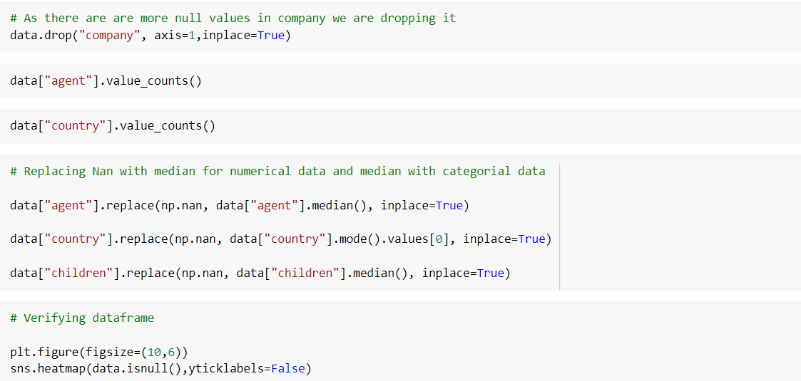
Procedure
figure9: Data Pre-processing

Slide 19
Procedure
STEP 5: Encoding Categorial Data
After data pre-processing data, next step is to create dummies for categorial data using fit.transform() command.
This step enables the model to perform more accurately by including categorial data.
We an also use pd.get_dummies() command for the same purpose.

Slide 20
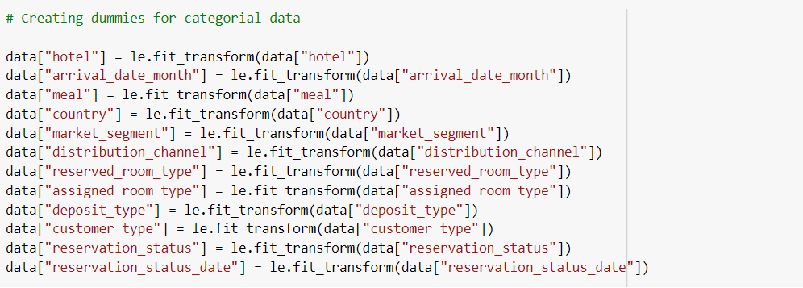
Procedure
figure10: Encoding

Slide 21
Procedure
STEP 6: Splitting Data into Input X Variable and Target y variables
Now we have to split the data as per the problem statement. For this problem statement we should split ‘is_canceled’ as target variable/dependent y variable and other independent variables as Input X variable .
STEP 7: Implementing Model
Finally after completion of all the other processes we have to implement the classifier models and should choose the best fit model by using score and accuracy parameter.

Slide 22
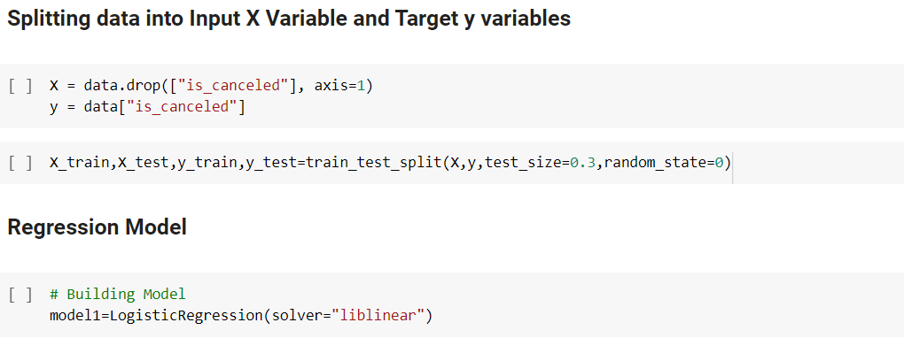
Procedure
figure11: Splitting and Creating model

Slide 23
Choosing Best fit Model
There are several binary classifier models we can use for this problem such as
Logistic Regression model
KNN Model
Decision Tree
Bagging Classifier
Adaboost Classifier
Gradient Boosting Classifier
Random Forest Classifier
Gaussian Naïve Bayes Model
SVM model

Slide 24
Choosing Best fit Model
For Logistic Regression model we get a score of 0.9899967692915176 for train set and 0.9891392355585337 for test dataset. It is more effective model even though it shows a good performance we should test other models too.
For KNN model we get an accuracy of 0.8806153502526733 which is less compared to Logistic Regression Model.
For Random Forest Classifier there is a score of 0.9970125917860234 which is far better than KNN model and Logistic Regression Model.
For Gaussian Naïve Bayes model we are getting a score of 0.9932155121869504 which is better comparative to all other classifiers.

Slide 25
Choosing Best fit Model
SVM model also have the average score of 0.9893067537761399.
All other models such as Decision Tree, Bagging Classifier, Adaboost Classifier, Gradient Boosting Classifier are giving score of 1.0 which are the best model among all .
Best Fit Model: I choose Decision Tree as a best fit model as it gives the score of 1.0 and also executes the program faster than other models. This model can able to with work with very large datasets in least possible time.

Slide 26
Conclusion
By testing all the models for the given problem statement. I can conclude that Decision Tree, Bagging Classifier, Adaboost Classifier, Gradient Boosting, Classifier are giving 100% accuracy. After that Random Forest Classifier is working best for the classification. Then Naïve bayes model executes well. After these Random Forest Classifier and SVM gives best performance. At last KNN has the least performance among all. While comparing compilation time, SVM takes more time than others. Where as Decision Tree takes the least time Which makes it as the best model for this problem.

