Slide 1


CSA1101 – OBJECT ORIENTED ANALYSIS AND DESIGN
Smart Water Consumption Monitoring and Leak Detection Management System
Presented by:
A.ADARSH – 192365002
Teja Srinivas - 192311280
M. Poojith Ganesh – 192311290 K. Krishna Charan - 192311316
Supervised by Madhan

Slide 2
ABSTRACT
The Smart Water Consumption Monitoring and Leak Detection Management System is designed using Object-Oriented Analysis and Design (OOAD) principles.
The system focuses on monitoring water consumption and detecting possible water leakage or abnormal water flow.
UML diagrams such as Use Case, Class, Sequence, Activity, Component, and Deployment diagrams are used to analyze and design the system.
The system consists of two main modules: Water Consumption Monitoring and Leak Detection, Alert and Management.
The proposed system helps in providing real-time monitoring, leakage alerts, and efficient water management.
Overall, the project presents an object-oriented and systematic approach to reduce water wastage and improve water resource management.

Slide 3
OBJECTIVES
Overview:
A smart water management system designed using Object-Oriented Analysis and Design (OOAD) principles to monitor water consumption, detect possible leakages, and provide timely alerts for efficient water management.
Problem Statement:
Traditional water distribution and consumption systems often lack continuous monitoring and proper management mechanisms. Water leakages and excessive consumption may remain undetected, resulting in significant water wastage.
Purpose:
To design an object-oriented Smart Water Consumption Monitoring and Leak Detection Management System that monitors water usage, identifies abnormal flow patterns indicating possible leakage, generates timely alerts, and supports efficient water resource management.

Slide 4
EXISTING SYSTEM
Overview:
Existing water management systems mainly depend on traditional water meters and manual monitoring to track water consumption.
Current Limitations:
Water usage is often monitored periodically rather than in real time, making it difficult to identify excessive consumption and leakage immediately.
Drawbacks:
Traditional systems may lack automatic leak detection, instant alerts, centralized management, and proper analysis of water consumption patterns, which can result in significant water wastage.

Slide 5
LITERATURE REVIEW/BACKGROUND
S.No | Title | Author / Year | Methodology Used | Drawbacks
1 | Smart Water Management: A Review of IoT-Based Technologies | S. S. Shinde et al., 2022 | Used IoT sensors and smart monitoring techniques to collect and manage water consumption data. | Limited focus on integrated leakage management.
2 | IoT-Based Smart Water Monitoring System | M. A. Al-Kuwari et al., 2023 | Used flow sensors, microcontrollers, and IoT communication for real-time water monitoring. | Depends on network connectivity and sensor accuracy.
3 | Water Leakage Detection Using Smart Sensors | A. Kumar, R. Sharma & P. Singh, 2024 | Analysed water flow patterns and sensor readings to identify possible leakage conditions. | False detection may occur during irregular water usage.
4 | Real-Time Water Consumption Monitoring Using IoT | S. Patel, N. Gupta & R. Verma, 2024 | Used smart meters and IoT platforms for continuous monitoring of water consumption. | Requires regular sensor calibration and maintenance.

Slide 6
PROBLEM STATEMENT
Traditional water management systems mainly rely on manual monitoring and periodic meter readings.
Water leakage and abnormal water consumption may remain undetected for a long time, resulting in water wastage.
Existing systems often lack real-time monitoring of water consumption and flow patterns.
There is limited capability for automatic detection of abnormal or continuous water flow.
Most conventional systems do not provide instant alerts and centralized management for leakage conditions.
Therefore, there is a need for a Smart Water Consumption Monitoring and Leak Detection Management System that provides real-time monitoring, automatic leak detection, timely alerts, and efficient water management.

Slide 7
METHODOLOGY
Technology Stack:
StarUML/Umbrello, OOAD, UML Diagrams, HTML, CSS, JavaScript, MySQL, Git/GitHub.
Architecture:
The system follows an object-oriented architecture consisting of the User Interface Layer, Business Logic Layer, and Database Layer.
Users interact with the system to monitor water consumption, view usage records, and receive leakage alerts.
The business logic processes water consumption data, identifies abnormal usage patterns, and manages leak detection and alert notifications.
All user details, water consumption records, leakage information, and alert data are securely stored and managed in the database, ensuring an efficient and maintainable water management system.

Slide 8
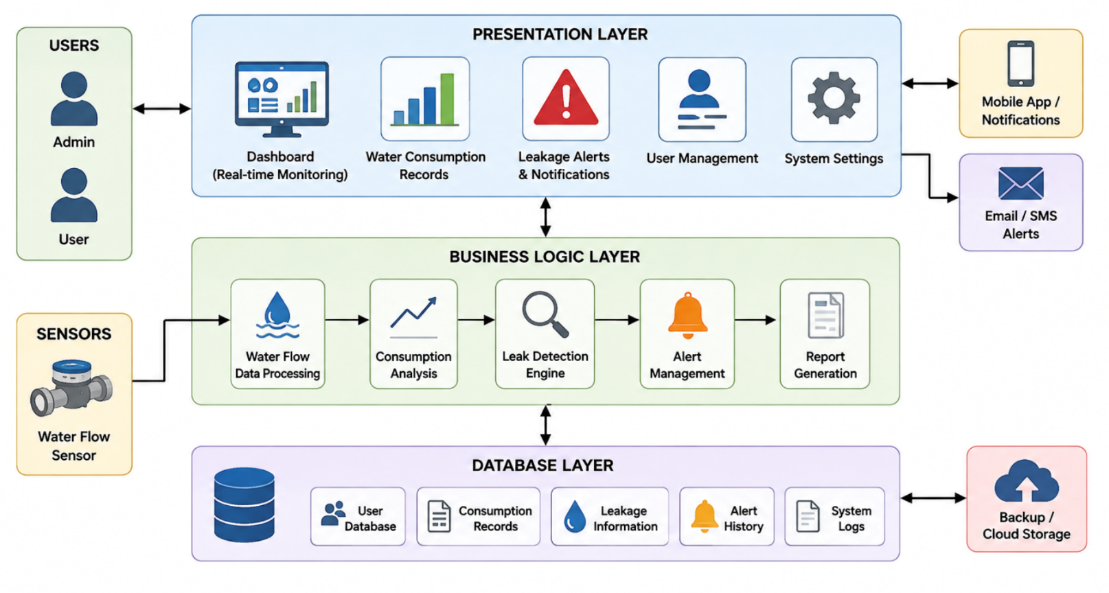
SYSTEM DESIGN / ARCHITECTURE

Slide 9
MODULES
MODULE 1: Water Consumption Monitoring
MODULE 2: Leak Detection and Alert Management
Module 3 Alert & Notification Management
Module 4 System Administration & Monitoring

Slide 10
Module 1: Water Consumption Monitoring
Objective:
To monitor water consumption, analyze usage patterns, and maintain water usage records.
Techniques Used:
Requirement Analysis, SRS, Use Case Analysis, Class Identification, and UML Modeling.
Key Features:
The module manages water usage data, monitors consumption levels, identifies excessive usage, and maintains consumption records.
Deliverables:
Use Case Diagram, Class Diagram, Activity Diagram, and Water Consumption Records.
Output:
Well-organized water consumption information, usage analysis, and monitoring reports.

Slide 11
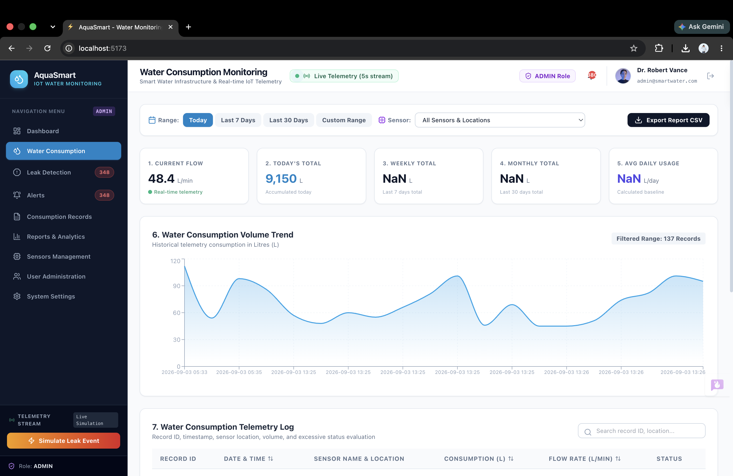
Module 1: Water Consumption Monitoring

Slide 12
Module 2: Leak Detection and Alert Management
Objective: To design an intelligent module for detecting water leakage and managing alerts using Object-Oriented Analysis and Design (OOAD) principles.
Techniques Used: UML modelling techniques such as Use Case, Class, Activity, and Sequence diagrams are used to represent leak detection, alert generation, and system interactions.
Key Features: The module identifies abnormal water usage, detects possible leakages, manages alert notifications, and maintains leakage history.
Deliverables: The module delivers leak detection models, alert management design, UML diagrams, and leakage record management.
Output: A complete leak detection and alert management system design with UML diagrams, alert records, and leakage reports.

Slide 13
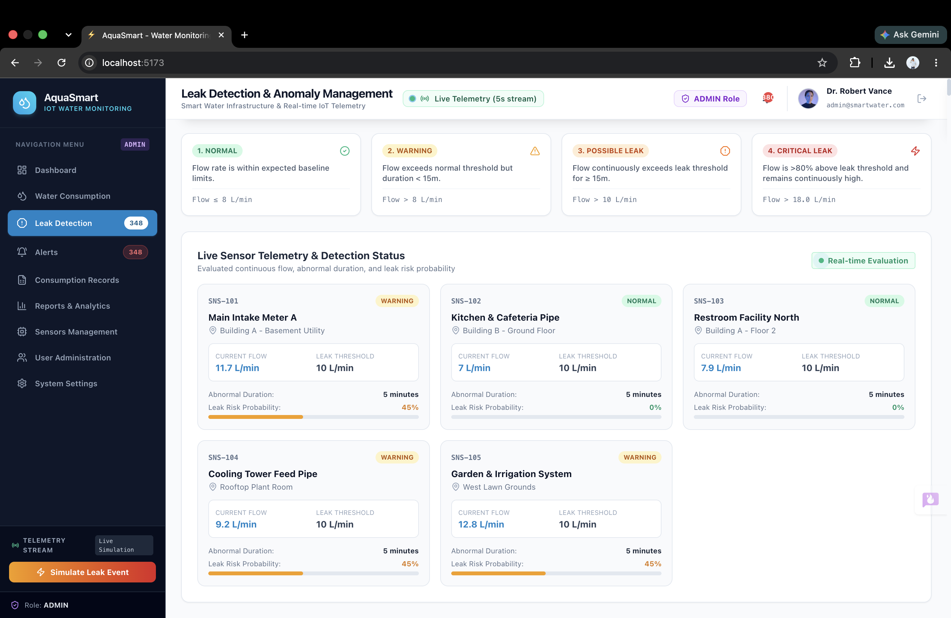
Module 2: Leak Detection and Alert Management

Slide 14
Module 3 Alert & Notification Management
Objective: To detect leakage events, generate alerts, and notify users or administrators about abnormal water usage.
Techniques Used: Requirement Analysis, Use Case Analysis, Sequence Modelling, Activity Modelling, and UML Design.
Key Features: The module detects abnormal water flow, generates leakage alerts, assigns alert severity, notifies users or administrators, and tracks alert status.
Deliverables: Sequence Diagram, Activity Diagram, Alert Management Model, and Notification Records.
Output: Timely leakage notifications, alert status information, and improved response to abnormal water usage.

Slide 15
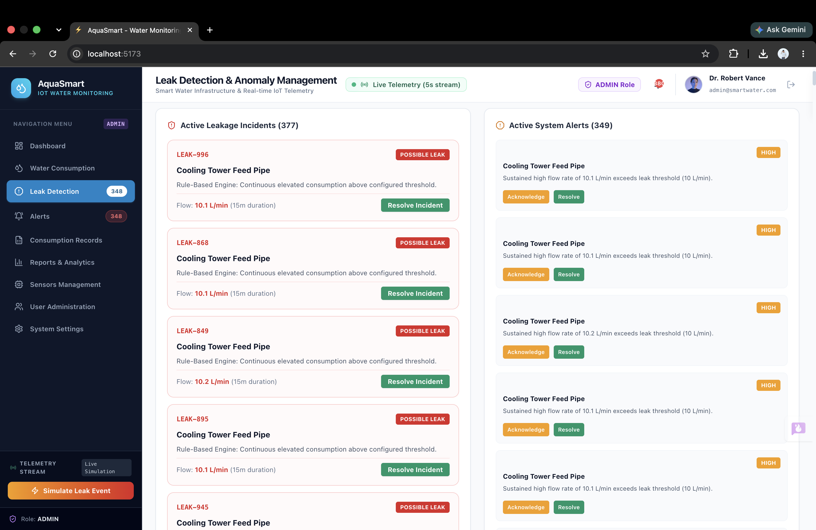
Module 3 Alert & Notification Management

Slide 16
Module 4 System Administration & Monitoring
Objective: To manage system users, configure monitoring parameters, monitor system status, and support overall system administration.
Techniques Used: Requirement Analysis, Use Case Analysis, Class Identification, UML Modelling, and System Design.
Key Features: The module manages users, configures leakage thresholds, monitors system status, manages system settings, and supports report generation.
Deliverables: Use Case Diagram, Class Diagram, Activity Diagram, and System Administration Model.
Output: Well-managed system configuration, user administration, monitoring information, and system reports.

Slide 17
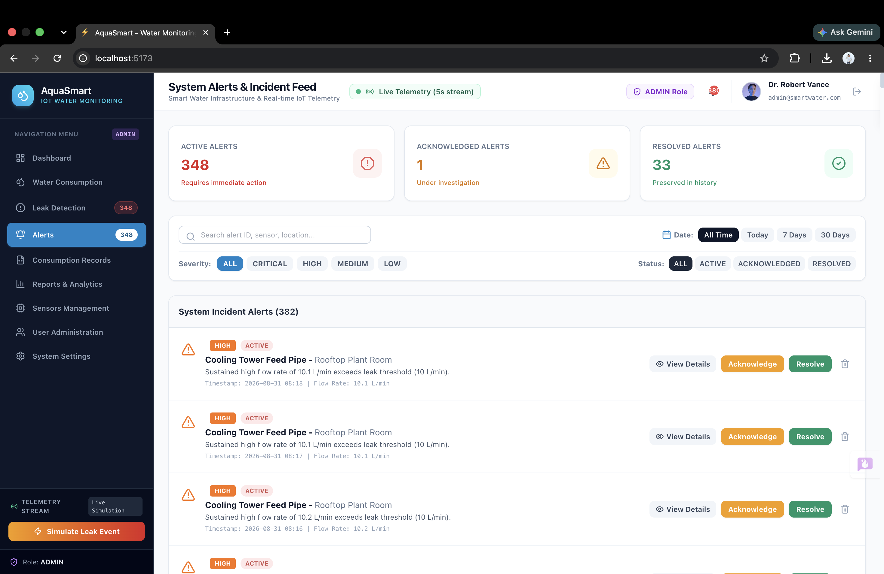
Module 4 System Administration & Monitoring

Slide 18
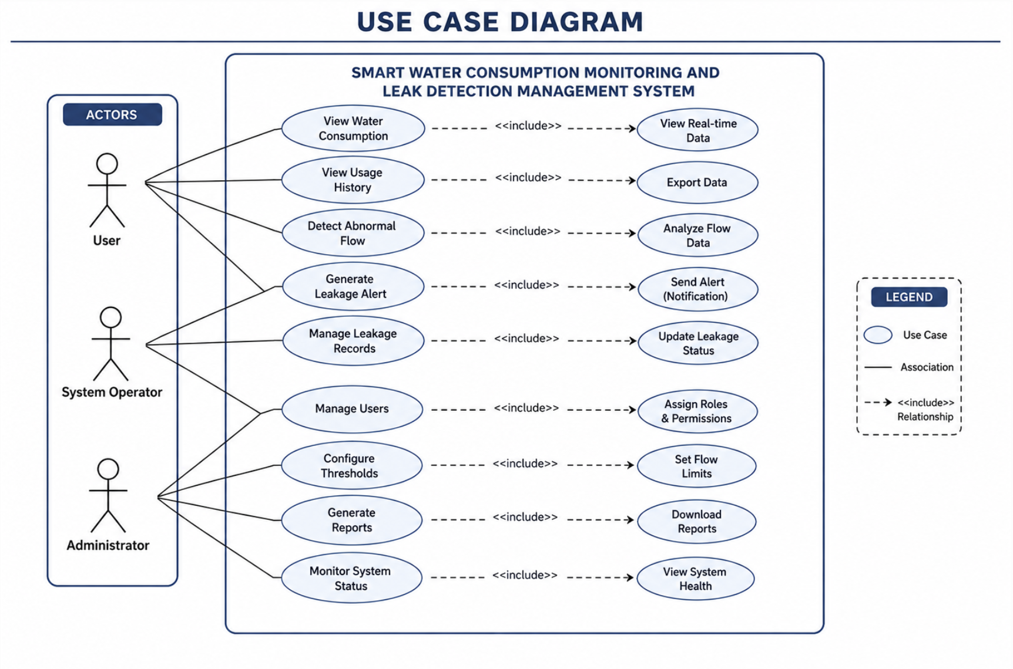
UML Diagrams

Slide 19
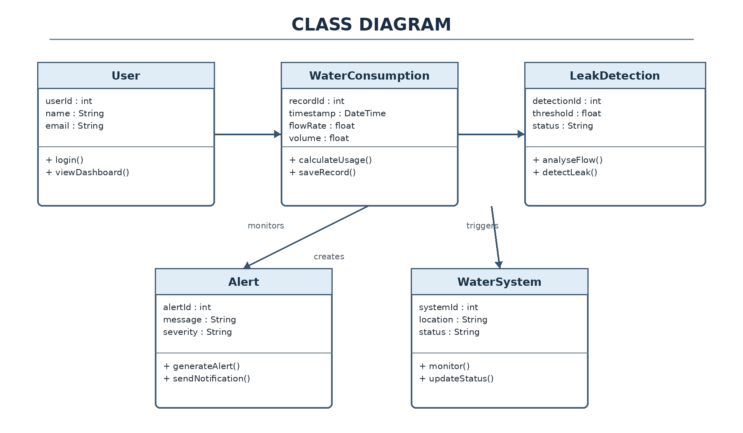
UML Diagrams

Slide 20
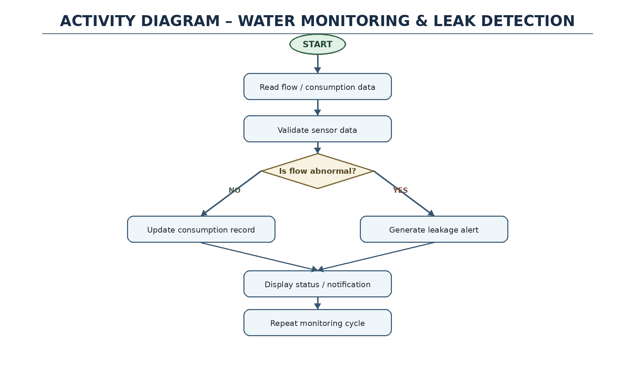
UML Diagrams

Slide 21
Results and Discussion
The system enables real-time monitoring of water consumption.
It helps identify abnormal water usage and possible leakages.
The OOAD design provides a modular and maintainable system architecture.
It supports efficient analysis of water usage patterns.
The proposed design helps in reducing water wastage and improving water management.
Final Output Delivered:
Water Consumption Monitoring Module for tracking water usage.
Leak Detection and Alert Management Module for managing leakage alerts.
UML diagrams and database design for complete system development.
Centralized records and reports for efficient water management.

Slide 22
CHALLENGES AND LIMITATIONS
Accurate water consumption monitoring depends on the reliability and calibration of the water flow data.
Detecting leakages can be challenging when normal water usage patterns are irregular or unpredictable.
The system may generate false alerts if abnormal water consumption is incorrectly identified as leakage.
Maintaining accurate water consumption, leakage, and alert records requires proper database management.
The system architecture should be scalable and maintainable to support future users, devices, and additional monitoring features.
The system may depend on continuous sensor data and proper communication for effective monitoring and alert generation.
Future expansion may require additional integration with IoT devices and advanced analytics, increasing system complexity.

Slide 23
FUTURE SCOPE
Integration of IoT-based smart sensors for continuous real-time water monitoring.
Development of a mobile application for remote monitoring and instant leak alerts.
Implementation of AI and Machine Learning to predict water consumption and detect leak patterns more accurately.
Integration with smart water meters for automated data collection and analysis.
Addition of advanced analytics and reporting to support efficient water management and conservation.

Slide 24
CONCLUSION
The proposed Smart Water Consumption Monitoring and Leak Detection Management System provides an effective solution for monitoring water usage and detecting possible leakages.
The application of Object-Oriented Analysis and Design (OOAD) principles ensures a modular, scalable, and maintainable system through well-structured software architecture and UML-based design.
The system includes essential features such as water consumption monitoring, abnormal usage detection, leakage management, alert generation, and record maintenance.
The proposed system offers an efficient and reliable approach to reduce water wastage, improve water resource management, and support timely decision-making

Slide 25
REFERENCES
I. Sommerville, Software Engineering, Pearson Education.
G. Booch, J. Rumbaugh, and I. Jacobson, The Unified Modeling Language User Guide, Addison-Wesley.
C. Larman, Applying UML and Patterns: An Introduction to Object-Oriented Analysis and Design, Pearson Education.
Object Management Group (OMG), Unified Modeling Language (UML) Specification.
A. K. Sharma and R. K. Gupta, “Smart Water Management and Leakage Detection Using IoT,” International Journal of Engineering Research and Technology.
ESP32 Documentation, Espressif Systems, for IoT-based monitoring and sensor integration.

Slide 26


