Slide 1
College Management System
Vikas Chavan (En.no:-EBENO322572159)
Poojith sai Geesala (En.no:-EBENO322579270)
Anjali I Devati (En.no:-EBENO322581246)
E. Tamil Selvan (En.no:-EBENO322580628)
Jahnavi (En.no:-EBENO322572159)
Guided by
Varadharajan A

Slide 2

College Management System
list of Entire Modules
1
Main page module
2
Login & Registration page module
3
Chatbot module
4
Admin module
5
Library module
6
Student module

Slide 3
1. Library Module
Goal of your module(s) :-
This library module will keep track of all the books and library information.
The software will be able to handle all the necessary information
It provides better and efficient service to users.
Reduce the workload.
Foster retrieval of information about the desired book.
Provide facilities for proper monitoring, reduce paperwork.
All details will be available on a click.
Be quick and more efficient.
College Management System

Slide 4
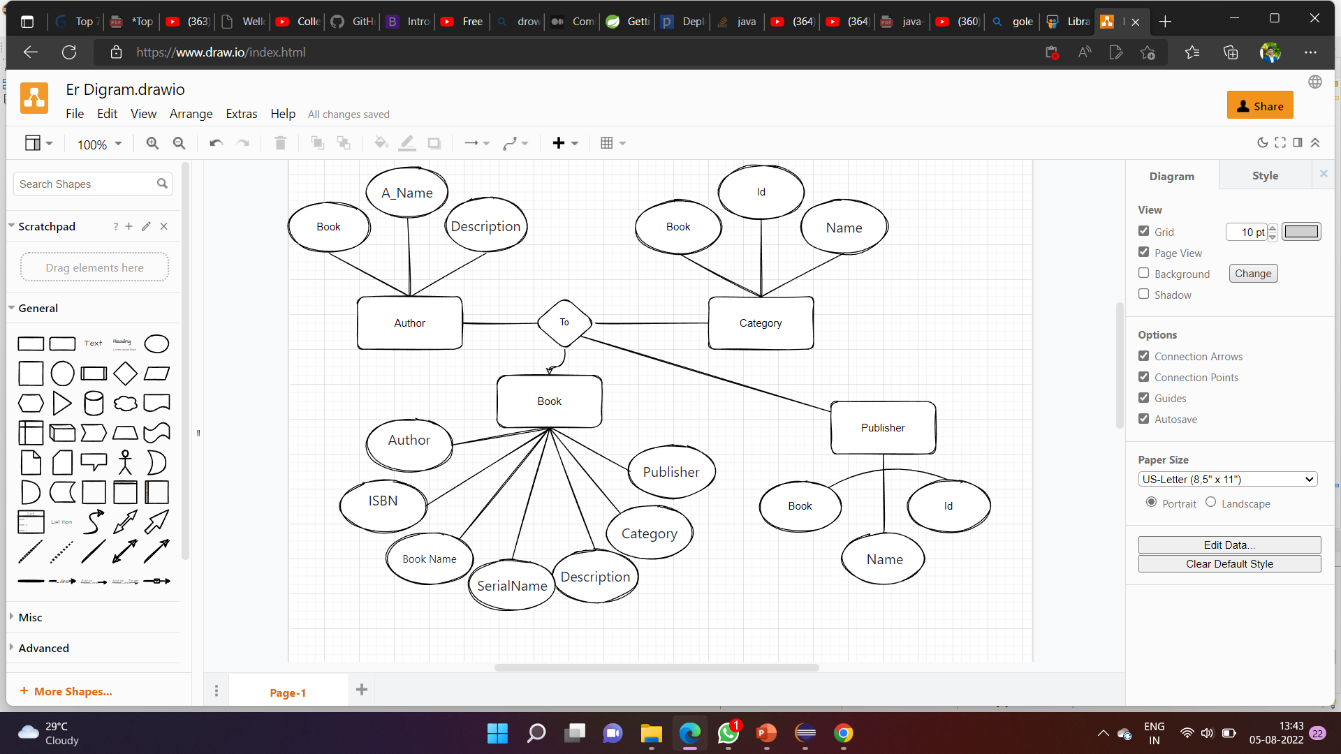
Sub- module
Authors
Information about author
Categories
Which type of book categories we have to mansion
Books
About the book information author ,categories & publisher information .
Publishers

Slide 5
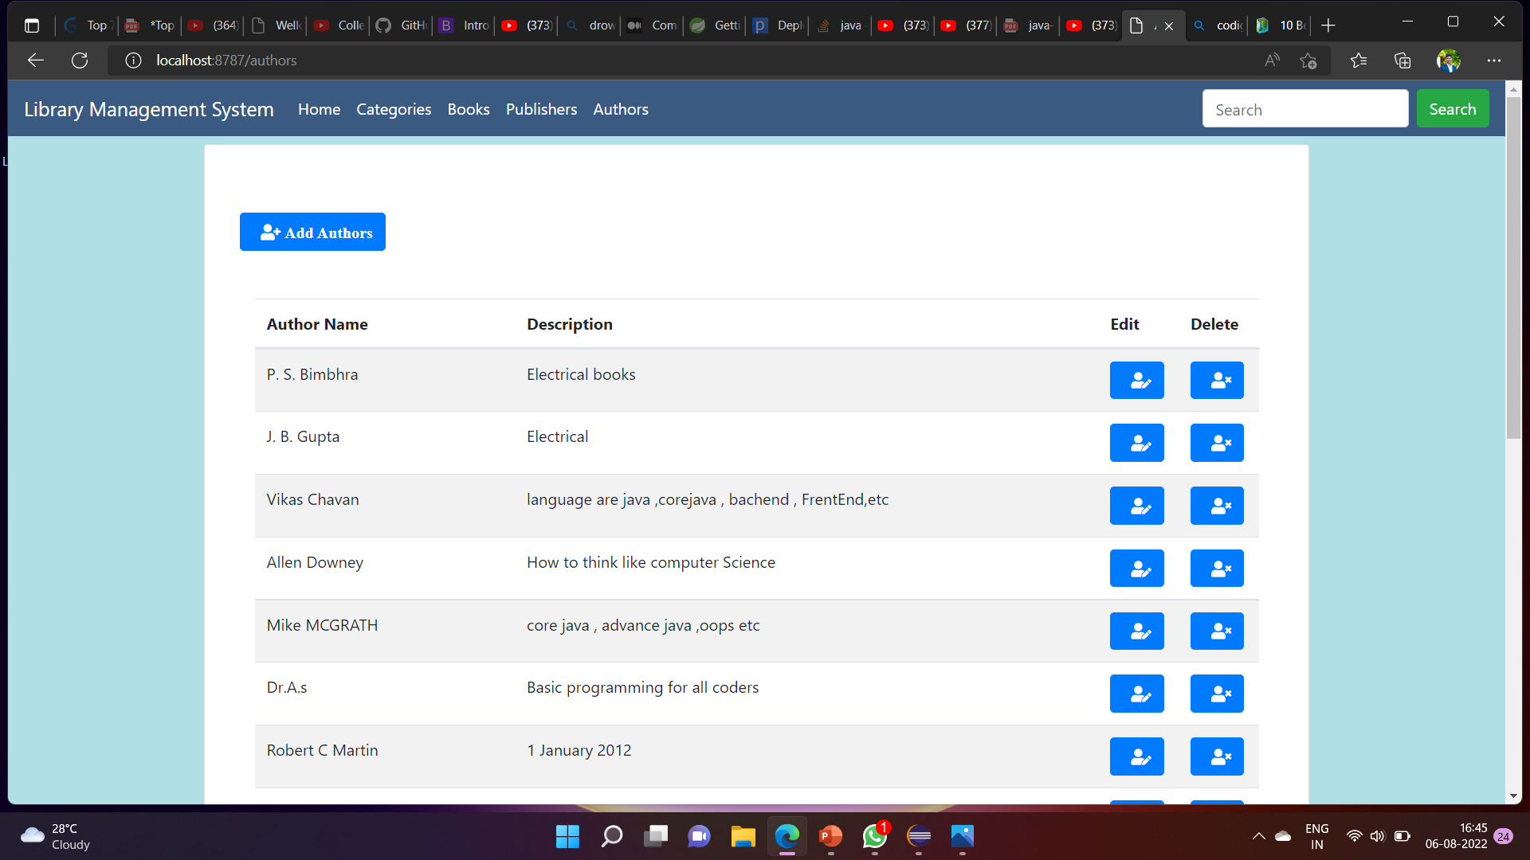
Screenshots

Slide 6
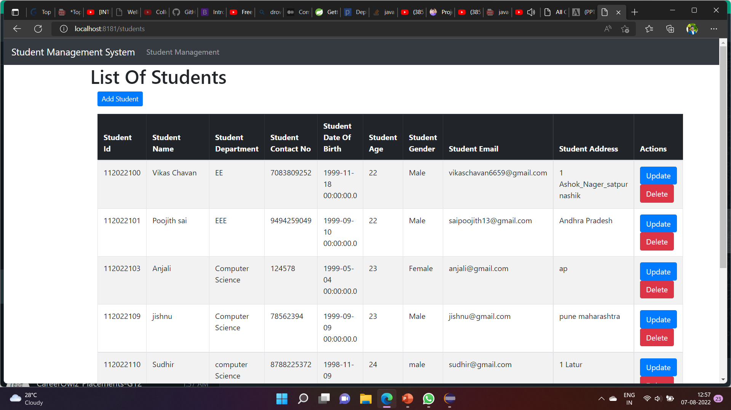
2. Student Management
Student Management System (SMS) is a solution tool that is designed to track, maintain and manage all the data generated by a Collage

Slide 7
Project Overview
Project Architecture
Staff
Admin
Student
Login
Dashboard
Library management
checkout
Academics
Facility

Slide 8
Tech architecture
Spring-core, MVC, data JPA
security
HTML
CSS,thymleaf
JavaScript
Spring Boot
Hibernate
Spring boot
Object persistence
Mapping with POJO
Browser
Frontend
Backend
Hibernate
Postman
DBviewer
Back-end
MySQL

Slide 9
Dataflow diagram
API Layer
API Layer
Business Layer
Dao Layer
Request
Req
Browser
Res
CONTROLLER
SERVICES
REPOSITORIES
Data
Base
Response
Spring Boot API

Slide 10
Challenging issues
When run the project for first time it showed error 404 Resource not found. Solution - I solved it by GlobalException it manages errors like - 401,404,500
Database Connection Problem
Change in –Application.property file we have to set back-end connection
College management system

Slide 11
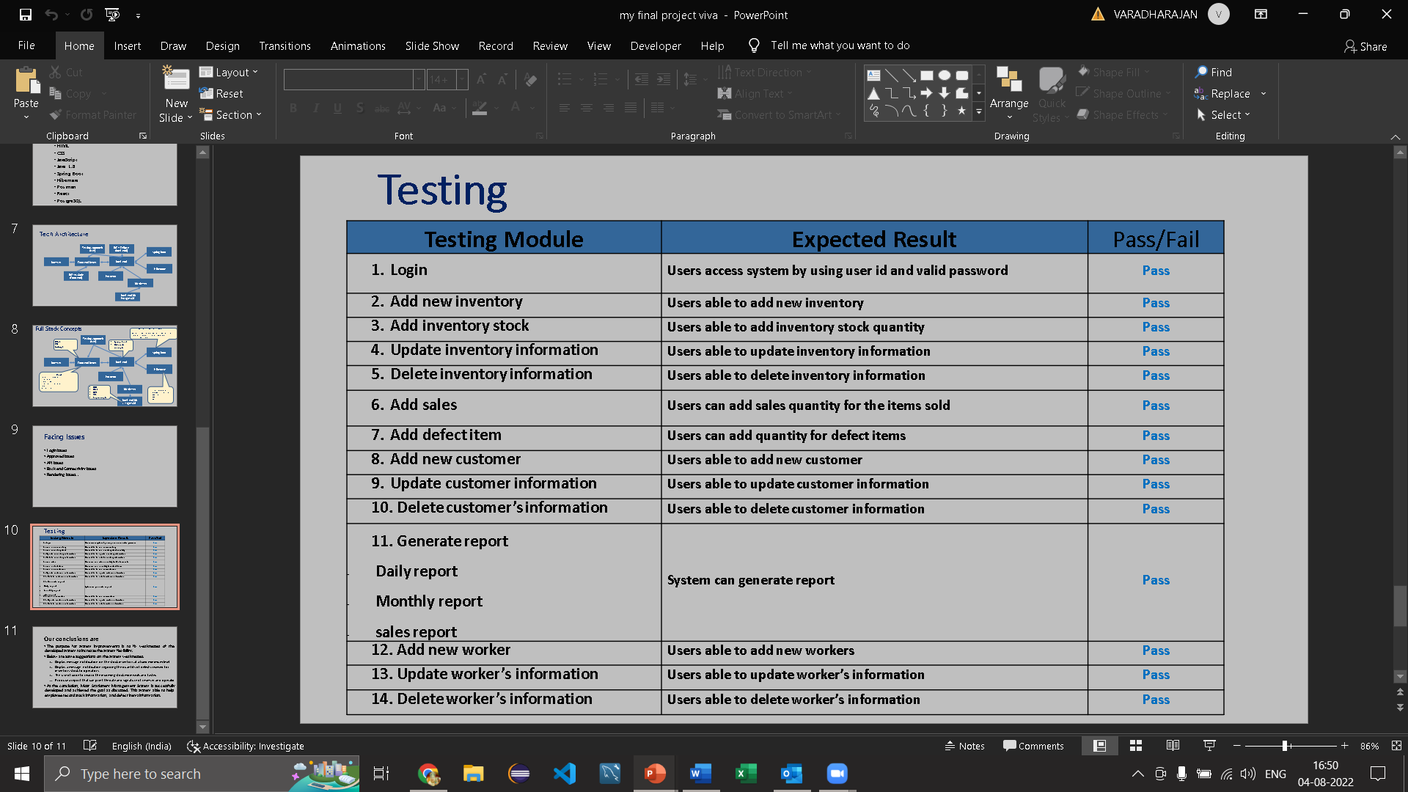
Testing
Tested result
Testing tools approach information
Zero defect certification information
Refer the example
College management system

Slide 12
Features About the module
Deleting
Deleting table info based on primary key is simple and easy
Updating
Displaying
Updating any info based on primary key
Delete
Displaying the information in database clean and clearly to understand
Deleting
Specific data
Update
Display
Updating
Of
Info
Displaying
The data
Inserting
Insert
Search
Searching info
Inserting new books and new students is very simple process .
By using searching option we can easily find out specific data within the hundreds of records.
Entering
New
data
Searching for specific data to display

Slide 13
Future Enhancement
We are not stopping here we want to improve further more.
There are lot more advancements in plan to be done in future and they will be definitely done with my teammates, every new advancement which we provide in future will make this page more and more attractive.
Online payment is also not applicable in many colleges the online payment is to be added
Demo & Paid versions
Similar to Online course enrollment Scheduling also should be done
Online enrollment of courses are new to nowadays colleges still now but we need to advance
Digital Payment
Online Scheduling
With voice-bot we will be one click away to the new kind of conversation.
Online Course Enrolment
College Management System
Voice Bot

Slide 14
Quality improvement task
1. Junit Testing concepts
2. Maven , Post Man ,GitHub, MySQL
DevOps tools approach
3. chatbot
4. Performance certification
(is there please add it)

Slide 15
THANK YOU
Your’s
Vikas Chavan
(En.no:-EBENO322572159)
Guided By: Varadarajan A

