Slide 1
IBM SkillsBuild Hackathon 2026
Topic Title - “AI-Based Stroke Risk Prediction and Analysis System”
Presenter’s Names – G.Poojitha,M.Sravani,T.Madhulika,M.Manjusha,T.Mishrutha
Presenter’s ROLL NUMBERS –23951A04C0,23951A04B9,23951A0491,23951A0496,23951A04A2

Slide 2
Introduction
The Stroke Risk Prediction System is a modern web-based healthcare application designed to assist individuals in evaluating their potential risk of experiencing a stroke based on a wide range of clinical measurements and lifestyle factors. Stroke is one of the leading causes of death and long-term disability worldwide, making early detection and preventive care extremely important. This system provides a simple yet effective platform where users can input their personal, medical, and lifestyle data—such as age, blood pressure, cholesterol levels, glucose levels, smoking habits, and physical activity—and receive an instant risk assessment expressed as a percentage.

Slide 3
Problem Statement
Lack of early detection systems for identifying individuals at risk of stroke.
People are often unaware of how multiple health and lifestyle factors contribute to stroke risk.
Manual health assessment is time-consuming and requires medical expertise.
Limited access to quick and affordable preliminary health risk analysis tools.
Difficulty in combining clinical data (BP, cholesterol, glucose, etc.) with lifestyle factors for accurate prediction.

Slide 4
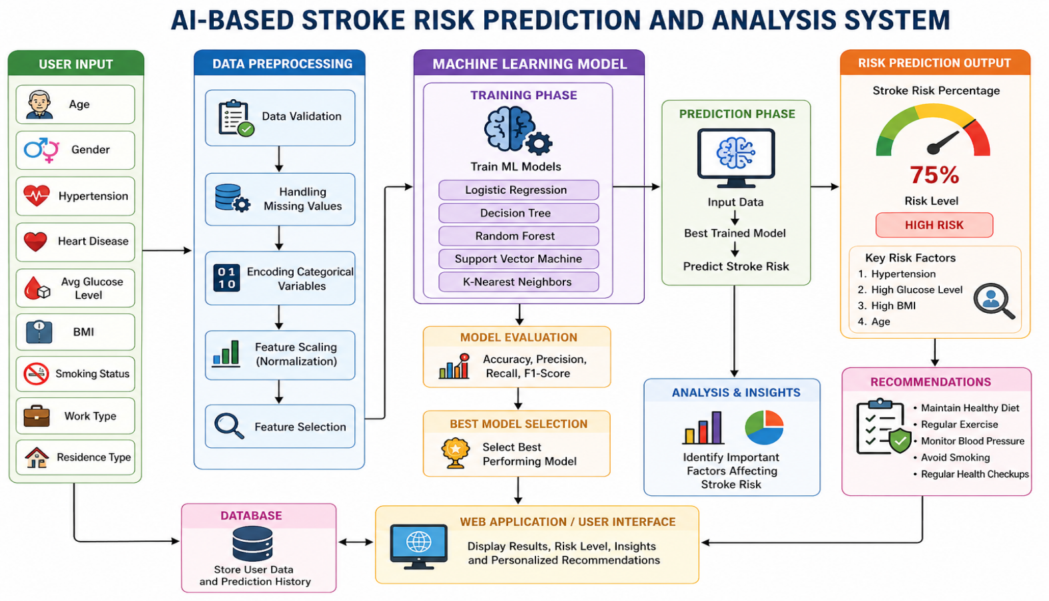
System Architecture

Slide 5
Objectives
To develop a system that can predict stroke risk accurately using clinical and lifestyle data.
To provide early identification of high-risk individuals to enable preventive action.
To integrate multiple factors such as age, medical history, and daily habits into a single assessment model.
To deliver instant risk evaluation results in a simple and understandable format.
To generate personalized health recommendations based on the user’s risk level.
To design a user-friendly and interactive interface for easy data input and result visualization.
To create a fully browser-based application that requires no installation or backend support.

Slide 6
Working Algorithm
Working Algorithm (Data Processing)
The system collects user input including demographic details, clinical measurements, lifestyle factors, and medical history.
Input data is validated to ensure all required fields are filled and values are within valid ranges.
A risk score is initialized to zero.
Each parameter (Age, Blood Pressure, Cholesterol, Glucose, BMI, etc.) is assigned a specific weight based on its impact on stroke risk.
Scores from all factors are combined to compute the total risk score using a weighted approach.

Slide 7
The total score is converted into a percentage to represent stroke risk.
Based on the percentage, users are classified into:
High Risk (60–100%) – Immediate medical attention required
Moderate Risk (30–59%) – Lifestyle changes recommended
Low Risk (0–29%) – Maintain healthy habits
The system provides personalized recommendations based on the user’s condition.
Final output includes risk percentage, category, and health suggestions displayed in a clear format.
Users can reset the form and perform multiple assessments easily.

Slide 8
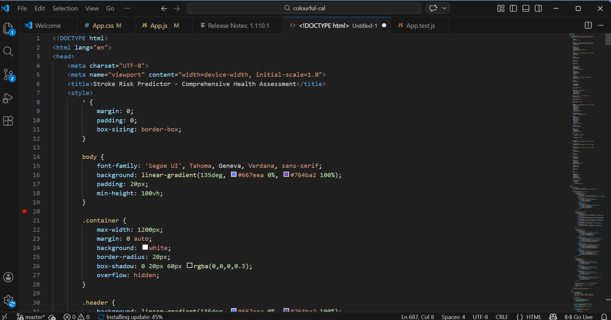
Code

Slide 9
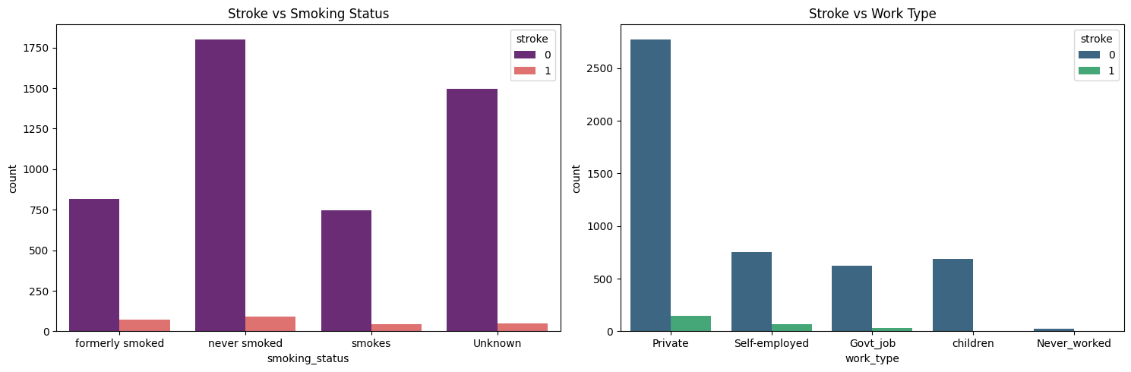
ML Outputs:

Slide 10
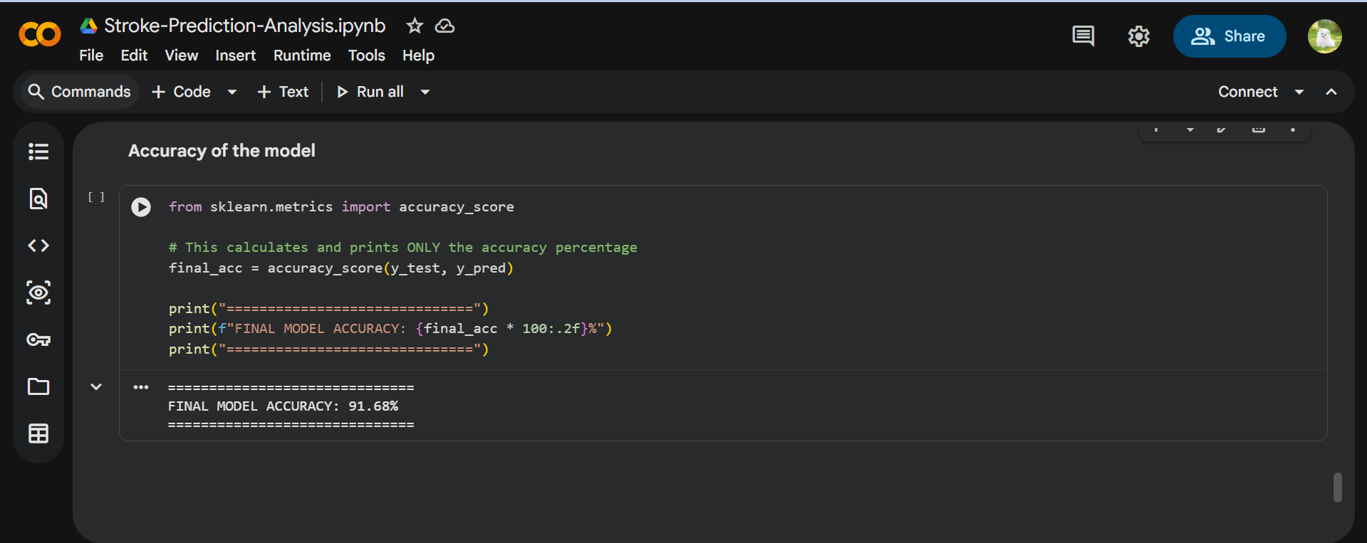

Slide 11
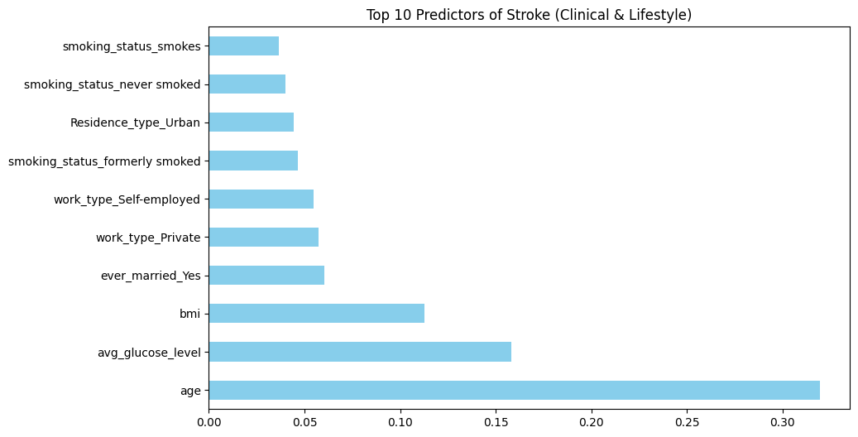

Slide 12
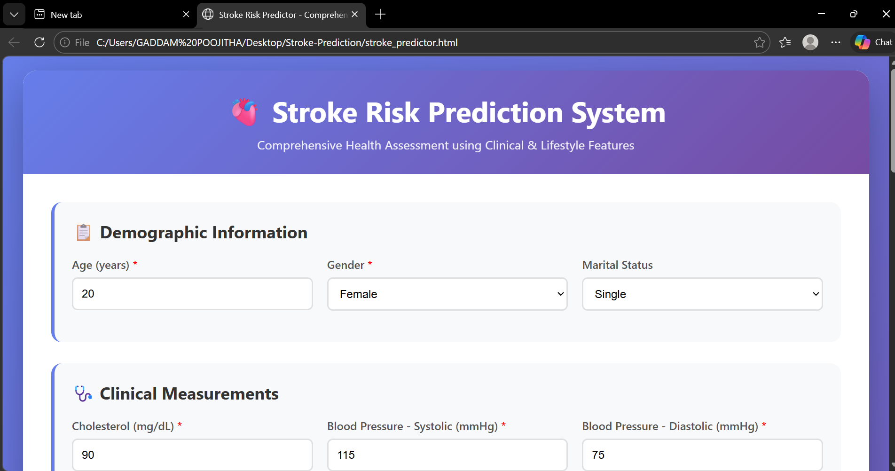
Output

Slide 13
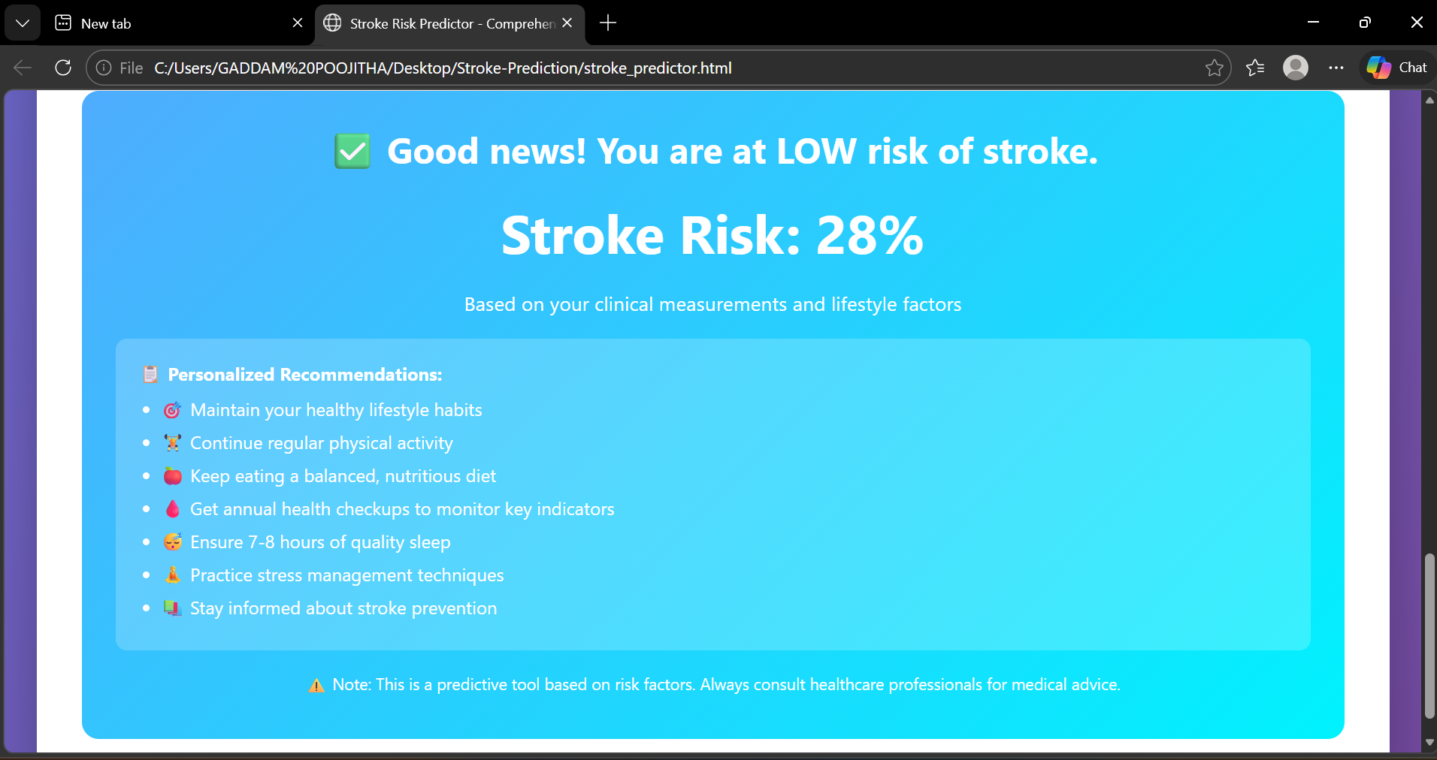

Slide 14
Advantages
Provides early detection of stroke risk, helping users take preventive measures in time.
Offers instant results, reducing the need for time-consuming manual assessments.
Combines multiple health and lifestyle factors for more comprehensive analysis.
Generates personalized recommendations based on individual risk levels.
Features a user-friendly interface, making it easy for anyone to use.
No installation or backend required, runs directly in the browser.
Accessible on multiple devices (mobile, tablet, desktop).
Helps in increasing health awareness among users.

Slide 15
Applications
Used in hospitals and clinics for preliminary stroke risk assessment.
Helpful for individual users to monitor their health and take preventive actions.
Can be integrated into healthcare web applications for real-time risk analysis.
Useful in telemedicine platforms for remote patient monitoring.
Supports fitness and wellness programs by tracking lifestyle-related risks.
Can be used by doctors as a decision-support tool for early diagnosis.
Applicable in health awareness campaigns to educate people about stroke risks.
Useful for research and data analysis in healthcare studies.
Can be integrated with mobile health apps for continuous monitoring.

Slide 16
Conclusion
The Stroke Risk Prediction System is an effective and user-friendly tool designed to assess an individual’s risk of stroke using a combination of clinical and lifestyle factors. By providing instant risk evaluation and personalized recommendations, the system helps users gain better awareness of their health condition and encourages early preventive measures. Its browser-based design ensures easy accessibility without the need for complex installations, making it suitable for a wide range of users. Although it does not replace professional medical diagnosis, it serves as a valuable preliminary assessment tool that can support healthier lifestyle decisions and reduce the chances of severe complications.

Slide 17


