Slide 1
IML MID TERM ASSIGNMENT
TEAM MEMBERS:
Immaneni Harshitha(D22019)
Madduri Uma(D22025)
Gujjula Poojitha(D22033)
Submitted to:
Gourab Nath Sir

Slide 2
An Introduction to Attrition Data
The dataset of an organization which consists of 1470 employees.
1237 (84% of cases) employees did not leave the organization while 237 (16% of cases) did leave the organization.
We can say that this company is based out of bio-technology and R&D because 41 % of employees from Life sciences and 31% are from Medical.
Attrition is the main column in our data set and we would like to find out why employees are leaving company.

Slide 3
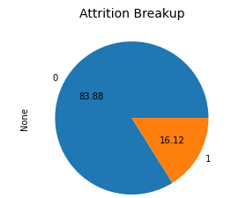
Looking at the Data
Males are 20% more than females
There are more middle aged employees(30-36)
60% employees of this organisation have voted for top 2 category for environment satisfaction so from this we can say that those 60% of employees are comfortable working in this organisation.
There are 5 different job levels with 60 %working in levels 1&2.
Attrition rate of this organization has greater than 10% (i.e.16.12%) ,so company is facing difficulties in employee retention.
This is to be studied in detail for it to be addressed

Slide 4
Univariate Analysis
Univariate analysis is the simplest form of analyzing data.
Uni means one, so in other words the data has only one variable. Univariate data requires to analyze each variable separately.
Data is gathered for the purpose of answering a question, or more specifically, a research question.

Slide 5
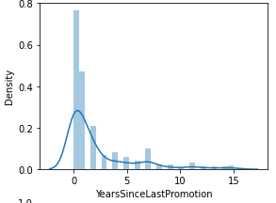
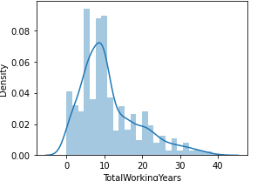
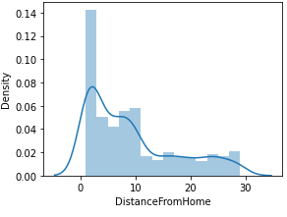
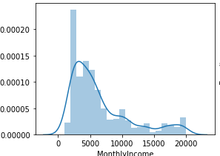
Insights from Univariate Analysis
Most of the employees recently got promoted.
Most of the employees worked for 5 years at their job role.
Most of the employees stay near the office.
Most of the employees get the less salary.

Slide 6
BIVARIATE ANALYSIS
Bivariate analysis is one of the statistical analysis where two variables are observed.
One variable here is dependent while the other is independent.
These variables are usually denoted by X and Y.
In our analysis we have considered the Gender, Department, Age, Education parameters and how they effect the attrition.

Slide 7
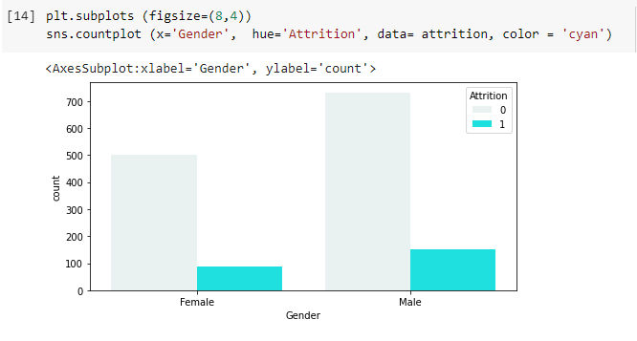
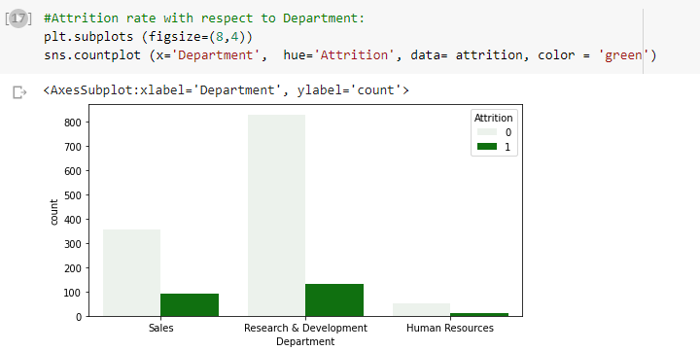
KEY INSIGHTS FROM BIVARIATE ANALYSIS
We have observed that the male employees has the highest attrition rate when compared to females.
Attrition Rate is higher in Research and Development Department.

Slide 8
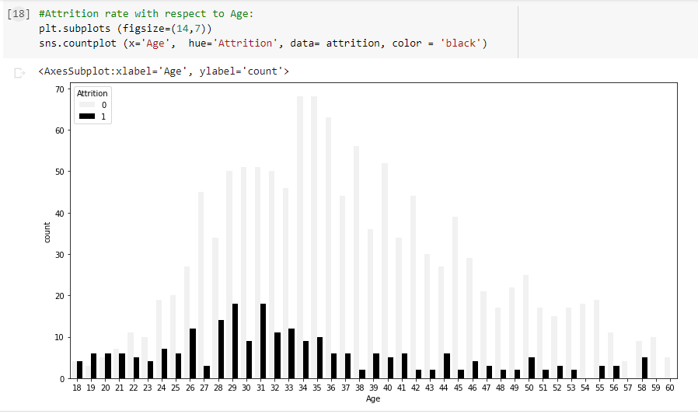
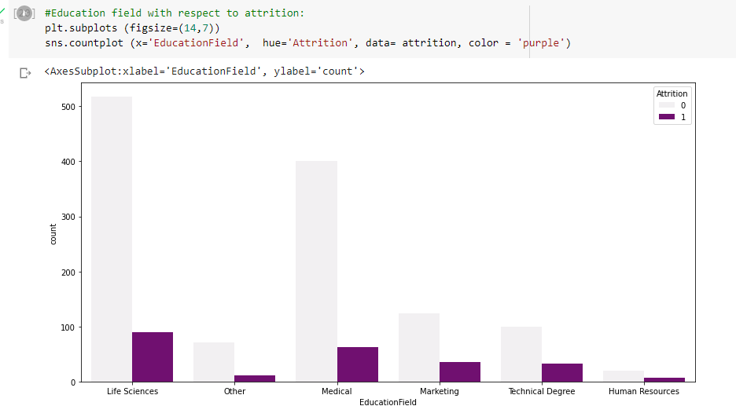
KEY INSIGHTS FROM BIVARIATE ANALYSIS
Attrition Rate is higher in the employees whose age group is between mid 20's and mid30's.
Attrition Rate is high in the employees whose Educational background is Life Sciences

Slide 9
MULTIVARIATE ANALYSIS
Multivariate analysis is based in observation and analysis of more than one statistical outcome variable at a time.
Multivariate analysis is important because there's often a need to find the relationships between each variable in a data set.
We have performed multivariate analysis on Marital status and Total working years.

Slide 10
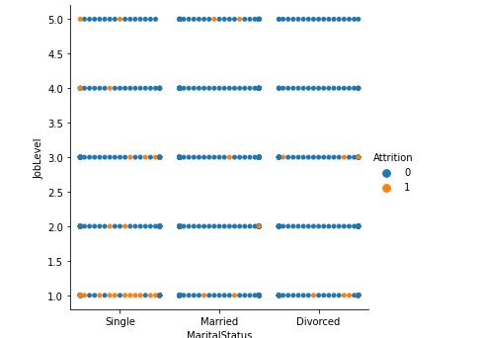
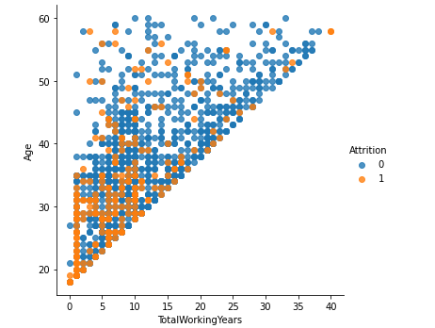
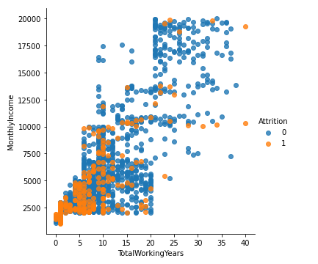
KEY INSIGHTS FROM MULTIVARIATE ANALYSIS
People who are more likely to quit are Single with lower income <5000
People at joblevel 1 and single tend to quit after 1 year work experience because they are ready to take risk.
This is as expected as total working years increases -job level ,monthly income and age increases.
People like changing jobs at lower job level ,at young age and when they have lower salary

Slide 11
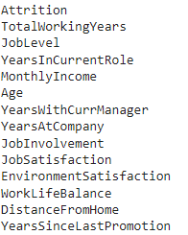
Finding the correlation
Correlation is a statistical term describing the degree to which two variables move in coordination with one another.
We have found the correlation for:

Slide 12
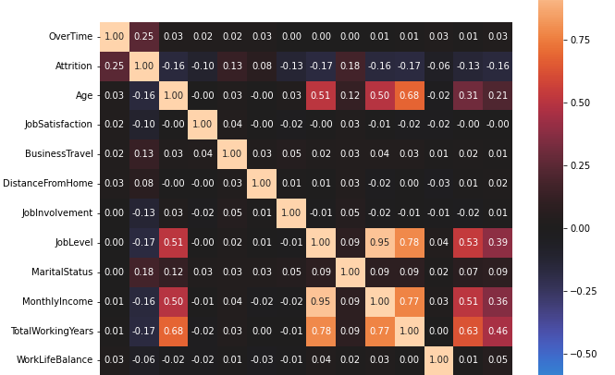
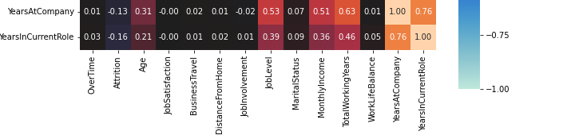
https://colab.research.google.com/drive/1_j6TfDSYx5zZed7wMTgXXHigSAlVJF-M?usp=sharing

Slide 13
Thank you

