Slide 1
Mutual Fund Analytics Capstone Project
Submitted By:
Kurapati Poojitha
Role:
Data Analytics Intern

Slide 2
Project Overview
The Mutual Fund Analytics project aims to analyze mutual fund performance,
investor behavior, fund house growth, and industry trends using advanced
data analytics techniques.
The project integrates multiple datasets and transforms raw financial
data into meaningful insights through ETL pipelines, database management,
performance analytics, and interactive Power BI dashboards.
Objectives
• Build ETL Pipeline
• Create SQLite Database
• Perform EDA
• Calculate Performance Metrics
• Build Interactive Dashboard
• Generate Investment Insights

Slide 3
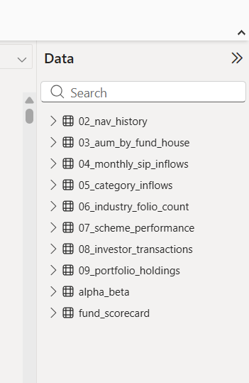
Datasets Used
The project uses multiple datasets covering different aspects
of mutual fund operations and investor activity.

Slide 4
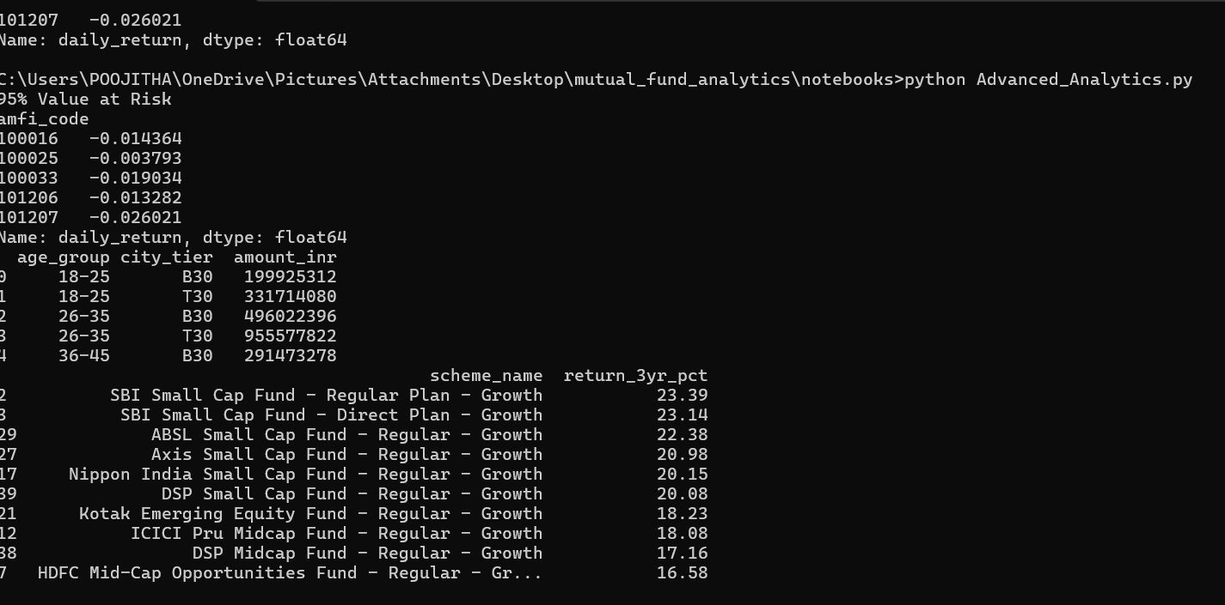
ETL Pipeline Architecture
The ETL pipeline was developed to automate the process of extracting, cleaning, transforming, and loading mutual fund data.
The workflow ensures consistency, reliability, and accuracy before analytics are performed.

Slide 5
SQLite Database Design
A relational SQLite database was created to store cleaned mutual fund datasets. Fact and dimension tables were used to improve query performance and data organization.

Slide 6
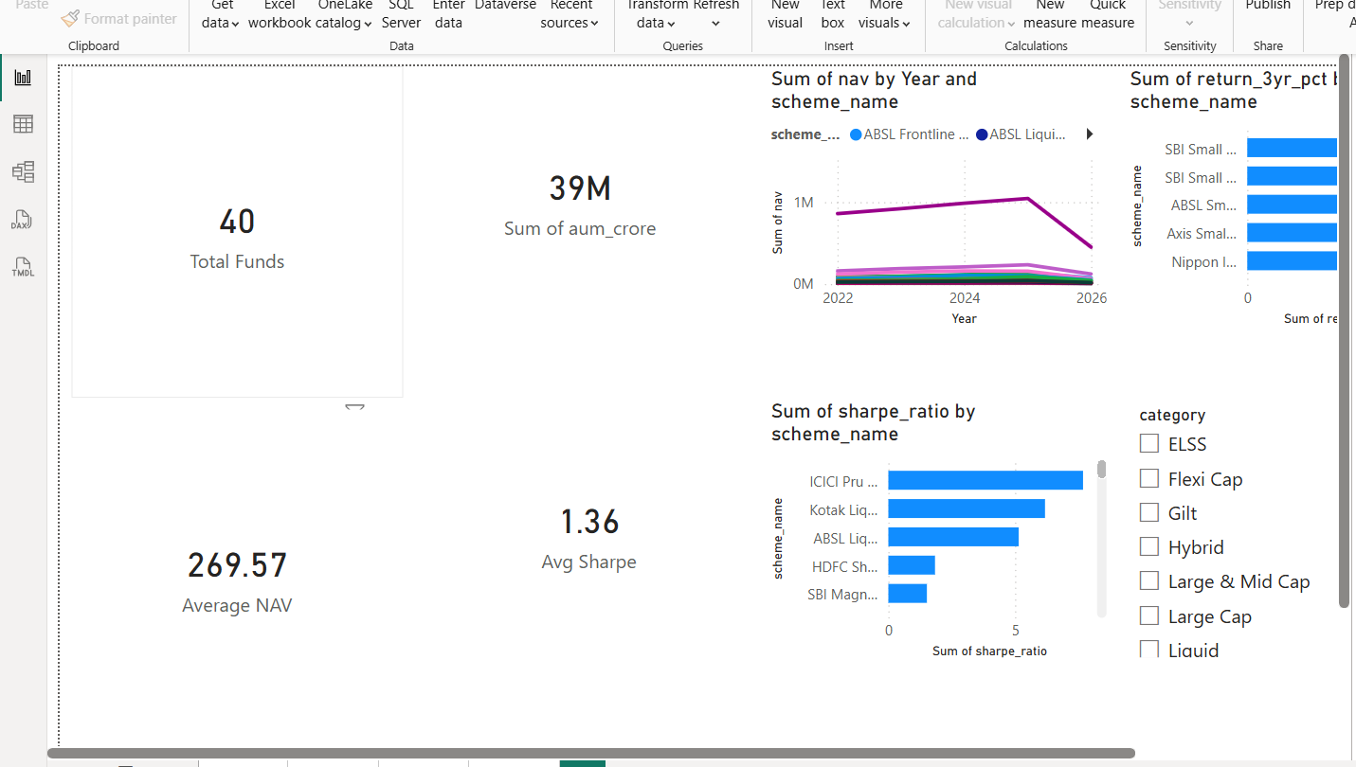
Exploratory Data Analysis
EDA was performed to identify trends, growth patterns, investor behavior, and fund performance across the mutual fund industry.

Slide 7
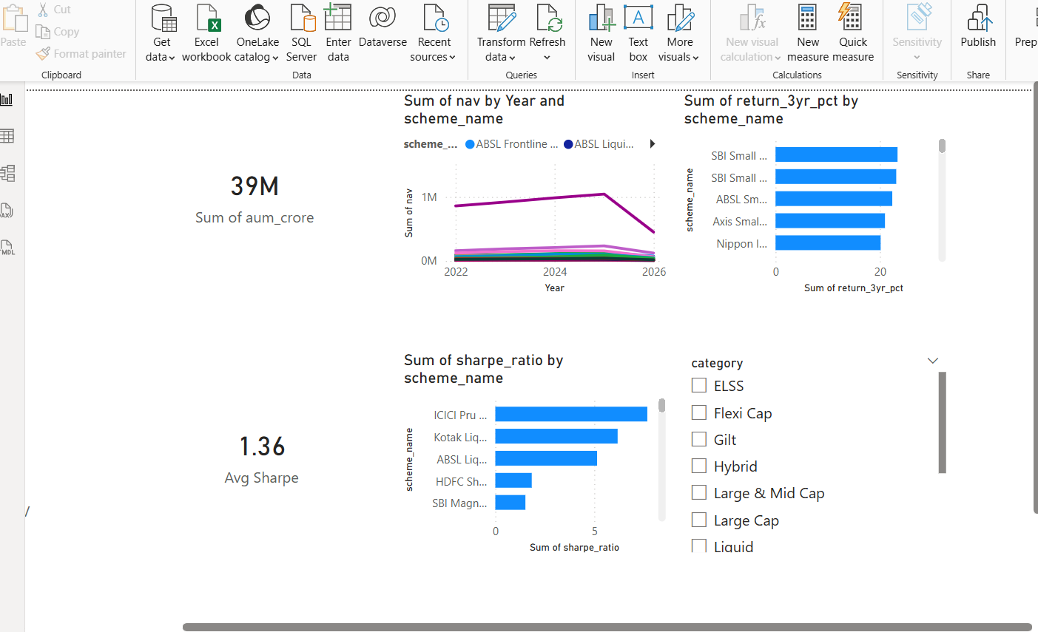
Investor Analytics
Investor demographic analysis was performed to understand participation across age groups, gender, and geography.

Slide 8
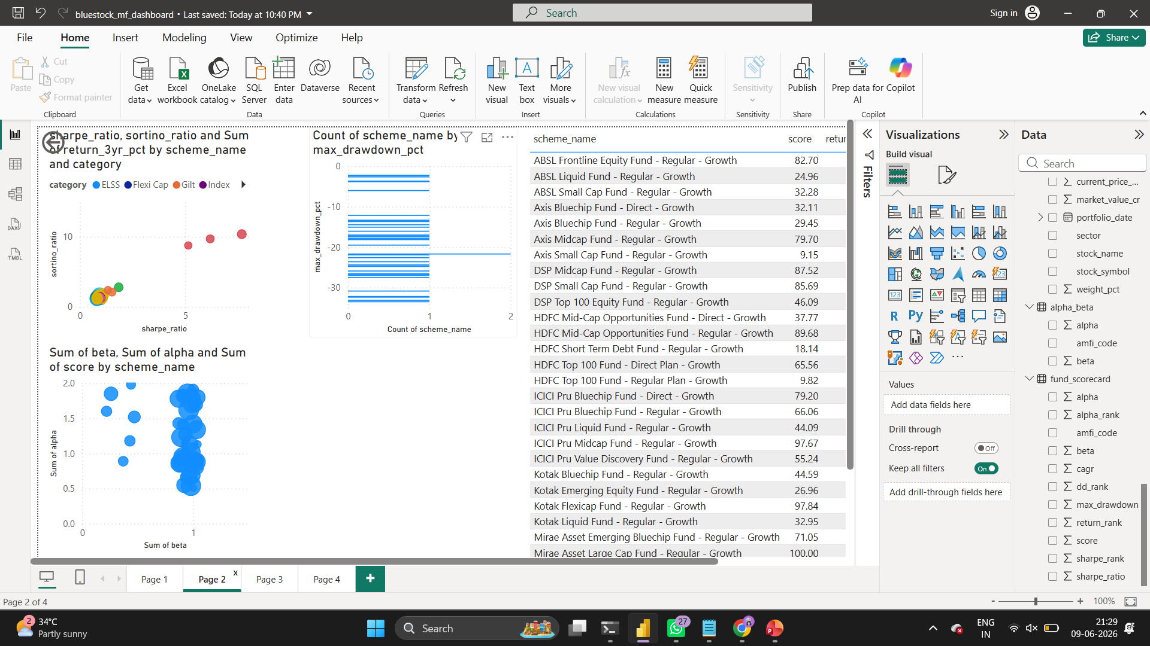
Fund Performance Analytics
Risk-adjusted performance metrics were calculated to evaluate mutual fund performance across multiple dimensions.
Metrics
• CAGR • Sharpe Ratio • Sortino Ratio • Alpha • Beta • Maximum Drawdown
Key Findings
Highest CAGR: AMFI 120505 Highest Sharpe: AMFI 148567 Highest Sortino: AMFI 148567

Slide 9
Advanced Analytics
Advanced analytical techniques were applied to assess
investment risk and investor behavior.
Analysis
• Value at Risk (VaR) • Cohort Analysis • Fund Recommendation Engine
Findings
Fund 101207 showed highest downside risk. Investors aged 26–35 contributed the highest investment amount. Small Cap Funds dominated the recommendation engine.

Slide 10
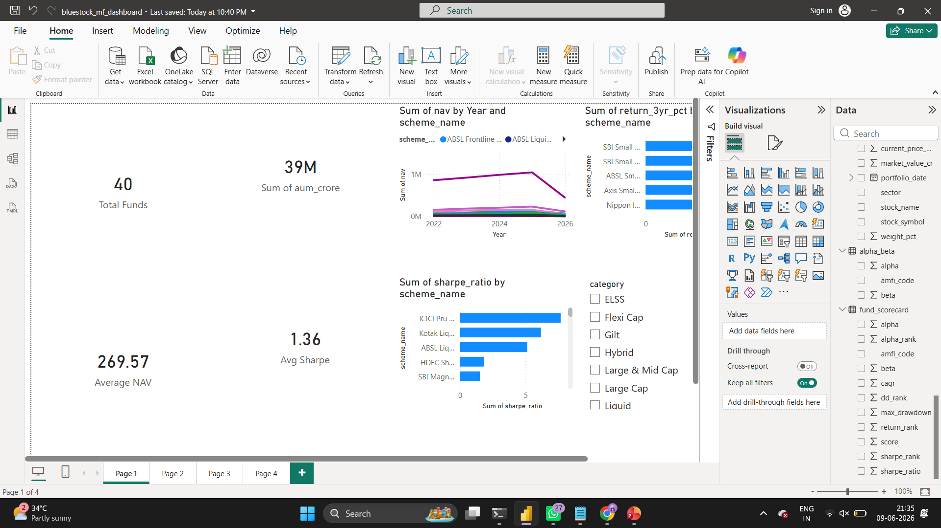
Interactive Power BI Dashboard
A four-page interactive dashboard was developed to provide insights into fund performance, investor activity, and industry growth.
Dashboard Pages
Executive Dashboard Performance Analytics Investor Analytics Industry Analytics

Slide 11
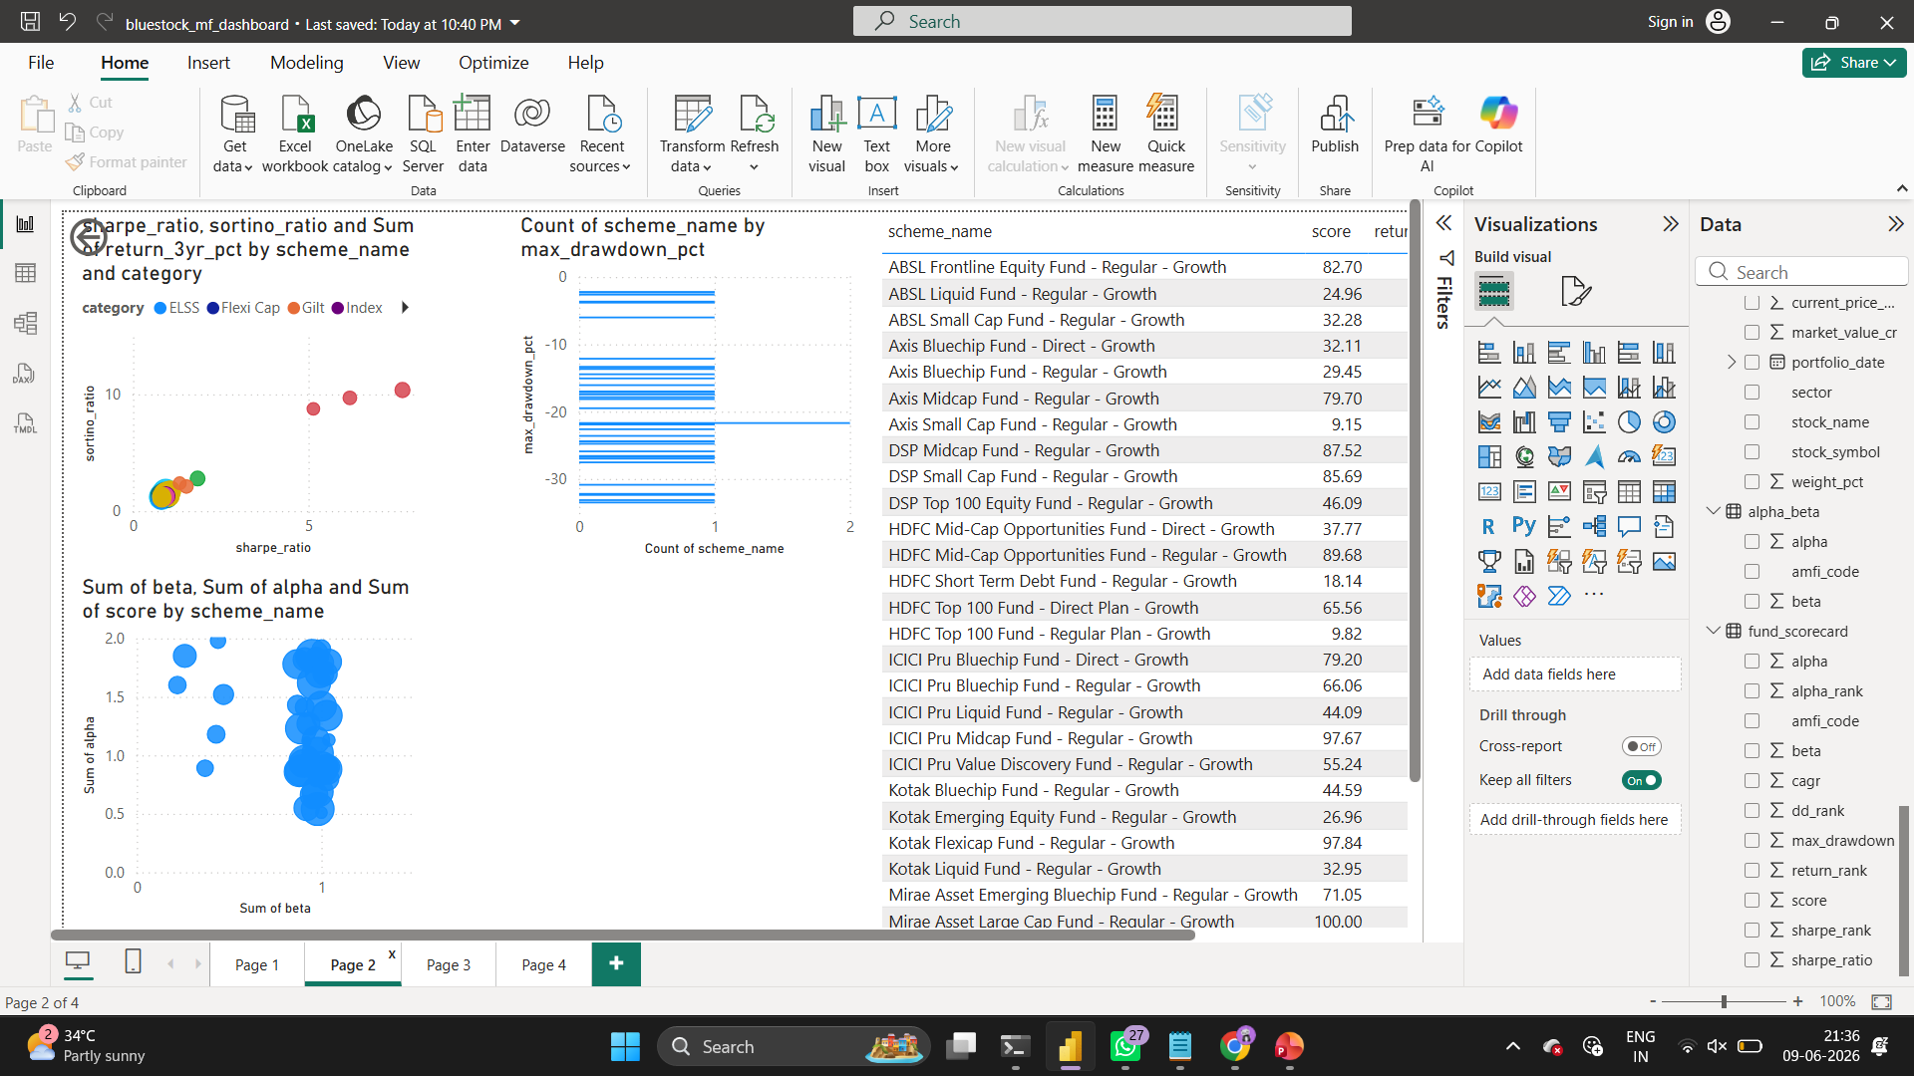
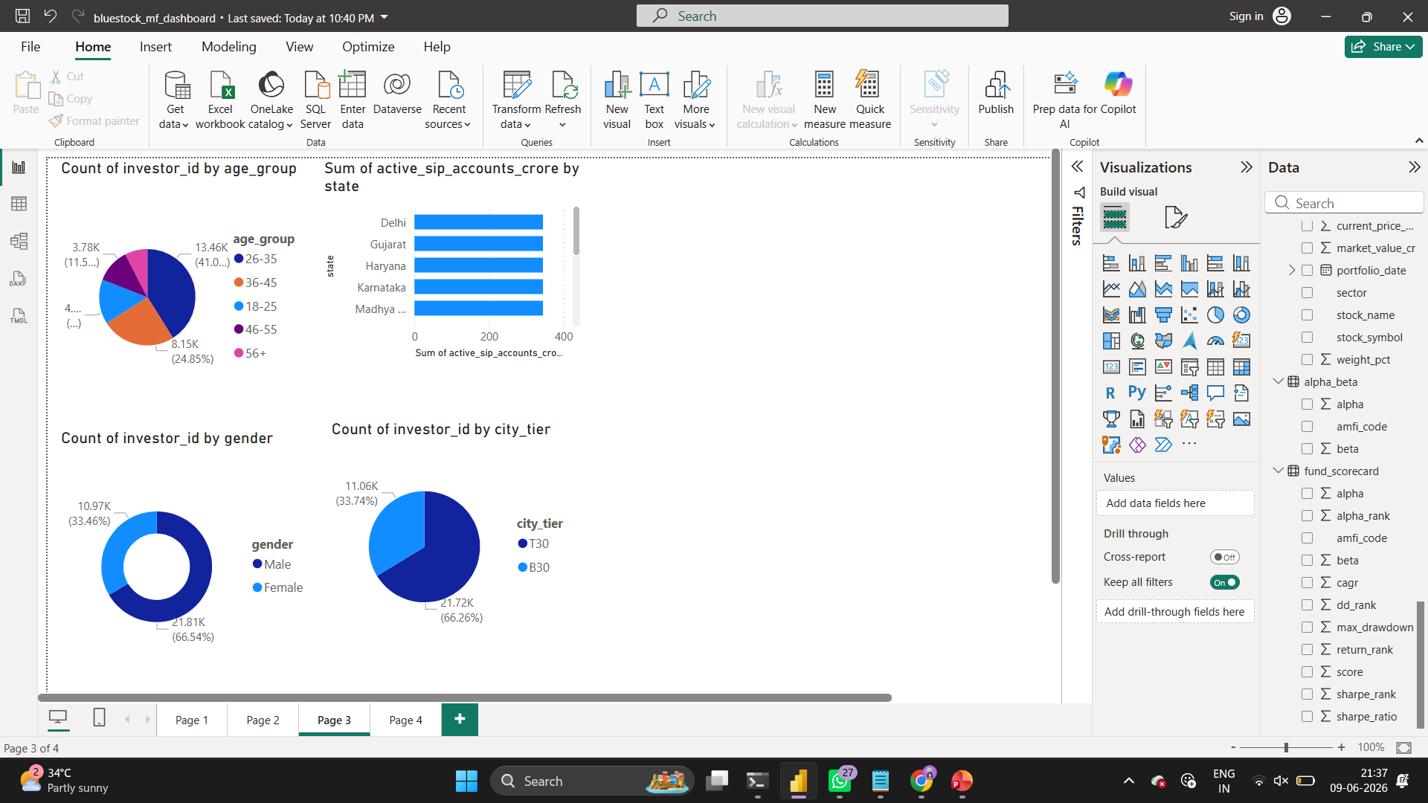
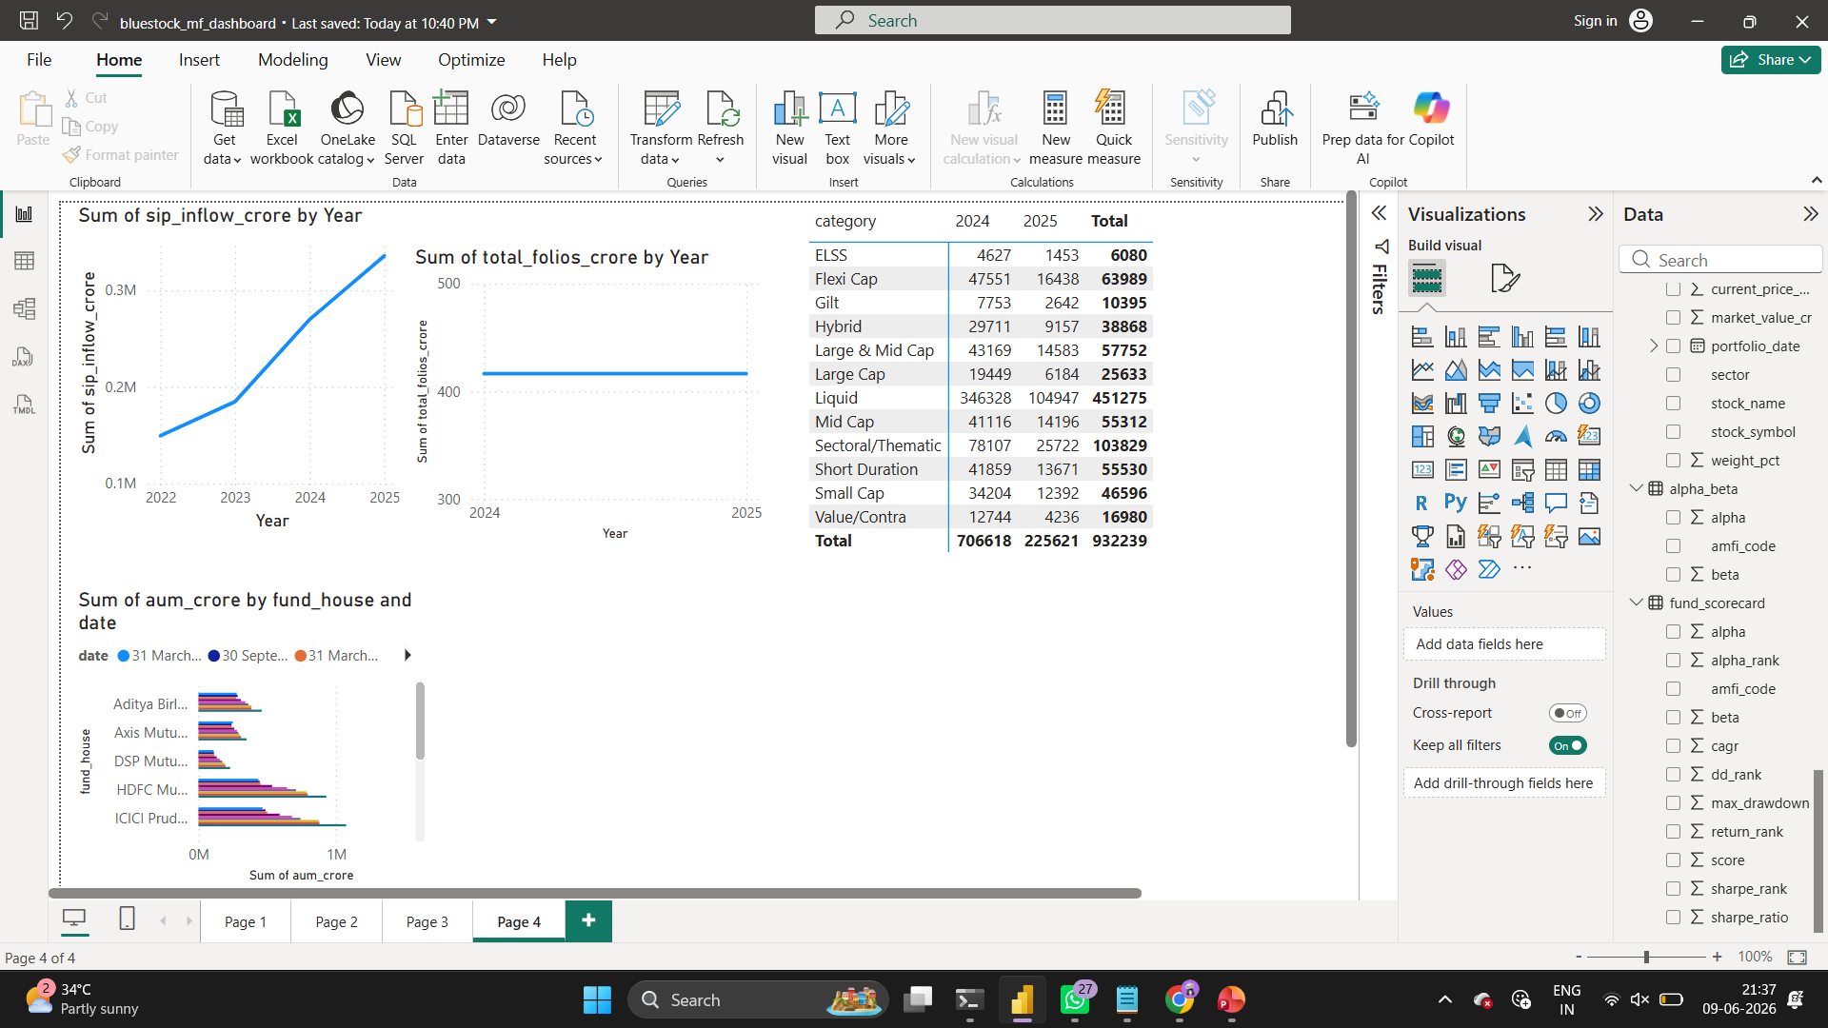

Slide 12
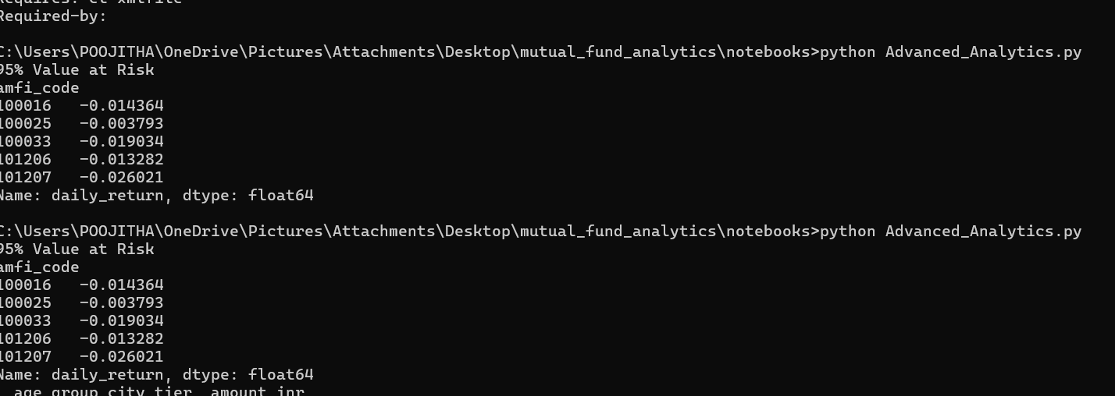
Key Findings
Content
1. SBI Mutual Fund dominated AUM. 2. Small Cap Funds delivered highest returns. 3. SIP inflows showed strong growth. 4. Investor participation doubled. 5. 26–35 age group invested the most. 6. T30 cities generated highest SIP volume. 7. Equity categories attracted maximum inflows. 8. Fund 148567 delivered best risk-adjusted returns. 9. Small Cap Funds dominated recommendations. 10. Dashboard improved investment visibility.

Slide 13
Conclusion & Future Scope
Conclusion
The Mutual Fund Analytics project successfully transformed raw mutual fund datasets into actionable business insights. The project demonstrated practical applications of Python, SQLite, Power BI, and financial analytics for investment decision support.
Future Scope
• Streamlit Application • Monte Carlo Simulation • Portfolio Optimization • Real-time NAV Tracking • Automated Reporting

Slide 14
Thank You
Questions & Answers

