Slide 1

Deep-Sea Fish Detection Using Convolutional Neural Networks (CNNs)
Presentation - 4
CSC-695 Directed Study
Under the Guidance of
Dr. Joe Zhang
By:
Poojitha Priyadarshini Madari
Mar 12 2025

Slide 2

Introduction
Project Aim: Identifying fish in underwater images.
Why It Matters: Supports marine research, fisheries management, and automation.
Techniques: CNNs (VGG16, ResNet50, EfficientNet) & YOLOv5.

Slide 3
Dataset Overview
Dataset Structure:
datasets/
├── train/
│ ├── images/
│ ├── labels/
├── valid/
│ ├── images/
│ ├── labels/
└── test/
├── images/
└── labels/
Dataset consists of images categorized into folders
But does not have explicit labels for individual fish species
It requires clustering (unsupervised learning)
Needed feature extraction + similarity matching (https://alzayats.github.io/DeepFish/)
YOLO Format: Images + Annotation files (.txt) with bounding boxes.

Slide 4
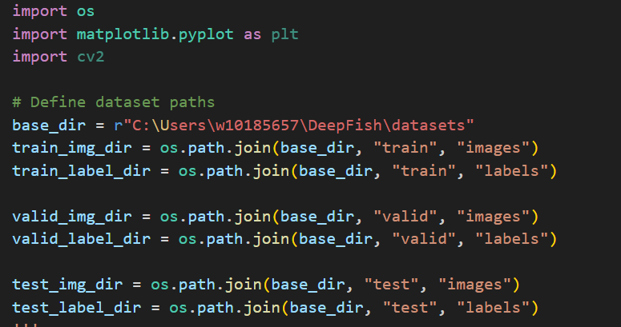
Dataset Challenges
No species labeling → Unable to classify fish
Some images contain no fish → Requires additional filtering.
Bounding box verification → Difficult to ensure annotation accuracy.
No predefined train-test split → Had to create partitions manually.

Slide 5
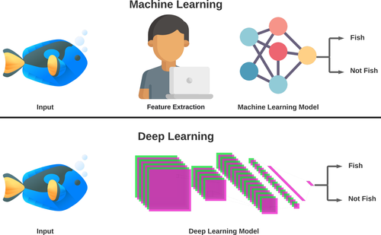
CNN-Based Approach
Why CNNs? They extract spatial patterns & detect fish effectively.
Models Chosen:
VGG16 → Simple & widely used, Deep model, high accuracy, computationally expensive.
ResNet50 → Avoids vanishing gradient issue.
EfficientNet → Optimized for performance vs. parameter count i.e. Balanced speed and accuracy.

Slide 6
YOLOv5 Architecture
Backbone: CSPDarknet53 extracts essential features from the image.
Neck: PANet (Path Aggregation Network) refines features at multiple scales.
Head: Predicts bounding boxes and classifies objects using anchor-based detection.
Output: Produces final bounding box predictions with confidence scores.

Slide 7
Initial YOLOv5 Implementation
YOLOv5 (You Only Look Once) is a state-of-the-art real-time object detection model.
It divides an image into a grid and predicts bounding boxes for objects within each grid cell.
The model is fast, lightweight, and widely used for detecting objects in images and videos.
Current Progress:
Set up dataset in YOLO format.
Pretrained model adaptation.
Partial results obtained.
Available Repository - git clone https://github.com/ultralytics/yolov5.git

Slide 8
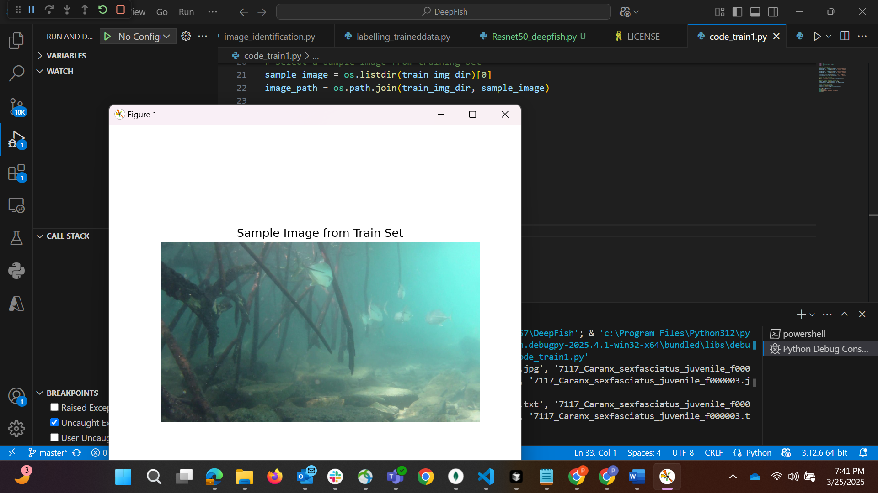
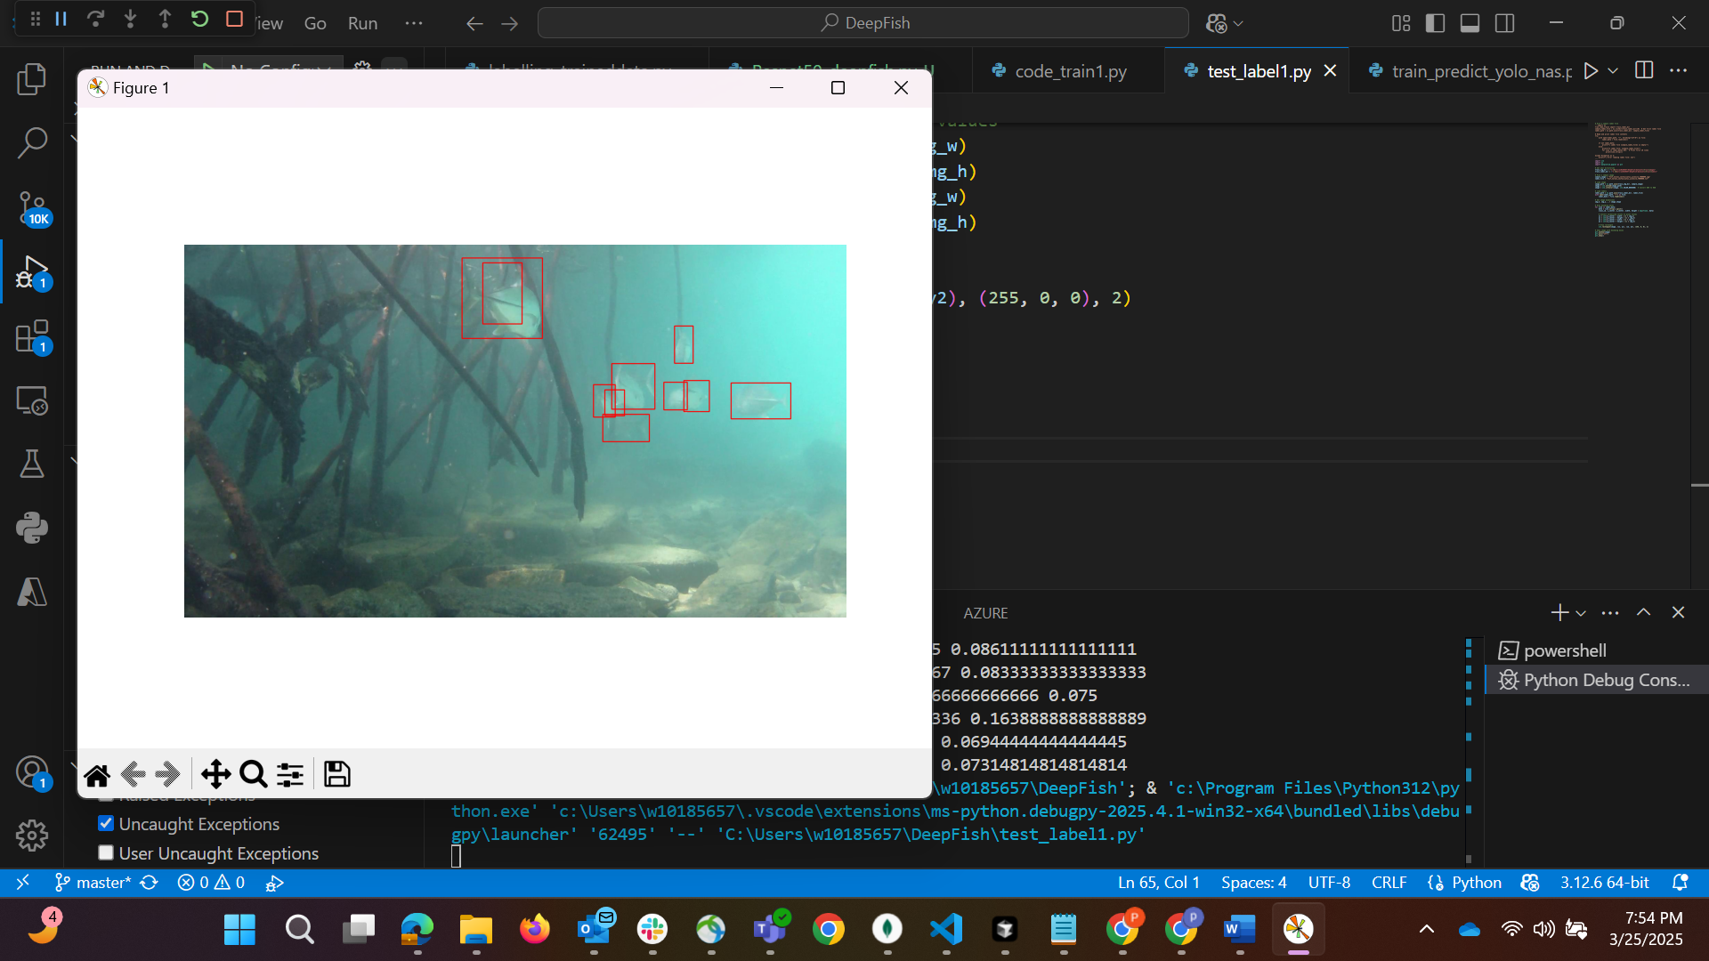

Slide 9
Comparison with Previous Work
Prior Research: Studies using traditional classification techniques with supervised learning.
Improvement:
Combined CNNs & object detection.
Addressed dataset issues with preprocessing.

Slide 10
Future Work
Next Steps:
Learn and improve YOLOv5 performance.
Test with more data.
Optimize for real-time applications.

Slide 11
References
Shah, Chiranjibi, et al. "An enhanced YOLOv5 model for fish species recognition from underwater environments." Ocean Sensing and Monitoring XV. Vol. 12543. SPIE, 2023.
Al Muksit, Abdullah, et al. "YOLO-Fish: A robust fish detection model to detect fish in realistic underwater environment." Ecological Informatics 72 (2022): 101847.
Saleh, Alzayat, Marcus Sheaves, and Mostafa Rahimi Azghadi. "Computer vision and deep learning for fish classification in underwater habitats: A survey." Fish and Fisheries 23.4 (2022): 977-999.
repository-code: 'https://github.com/ultralytics/ultralytics’ ;url: 'https://ultralytics.com’
https://github.com/alzayats/DeepFish

Slide 12
Thank you!!!!

