Slide 1

Deep-Sea Fish Detection Using CNNs
CSC-695 Directed Study
Under the Guidance of
Dr. Joe Zhang
By: Poojitha Priyadarshini Madari
Feb 19 2025

Slide 2
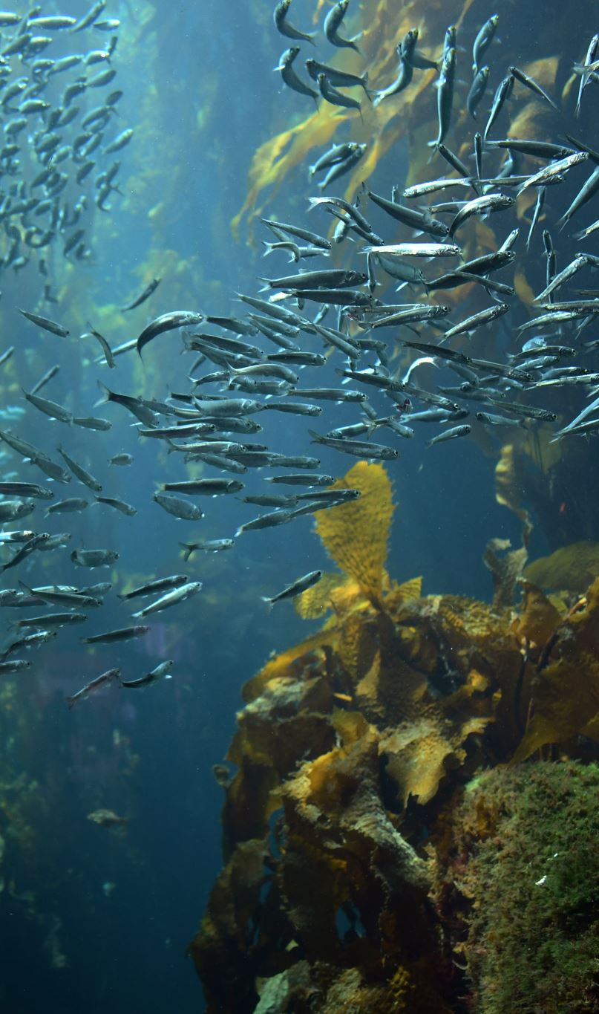
Project Overview
Detecting deep-sea fish species is challenging due to low visibility and complex backgrounds.
CNNs provide a powerful tool for accurate species detection and classification.
Goal: Develop a robust CNN model for real-world underwater detection.

Slide 3
Methodology: Convolutional Neural Networks (CNNs)
Base Models: VGG16, ResNet50, EfficientNet
Data Augmentation: Rotation, scaling, contrast adjustments
Transfer Learning: Using pre-trained models for improved accuracy
Hyperparameter Optimization: Fine-tuning learning rate, batch size, dropout

Slide 4
Dataset: SEAMAPD21
Publicly available dataset with ~28,328 images & 90,000 annotations
130 fish species captured in real-world underwater environments
Includes complex backgrounds and varying lighting conditions
Source: GitHub (https://github.com/SEFSC/SEAMAPD21)

Slide 5
Initial Findings
Literature review highlights success with YOLO and CNN-based models
Key challenge: Limited annotated datasets for deep-sea species
Need for robust preprocessing to enhance model performance

Slide 6
Challenges and Proposed Solutions
Dataset Limitations: Need more annotated images → Solution: Collaborative data collection
Low Visibility & Background Noise → Solution: Advanced image enhancement
Similar-Looking Species → Solution: Feature engineering and deeper CNN layers

Slide 7
Next Steps: Two-Week Plan
Week 1:
Data exploration and preprocessing
Implement augmentation and prepare dataset
Train baseline CNN models
Week 2:
Optimize CNN architectures (VGG16, ResNet, EfficientNet)
Evaluate performance (precision, recall, F1-score)
Analyze misclassifications and refine approach

Slide 8
Conclusion
CNNs offer a promising solution for deep-sea fish detection
Challenges include dataset limitations and underwater image complexity
Next steps focus on refining models for better accuracy
Expected impact is improved marine species monitoring and conservation efforts

