Slide 1

Advanced Control and Analytical Study of Battery Energy Management Systems in Electric Vehicles using Machine Learning
Presented By:
C POOJITHA (23BFA33L05)
M BHOOMIKA (22BFA33165)
KAVALI SATHYA VARSHINI (22BFA33154)
POTHA OMKAR (22BFA33198)
Under the guidance of
Mrs.M. Roja
Assistant Professor
DEPARTMENT OF COMPUTER SCIENCE AND ENGINEERING (AI & ML)
SRI VENKATESWARA COLLEGE OF ENGINEERING
(Autonomous)
Karakambadi Road, Tirupati-517507
2022-2026

Slide 2
OUTLINE
Abstract
Introduction
Problem Statement
Existing system
Disadvantages
Proposed system
Advantages
System Requirements
System Architecture
Modules
UML Diagrams
Output Screenshots
Conclusion
Future Enhancement

Slide 3
ABSTRACT
The global transition toward sustainable mobility has significantly accelerated the demand for Electric Vehicles (EVs). To cater to this surge, automotive industries—both established manufacturers and emerging startups—are compelled to enhance production efficiency while simultaneously minimizing costs to remain competitive Particularly in the domain of energy storage and battery management systems. To address these challenges, the integration of digital twin technology offers a transformative solution. By creating virtual replicas of both production facilities and vehicle components, manufacturers can simulate, analyze, and optimize assembly processes. This not only reduces production time but also ensures high-quality outcomes in mass manufacturing environments. The battery energy management system (BEMS) represents one of the most complex and critical aspects of EV performance. The proposed approach enables intelligent estimation of battery parameters, enhances energy utilization, and improves system reliability and lifespan. Through predictive analytics and data-driven insights, this research contributes to developing smarter and more efficient EV battery management frameworks, supporting the broader vision of sustainable transportation

Slide 4
INTRODUCTION
Electric Vehicles (EVs) are becoming a major solution for achieving clean and sustainable transportation. Since EVs depend entirely on battery performance, an efficient battery management system is essential for ensuring range, safety, and reliability. With the rise in EV adoption, industries require smarter systems that can accurately monitor battery conditions and predict their behavior. Machine learning helps overcome the limitations of traditional methods by providing more accurate battery state estimation and performance prediction. At the same time, digital twin technology enables virtual testing and optimization of battery systems. By combining both approaches, this project aims to develop an intelligent and efficient framework for controlling and analyzing battery energy systems in electric vehicles. Furthermore, the increasing demand for high-performance battery systems requires advanced monitoring and control techniques to enhance efficiency and lifespan.Data-driven approaches enable real-time analysis of battery parameters such as temperature, voltage, and state of charge, improving decision-making processes.The integration of intelligent algorithms helps in early fault detection, reducing the risk of battery failures and improving overall system reliability.

Slide 5
PROBLEM STATEMENT
Electric Vehicles depend entirely on their battery performance, but the current battery management systems are not accurate or intelligent enough to handle real-world conditions. They struggle to predict battery health, cannot adapt to temperature or load changes, and offer no virtual simulation support. This leads to poor energy efficiency, faster battery degradation, and unreliable performance. There is a clear need for a smarter system that can accurately monitor, predict, and optimize battery behavior in electric vehicles.

Slide 6
EXISTING SYSTEM
The existing Battery Management Systems (BMS) used in electric vehicles mainly rely on rule-based logic and predefined mathematical models that interpret battery voltage, current, and temperature readings. As highlighted in the reference paper, these model-driven approaches struggle to capture the complex and non-linear behavior of lithium-ion batteries, making them less accurate under varying real-world conditions. They are unable to adapt effectively to changes in temperature, load, or driving patterns, which leads to unreliable state estimation. The base paper also emphasizes that traditional systems operate without virtual simulation or digital twin support, resulting in slow, costly, and hardware-dependent validation processes. This lack of adaptability and predictive capability makes existing BMS less efficient for modern electric vehicle requirements.

Slide 7
DISADVANTAGES
Limited Accuracy in Battery State Estimation Traditional BMS models cannot accurately estimate State of Charge (SoC) or State of Health (SoH) when battery conditions change, leading to unreliable performance predictions.
Poor Adaptability to Real-World Conditions Since rule-based systems depend on fixed reference values, they fail to adapt to variations in temperature, load, driving behavior, and aging effects.
No Predictive Intelligence Existing systems cannot forecast battery degradation or detect issues early. This results in unexpected failures and reduced operational safety.
Absence of Virtual Simulation or Digital Twin Support Without a digital twin environment, testing and validation become slow, costly, and heavily dependent on physical hardware.
Faster Battery Degradation Inefficient monitoring and lack of optimized control strategies lead to poor energy utilization and accelerate battery aging over time.

Slide 8
PROPOSED SYSTEM
The proposed system introduces an intelligent Battery Energy Management System that combines Machine Learning and Digital Twin technology. Machine Learning is used to accurately predict battery behavior, estimate key parameters, and detect issues early. Digital Twin technology creates a virtual model of the battery system, allowing real-time simulation, testing, and optimization without relying on physical hardware. By integrating these two technologies, the system can monitor battery performance more precisely, adapt to changing conditions, and improve energy utilization. This leads to better efficiency, longer battery life, and more reliable performance in electric vehicles.

Slide 9
ADVANTAGES
Improved Accuracy Machine learning provides more precise estimation of battery health and performance compared to traditional methods.
Early Problem Detection Predictive analysis helps identify battery issues before they cause failures, improving safety and reliability.
Better Energy Utilization Optimized control strategies ensure efficient charging and discharging, reducing energy loss.
Extended Battery Lifespan Smarter monitoring and optimized usage slow down battery aging and improve long-term performance.
Cost-Effective Testing Digital twin simulations reduce the need for physical testing, saving time, effort, and resources.
Real-Time Adaptability The system adjusts itself based on temperature, load, and driving conditions, ensuring stable performance in all environments.

Slide 10
SYSTEM REQUIREMENTS
Hardware Requirements :
Processor : Intel Core i3 / i5 or AMD Ryzen 3 / 5 RAM : 8 GB or more Hard Disk : 20 GB or more free space Monitor : VGA / SVGA / LCD / LED Keyboard : Standard 104-key keyboard

Slide 11
SOFTWARE REQUIREMENTS
Operating System : Windows 10 / 11 Programming Language : Python 3.x Python Libraries : NumPy, Pandas, Scikit-Learn Simulation / Modeling : MATLAB / Simulink (optional) Development Platform : Jupyter Notebook / Google Colab/VS Code Version Control : GitHub Documentation Tools : MS Word / PowerPoint

Slide 12
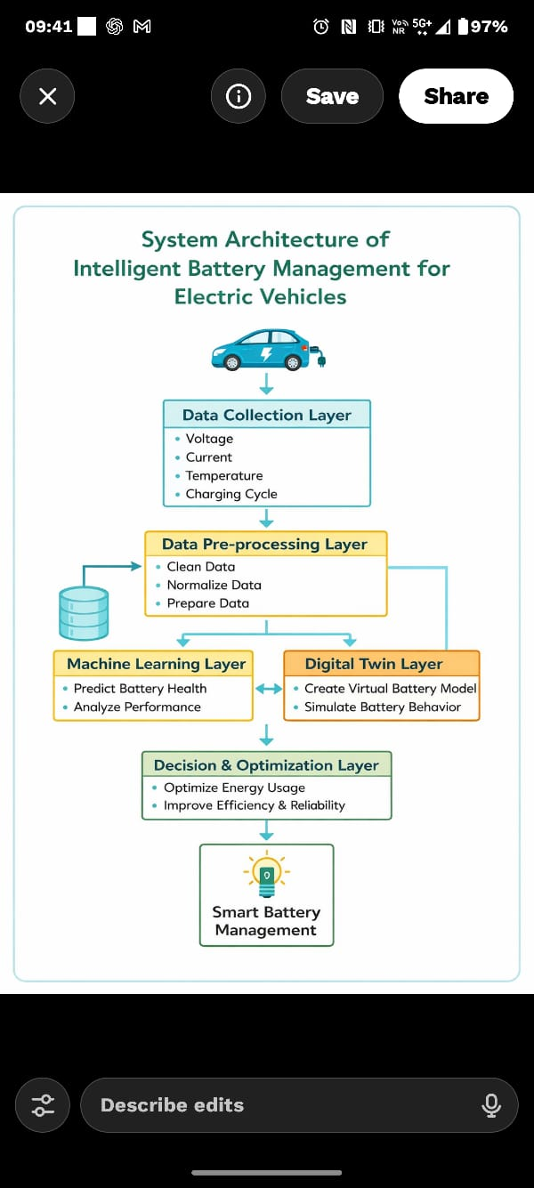
SYSTEM ARCHITECTURE

Slide 13
MODULES
Data Collection Responsible for gathering battery parameters such as voltage, current, temperature, and usage history.
Data Preprocessing Handles data cleaning, normalization, and preparation for machine learning models.
Machine Learning Predicts battery state and performance using intelligent data-driven techniques.
Digital Twin Creates a virtual replica of the battery system for simulation and testing without physical hardware.
Performance Analysis Analyzes results and optimizes battery behavior to improve lifespan and energy efficiency.

Slide 14
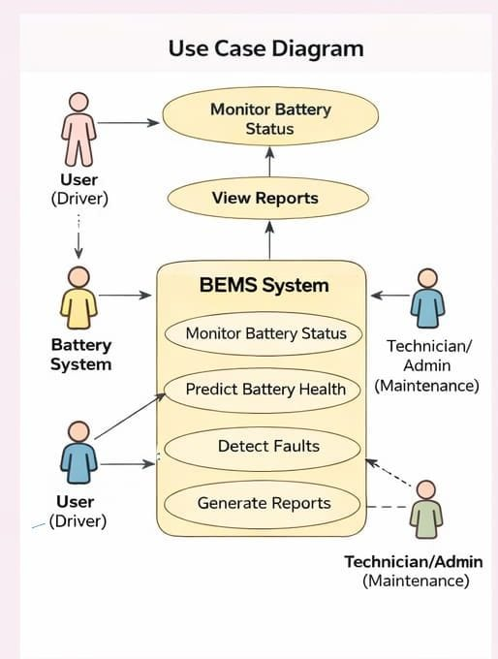
UML DIAGRAM

Slide 15
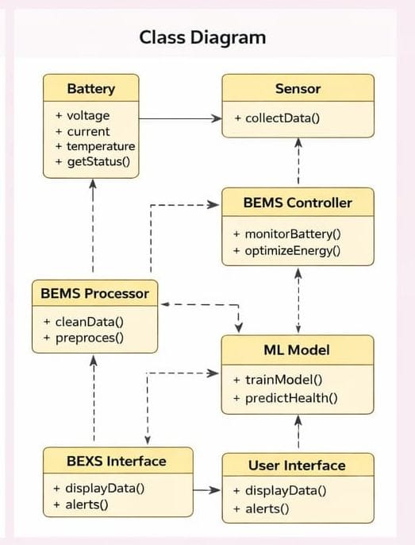
UML DIAGRAM

Slide 16
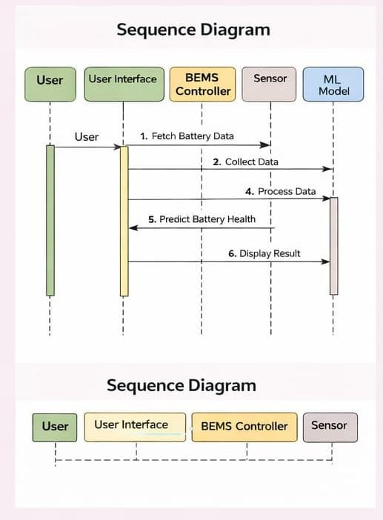
UML DIAGRAM

Slide 17
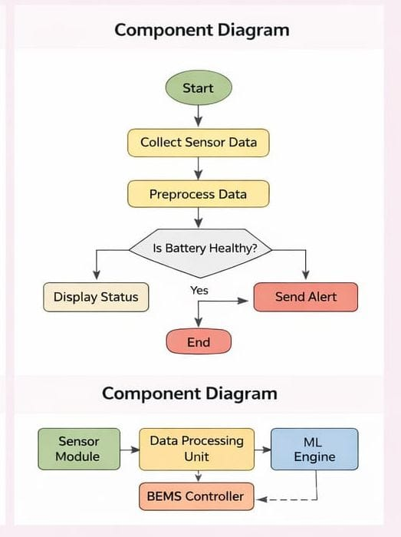
UML DIAGRAM

Slide 18
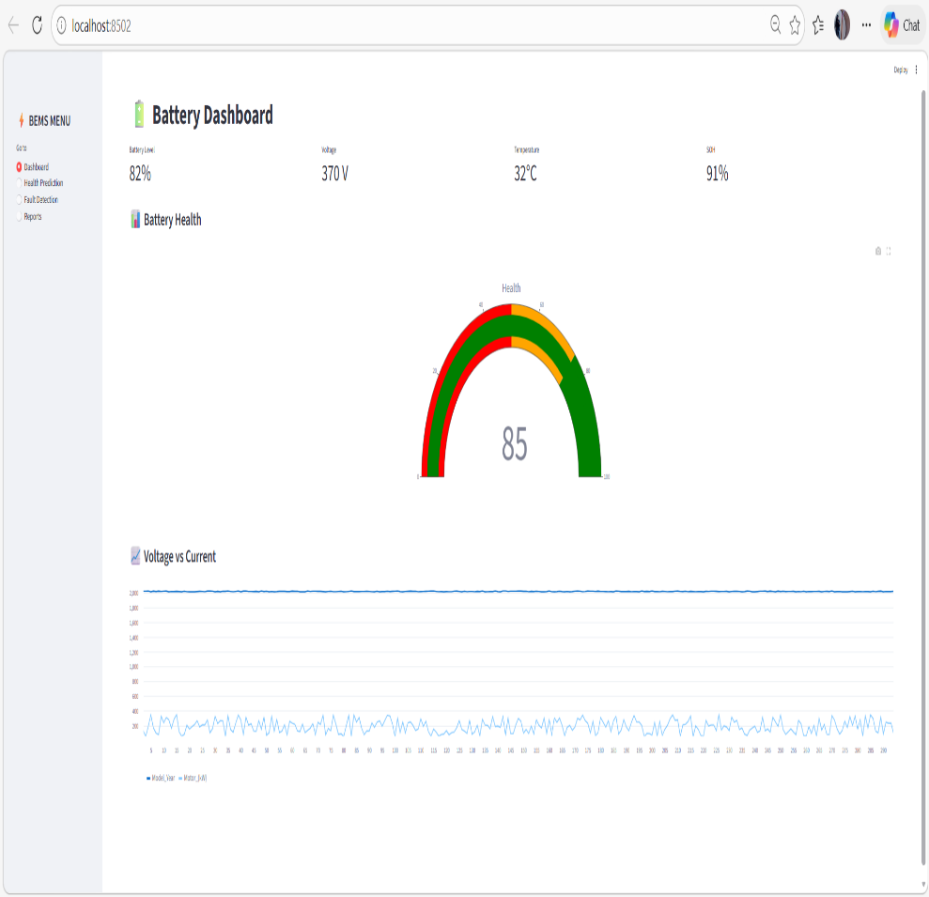
OUTPUT SCREENSHOT

Slide 19
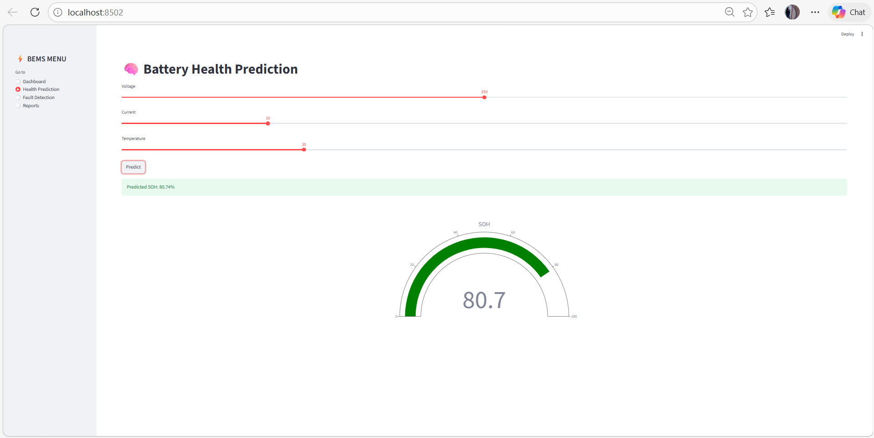
OUTPUT SCREENSHOT

Slide 20

OUTPUT SCREENSHOT

Slide 21
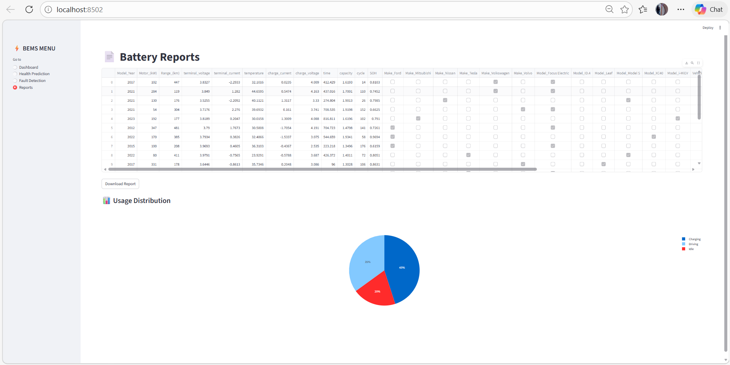
OUTPUT SCREENSHOT

Slide 22
CONCLUSION
The proposed Battery Energy Management System (BEMS) using Machine Learning improves the efficiency and reliability of electric vehicles. It enables accurate prediction of battery health, helping in early fault detection and preventive maintenance. The system optimizes charging and discharging cycles, enhancing battery lifespan and performance. Integration of intelligent data analysis reduces energy wastage and improves overall system efficiency. This approach supports the development of sustainable and smart electric mobility solutions.

Slide 23
FUTURE ENHANCEMENT
Integration of real-time IoT sensors for more accurate and continuous battery monitoring.
Use of advanced Machine Learning / Deep Learning models for higher prediction accuracy.
Implementation of cloud-based data storage for large-scale analysis and remote access.
Development of a mobile/web application for user-friendly monitoring and alerts.
Incorporation of fast-charging optimization techniques to reduce charging time safely.
Enhancing system with thermal management to prevent overheating issues.
Applying AI-based fault diagnosis for automatic detection and correction of failures.
Expansion to support renewable energy integration (like solar-powered EV charging).

Slide 24


