Slide 1

AI-Powered Real-Time Market Sentiment Dashboard

Slide 2

REAL-TIME MARKET SENTIMENT DASHBOARD
User friendly Interface
Get the stock details by name
AI based prediction for stocks
Sentimental Analysis based on social, economic events and news
Pictorize the most common words
Getting the accurate predictions

Slide 3
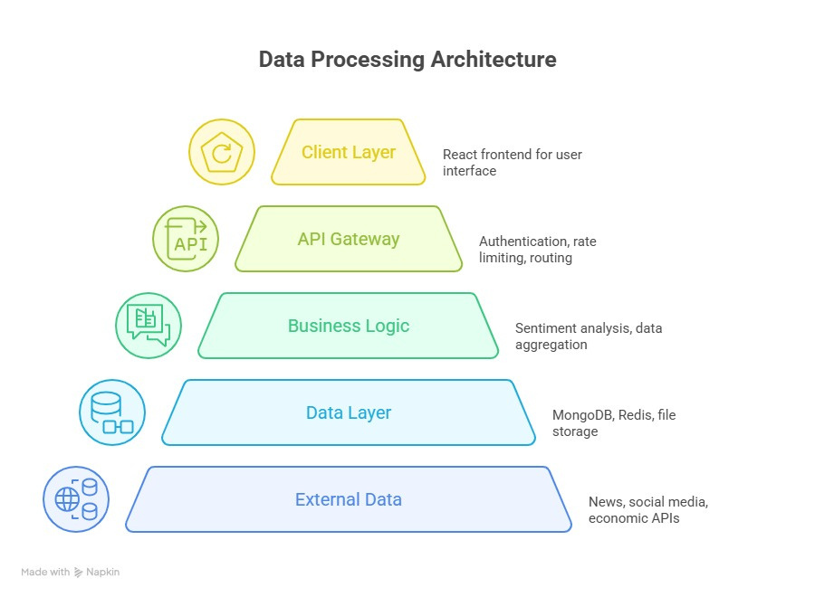
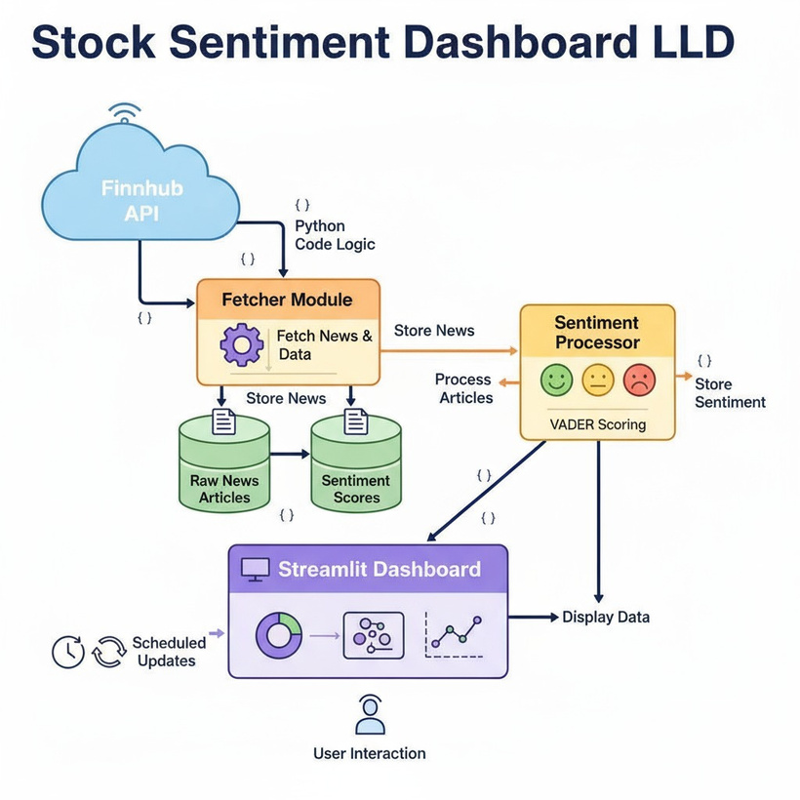
HIGH LEVEL DESIGN:
LOW LEVEL DESIGN:

Slide 4

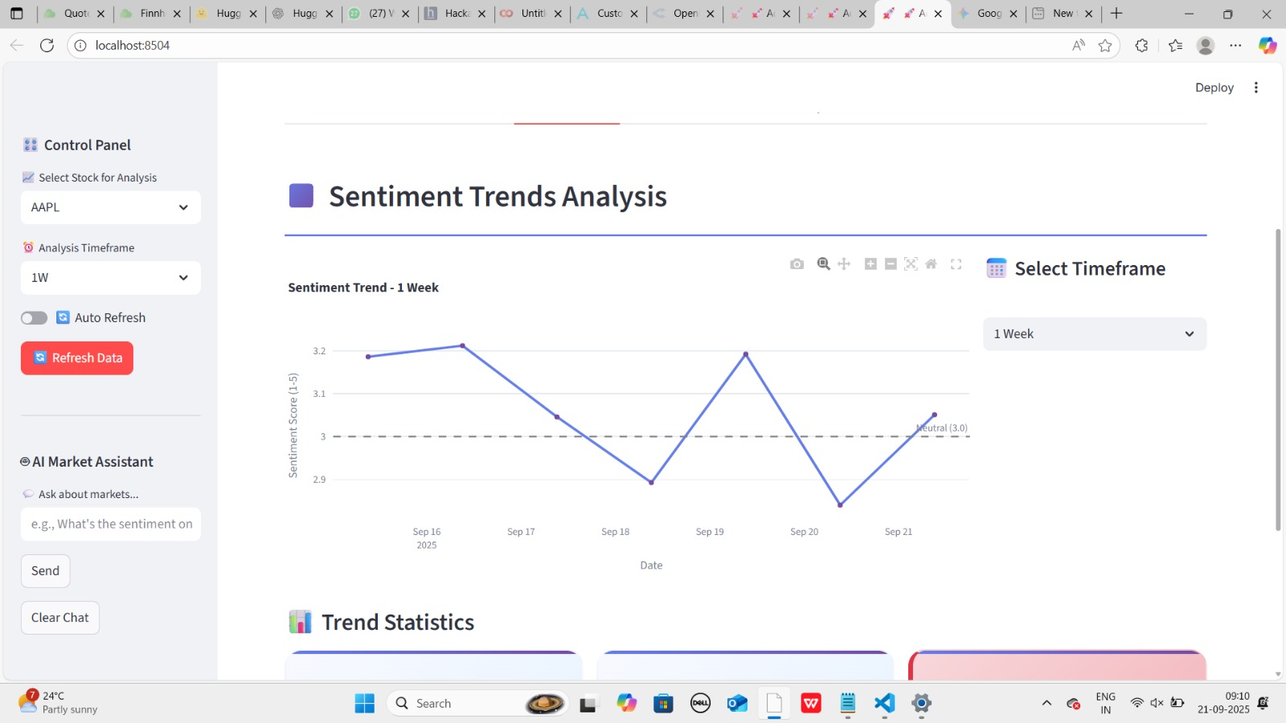
Solution:
An AI-powered dashboard that collects, analyzes, and visualizes real-time market sentiment from multiple sources to help investors make informed decisions.
APPROACH
User Interaction
Data Collection
Data Preprocessing
Sentiment Analysis
Aggregation
Visualization
Historical Comparison

Slide 5

Impact
Informed trading decisions
Risk reduction and better portfolio management
Enhanced market awareness
Values
Real-time market sentiment analysis
AI-driven actionable insights
Interactive, user-friendly dashboard

Slide 6

Limitations and Constraints:
Data Dependency: Accuracy depends on the quality and timeliness of news, social media, and economic data.
Model Limitations: Sentiment analysis and predictions may have errors or misinterpret context.
Resource Requirements: Real-time analysis requires robust computing power and reliable internet connectivity.

Slide 7
Thank you

