Slide 1
Line following Robot

Slide 2
Line Following Robot
Project Members | Roll Numbers
Keerthana Lakshmi | CB.EN.U4ECE22028
Supriya Ilangovan | CB.EN.U4ECE22052
Challa Poojitha | CB.EN.U4ECE22064
Ragul kk | CB.EN.U4ECE21041

Slide 3
Contents
01.
02.
03.
Objectives
Introduction
Problem Statement
04.
05.
Block diagram Working
Circuit Diagram

Slide 4
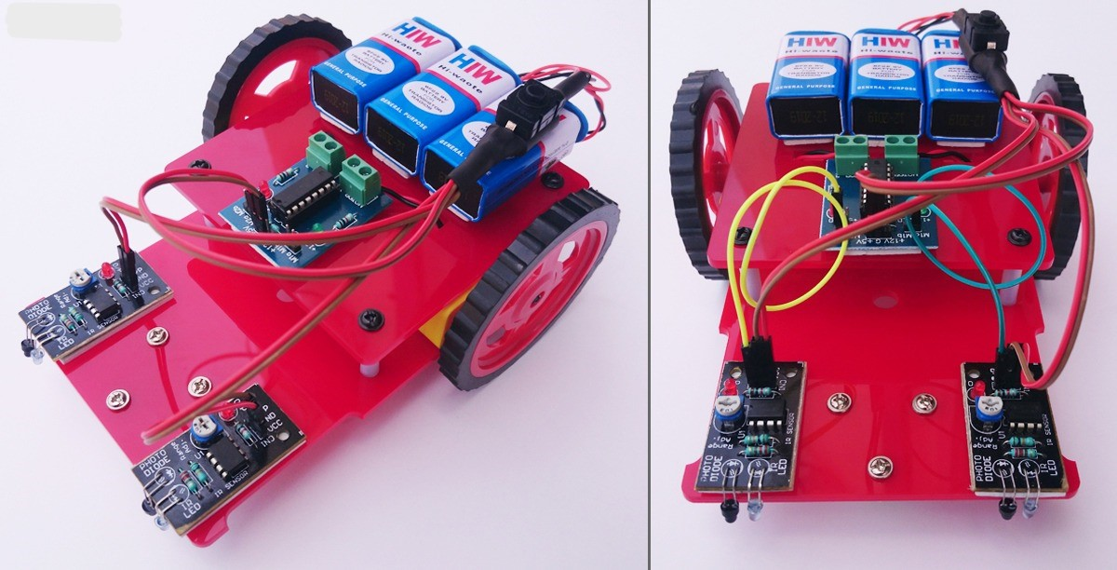
Problem Statement
To develop a line following robot without microcontroller that follows star pattern.

Slide 5
Objectives
01.
Design and develop a Line Follower Robot (LFR) that can accurately follow a designated black or white line using basic electronics and logic circuits, without utilizing a microcontroller.
The robot should incorporate a pair of IR sensors for line detection and four motors for controlling movement and direction.
02.
To consider the potential for advanced features beyond basic line following, such as tracing the shortest path between start and end points or navigating through line mazes
03.

Slide 6
Introduction
What is a line follower?
Line follower is a machine that can follow a path. The path can be visible like a black line on a white surface (or vice-versa) or it can be invisible like a magnetic field.
What is the need to build a line follower?
Sensing a line and maneuvering the robot to stay on course, while constantly correcting wrong moves using feedback mechanism forms a simple yet effective closed loop system.

Slide 7
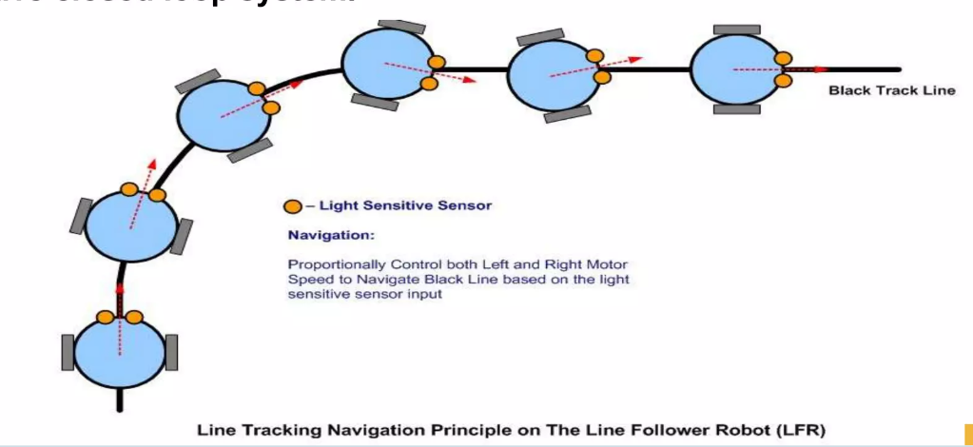

Slide 8
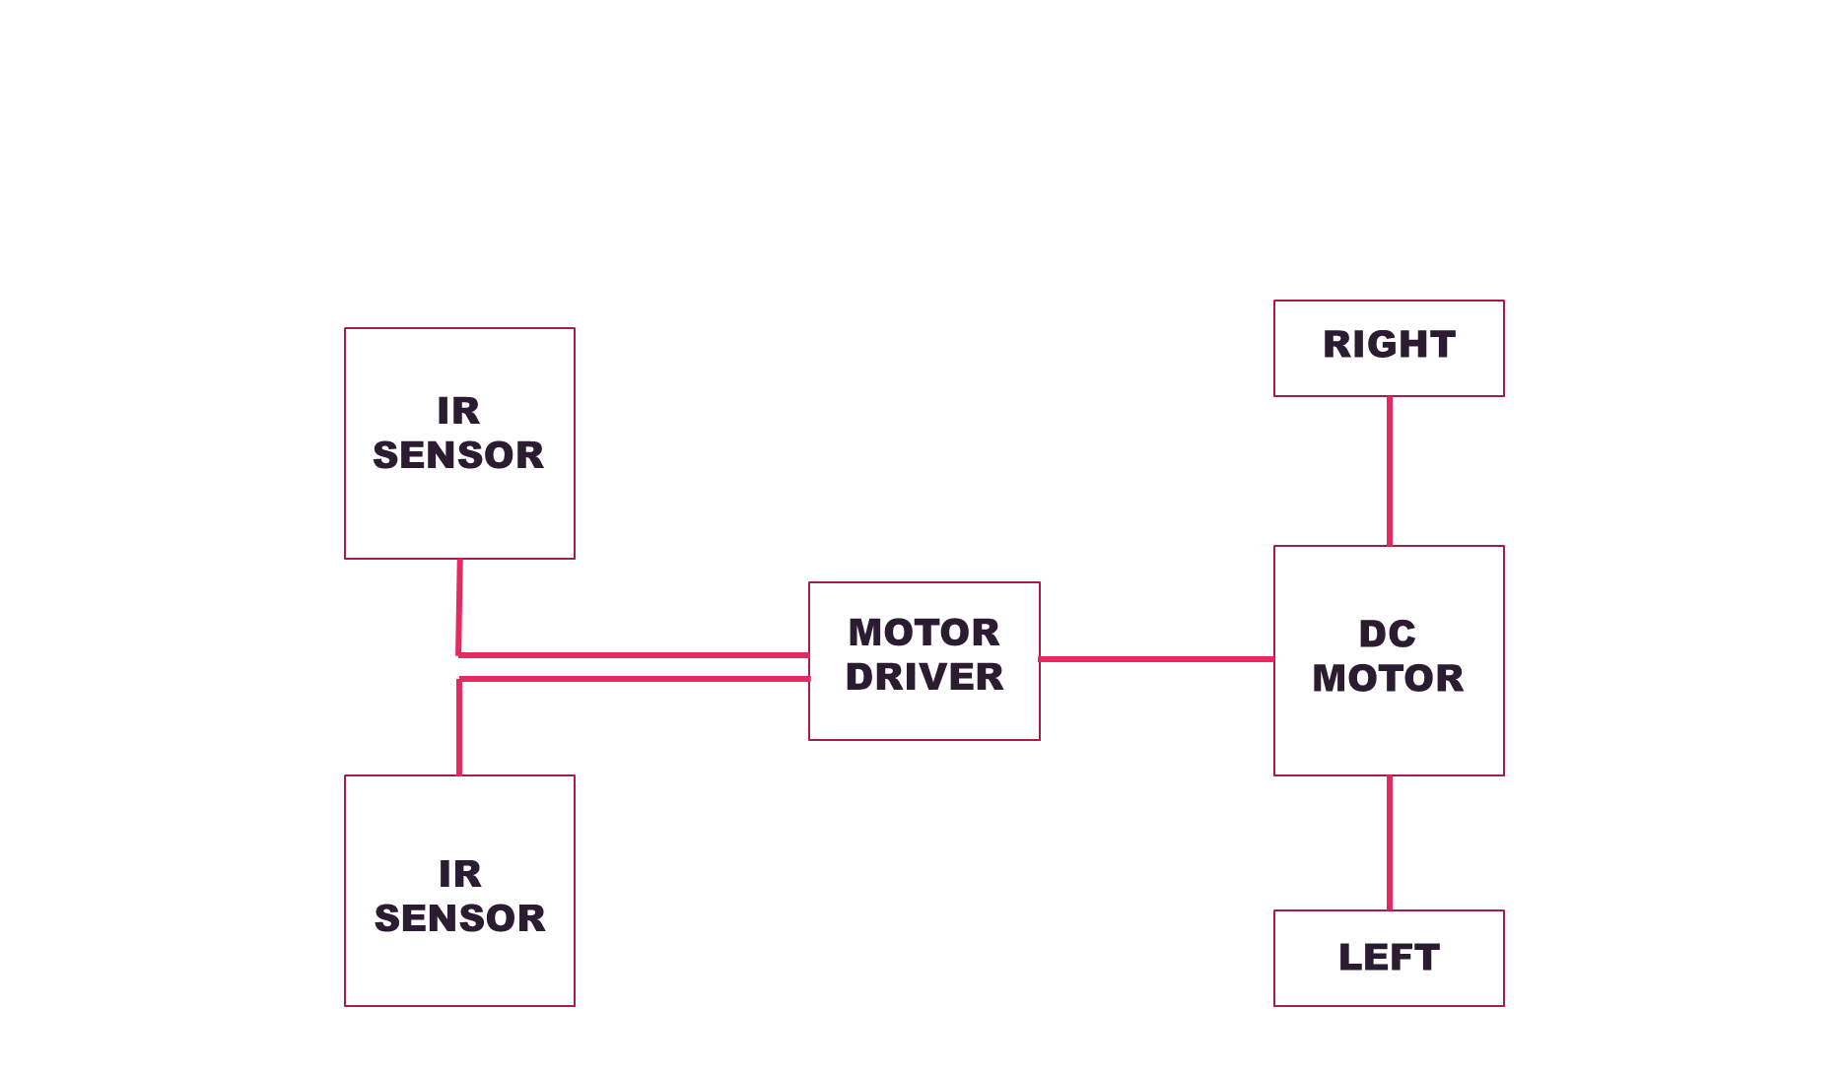

Slide 9
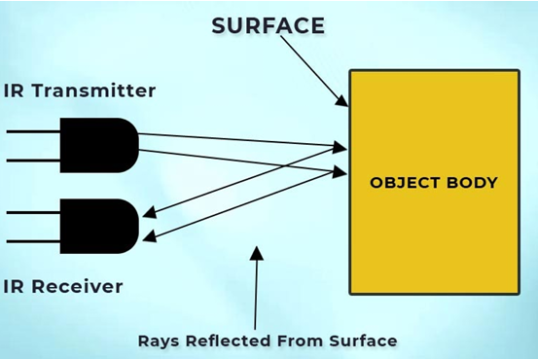
COMPONENTS
IR Sensor
An IR sensor, made up of an IR transmitter (LED) and receiver (photodiode), detects objects by transmitting IR rays and sensing reflections. White surfaces reflect IR rays, while black surfaces absorb them, enabling line detection. This principle is used to build logical circuits for line-following bots.

Slide 10
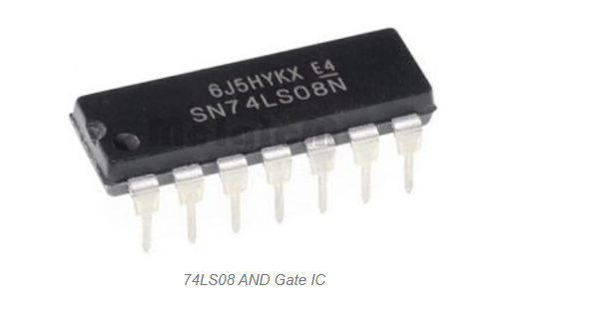
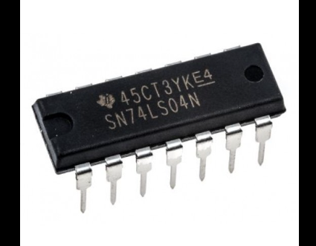
Role of AND and NOT gates
The AND gate ensures the robot moves straight when multiple sensors (usually the middle ones) detect the line simultaneously, outputting HIGH (1) only in this condition.
The NOT gate helps ensure that the robot responds accurately to the black/white line transitions and intersections.

Slide 11
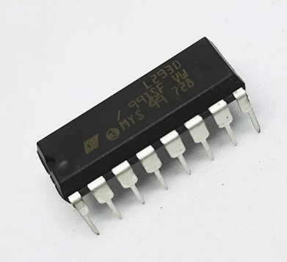
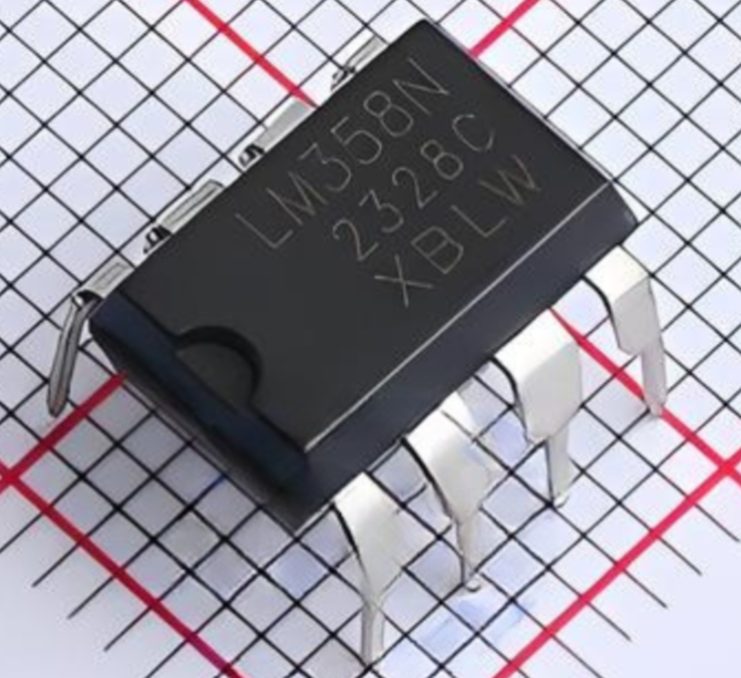
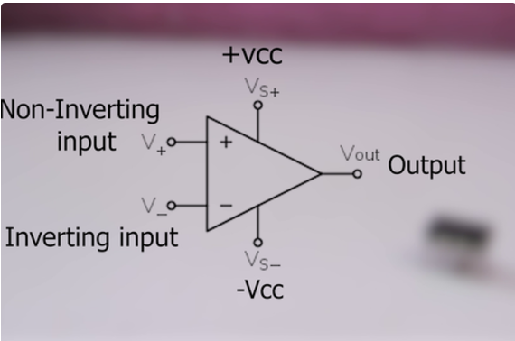
L293D (Motor driver IC)
The L293D is a motor driver IC with two H-bridges to control two DC motors independently in forward or reverse directions. It has separate logic and motor power pins, making it versatile for various applications.
LM358 IC
Acts as a comparator to process signals from line sensors and determine the robot's position relative to the line. Provides a HIGH or LOW signal to the motor driver to adjust the robot's movement.

Slide 12
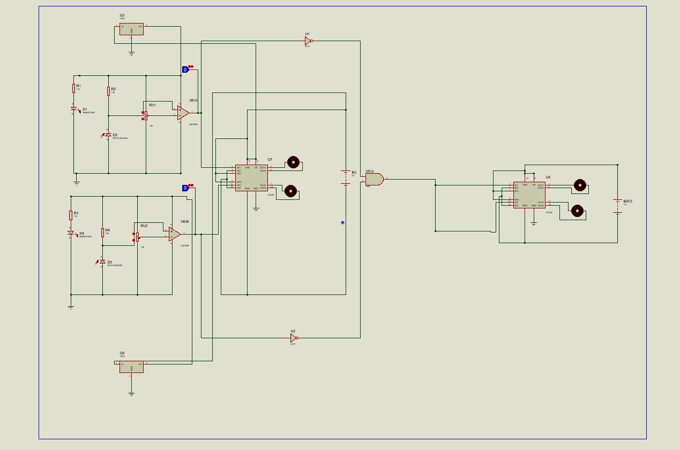
Circuit Diagram

Slide 13
THANK YOU

