Slide 1

MACHINE LEARNING MINI-PROJECT
Drawing: A New Way to Search
Recognising hand-drawn doodles with the QuickDraw dataset
Ramitha (PES1UG24AM) & Poojitha(PES1UG24AM384)
UE24CS352A - Machine Learning
Notes:
Introduce the team and the one-line idea: teach a computer to recognise what you draw.

Slide 2



Problem Statement
The idea
Our goal
The challenge
Search starts with typed words, yet sometimes it is easier to sketch what you mean.
Classify a hand-drawn doodle into the correct object category.
Abstract sketches, only 28 x 28 pixels, and look-alike classes.
Notes:
Motivation: searching by drawing. Then the goal and why it is hard.

Slide 3
Dataset: Google QuickDraw
28x28
10
80/10/10
pixels per doodle
object classes
train / val / test
Drawings from players of Google's Quick Draw! game.
Numpy bitmap version with thousands of images per class.
Pixels scaled to 0-1; a black/white version is tested too.
Fixed random seed, so every model sees the same split.
Notes:
Add the exact class names and images per class from the repo README.

Slide 4



Approach: Four Models Compared
Logistic Regression
SVM
Fast baseline. Treats pixels as flat features.
Linear (linear decision boundaries) and RBF(complex, nonlinear boundaries) kernels, trained on a subset.
CNN from scratch
MobileNetV2
Learns shapes with conv and pooling layers.
Transfer learning from ImageNet, frozen base.
Every model is compared on accuracy and training time.
Notes:
Classical ML (Poojitha) vs deep learning (Ramitha). Same data and split for every model.

Slide 5
Implementation: Our CNN
Input
Conv
MaxPool
Conv
MaxPool
Dense
Softmax
28x28
32 filters
2x2
64 filters
2x2
128
10 classes
Ablations tested
Remove a conv layer
Remove pooling
Smaller dense layer
Binarised input
Tools: Python, scikit-learn, TensorFlow/Keras, Gradio, GitHub
Notes:
Walk the layers left to right, then explain why each ablation was tried.

Slide 6
Results
Model | Test accuracy | Training time | Notes
Logistic Regression | 69.30% | TBD | Baseline
Linear SVM | 67.00% | TBD | Subset
RBF SVM | 82.40% | TBD | Subset
CNN (best variant) | 92.40% | TBD | From scratch
MobileNetV2 | 90.40% | TBD | Transfer learning
Note: Test sample sizes differed across models, so this is not a perfectly controlled comparison. MobileNetV2 results are preliminary because the test dataset was used for validation during training.
Notes:
Fill from RESULTS.md before presenting.

Slide 7
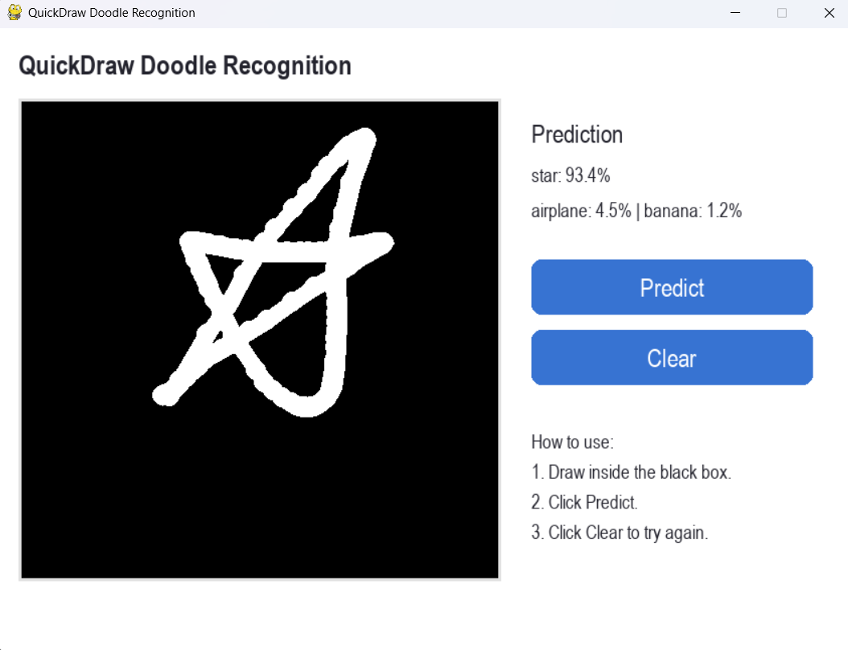
Live Demo: Draw and Predict
1
Draw a doodle on the canvas
1st guess
2
The CNN predicts live
2nd
3
See the top-3 guesses
3rd
4
Try look-alike classes
Layout preview
Notes:
Switch to the live app here: python app/demo.py

Slide 8

Conclusions and Future Work
What we compared
What we found
What is next
Developed a QuickDraw doodle recognition system to classify hand-drawn sketches into 10 categories.
Compared Logistic Regression, Linear SVM, RBF SVM, CNN, and MobileNetV2.
The CNN achieved the highest measured accuracy of 92.40%.
Among classical machine learning models, RBF SVM performed best with 82.40% accuracy.
Built a demo that displays the top-3 predicted classes for a drawing.
Improve recognition of visually similar doodles.
Improve the demo interface and prediction speed.
Notes:
Replace these with your real findings and numbers.

Slide 9
Thank you

