Slide 1

DELISH DRIVE
2210030123 - K. POOJITHA 2210030070 - DEEKSHITHA 2210030074 - M. NAMITHA 2210030177 - D. GAYATHRI

Slide 2

App Functionality
1
Real-Time Tracking
Users can track the status of their orders in real-time, ensuring transparency and reliability.
2
Customizable Orders
Customers can personalize their orders, allowing them to select specific preferences and add notes.
3
Discounts & Offers
The app provides exclusive discounts and offers to enhance user loyalty and satisfaction.

Slide 3

Technologies - MERN
MongoDB
Express
React
Node JS
Stores data efficiently, offers flexibility for our application needs.
Simplifies server-side logic, facilitates routing for seamless communication.
Constructs dynamic user interfaces with reusable components for interactivity.
Executes server-side JavaScript, enabling scalable and efficient backend operations.

Slide 4



User Experience and Interface Design
User-Friendly
Modern Aesthetics
Responsive Design
The interface is designed to be intuitive, ensuring a seamless and enjoyable user experience.
The design incorporates modern aesthetics, enhancing the app's visual appeal and usability.
Responsive layouts adapt to various devices, providing consistent usability across different platforms.

Slide 5
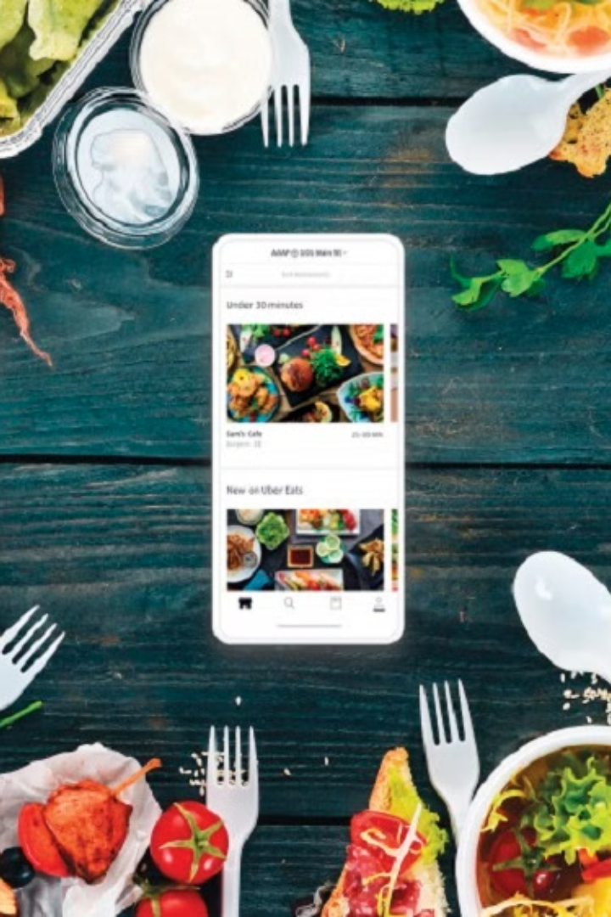
Who is benefitted?
Customers: Enjoy the convenience of ordering food from a variety of restaurants at their fingertips, with options for delivery or pickup.
Restaurants: Expand their customer reach without investing in their own delivery infrastructure, increasing sales and visibility.
Delivery Drivers: Earn income through flexible work opportunities, delivering food to customers and supporting local businesses.

Slide 6




Challenges Faced During Development
Integration
Integrating various features while maintaining performance posed a significant challenge.
Security
Ensuring robust security measures against potential threats demanded meticulous attention.
Scalability
Scaling the app's infrastructure to support increased demand required strategic planning.

Slide 7
Future Plans and Updates
1
Feature Expansion
Enhance the app with new features like AR menus and voice-based commands for navigation.
2
Partnerships
Forge strategic partnerships with local restaurants to expand the app's menu offerings.

Slide 8

THANK YOU

