Slide 1

DEPARTMENT OF COMPUTER SCIENCE AND ENGINEERING
Professional Training -1
MOVIE RECOMMENDATION SYSTEM USING COLLABORATIVE FILTERS
Project Supervisor: MS.K.Dhanalakshmi
Name of the Student: Machineni Poojitha Chowdary
Register Number:42110716

Slide 2
Presentation Outline
Course Certificate
Introduction
Abstract
Objectives
System Architecture / Ideation Map
Module Implementation
Application Snapshots
Results and Discussions
Conclusion & Future work
References

Slide 3

Course Certificate

Slide 4
Introduction
What is a Movie Recommendation System?
A software tool that suggests movies to users based on their preferences, viewing history, and behaviors.
Importance:
Enhances user experience by providing personalized content.
Increases engagement and retention on streaming platforms.
Types of Recommendation Systems:
Content-Based Filtering: Recommends movies similar to those the user has liked in the past.
Collaborative Filtering: Uses user interaction data to find patterns and recommend movies.

Slide 5
Collaborative Filtering:
Definition: A method that predicts user preferences based on the behavior of similar users.
Two Main Approaches:
User-User Collaborative Filtering:
Identifies users with similar tastes and recommends movies they have liked.
Item-Item Collaborative Filtering:
Analyzes similarities between movies based on user ratings and suggests similar films.
Implementation Steps:
Data Collection: Gather user ratings, reviews, and viewing history.
Matrix Creation: Build a user-item matrix from the collected data.
Similarity Calculation: Use metrics like cosine similarity or Pearson correlation to find similar users/items.
Recommendation Generation: Provide users with movie suggestions based on similarities.

Slide 6
Abstract
This project focuses on developing a movie recommendation system using a collaborative filtering approach. Collaborative filtering is a widely used method in recommendation systems where user preferences are leveraged to predict items they might like based on the preferences of similar users. The system utilizes datasets containing movie information and user ratings to construct a user-movie rating matrix. The matrix is then analyzed to identify patterns in user behavior, enabling the prediction of ratings for unseen movies. The recommendation engine aims to enhance user experience by providing personalized movie suggestions, offering an effective solution for navigating large catalogs of films.

Slide 7
Objectives
Personalized User Experience:
To provide tailored movie recommendations based on individual user preferences and viewing history, enhancing user satisfaction and engagement.
Increase User Retention:
To encourage users to spend more time on the platform by consistently delivering relevant movie suggestions, thereby reducing churn rates.
Leverage User Data:
To effectively utilize user interaction data (ratings, reviews, watch history) to improve the accuracy of recommendations over time.
Facilitate Content Discovery:
To help users discover new movies they might enjoy based on the preferences of similar users, thereby broadening their viewing choices..
Mitigate Cold Start Problem:
To develop strategies to provide recommendations for new users and new movies with limited interaction data, enhancing the system's effectiveness from the outset.

Slide 8
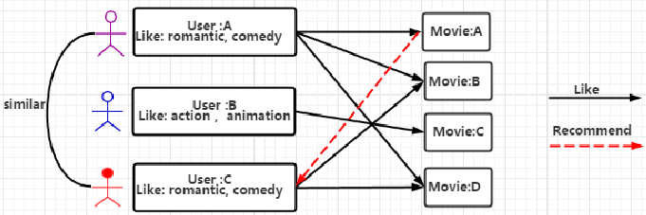
System Architecture/ Ideation Map
Collaborative Filtering: A Visual Representation:
11 November 2021
Department of CSE
8

Slide 9
This diagram illustrates the concept of user-based collaborative filtering in a movie recommendation system.
Users: Each user has a profile that includes their preferences (e.g., "romantic, comedy" for User A).
Movies: The system maintains a database of movies.
Similarity: The system calculates the similarity between users based on their shared preferences. In this example, User A and User C are considered similar due to their shared interest in "romantic" and "comedy" movies.
Recommendation: For a given user (e.g., User C), the system recommends movies that similar users have liked. Since User A (similar to User C) likes Movie B, the system might recommend Movie B to User C.
Key points:
The dashed lines represent recommendations.
The system assumes that users with similar preferences will also like similar movies.
The effectiveness of this approach depends on the quality of the similarity metric and the availability of sufficient data.

Slide 10
Implementation
1. Importing Libraries
The project uses Python libraries like pandas, Gradio, and others for data manipulation and building the user interface. Key imports are:
pandas:
Used for data manipulation and analysis.
Helps load and handle datasets such as movie information, user ratings, and movie poster URLs.
Gradio:
A Python library that creates an easy-to-use web-based interface for machine learning models or applications.
Used to build the user interface where users can input a movie name and receive recommendations as output

Slide 11
2. Data Loading
It loads three datasets into pandas dataframes:
Movie Data: Contains basic information about the movies (e.g., titles, genres, year of release).
Rating Data: Contains user ratings for movies, which is the key input for collaborative filtering.
Movie Poster Data: Contains URLs for movie posters to be displayed in the recommendation system.
Sample Data Structure:
Movie Data (movie.csv):
MovieID | Title | Genre
1 | Toy Story | Animation
2 | Jumanji | Adventure

Slide 12
Rating Data (rating.csv):
UserID | MovieId | Rating
1 | 1 | 4.5
2 | 2 | 3.0
Poster Data (moviePoster.csv):
MovieID | PosterURL
1 | http://example.com/toy_story.jpg
2 | http://example/Jumanji.jpg

Slide 13
3. Distribution of Ratings(Visualization):
The histogram visualizes the distribution of movie ratings provided by users.
Understanding this distribution helps identify how users rate movies and highlights trends in user preferences.
The KDE curve overlayed on the histogram provides a smooth estimation of the probability density function of the ratings.
The histogram can reveal how ratings are distributed among movies:
Peaks: Areas with a higher number of ratings (e.g., if many movies received a rating of 4 or 5, it indicates user preference).
Skewness: If the distribution is skewed to one side, it may suggest user bias towards higher or lower ratings.
Outliers: Unusual ratings (e.g., very low or very high) can be identified.

Slide 14
X-Axis: Represents the rating values, typically on a scale from 1 to 5 (or 1 to 10, depending on your dataset).
Y-Axis: Indicates the number of movies that received each specific rating.
Bins: The histogram divides the range of ratings into 10 equal intervals (bins) for better visualization of the data.
Code:
import matplotlib.pyplot as plt
import seaborn as sns
plt.figure(figsize=(10, 6))
sns.histplot(ratings['Rating'], bins=10, kde=True)
plt.title('Distribution of Ratings’)
plt.xlabel('Rating’)
plt.ylabel('No of movies’)
plt.show()

Slide 15
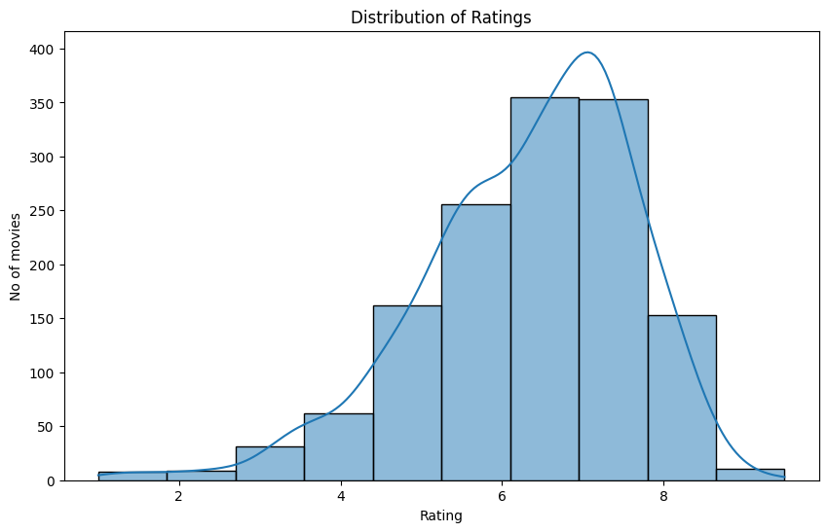

Slide 16
Creating a Sparse Matrix for Efficient Processing:
Sparse matrices are used to efficiently store data with a large number of zero or empty entries.
In recommendation systems, this is particularly useful because most users do not rate all available items (e.g., movies), resulting in many unfilled entries in a rating matrix.
Code:
from scipy.sparse import csr_matrix
# Convert the DataFrame into a sparse matrix
csr_data = csr_matrix(final_dataset.values)
# Reset the index of the final dataset for clarity
final_dataset.reset_index(inplace=True)
# Display the sparse matrix
print(csr_data)

Slide 17
Implementing K-Nearest Neighbors for Recommendations:
KNN is a popular algorithm used in recommendation systems for finding similar items or users.
It works by identifying the 'K' most similar items (or users) based on their ratings.
Code:
from sklearn.neighbors import NearestNeighbors
# Initialize the KNN model
knn = NearestNeighbors(metric='cosine', algorithm='brute', n_neighbors=20, n_jobs=-1)
# Fit the model to the sparse matrix
knn.fit(csr_data)

Slide 18
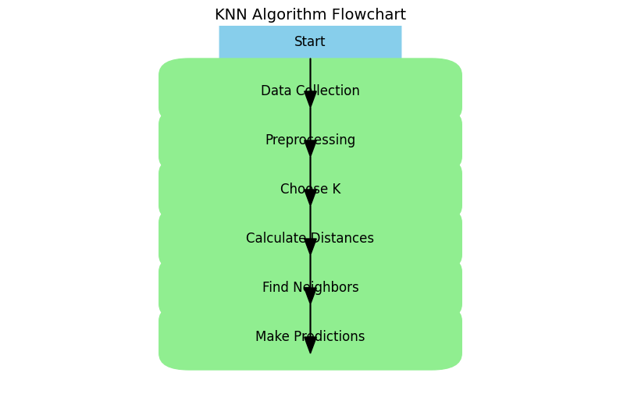
Breakdown of the Code:
Importing the Library:
from sklearn.neighbors import NearestNeighbors: Imports the KNN class from the Scikit-learn library.
Model Initialization:
metric='cosine': Uses cosine similarity as the distance metric.
algorithm='brute': Applies the brute-force approach to find neighbors.
n_neighbors=20: Sets the model to find the 20 nearest neighbors.
n_jobs=-1: Utilizes all available CPU cores for faster processing.
Fitting the Model:
knn.fit(csr_data): Fits the KNN model to the sparse matrix of movie ratings.

Slide 19
Movie Recommendation Function:
The get_recommendation(movie_name) function generates movie recommendations based on a given movie name.
It employs the K-Nearest Neighbors (KNN) algorithm to identify similar movies.
Function Steps
Input:
Accepts a movie name as input
Code:
def get_recommendation(movie_name):
2.Search for Movies:
Filters the movies DataFrame to find matches
Code:
movie_list = movies[movies['Movie'].str.contains(movie_name)]

Slide 20
3.Check Matches:
If matches exist, retrieve the first movie's ID.
Code:
if len(movie_list):
movie_idx = movie_list.iloc[0]['movieId’]
4.Find Nearest Neighbors:
Use KNN to find similar movies.
Code:
distance, indices = knn.kneighbors(csr_data[movie_idx], n_neighbors=11)
5.Sort Recommendations:
Sorts neighbors by distance, excluding the input movie.
Code:
rec_movies_indices = sorted(list(zip(indices.squeeze().tolist(), distance.squeeze().tolist())), key=lambda x: x[1])[:0:-1]
6.Compile Recommendations:
Collect recommended movies and their distances

Slide 21
Code:
recommended_movies = []
for val in rec_movies_indices:
movie_idx = final_dataset.iloc[val[0]]['movieId']
idx = movies[movies['movieId'] == movie_idx].index
recommended_movies.append({'Movie': movies.iloc[idx]['Movie'].values[0], 'Distance': val[1]})
7.Return Recommendations:
Outputs a DataFrame with recommended movies.
Code:
df = pd.DataFrame(recommended_movies, index=range(1, 11))
return df
8.Error Handling:
Returns an error message if no movie is found
Code:
else:
return "Movie not Found.."

Slide 22
Interactive Movie Recommendation System:
1. Introduction to Gradio:
Gradio is a Python library that creates user-friendly web interfaces for machine learning models.
It allows users to interact with your recommendation system by simply inputting a movie name.
2. Key Components of the Code:
Code:
import gradio as gr
Gradio Import: The Gradio library is imported to enable building the web interface.
Code:
def recommend_movies(movie_name):
df = get_recommendation(movie_name)
if isinstance(df, pd.DataFrame):
return df.to_string(index=False)
else:
return df

Slide 23
Recommendation Function: The function recommend_movies(movie_name) is used to get movie recommendations.
If the result is a DataFrame, it converts it into a string format for display.
If no match is found, it returns "Movie not Found."
3. Gradio Interface:
Code:
app = gr.Interface(
fn=recommend_movies,
inputs="text",
outputs="text",
title="Movie Recommendation System",
description="Enter a movie name to get a list of Recommended Movies"
)
Gradio Interface: The gr.Interface() function is used to create an interactive interface for the system.
Inputs: A text input box where users can enter the movie name.
Outputs: The system displays a list of recommended movies as text.

Slide 24
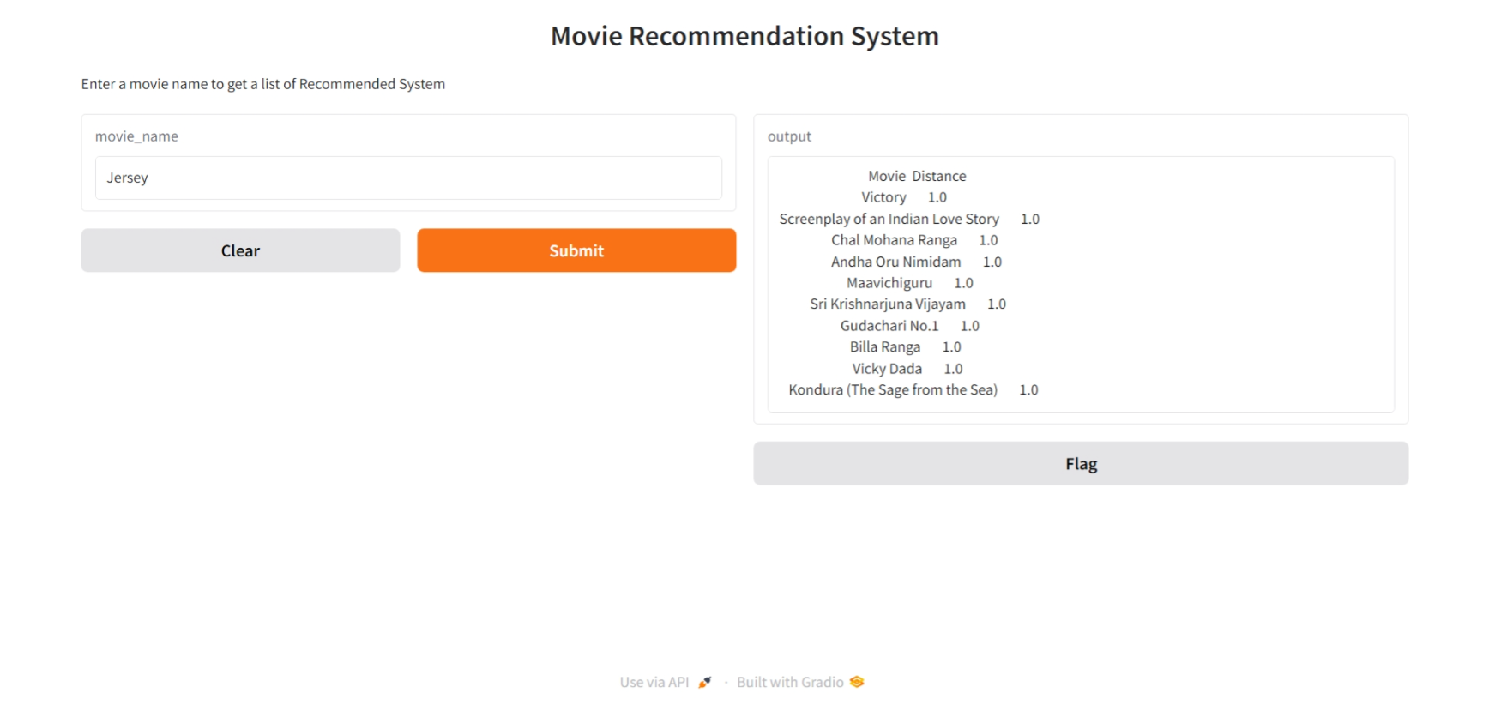
4. App Launch:
Code:
app.launch()
Launch Interface: This command launches the Gradio interface as a web app, allowing users to interact with the recommendation system directly from the browser.

Slide 25
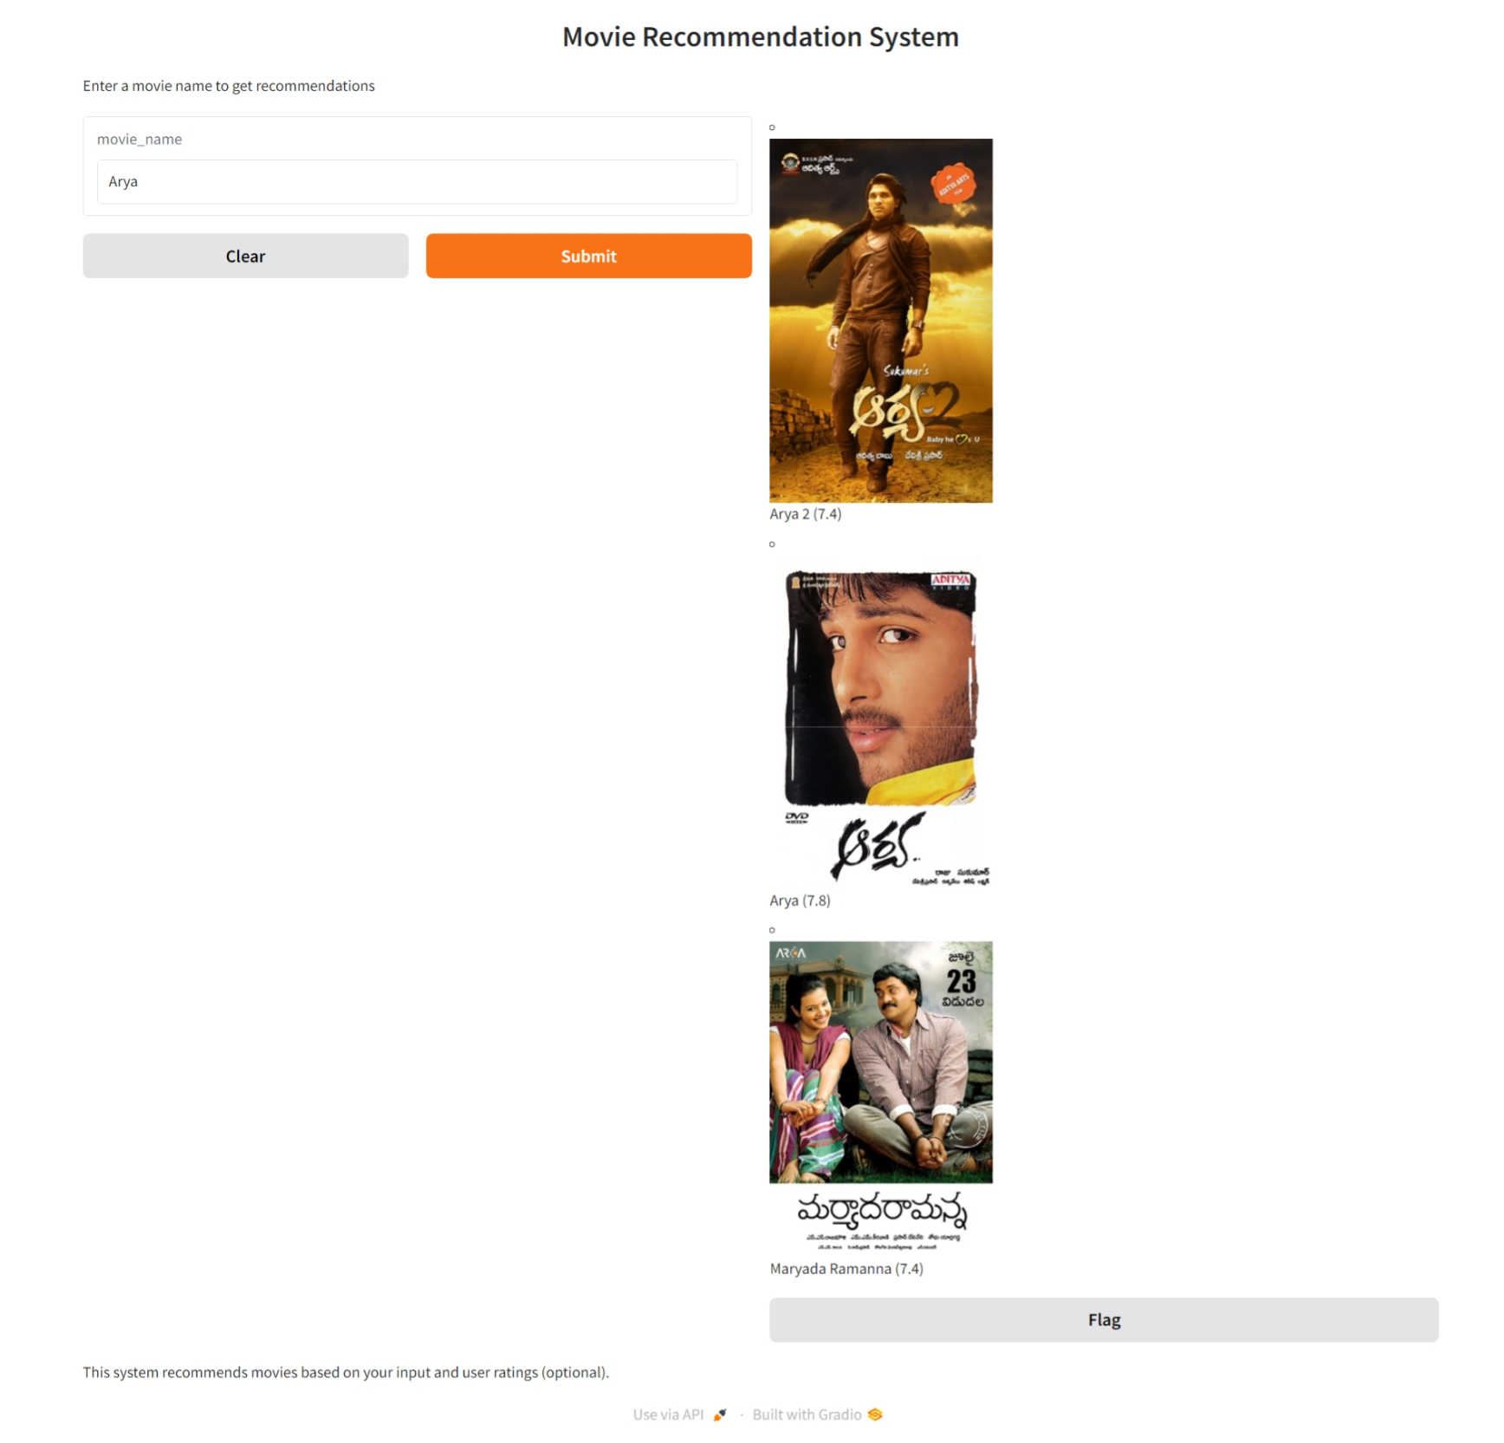

Slide 26
Limitations and Overcomes
1. Cold Start Problem
Limitation: Difficulty in recommending for new users and movies due to lack of data.
Overcome: Incorporate demographic data for new users and utilize content-based filtering based on movie metadata.
2. Scalability
Limitation: Computationally expensive with growing user and item data.
Overcome: Apply matrix factorization techniques and utilize distributed computing for efficient processing.
3. Overfitting
Limitation: Risk of overfitting to training data, affecting model performance on new data.
Overcome: Use regularization techniques to improve generalization.

Slide 27
Conclusion
Effective Recommendation System: Collaborative filtering successfully generated personalized movie recommendations by predicting user preferences based on their historical behavior.
Best Algorithm: Matrix Factorization outperformed other methods, offering the most accurate predictions, especially with large and sparse datasets.
Challenges: Data sparsity and the cold start problem limited the system's effectiveness for new users and movies.
Future Improvements: Explore hybrid models and incorporate additional data (e.g., user demographics or implicit feedback) to improve accuracy and tackle limitations.
Real-World Impact: These recommendation systems are crucial for enhancing user engagement on streaming platforms, enabling users to discover new content efficiently.

Slide 28
References
Books and Articles:
Berkhin, P. (2006). Survey of Clustering Data Mining Techniques. In: Clustering, 1-12.
Koren, Y., Bell, R., & Volinsky, C. (2009). Matrix Factorization Techniques for Recommender Systems. Computer Science Department, University of Minnesota.
Web Resources:
Netflix Prize: The competition to improve the Netflix recommendation algorithm. Available at: Netflix Prize
Goodfellow, I., Bengio, Y., & Courville, A. (2016). Deep Learning. MIT Press. Available at: Deep Learning Book
Software and Tools:
Surprise: A Python scikit for building and analyzing recommender systems. Available at: Surprise Library
TensorFlow: An open-source library for numerical computation and machine learning. Available at: TensorFlow
Tutorials and Online Courses:
Coursera: Machine Learning Specialization by Andrew Ng. Available at: Coursera ML
edX: Data Science MicroMasters Program. Available at: edX Data Science

Slide 29
THANK YOU

