Slide 1
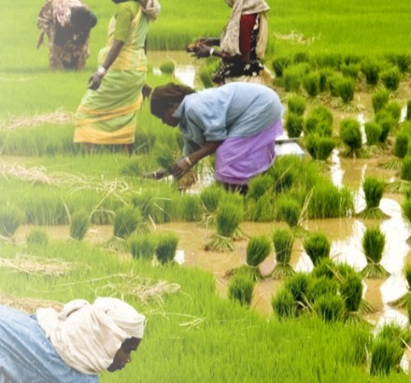

SOCIAL INTERNSHIP PRESENTATION
Website Revamp for Kairali Agriculture Multi State Co-operative Society Ltd.
Understanding the organisation, the task, the approach, and the website prototype built
Student: Poojitha K (251620140002)
Faculty Mentor: Prof. Abhijeet Tewary
Programme: MBA – Technology Management (2025–27)
Organisation: Kairali MSCS Ltd., Thrissur, Kerala
Photo: Wikimedia Commons (placeholder field image)

Slide 2
About Kairali
A farmer-owned cooperative, not an NGO: owned by its members and sharing its surplus with them
2022
55
45,000+
500+
Registered under the Ministry of Cooperation, GoI
Branches: 50 in Kerala, 5 in Tamil Nadu
Shareholders (as reported)
Employees (as reported)
What Kairali does
Agriculture & allied farming
Member services
Support for farming, dairy, poultry and fisheries
Savings and profit-share contribution schemes for members
Green initiatives
Products
Carbon Credit Project, Integrated Eco Farm, farm tourism, waste management
Kera Tech (coconut), Ecoharvest (home care), Bee Craft (honey), Green Pad (herbal sanitary napkins)
Kairali Website Revamp | TAPMI Social Internship 2026–27
2
Notes:
Mission: create opportunities in agriculture, solve farmers' problems and bring back the value of traditional farming. Milestones: 2023 first Annual Day; 2024 Green Pad and Carbon Credit Project launched, Gold Standard discussions in Geneva; 2025 Global Indian Switzerland Business Achievement Award; 2026 50th branch, MoU with NCUI, Jawaharlal Nehru Excellence Award.

Slide 3
My Task and the Requirements
Kairali has grown fast since 2022, but its website has not kept up
The task
What the audit of the live site found
Redesign and rebuild Kairali's website so that members, would-be members, buyers and partners can understand, trust and act on what Kairali offers.
14 / 52
products had a full description on the site
Requirements agreed with the NGO mentor
Conflicting facts: two vision statements; Chairman's name spelt five ways on one page
Poor upkeep: "© 2023" footer; Contact link to an unbranded Wix page; broken phone link
Confusing layout: one long About page; duplicated product menus;
Add to basket: "Add to basket" button for limited orders
Weak proof: one testimonial with a stock photo; few real farmer photos
A clearer site structure
Product ranges shown properly
Green projects explained
Membership information
A modern, professional look
Kairali Website Revamp | TAPMI Social Internship 2026–27
3

Slide 4
Approach
Design thinking: empathise, define, ideate, prototype, test
1
Audit
2
Define
3
Structure
4
Build
5
Hand over
Team audit of the live site; every point re-checked on
Problem tree and key gaps found
9-tab navigation agreed; each topic lives in one place only
Prototype in 5 versions, following the approved homepage design
Packaged site, guide and list of inputs needed from Kairali
Options considered
ROOT CAUSE
No one owns the content, and there is no single source for it.
Rejected
Patch WordPress, Wix builder, mobile app
Postponed
Full online shop (no payment, stock or delivery process yet)
The problem is organisational, not technical. A new design alone would still show missing and conflicting facts.
Limited
WhatsApp, used only for sending orders
Chosen
Simple website generated from one set of content files
Kairali Website Revamp | TAPMI Social Internship 2026–27
4

Slide 5
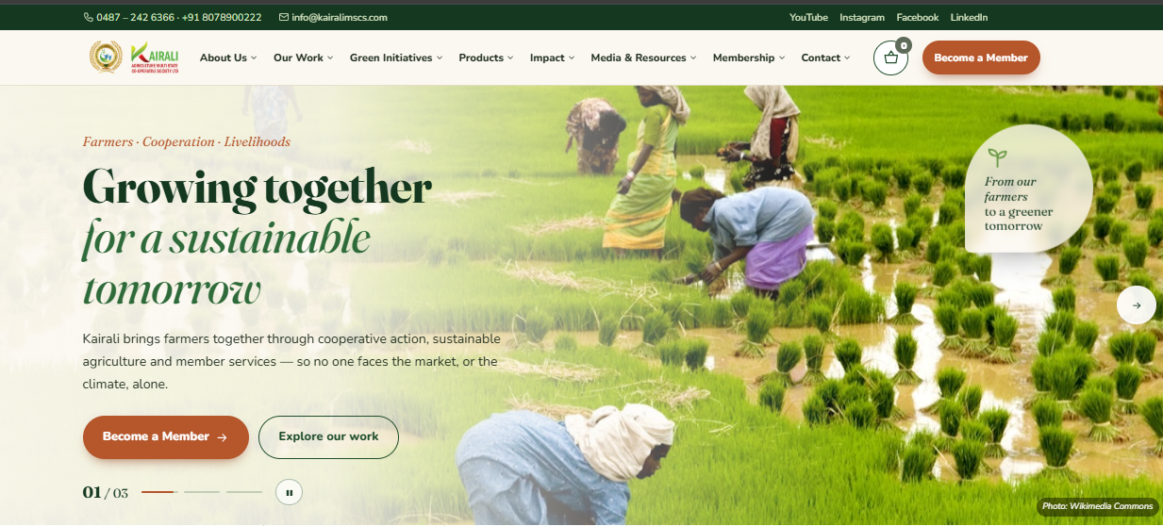
The Website Built
A 44-page prototype where every fact is stored once and appears the same everywhere
9 sections, 44 pages
Home, About, Our Work, Green Initiatives, Products, Impact, Media, Membership, Contact
52-product catalogue
Filters, search and a details window for every product
Order-enquiry basket
Sends orders by WhatsApp or email;
One place for resources
9 brochure downloads and a 55-branch directory
Prototype homepage, following the design direction Kairali approved
Clean records
34 news items in one date format, with filters
Tech stack: HTML5, CSS3 and plain JavaScript; a Node.js script builds all pages from four data files. No paid tools, no licence cost.
Built for access
Mobile-first, screen-reader and keyboard friendly
Kairali Website Revamp | TAPMI Social Internship 2026–27
5

Slide 6
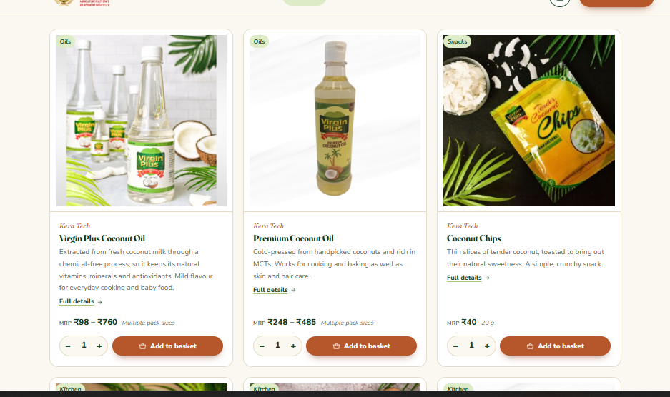
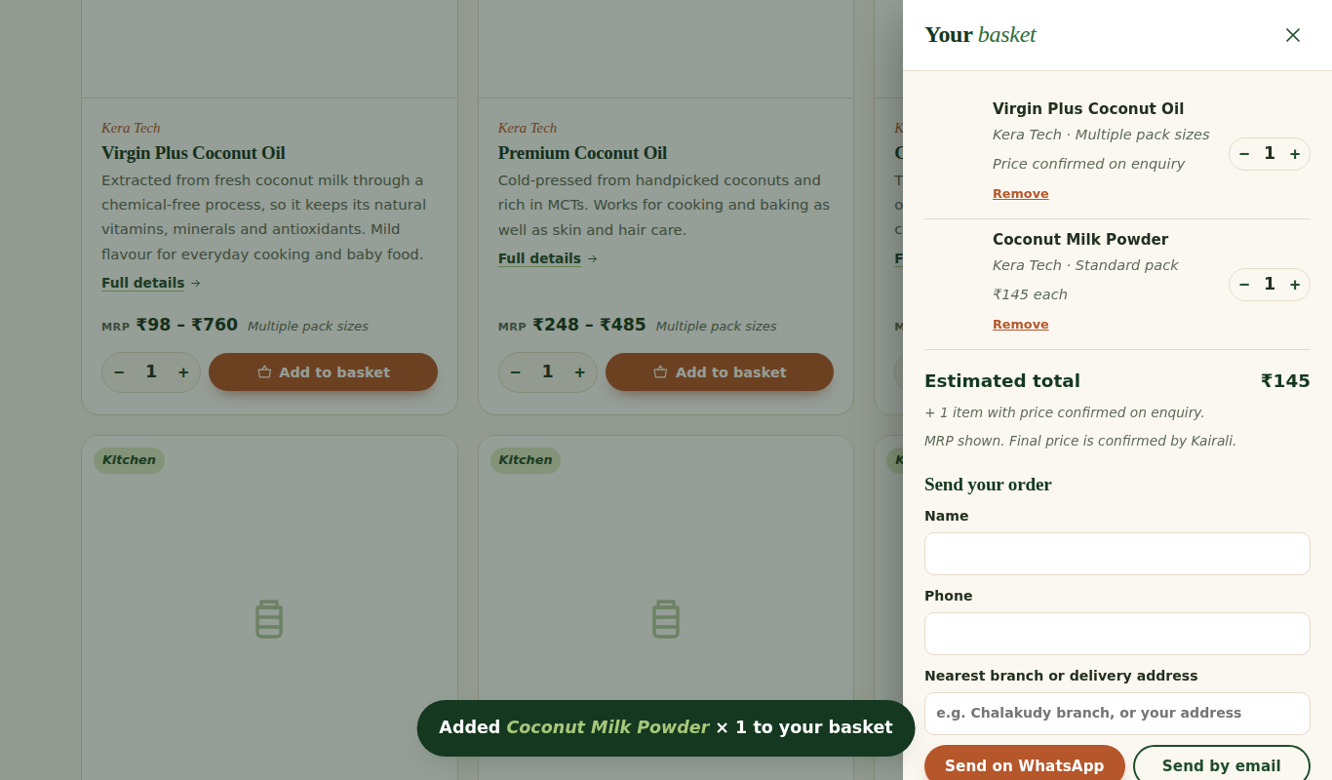
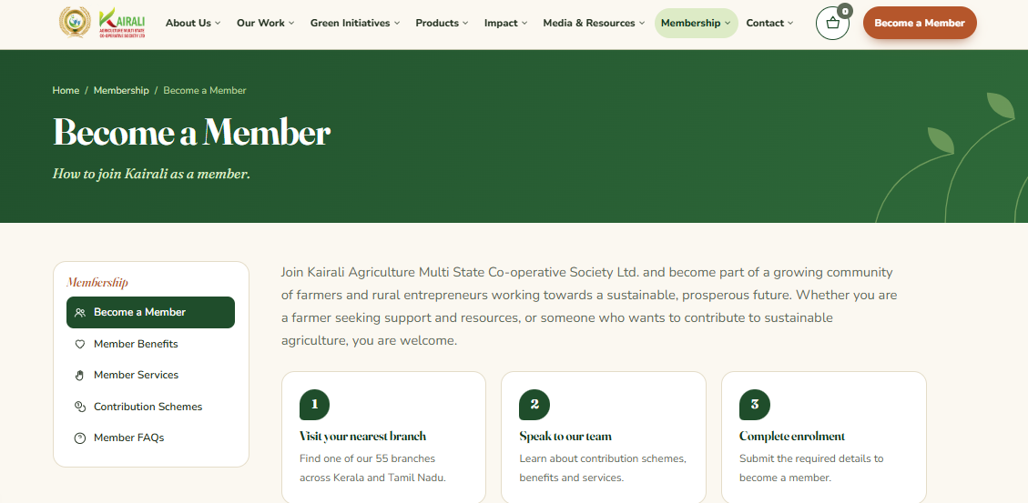
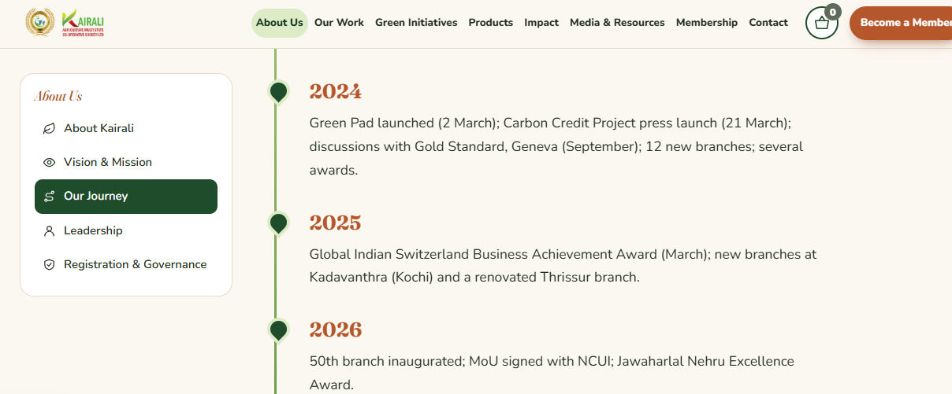
Key Pages of the Prototype
Screens captured from the working site (version 5)
Products: every card has a description, price or "price on request", and Add to basket
Order basket: estimated total, then "Send on WhatsApp" or "Send by email"
Become a Member: three clear steps, linked to the branch directory
Our Journey: one clean timeline instead of one long About page
Kairali Website Revamp | TAPMI Social Internship 2026–27
6

Slide 7
Data Needed and Future Enhancements
Status: prototype complete and tested, not yet live. Awaiting Kairali's response after hand-over.
Inputs needed from Kairali to go live
Future enhancements
Hosting: choice of web host and approval to launch
Owners: one person for website content
Products: approve 29 draft descriptions; prices for 40 products; resolve price ranges
Facts: Chairman's name spelling, branch count (50 or 55), NCUI MoU year, main YouTube channel
Photos: real field photos taken with consent; permission for NCUI event photos
Content: final vision wording, 3–5 member stories, missing brochures
1
Malayalam and Tamil versions
the most useful next step for farmer-members
2
Upcoming projects
Update future projects content
3
Online payment
once payment, stock and delivery processes exist
4
Member portal
scheme balances, with proper data protection
5
Verified impact page
measured results from the Carbon Credit Project
Kairali Website Revamp | TAPMI Social Internship 2026–27
7

