Slide 1


E-COMMERCE PROJECT · 2026
Poojitha K · Anushka Mahato · Sriparno Chowdhury · Akshaya Tantri
Postr.
Made for your space.
Live store · mypostr.store
01 / 25
Notes:
Open by naming the brand and the ask: this is a real store, not a mock-up. Fifty-two designs live, thirteen orders recorded, a working admin panel behind it. Introduce the four of us and say we will walk the marking scheme in order: technology, marketing, conversion, profitability, then planning and execution.

Slide 2

CONTENTS
What we'll cover
01
Technology & digital enablement
Storefront, Razorpay, admin analytics, memory vault, AI and chatbot
02
Digital marketing & acquisition
Channel strategy, content, SEO, campaigns and what we tested
03
Sales & customer conversion
The traffic-to-order journey and the tactics that closed it
04
Business performance
Revenue, cost, profit, margin and return on what we spent
05
Planning, challenges, adaptability
The two-week build, supplier risk and the ideas we dropped
06
Execution & reflection
Who owned what, and what the build actually taught us
Postr.
02 / 25
Notes:
Keep this short. Say the six blocks follow the marking scheme exactly, and that every claim from here on is backed by a screenshot from the live admin panel or Instagram Insights.

Slide 3

THE BRAND
A wall that sounds like you
Postr. prints the films, lyrics, athletes and photographs people already care about — on 250 GSM matte art paper, hand-checked, shipped in a rigid tube. Fifty-two ready-made designs, plus anything a customer sends us.
52
3
48h
∞
designs across five collections — cinema, Desi Dil, sport, grit and comfort watch.
sizes — A4 at ₹90, A3 at ₹120 and 13 × 19 at ₹150.
dispatch, in a rigid tube, tracked from order to fulfilment.
made to order — send a photo, a lyric or an inside joke, see a preview first.
Postr.
03 / 25
Notes:
The positioning line to say out loud: the things you love should not live only in your camera roll. Ready-made catalogue for volume and discovery, custom work for margin and emotional pull. Both sell — the order mix later proves it.

Slide 4
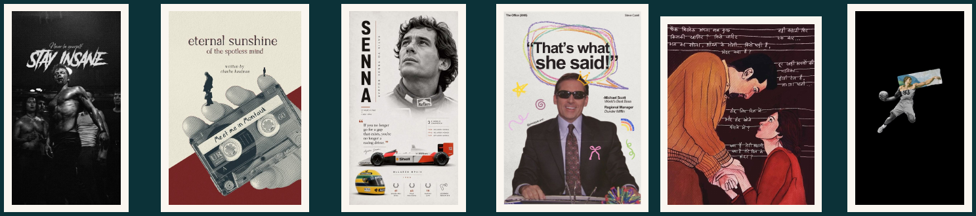

THE CATALOGUE · VOLUME ONE
Five collections, one wall
19
10
13
6
4
Cinema That Stays With You
Desi Dil
Legends Of The Game
Grit & Glory
Comfort Watch
Postr.
04 / 25
Notes:
Every design carries an SKU — PSTR-CIN-01, PSTR-DES-04 and so on. That code is not decoration: it is what lets a customer DM four characters and have an order created without a single clarifying message. Mention that the catalogue itself is a shareable PDF we send on WhatsApp.

Slide 5
THE MODEL
Direct to customer, three price points
Size | Dimensions | Price | Margin | Best for
A4 | 8.3 × 11.7 in | ₹90 | 44% | Desks and collage grids
A3 | 11.7 × 16.5 in | ₹120 | 37% | The everyday hero size
13 × 19 | 13 × 19 in | ₹150 | 33% | Above a bed or a sofa
Bundle nudge
Add-ons
Custom work
Any three posters take 15% off, applied automatically at checkout — no code to remember.
Polaroid sets, wooden tripod stands and gifting wraps sit on top of the print and lift the order value.
Photos, lyrics, festival and business posters, priced per job. Highest margin line we run.
Postr.
05 / 25
Notes:
These are the live store prices: A4 ₹90, A3 ₹120, 13 × 19 ₹150 — pitched at a student budget so a first poster is an impulse buy. The print-cost column is what we pay the vendor per sheet; the gap between price and print cost is the margin the dashboard reports. The difference between single-sheet and bulk-run cost is the supplier problem we come back to on the challenges slide.

Slide 6
01 · TECHNOLOGY INTEGRATION & DIGITAL ENABLEMENT
Eight components, one order
STOREFRONT
PAYMENTS
BACKEND API
RECORDS
Shopify
Razorpay
Node.js
Database
mypostr.store — browse, customise, cart and checkout.
UPI, cards, wallets; a webhook confirms each payment.
Order id, invoice PDF, QR id and email, per order.
Orders, customers, QR mapping, usage and invoices.
LIVE
LIVE
LIVE
LIVE
ADMIN PANEL
MEMORY STORAGE
PERSONALISATION
SUPPORT
React / Next.js
Cloudflare R2
AI picks
Chatbot
Orders, status, costs, uploads and storage quota.
One folder per QR id — photos, videos, invoice.
Poster suggestions from browsing and past orders.
Order status, size help and fast catalogue search.
LIVE
LIVE
NOT LIVE
NOT LIVE
Postr.
06 / 25
Notes:
Be straight about the dashed boxes: six components are live and running orders today — Shopify, Razorpay, the Node.js backend, the database, the React/Next.js admin panel and Cloudflare R2 — while two are specified and scoped but not shipped. Claiming an AI engine we have not built would be the easiest thing to get caught on. What we can defend is that both have a defined trigger, a data source and a place in the stack.

Slide 7
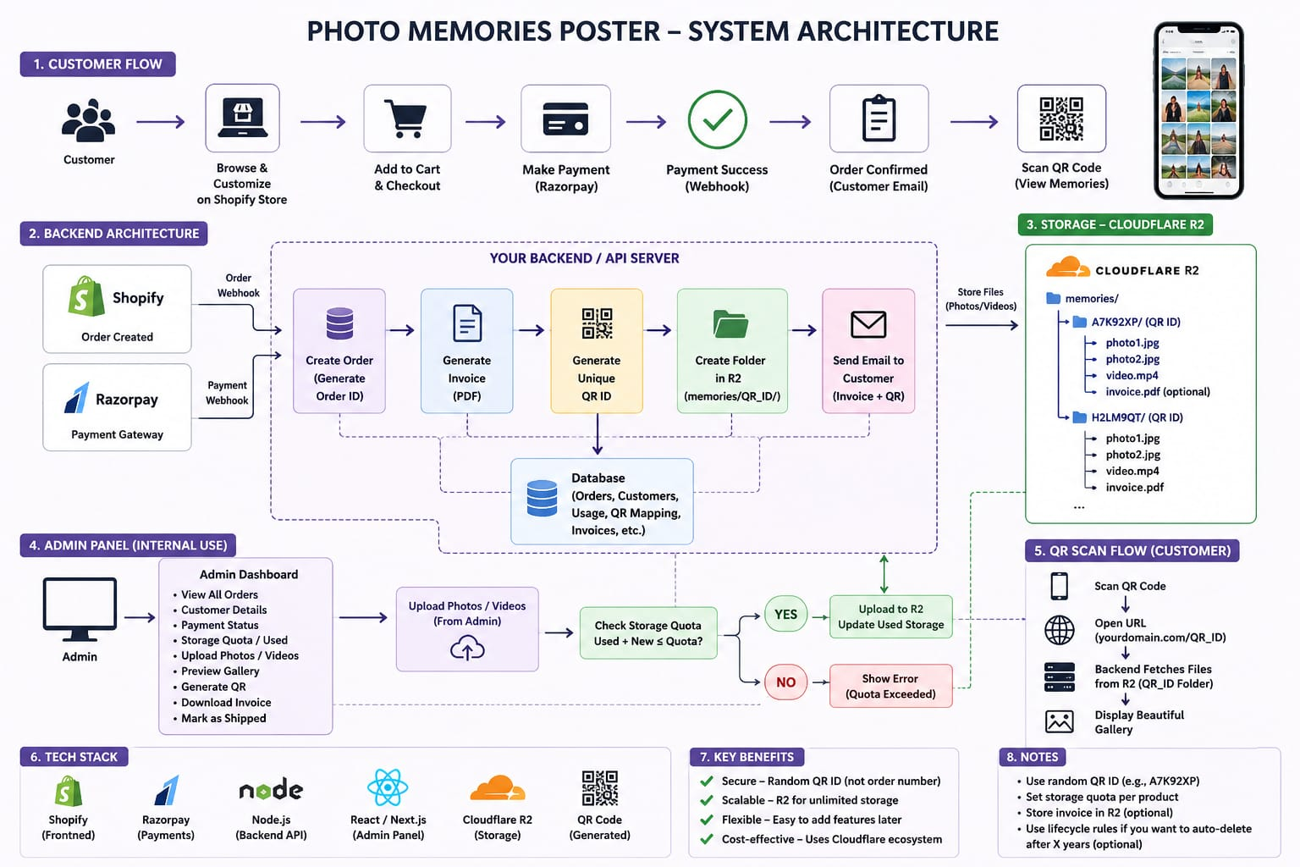
01 · TECHNOLOGY INTEGRATION · ARCHITECTURE
System architecture, end to end
1
Customer customises and checks out on the Shopify store
2
Pays through Razorpay; the payment webhook confirms success
3
Node.js backend creates the order id and an invoice PDF
4
Generates a random QR id and an R2 folder, memories/QR_ID/
5
Emails the customer the invoice and the QR code
6
Scanning the QR loads that folder as a gallery
Postr.
07 / 25
Notes:
Walk the diagram top to bottom: customer flow, backend, storage, admin, QR scan. Step two is the one to dwell on — nothing happens until Razorpay's webhook tells our backend the payment succeeded, so the revenue on the dashboard is only verified money. Why Razorpay: UPI is how students pay, and no card number, CVV or UPI PIN ever touches our server. Why a random QR id like A7K92XP rather than the order number: nobody can guess their way into someone else's memories. Why Cloudflare R2: cheap, scalable storage with no bandwidth fees on gallery views.

Slide 8
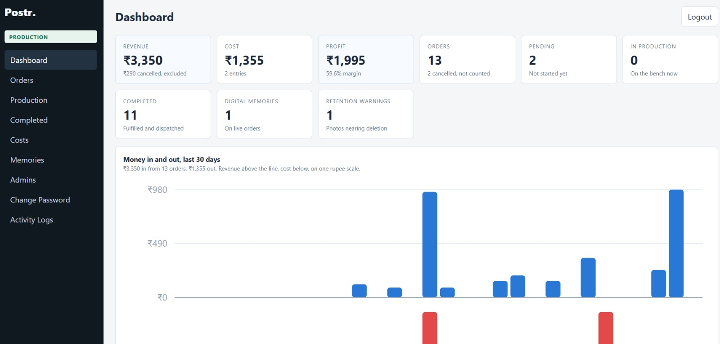
01 · TECHNOLOGY INTEGRATION · ANALYTICS
The admin panel is our analytics layer
What it reads live
Revenue ₹3,350, with ₹290 of cancellations excluded rather than hidden
Cost ₹1,355 booked against the same window
Profit ₹1,995 at a 59.6% margin, computed, not typed
13 orders · 11 completed · 2 pending · 2 cancelled
1 digital memory live · 1 retention warning raised
Postr.
08 / 25
Notes:
The sidebar is the argument: Dashboard, Orders, Production, Completed, Costs, Memories, Admins, Change Password, Activity Logs. Costs sit beside revenue on the same screen, which is why we can quote a margin without opening a spreadsheet. Offer to open the live panel if the room asks.

Slide 9
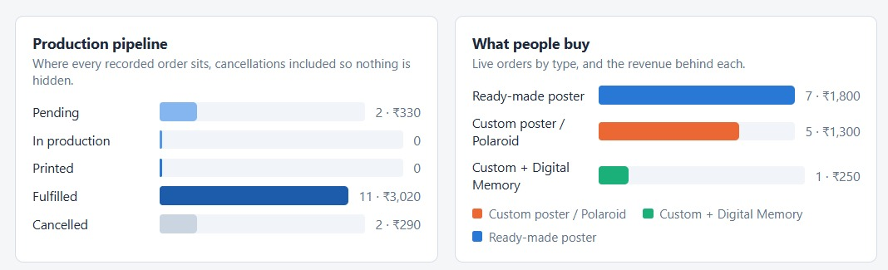
01 · TECHNOLOGY INTEGRATION · ORDER STATUS
Every order has a state
Pending → In production → Printed → Fulfilled, with cancellations recorded rather than deleted. Eleven of thirteen orders are fulfilled and ₹3,020 has been dispatched; the ₹290 cancelled sits in the ledger and out of the revenue figure.
Postr.
09 / 25
Notes:
Two points. First, nothing is deleted — a cancelled order stays visible with its value, because a dashboard that quietly drops bad news is useless for managing the business. Second, zero orders sitting in production or printed at the time of the screenshot is the 48-hour promise working, not an empty queue.

Slide 10
01 · TECHNOLOGY INTEGRATION · DATA
The digital vault, and keeping it shut
How a memory gets on a wall
What protects it
Each order gets a random QR id, such as A7K92XP
Photos and videos go to Cloudflare R2 under memories/QR_ID/
Admin upload checks the quota: used plus new must fit the plan
Scanning the QR opens the gallery, fetched from that folder only
One live vault today, tracked on the dashboard as a Digital Memory
Random QR id, never the order number — vaults cannot be guessed
Admin area behind login, with a separate Change Password screen
Activity Logs record every admin action against an order
Storage quota per product stops uploads that would exceed it
Retention warnings fire before anything expires — one open today
Postr.
10 / 25
Notes:
This is the differentiator no marketplace copies easily, and also the biggest risk we carry. Somebody's engagement photos sitting in our storage is a security problem before it is a feature. The retention warning on the dashboard exists so a vault never dies silently on a customer.

Slide 11
01 · TECHNOLOGY INTEGRATION · NEXT BUILD
Two systems we have specified, not shipped
AI poster recommendations
Support chatbot
Fifty-two designs is already too many to scroll on a phone. The model we have scoped ranks the catalogue per visitor instead of showing it alphabetically.
Most incoming messages are three questions: where is my order, which size fits my wall, and do you have this film. All three are answerable from data we already hold.
SIGNALS IT USES
WHAT IT ANSWERS
Collection viewed, SKUs added to cart, size chosen, and the mood of past orders — a Desi Dil buyer is shown lyric prints, not Formula One.
Order status straight from the pipeline, size guidance from wall dimensions, and SKU search across all fifty-two designs.
WHY IT MATTERS HERE
WHERE IT HANDS OVER
Our bundle discount needs three items in a cart. Recommendations are how the second and third get there.
Anything custom goes to a human on WhatsApp, because a brief with a photo still needs judgement.
Postr.
11 / 25
Notes:
If asked why these are not built: order volume does not justify them yet. A recommender trained on thirteen orders recommends noise. We would rather show a specification we can defend than a demo that would mislead.

Slide 12
02 · DIGITAL MARKETING & CUSTOMER ACQUISITION
One channel, worked hard
Channel strategy
Content pillars
Instagram @postr.4 is the front door; the bio link is the only route to the store, so every tap is measurable. WhatsApp handles custom briefs, where a photo and a conversation are needed. No paid spend — the ₹800 software budget went to hosting, not ads.
Four repeating formats: room styling shots that show scale, poster reveals against a wall, film and lyric nostalgia that earns shares, and behind-the-print clips from the vendor. Stories carry reach, posts carry the link.
SEO & discoverability
Campaigns & targeting
Captions and hashtags written around what people actually search — #WallPosters, #AestheticRoom, film and artist names. Design titles double as search terms, and every SKU page carries its own title and description on the store.
Campus-first: hostel rooms, gifting in threes, group trips. Festival drops timed to the calendar, including a Chaturthi 2026 poster. The bio link is UTM-tagged — utm_source=ig, utm_medium=social, utm_content=link_in_bio — so store traffic is attributable.
Postr.
12 / 25
Notes:
Defend the single-channel choice: with a two-week window and no ad budget, going deep on the platform where the audience already sits beat spreading thin across four. The UTM tag is worth pointing at — it is the difference between hoping Instagram drove traffic and knowing it.

Slide 13
02 · DIGITAL MARKETING · 30-DAY SNAPSHOT, 21 AUG – 19 SEP 2026
Reach is running ahead of the follower count
1,796
314
34
53
27
Total views
Profile visits
Bio link taps
Interactions
New followers
65.5% of all views came from people who do not follow us — discovery is doing more work than the audience we have built.
314 profile visits produced 27 follows. The profile page, not the feed, is the weakest step in the journey.
34 bio link taps are the real pool of intent. Every conversion on the next slides is drawn from them.
Postr.
13 / 25
Notes:
Instagram will not release gender or age breakdowns at 27 followers — Meta needs a larger base before it publishes demographics. Say that plainly if asked; it is a platform limit, not a gap in our reporting.

Slide 14
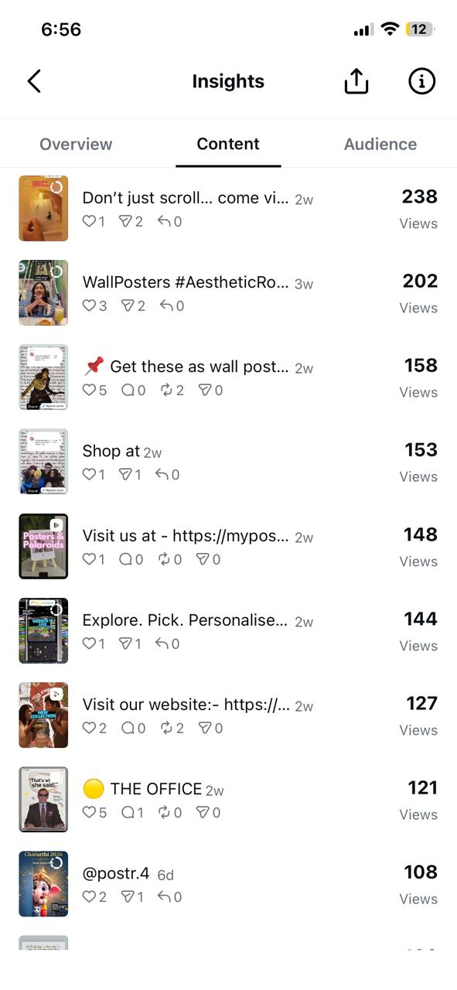
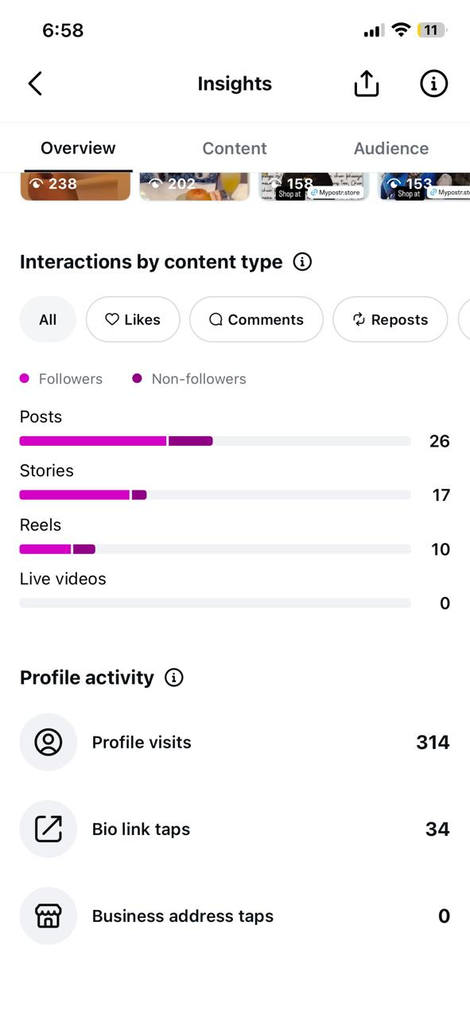
02 · DIGITAL MARKETING · CONTENT PERFORMANCE
Stories carry reach, posts carry intent
900
475
413
Story views
Post views
Reel views
Stories took half of all reach, but posts produced 26 of the 53 interactions from barely a quarter of the views. Reels drew 413 views and only 10 interactions.
Top piece: "Don't just scroll… come visit" at 238 views, about 18% ahead of the next best. A direct invitation beat every product-first caption we ran.
Every post near the top of the list carries the store link or a Shop-at tag. Reach without a route to the store does not convert.
Postr.
14 / 25
Notes:
The managerial read: stories are cheap to make and buy attention, posts are where you spend effort because they convert attention into a tap. That split is what the next term's content calendar should be built on — more stories for frequency, fewer but better posts carrying the link.

Slide 15
02 · DIGITAL MARKETING · EXPERIMENTATION
What we tested, and what it told us
Test | What we changed | What came back
Format mix | Stories against posts against reels | Stories took 900 views, half of all reach; posts took 26 of 53 interactions
Caption hook | A direct invitation against a product-first line | "Don't just scroll… come visit" led at 238 views
Link placement | Bio link, in-caption URL and a Shop-at tag | 34 bio taps; link-bearing posts filled the top of the list
Follow-up email | Re-contacting leads who had already engaged | 3 more paying customers from an audience we already had
Festival timing | A Chaturthi 2026 drop against evergreen designs | 108 views in the six days after posting
The pattern across all five: reach was never the constraint. The constraint was giving a viewer somewhere to go in the same breath.
Postr.
15 / 25
Notes:
Be honest about sample size: these are directional reads on a 30-day window, not statistically clean A/B tests. What makes them useful is that each one changed what we did next — the follow-up email in particular was a reaction to seeing 34 taps produce only 5 orders.

Slide 16
03 · SALES & CUSTOMER CONVERSION
From a scroll to an order
1,796
314
34
5
8
Views
Profile visits
Bio link taps
Customers from taps
Total customers
Top of funnel
17.5% of views
10.8% of visits
14.7% of taps
+3 from follow-up email
Thirteen orders were recorded in the admin panel over the same window. Instagram engagement and the follow-up email are the traceable sources behind eight of the customers; end to end, a view converted at roughly 0.28%.
Postr.
16 / 25
Notes:
The 14.7% tap-to-customer rate is the number to lead with — it is far above a typical e-commerce benchmark, because a bio-link tap is already a qualified visitor. The weak step is 314 visits to 34 taps. Fixing the profile and landing page is where the next order comes from, not more reach.

Slide 17
03 · SALES & CUSTOMER CONVERSION
What turned intent into an order
One tap to the store
SKU shorthand
Bundle nudge
The UTM-tagged bio link lands on the catalogue, not a homepage. No menu to hunt through.
Every design carries a code. A DM saying PSTR-CIN-01, A3 becomes an order in one message.
Three posters take 15% off automatically. It lifts basket size without a coupon to explain.
Payment in two taps
Preview before print
Follow-up that closes
UPI through Razorpay. Nobody types a card number on a phone at eleven at night.
Custom orders see a mock-up first. It removes the fear of paying for something unseen.
An outreach email to warm leads recovered 3 customers who had engaged but not bought.
Postr.
17 / 25
Notes:
Pick two to narrate rather than reading all six. SKU shorthand and the follow-up email are the ones with evidence attached: the codes come straight from the catalogue, and the email is three of our eight customers.

Slide 18
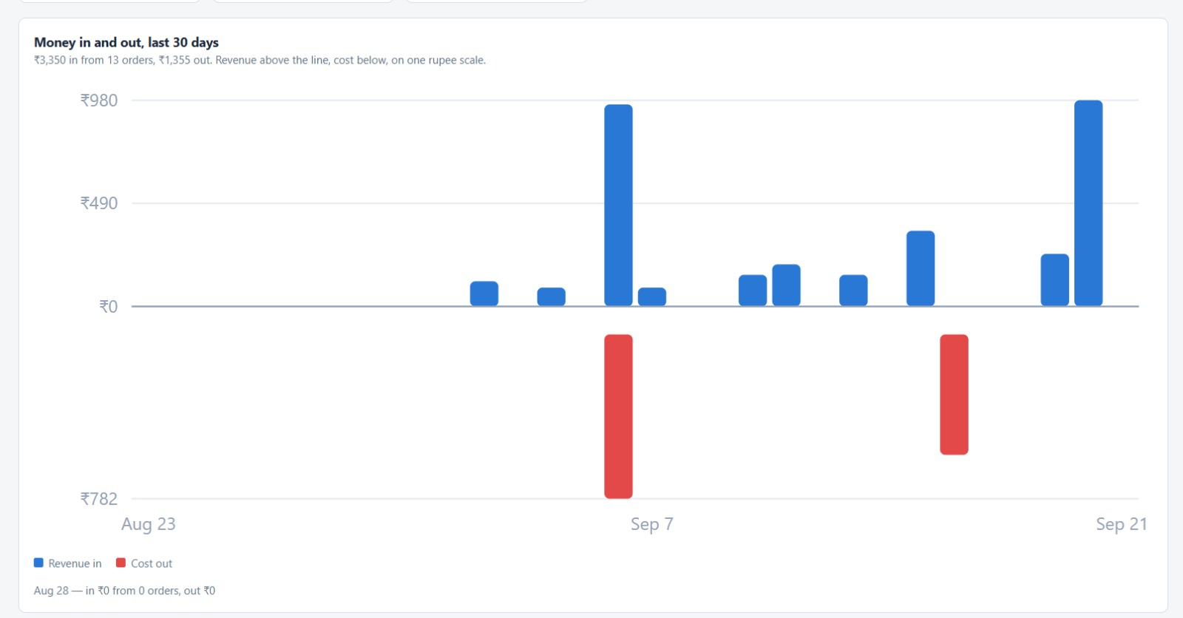
04 · BUSINESS PERFORMANCE & PROFITABILITY
₹3,350 in, ₹1,355 out
REVENUE
₹3,350
COST
₹1,355
PROFIT
₹1,995
MARGIN · 13 ORDERS
59.6%
Postr.
18 / 25
Notes:
Point at the two red bars. Cost is lumpy because printing is batched — we pay the vendor in runs, not per order. That is the whole reason bulk pricing matters, and it is why a thin run of orders is more expensive per poster than a fat one.

Slide 19
04 · BUSINESS PERFORMANCE · UNIT ECONOMICS
Where the ₹3,350 came from
Order type | Orders | Revenue | Share
Ready-made poster | 7 | ₹1,800 | 54%
Custom poster / Polaroid | 5 | ₹1,300 | 39%
Custom + Digital Memory | 1 | ₹250 | 7%
Total counted | 13 | ₹3,350 | 100%
₹258
₹104
₹153
147%
Average order value
Cost per order
Profit per order
Return on ₹1,355 spent
Postr.
19 / 25
Notes:
Two readings. Ready-made is the volume engine at 54% of revenue, but custom work is 46% from six orders — higher value per order and the line we should grow. Against the ₹4,000 we put in, ₹1,000 each, the ₹1,995 profit has returned about half the seed capital inside the first cycle.

Slide 20
05 · CHALLENGES
The two problems that nearly stopped us
Supplier selection
Standard print quality
THE PROBLEM
THE PROBLEM
Bulk pricing only pays at a volume we did not have. A single print costs [₹__]; the same print in a bulk run costs [₹__]. At thirteen orders we were buying at the wrong end of that curve.
Colour and paper weight drifted between runs. A poster is judged in the first two seconds on a wall — a dull black or a thin sheet undoes the whole brand promise.
WHAT WE DID
WHAT WE DID
Fixed the spec at 250 GSM matte art paper, physically checked every print against a reference before packing, and sent rejects back to be rerun at the vendor's cost rather than shipping them.
Quoted three local vendors against the same spec, negotiated per-piece rates on committed monthly volume, and batched orders into runs instead of printing one at a time. Printing stays on demand, so there is no unsold stock.
Postr.
20 / 25
Notes:
Sriparno ran both of these. The negotiating position was weak — a student brand with no history asking for bulk rates — so what worked was committing to volume over a term rather than haggling on a single job. The physical check is unglamorous and it is the reason we have had no replacement claims.

Slide 21
05 · PLANNING
Two weeks, four gates
DAYS 1–2
DAYS 3–5
DAYS 6–9
DAYS 10–14
Operational frame
Tech blueprint
Stack finalised
Website build
Product scope, price points, vendor shortlist and who owns which lane. Nothing technical until this was settled.
Order lifecycle drawn on paper: states, cost entries, what the admin panel must show. Three days of design, no code.
Storefront, Razorpay account and keys, vault storage and admin authentication chosen and tested end to end.
Catalogue, checkout, admin panel and test orders pushed through the full pipeline before the store opened.
The sequence was the point. Because the order lifecycle was drawn before anything was built, the admin panel matched how the business actually runs on day one — states, cancellations and costs included rather than bolted on later.
Postr.
21 / 25
Notes:
If asked what we would change: the vendor shortlist should have been a gate, not a task inside the first two days. Every operational surprise we hit later traced back to picking suppliers in parallel with building rather than before it.

Slide 22

05 · ADAPTABILITY · LEARNING FROM FAILURE
The convertible box did not survive contact with a supplier.
Our pitch promised packaging that folded out into a desk stand, a pen holder or a vase. No local vendor would run custom die-cut boxes at our order size, and the quotes that did come back cost more than the poster inside them.
DROPPED
ADOPTED
LEARNED
The eco groove-box
Small wooden tripods
Design to the supply chain
No vendor at our volume, and a unit cost above the product it was protecting.
Off the shelf, cheaper per unit, and they keep the moment that mattered — it stands on your desk.
Build packaging around what a supplier already makes, not around what looked good in the deck.
Postr.
22 / 25
Notes:
This is the honest slide and worth slowing down on. We did not abandon the idea because it was bad; we abandoned it because it was unbuyable at our scale. Separating the promise — something that stands on a desk — from the mechanism let us keep the first and replace the second in a day.

Slide 23
06 · EXECUTION
Four people, four lanes
Sriparno Chowdhury
Poojitha K
Akshaya Tantri
Anushka Mahato
WEBSITE
TECH STACK & PAYMENTS
MARKETING & LEADS
OPERATIONS & SOURCING
Storefront build
Catalogue and SKU pages
Cart and checkout flow
Admin panel screens
Instagram and content
Campaigns and targeting
Lead generation
Follow-up outreach
Stack decisions
Razorpay integration
Payment verification
Admin auth and vault
Order sorting and dispatch
Vendor selection and talks
Printing cost negotiation
Print quality checks
Postr.
23 / 25
Notes:
Say why lanes rather than shared tasks: with a fourteen-day window, handoffs were the expensive part. Each lane owned a decision end to end and reported into a daily check-in. The one place lanes crossed deliberately was the order lifecycle, which operations, website and payments all had to agree on before day six.

Slide 24
06 · LEARNING & MANAGERIAL REFLECTION
What the build actually taught us
Payment integration
Dashboard creation
Opening a gateway account is the easy half. The work is refusing to create an order until the payment is verified on our own server — that single rule is why the revenue number on the dashboard can be trusted in front of a room.
Building the admin panel forced us to define the business. An order needs states. Cancellations get recorded, not deleted. Cost sits beside revenue on one screen, or nobody checks it. The dashboard is the operating model made visible.
Protecting the digital vault
The managerial takeaway
Somebody else's photographs are a responsibility before they are a feature. Order-scoped access, an admin area behind login, activity logs and a retention warning before deletion are the minimum, not the polish.
Fix the supplier before the storefront. Every constraint we discovered late — bulk pricing, print drift, packaging — cost more to unwind than any feature we built early. Operations sets the ceiling that technology and marketing work under.
Postr.
24 / 25
Notes:
Land the last card hardest — it is the answer to "what would you do differently". Also worth naming the next three moves: fix the 314-to-34 profile step, grow custom orders because they carry the higher value, and get print volume to a point where bulk rates apply.

Slide 25
Postr.
Fifty-two designs. One wall that finally sounds like you.
STORE
mypostr.store
INSTAGRAM
@postr.4
PROJECT TEAM
Poojitha K
Anushka Mahato
Sriparno Chowdhury
Akshaya Tantri
EMAIL
hello@postr.store
Thank you.
Postr.
25 / 25
Notes:
Close by offering to open the live store and the admin panel on a phone. The strongest thing we have is that none of this is a mock-up: thirteen real orders, eleven fulfilled, ₹1,995 of real profit. Invite questions on supplier economics and on the vault security model — those are the two we can go deepest on.

