Slide 1
ADDING TRAVIS CI TO YOUR PROJECT
Presented by
Rohit NANI
Papu shah
Sachin Shetty
Poojitha singam
Yaswanth yarram

Slide 2
What is Travis CI ?
A hosted continuous integration service. It is integrated with GitHub or others. And Can run unit-test in isolation and complain if test fail but Travis can run almost arbitrary code.
An Open Source
Distributed
Build System

Slide 3
What can Travis do?
Check code quality
First class support for 21 languages.
Pre-installed build & test tools.
Deploy to cloud services
Provide feedback
Parallel builds with different environments.

Slide 4
HOW TRAVIS CI WORKS ?
we fork a project into our GitHub account.
GitHub has many internal configuration settings which also includes hook to Travis-CI.

Slide 5
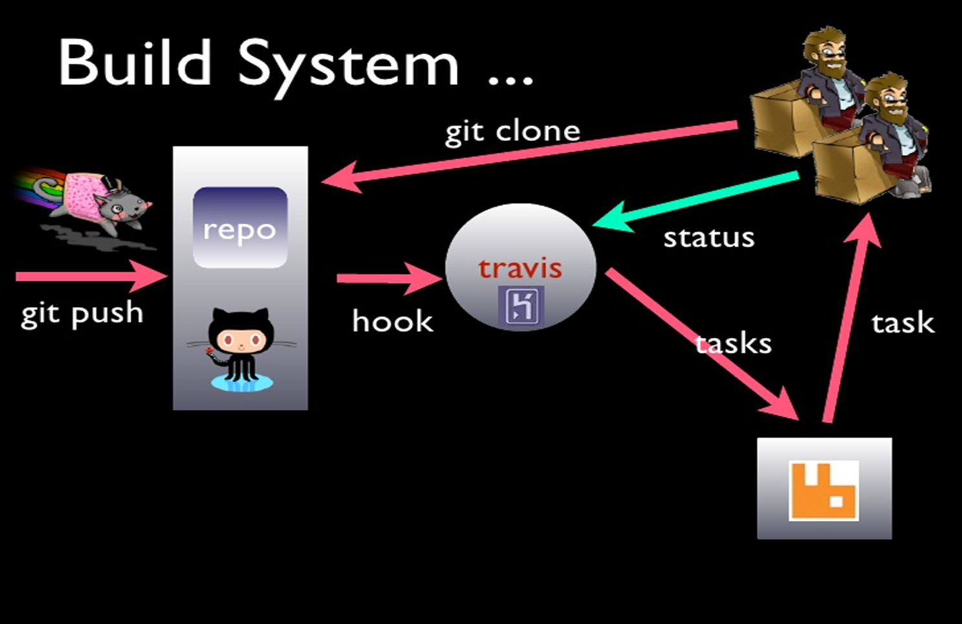

Slide 6
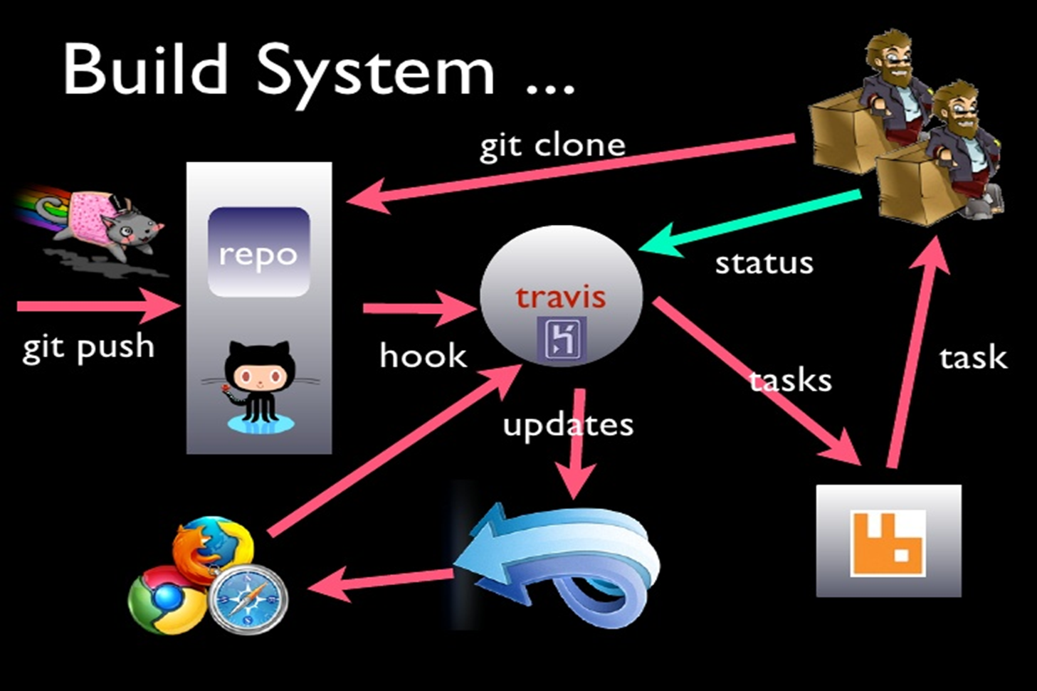

Slide 7
PROS
Easy to configure.
Lightweight and easy to set up.
Free for open source projects.
No dedicated server needed.
Great integration with GitHub and cloud services.
Fast (Usually)
It is very popular.

Slide 8
CONS
Easy to configure
No manual builds
Not suitable for high-security projects
Enterprise plans come with a cost
Limited options for customization

Slide 9
ANY QUERIES ?

Slide 10
THANK YOU

