Slide 1
Final Presentation

Slide 2
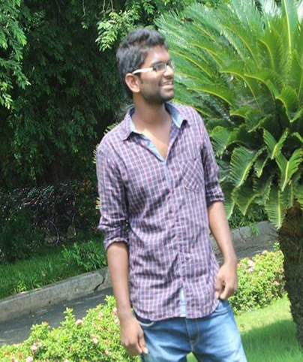

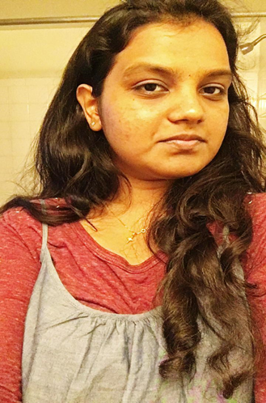
Team Members
Harshith Gudapati
Mouni Krishna
Poojitha Singam

Slide 3
Lessons Learned
What were the lessons that you learned on this project and why?
By completing all this milestones in this project we as a team learned how to use issues using Jira and learned how to Create a project Management plan using MS Project.
What was the most difficult component of this project and why?
We had difficulty while creating the cost estimate because we were not sure what to include in the Sheet but at the end we were able to completed it.

Slide 4
Lessons Learned(cont..)
What techniques did your team use to jell your team and why?
We tried to communicate on daily basis and met in our Apartments during our submissions which I guess bought our team together.
What was the most interesting component of this project and why?
Working on Gantt Chart and Jira where the most interesting Parts of our projects because this Is our first time using this components.

Slide 5
Lessons Learned(cont..)
What did you like or dislike about this project?
As a team we loved this project because now we know how to estimate cost and maintain registers for issues, risks which would be always beneficial for our carrier in IT.

Slide 6
Thank You

