Slide 1
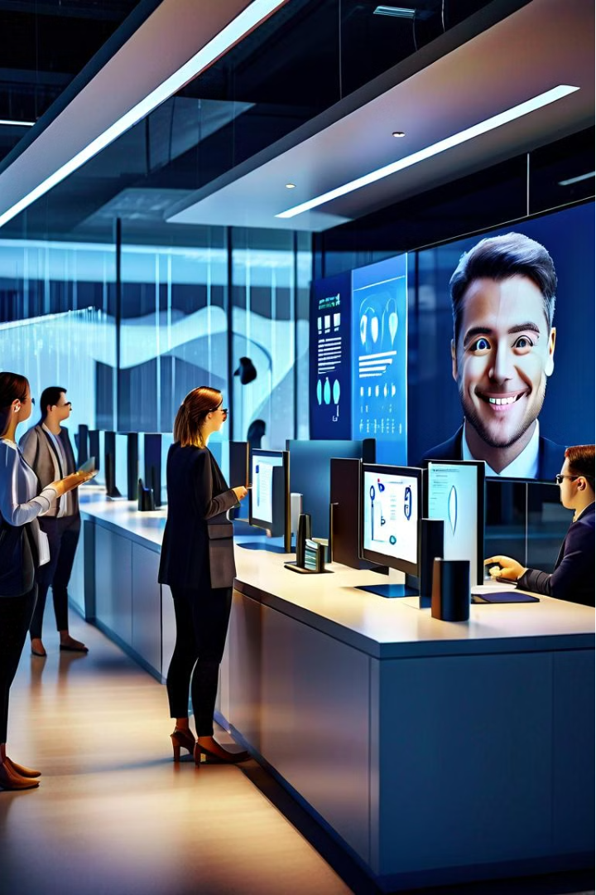

VKR VNB AGK COLLEGE OF ENGINEERING
Attendance Capture System Using Facial Recognition
Under the Esteemed Guidance of
G Venkata Ratnam M.Tech.,Ph.D.
Presented By:
E Poojitha (20NH1A0521)
K Sanjeev (20NH1A0549)
K SashankRoy (20NH1A0546)
L NagaRaju (20NH1A0556)

Slide 2
Overview of the Flask Framework
Lightweight and Flexible
Rapid Prototyping
Powerful Ecosystem
Flask is a minimalist Python web framework that's easy to learn and offers a great deal of flexibility in building web applications.
Flask's simplicity and lack of boilerplate code makes it an excellent choice for quickly building and iterating on web projects.
The Flask ecosystem provides a wide range of extensions and libraries to enhance functionality, from authentication to database integration.

Slide 3
Setting up the Development Environment
1
Install Python
2
Set up a Virtual Environment
Ensure you have the latest version of Python installed on your system.
Create a dedicated virtual environment to manage your project dependencies.
3
Install Flask and Dependencies
4
Configure Your IDE
Set up your preferred Integrated Development Environment (IDE) to work with Flask.
Use pip to install Flask and any other required libraries for your project.

Slide 4
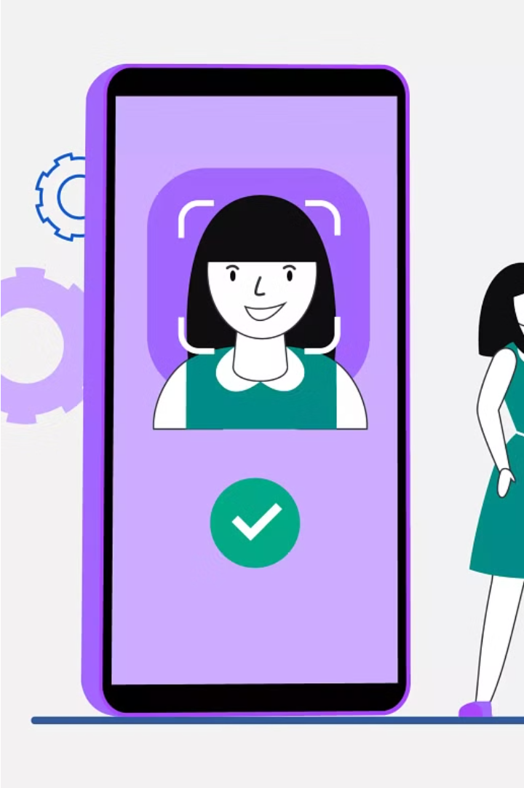
Designing the User Interface
Intuitive Layout
Ensure the user interface is well-organized and easy to navigate.
Responsive Design
Implement a responsive design that adapts to various device sizes and screen resolutions.
Consistent Branding
Incorporate your organization's branding elements, such as colors and logos, to create a cohesive visual identity.
Accessibility
Consider accessibility guidelines to make the interface inclusive and usable for all users.

Slide 5

Implementing Face Detection and Recognition
1
Face Detection
Leverage computer vision libraries, such as OpenCV, to detect and locate faces within the captured video stream.
2
Face Recognition
Employ facial recognition algorithms to identify individuals based on their unique facial features.
3
Continuous Improvement
Continuously train and refine the facial recognition model to improve accuracy and reliability over time.

Slide 6
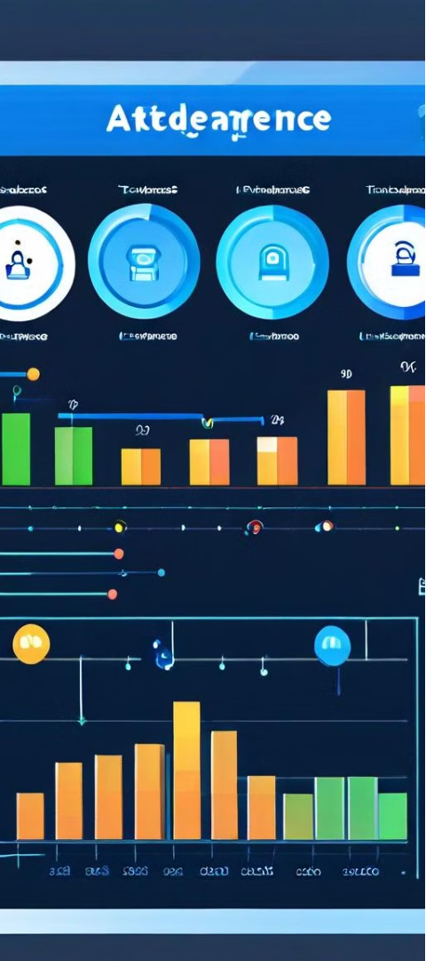



Integrating the Attendance Tracking Functionality
Time Logging
Accurately record the time when each employee checks in and out using the facial recognition system.
Attendance Reports
Generate detailed attendance reports that provide insights into employee work hours and punctuality.
Data Analytics
Leverage the attendance data to analyze trends, identify patterns, and optimize workforce management.

Slide 7




Handling User Authentication and Authorization
Secure Authentication
Role-based Access
Data Privacy
Secure Communication
Prioritize data privacy and comply with relevant regulations, such as GDPR, to protect employee information.
Establish different user roles (e.g., admin, manager, employee) and customize access privileges accordingly.
Implement robust authentication mechanisms, such as password-based or multi-factor authentication,
Implement secure communication protocols, like HTTPS, to protect data transmission between the client and server.

Slide 8
Deployment and Maintenance Considerations
Hosting Platform
Choose a reliable cloud platform or web hosting service to deploy your Flask application.
Scalability
Ensure the system can handle increasing user loads and data volumes as the organization grows.
Monitoring and Logging
Implement robust monitoring and logging mechanisms to track system performance and address any issues.
Maintenance and Updates
Maintain the system by regularly updating dependencies, applying security patches, and addressing bug fixes.

Slide 9
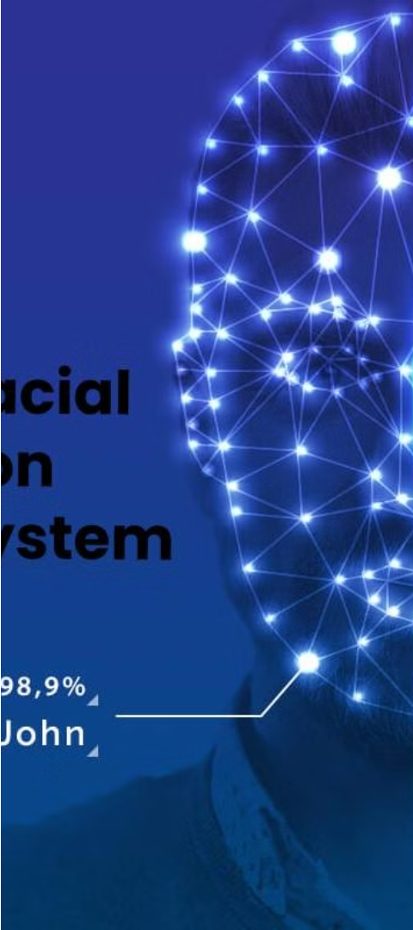
Advantage and Applications
Flask offers several advantages, such as its simplicity and flexibility, making it suitable for developing small to medium-sized applications. This framework is commonly used for building web applications, REST APIs, and prototyping. It allows for easy integration with other libraries and technologies, making it a popular choice among developers.

Slide 10
THANK YOU….

