Slide 1
Heart Disease Prediction Using Machine Learning Algorithms
An Analysis of Predictive Techniques for Healthcare Applications

Slide 2
Abstract
Heart disease remains one of the leading causes of mortality globally. This research leverages machine learning techniques to predict heart disease using a publicly available dataset. Data preprocessing, visualization, and evaluation methodologies are employed. Logistic Regression was identified as the most accurate model, supporting medical experts in decision-making.

Slide 3
Dataset Overview
The dataset consists of 303 rows and 14 columns, containing both categorical and continuous data. The target variable indicates the presence or absence of heart disease. Data cleansing involved removing two rows with null values.

Slide 4
Data Visualization
Visualization techniques included correlation matrices to identify significant features, such as Age. Graphs were plotted to examine the ratio of patients with and without heart disease.

Slide 5
Methodology
This study employs machine learning algorithms, including Random Forest, SVM, Decision Tree, and Logistic Regression. The models were implemented using Python. Cross-validation techniques were used to assess the accuracy and robustness of the models.

Slide 6
Algorithm Performance
Random Forest: High accuracy but overfitting potential.
SVM: Effective for small datasets but computationally intensive.
Decision Tree: Fast but less robust to noise.
Logistic Regression: Demonstrates the highest accuracy and simplicity.

Slide 7
Results
Cross-validation revealed that Logistic Regression provides the highest accuracy among the tested algorithms. The correlation of age with heart disease was identified as a key finding.

Slide 8
Conclusion and Future Work
Conclusion:
Logistic Regression is the most reliable model for this dataset, aiding in data-driven medical diagnostics.
Future Work:
1. Expand the dataset with more diverse demographics.
2. Implement advanced ensemble methods.
3. Explore deep learning techniques for improved predictions.
4. Develop real-time diagnostic applications.

Slide 9
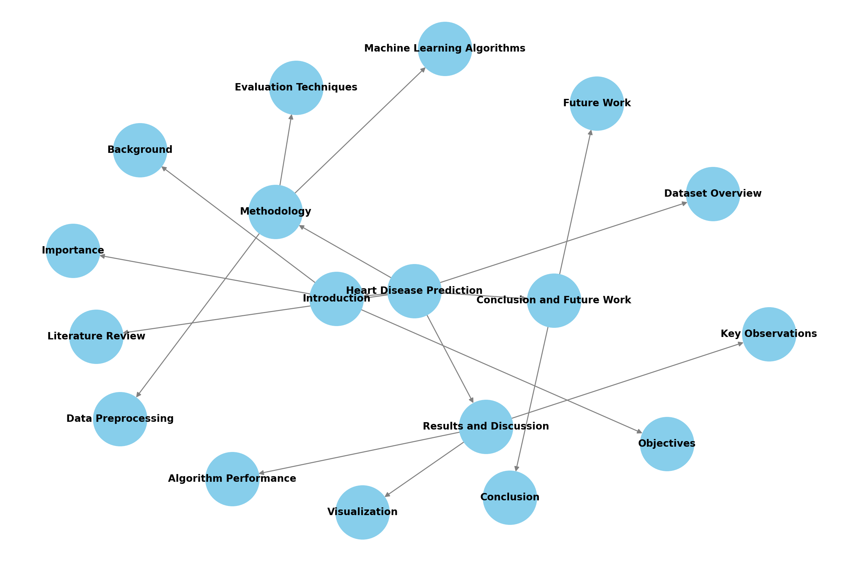
Mind Map

Slide 10
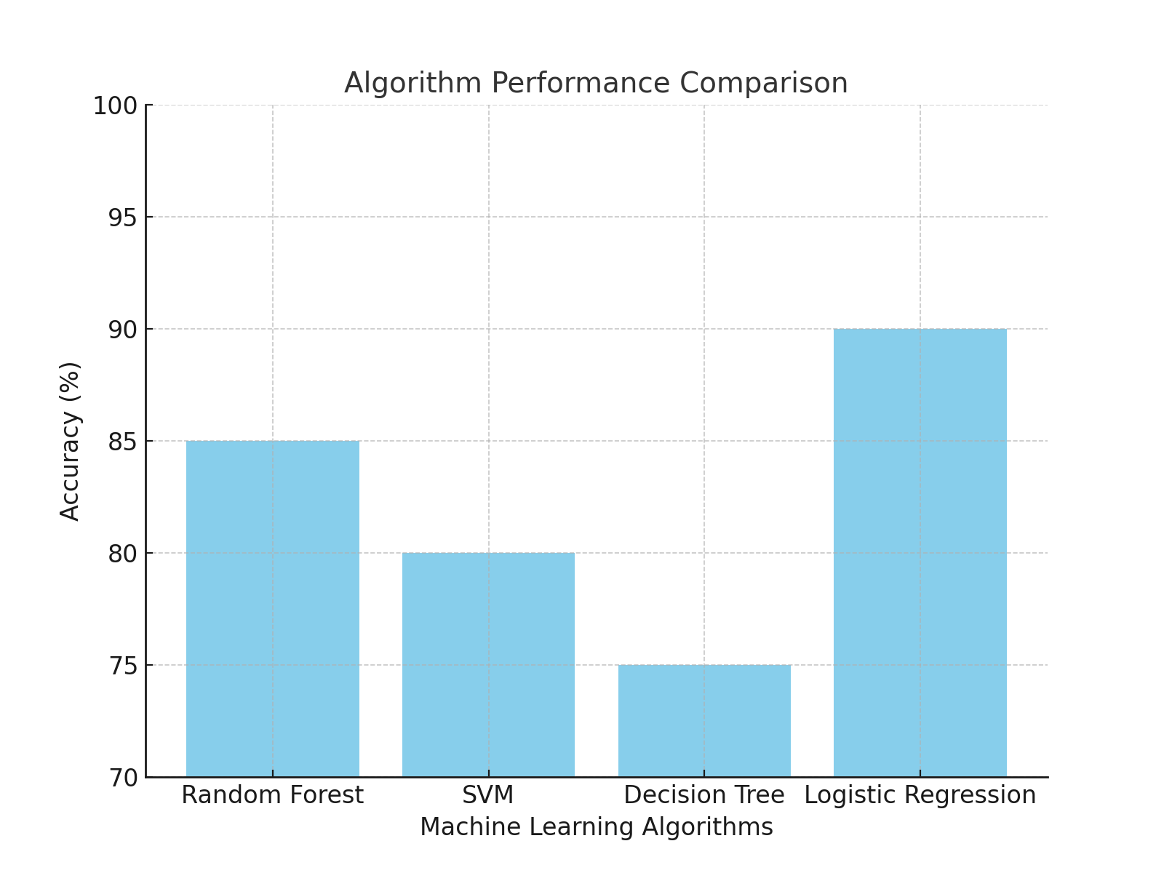
Algorithm Performance Bar Chart

Slide 11
Thank You

