Slide 1

SmartClaimMate
An AI-Powered Insurance Claim Assistant
Built with IBM watsonx.ai + RAG
Presented by: Poojitha Guduru
& Balaji Prasad Thulasiram
Notes:
Hi, I’m Poojitha Guduru. This is my hackathon project — SmartClaimMate — an AI-powered assistant that simplifies health insurance claims using IBM watsonx.ai and Retrieval-Augmented Generation, or RAG."
Have you ever had an insurance claim denied without knowing why? Or spent hours trying to understand dense policy documents? What if AI could do all of that instantly — and explain it in plain language?”

Slide 2

The Problem We Address
Long wait times for insurance claim responses
Confusing denial reasons
Burdensome paperwork and policy documents
Lack of clear next steps for patients
Notes:
Many people struggle to understand why their claims were denied, what documents are missing, or what to do next. Customer support is slow, and insurance documents are hard to read."

Slide 3

Meet SmartClaimMate
Built using IBM watsonx.ai and RAG
Uses document grounding to find answers
Explains denial reasons and policy terms
Offers tone-customized responses and next steps
Notes:
“It’s not just another chatbot — it understands context, offers personalized responses, and even rewrites suggestions in tones like friendly, formal, or assertive based on what the user prefers.”

Slide 4
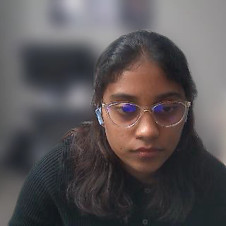
Why This Matters
Saves time and reduces confusion
Improves trust and transparency
Built to scale across insurers
Reduces support tickets and appeals
Notes:
SmartClaimMate helps users navigate insurance with clarity and confidence. It’s scalable, impactful, and powered by watsonx."

Slide 5


Thank You
Project: SmartClaimMate
Email: poojithaguduru9@gmail.com
Email: urstrulybalaji7@gmail.com
Linkedin: https://www.linkedin.com/in/poojitha-guduru-300859202
Linkedin: https://www.linkedin.com/in/balaji-prasad-csm%C2%AEcspo%C2%AE-043b89217
Submitted for IBM watsonx.ai Hackathon 2025
Notes:
“Thank you for this opportunity — and I hope SmartClaimMate shows how AI can deliver real value in the healthcare journey.”

