Slide 1


Social Media Manipulative Content Detection and Risk Assessment Using NLP
DSA0308-Natural Language Processing
PRESENTED BY :
M Poojitha Reddy – 192472352
Ch Sai sri- 192472367
GUIDED BY :
Dr Kumaragurubaran T

Slide 2
INTRODUCTION
Social media has become a major platform for sharing news, opinions, alerts, and information.
However, online content can use emotionally charged, sensational, urgent, or exaggerated language to influence user behavior.
Such communication may encourage users to click links, share information, or take immediate action without careful verification.
This project develops a Social Media Manipulation Analyzer that examines the linguistic characteristics of social-media content.
The system analyzes two types of input: social-media posts and messages associated with links.
It identifies patterns such as emotional language, sensationalism, urgency, excessive capitalization, punctuation, calls-to-action, and suspicious requests.
A machine-learning component using TF-IDF and classification algorithms provides additional text classification support.

Slide 3
PROBLEM STATEMENT
Social media users are exposed to large amounts of online content containing sensational, emotional, urgent, and persuasive language.
Such language can influence users to click links, share posts, provide information, or take immediate actions without proper verification.
Existing misinformation detection systems often focus mainly on classifying content as fake or real, which may not explain the linguistic techniques used to influence users.
Users therefore need an understandable way to identify manipulative communication patterns in social-media posts and link-associated messages.
The proposed system addresses this problem by analyzing textual content for emotional language, sensationalism, urgency, excessive capitalization, punctuation, calls-to-action, and suspicious requests.
It generates a Manipulation Risk Score along with detected linguistic signals and explanations, helping users understand the characteristics that may make a message manipulative.

Slide 4
S. NO | Author(s) & Year | Title | Methodology | Findings / Limitations
1 | Ahmed H., Traore I., & Saad S. (2018) | Detecting Opinion Spam and Fake News Using Text Classification | Used TF-IDF feature extraction with machine learning classifiers such as Naïve Bayes and SVM. | Lower accuracy when handling complex or ambiguous text; sensitive to feature selection.
2 | Shu K., Sliva A., Wang S., Tang J., & Liu H. (2017) | Fake News Detection on Social Media: A Data Mining Perspective | Surveyed data mining and NLP techniques for misinformation detection. | Require extensive text preprocessing and may not generalize well to unseen misinformation..
3 | Wang W. Y. (2017) | Liar, Liar Pants on Fire: A New Benchmark Dataset for Fake News Detection | Introduced the LIAR dataset and evaluated machine learning models. | Performance decreases when applied to real-time social media data with evolving content.
4 | Pérez-Rosas V., Kleinberg B., Lefevre A., & Mihalcea R. (2018) | Automatic Detection of Fake News | Applied linguistic feature extraction and machine learning classifiers. | Showed that combining linguistic features with classification algorithms improves detection accuracy.
5 | Devlin J., Chang M. W., Lee K., & Toutanova K. (2019) | BERT: Pre-training of Deep Bidirectional Transformers for Language Understanding | Introduced the BERT transformer model for NLP tasks. | Relies only on textual patterns and may fail to detect context-dependent misinformation.
6 | Kaliyar R. K., Goswami A., & Narang P. (2021) | FakeBERT: Fake News Detection in Social Media with BERT | Combined BERT embeddings with deep learning for fake news classification. | Large model size makes real-time deployment difficult on resource-limited systems.

Slide 5
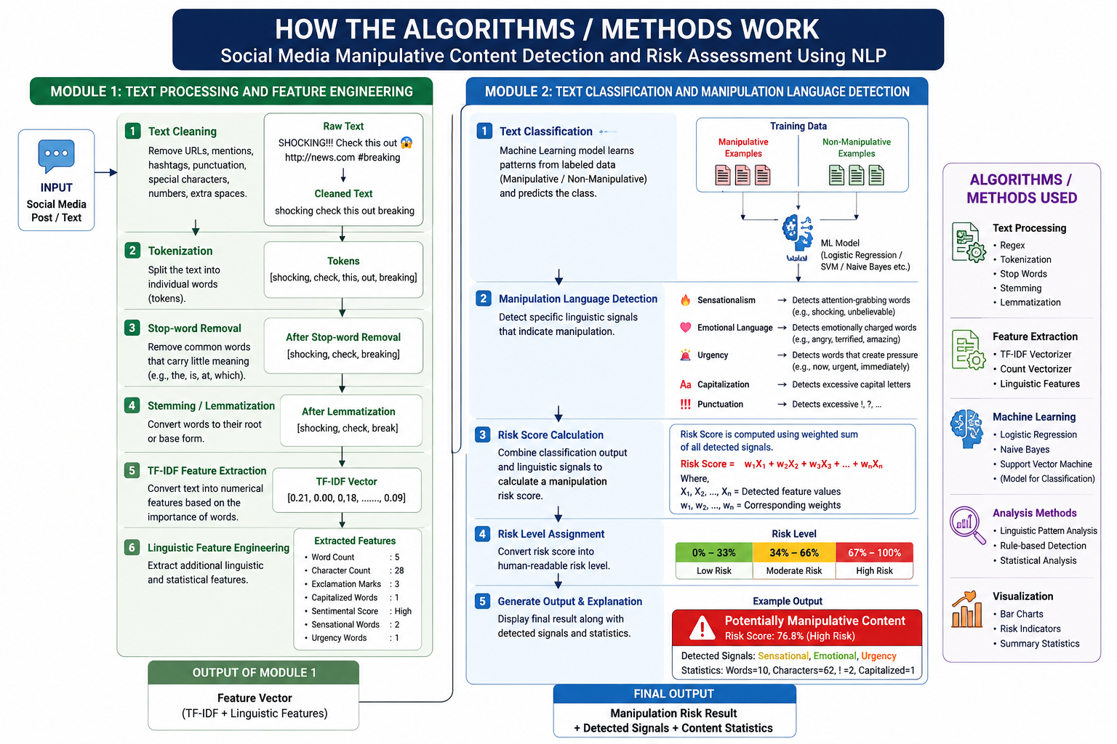
Working of algorithms :

Slide 6
Module 1: Text Processing and Feature Engineering
Text Preprocessing
Convert text to lowercase
Remove URLs and special characters
Remove stop words
Apply lemmatization
TF-IDF Feature Extraction
Converts the cleaned text into numerical feature vectors.
Uses Term Frequency–Inverse Document Frequency (TF-IDF).
Uses unigrams and bigrams to capture individual words and word combinations.
Linguistic Feature Extraction
Emotional Language
Sensationalism
Urgency
Capitalization
Punctuation
Call-to-Action phrases
Suspicious Request phrases
Feature Scoring
Each detected linguistic characteristic is converted into a 0–100 score.
These scores are later used to calculate the overall Manipulation Risk Score.

Slide 7
Module 2: Text Classification and Misinformation Detection
Naive Bayes
A probabilistic classification algorithm.
Estimates the probability of each class based on the words present in the text.
Suitable for text classification because it works efficiently with high-dimensional TF-IDF features.
Logistic Regression
A supervised classification algorithm used for binary classification.
Learns the relationship between TF-IDF features and the dataset labels.
Produces a classification decision based on learned feature weights.
Support Vector Machine (SVM)
Finds a decision boundary that separates the two classes.
Effective for high-dimensional text data.
The implementation uses LinearSVC.
Model Evaluation
The three models are evaluated using:
Accuracy
Precision
Recall
F1-Score

Slide 8
FUTURE SCOPE
Multilingual Content Analysis – Extend the system to analyze manipulative content in multiple Indian and international languages, including Tamil, Telugu, Hindi, and Malayalam.
Multimodal Content Detection – Integrate image, video, and audio analysis along with text to detect manipulation in memes, edited images, misleading videos, and voice-based content.
Advanced Transformer Models – Use models such as BERT, RoBERTa, and multilingual transformers to improve the detection of subtle linguistic manipulation and contextual meaning.
Real-Time Social Media Monitoring – Develop a real-time monitoring system that can analyze posts and provide an immediate manipulation risk score as content is published or shared.
Improved Context and Conversation Analysis – Incorporate previous posts, comments, and conversation context to better understand manipulative content that depends on surrounding information.

Slide 9
CONCLUSION
This project presents an effective approach for detecting misinformation on social media using Natural Language Processing (NLP), TF-IDF feature extraction, and text classification.
By preprocessing textual data and transforming it into meaningful numerical features, the system accurately classifies social media posts as genuine or misleading.
The proposed approach provides a computationally efficient and reliable solution compared to more complex deep learning methods, making it suitable for real-time applications.
Overall, the project demonstrates how NLP and machine learning can be effectively utilized to combat the rapid spread of misinformation, helping users access more reliable information and promoting a safer digital communication environment.

Slide 10
THANK YOU

