Slide 1

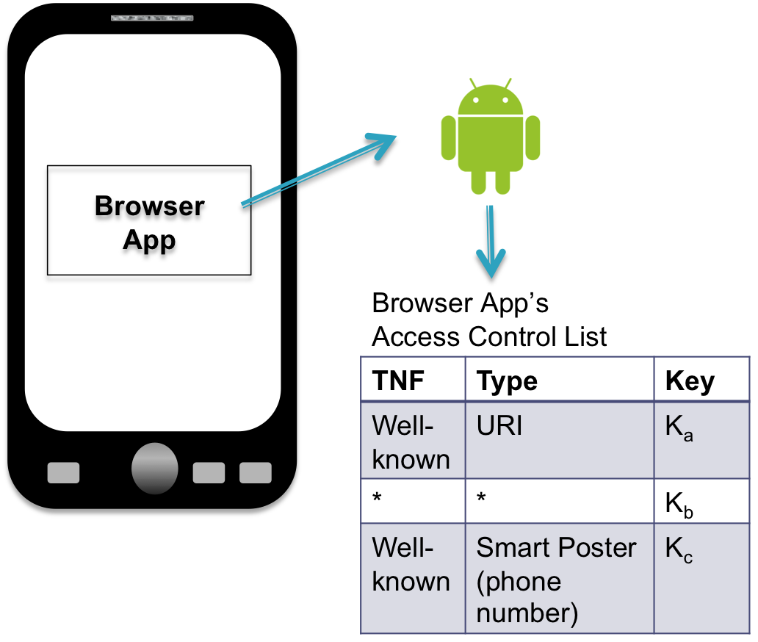
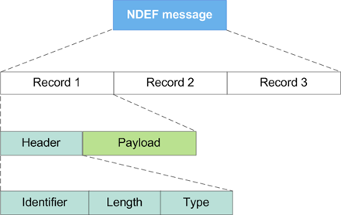
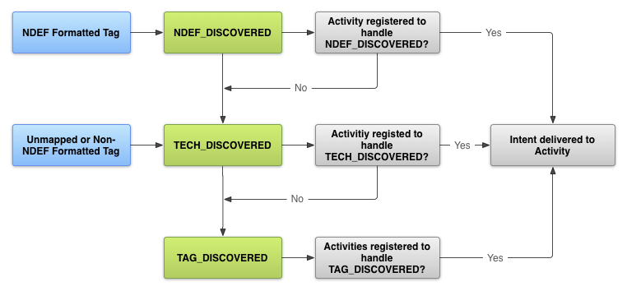
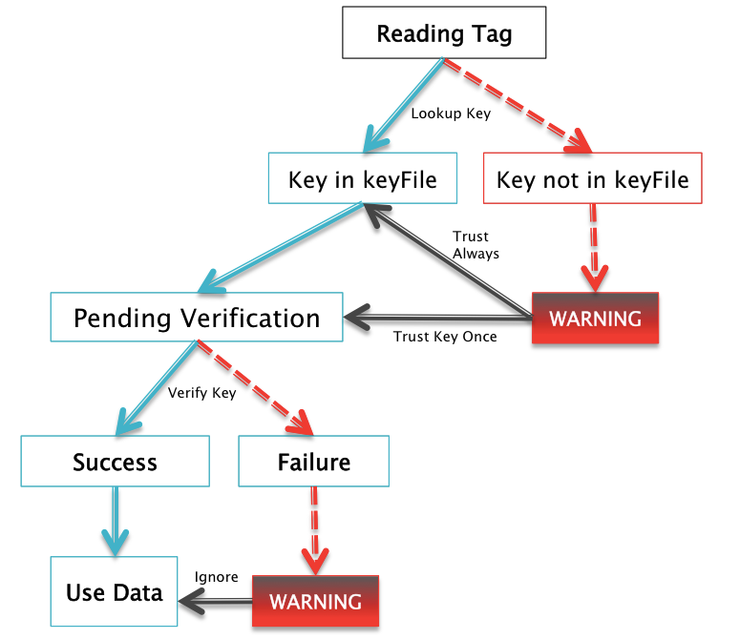
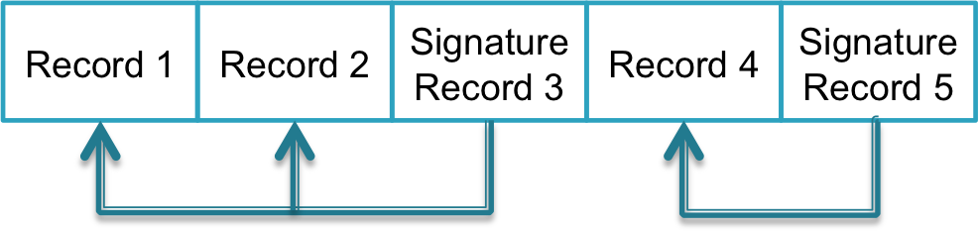

Fine-grained Access Control for NFC Applications
Max Feldman, Stephanie Rogers, Richard Xia
Introduction
Design
Implementation
Android applications may automatically use data from unsafe NFC tags without user warning
We propose a mechanism for fine-grained access control for NFC applications which is both secure and usable
Goal: Provide usable trust model for NFC tags
Per-application access control list
Grant permission for application to automatically launch programs when scanning tags signed with authorized key
Restrict by tag type
Users can revoke keys
Built access control lists per application and per type as an application library API instead of OS hacking
Written tags with signatures are backwards compatible with devices that don’t support signatures
Built operations for reading, writing, and verifying NDEF signatures, since Android doesn’t natively support it
Did not run into any other difficulties
Background
NFC
Short-range wireless communication (up to 10 cm)
NDEF format:
Android Intents
Automatically dispatch intent when a tag is swiped based on tag type
NFC Signature Record Type Definition
Signs all preceding records
Uses certificate authority
Not widely adopted (not supported by Android yet)
Threat Model
Malicious Tags
Open malicious URL or call tolled phone number
Privacy
Unencrypted data and eavesdropping
We don’t address this
Evaluation & Discussion
Access control is done by OS, so application developers do not need to choose to implement this
Users can be offered different policies for handling tags with new keys
Choose best policy per app
E.g. apps which don’t use data from tags in a potentially dangerous way can just accept all tags
Apps which connect to the internet can be restricted
http://developer.android.com/guide/topics/connectivity/nfc/nfc.html
Workflow
When a user scans an unknown tag, present a warning
Accept once, accept permanently, reject
Total | Internet | Phone call | SMS
251 | 201 | 153 | 38
Permission breakdown of NFC apps
Conclusion
Access control based on tag author, tag type, and application allows for secure, but unobtrusive security
Trust is user-defined rather
Provide minimal amount of annoying warnings
In the future, perform a user study to measure the effectiveness and usability of this design
Actually implement on OS level

