Slide 1
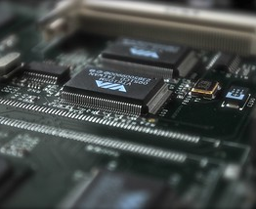
Presence Detection using IR sensor
Team: Electrotech
Anushka Srivastava
Faiziya Akhtar
Hari Bhajan Singh
Kartikeya Patel
Komal Sharma

Slide 2

AIM
The "Presence Detection Using IR Sensor" project aims to develop a reliable and cost-effective system for detecting the presence of humans in a given area using Infrared (IR) sensor technology. This system holds potential applications in various fields, including home automation, security, energy conservation, and industrial automation.

Slide 3
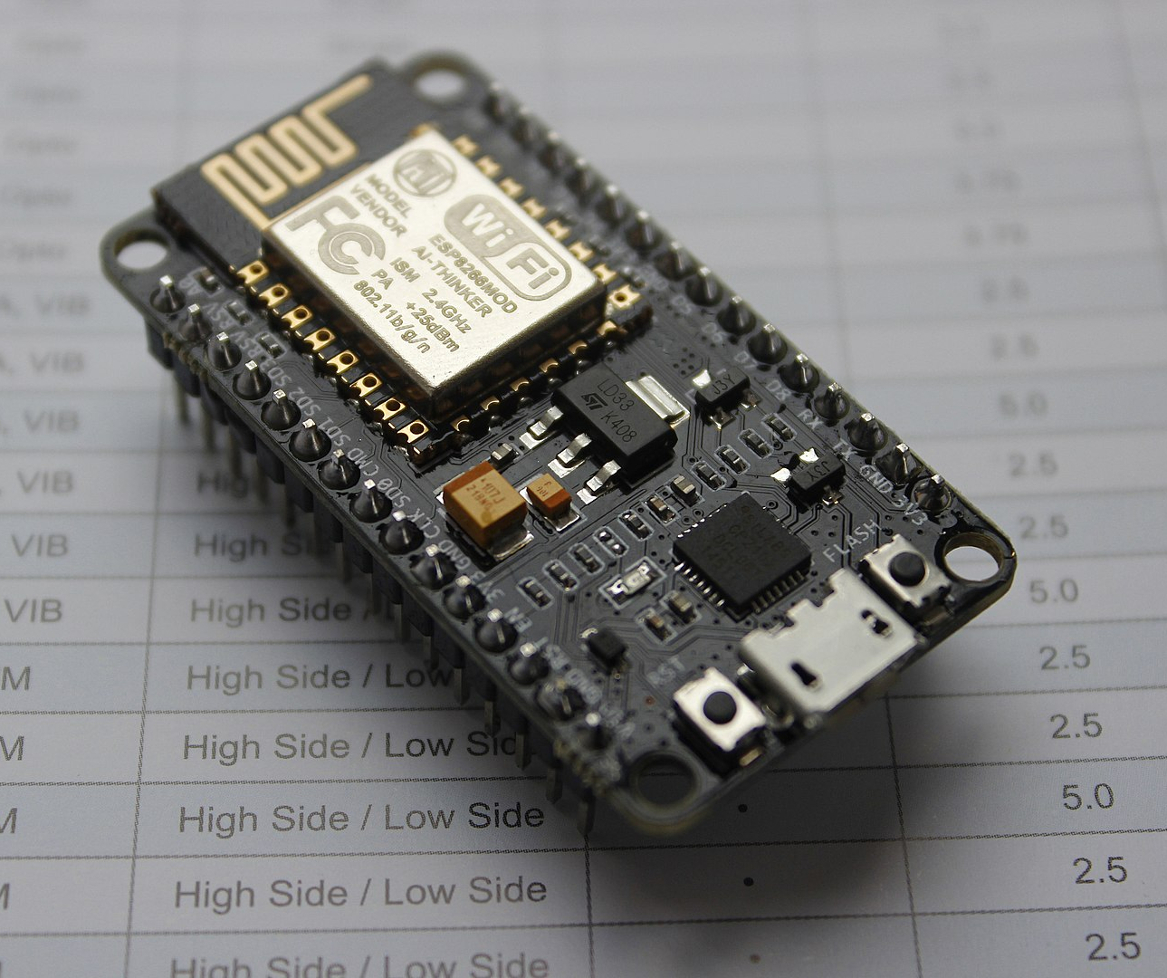
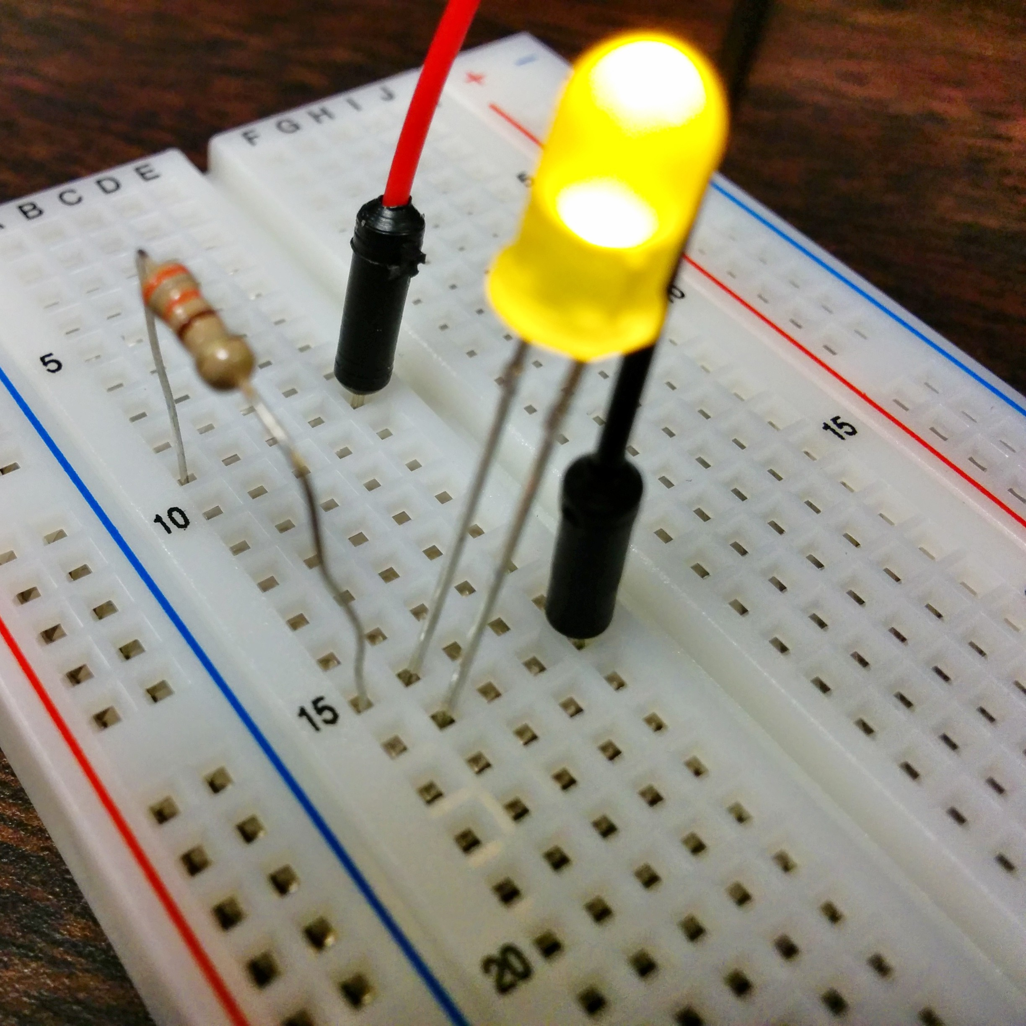
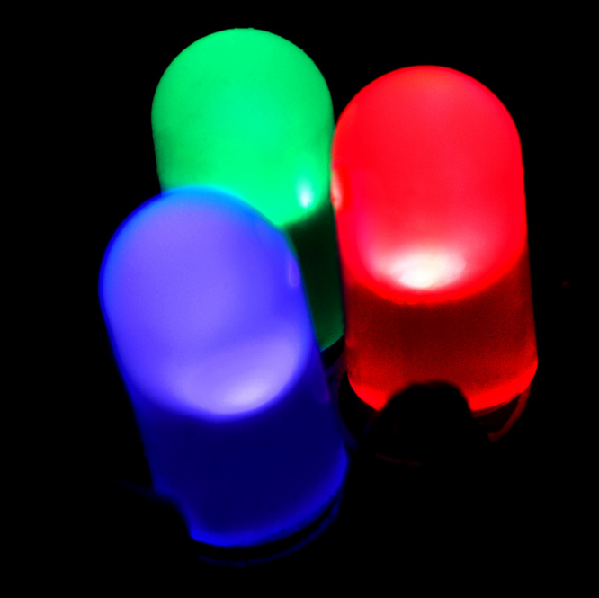
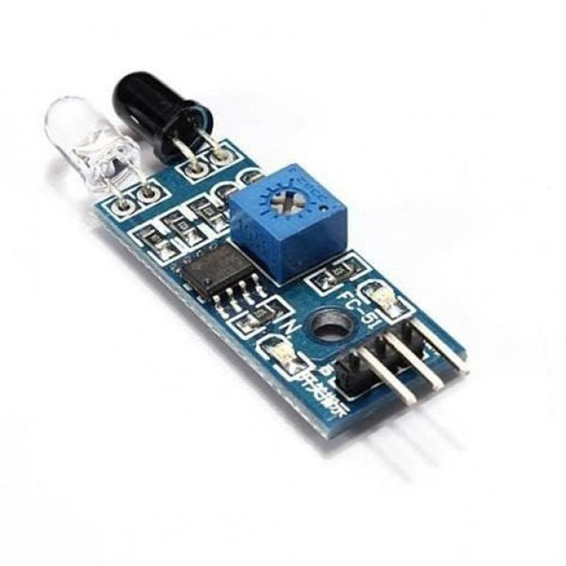
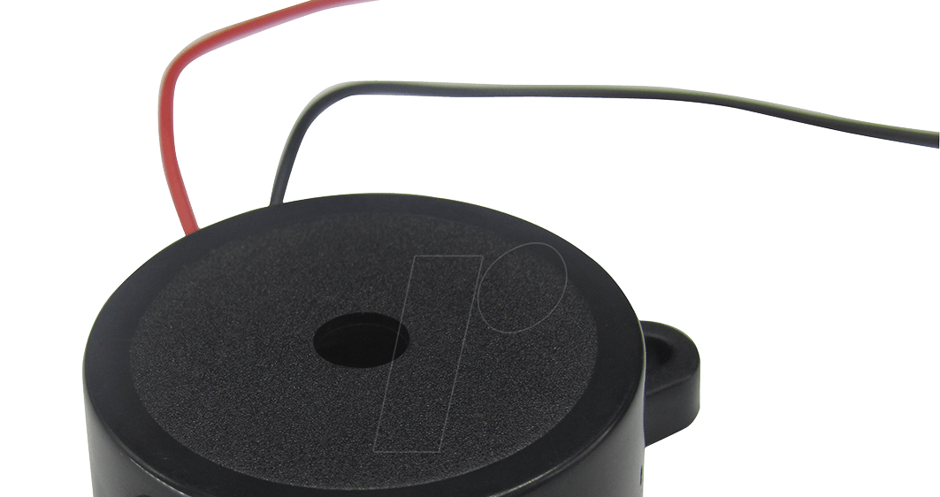
HARDWARE COMPONENTS
ESP 8266: It is a low-power MCU-based system on a chip (SoC) with integrated 2.4 GHz Wi-Fi and Bluetooth® Low Energy (Bluetooth LE). ​
IR Sensor Module: The operating voltage is 5V DC, I/O pins – 3.3V & 5V, the range is up to 20 centimeters, the supply current is 20mA​
Piezo Buzzer: The Operating Voltage: 5V DC, Frequency: 3,300Hz, Current: <15mA, Operating Temperature: - 20° to +60°C, Number of pins: 2​
Led​
Jumper Wires​
Breadboard​

Slide 4
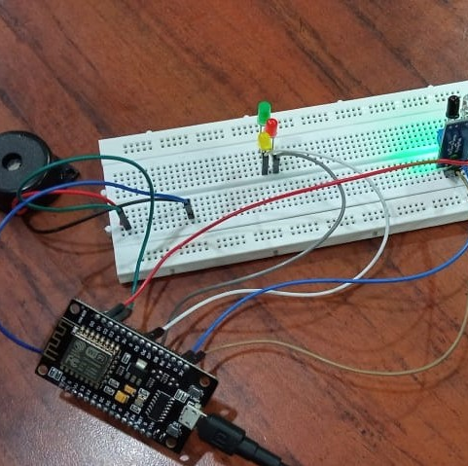
CIRCUIT

Slide 5

APPLICATIONS
Home Automation: Smart lighting and climate control systems that adjust settings based on occupancy.
Security Systems: Intrusion detection and alert systems for homes and businesses.
Energy Conservation: Energy-efficient lighting and HVAC control in commercial buildings.
Industrial Automation: Enhancing workplace safety by detecting the presence of workers near dangerous machinery.

Slide 6

CONCLUSION
The "Presence Detection Using IR Sensor" project is a technology initiative focused on utilizing infrared (IR) sensor technology to develop a sophisticated system capable of detecting the presence of humans. This system aims to provide precise and instantaneous detection, leading to improved convenience, security, and energy conservation across a range of settings and scenarios. The primary goal of this project is to demonstrate how IR sensors can be harnessed to create inventive and useful solutions that address contemporary challenges.

