Slide 1
LEASHED AGENT PLATFORM
EVERY PAYMENT ON-CHAIN
TRUST LAYER FOR AI AGENTS
One leash, every payment, independently checked.
A chain-enforced spending cap. A receipts ledger. A CRE auditor that attests the verdict on Sepolia. A fiat on-ramp via PromptPay.
TOKEN2049 Origins Hackathon · 6–8 Oct 2026 · Marina Bay Sands
Team Leashed — main track + Cardano · Chainlink CRE · NOWNodes
the poster on slide 5 was bought by the agent · every line of code written during the 36h sprint

Slide 2
POSITIONING · TRUST LAYER FOR AI AGENTS
AI agents already spend money.
Nobody is holding the leash.
No enforced budgets
x402 agents pay per call with whatever the key holds — spending caps live in app code, not the chain
No receipts
once the API call returns, the payment evidence is scattered across explorers, if it exists at all
No independent audit
the agent's operator grades its own homework — there is no third party vouching for the books
No fiat on-ramp
a Thai shop owner cannot top up an agent from a bank app today
THE TRUST LAYER IS MISSING
x402 Foundation stats — 75.4M txs but only $24.2M volume in 30 days (Aug 2026): micropayments dominate, oversight does not exist.

Slide 3
SOLUTION · THE FOUR PIECES
Leash · Receipts · Audit · Funding
The Leashed Agent Platform is the trust layer that holds an AI agent to four chain-enforced promises:
LEASH
RECEIPTS
AUDIT
FUNDING
Spending cap set by the human and enforced by the ThaiFi chain itself (AccountKeychain, TIP-1011). Revocation is instant and on-chain.
Every payment on every rail becomes one ledger entry — amount, purpose, explorer link — readable like a bank passbook.
A Chainlink CRE workflow re-checks the whole ledger and attests the verdict on-chain. Neither the agent nor we can forge it.
Budget runs low → the agent shows a PromptPay QR → 1 THB = 1 THCFI, straight from any Thai banking app.
IT ALREADY WORKS

Slide 4
One agent, two payment rails, one independent auditor
HUMAN OWNER
RAIL 1 · THAIFI MPP (chain 17)
passkey wallet · sets the cap · one-click revoke
Qwen3.8 copy 0.2 THCFI · iApp poster 1.5 THCFI · PromptPay top-up
CHAINLINK CRE AUDITOR
cron → fetch receipts → risk checks → on-chain attestation (Sepolia)
LEASHED AGENT
RAIL 2 · CARDANO x402 (preprod)
plans the job · pays per call · budgets itself
our own seller: receipt verification 0.10 tUSDM — payments are core, not a bolt-on
NOWNodes RPC
multichain data plane for receipt verification
Solid arrows = real, explorer-linked calls made during the sprint.

Slide 5
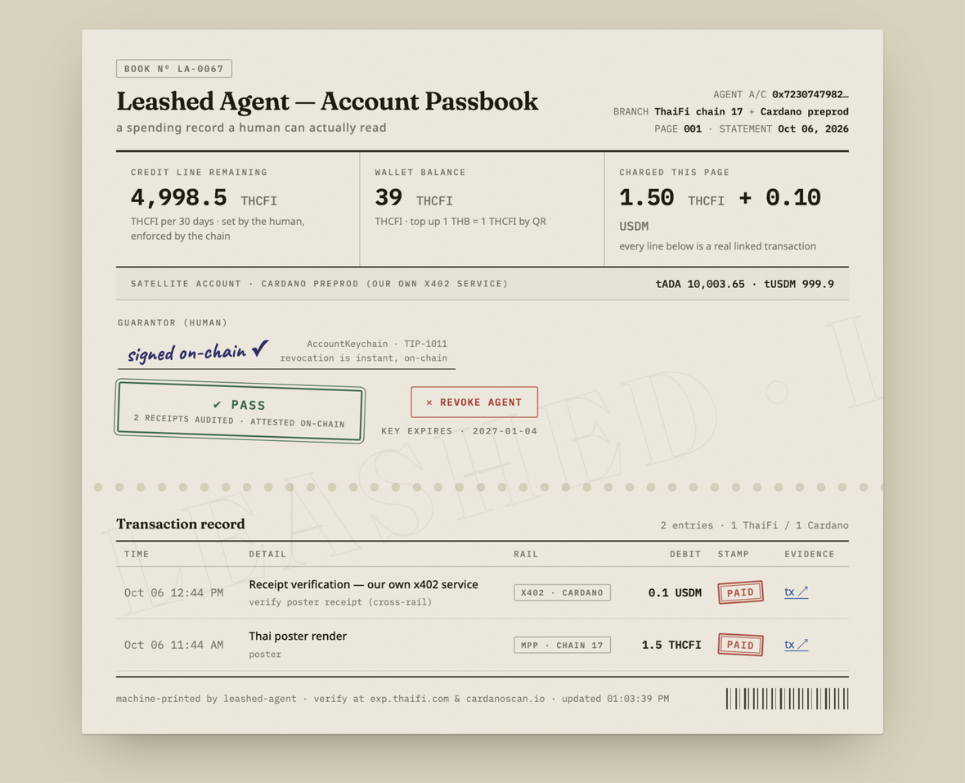

RECORDED IN-SPRINT
EVIDENCE · TRUST LAYER IN ACTION
Every trust-layer promise was kept, on-chain, during the sprint.
Leash · 4,998.5 / 5,000 THCFI (on-chain cap, decremented by the chain itself)
Receipts · 2 on-chain payments, explorer-linked
Audit · CRE verdict ✔ PASS, attested on Sepolia
Funding · 1 THB → 1 THCFI via PromptPay QR

Slide 6
NOT MOCKS
EVIDENCE · THE LEASH HELD
The trust-layer evidence chain judges can click
Promise | Rail | Amount | Proof (live links)
Receipts · agent buys Thai poster | ThaiFi MPP · chain 17 | 1.5 THCFI | exp.thaifi.com/tx/0xf6e9…3b65e
Receipts · agent pays OUR x402 seller | x402 · Cardano preprod | 0.10 tUSDM | cardanoscan.io/tx/5e796a4c…bdc0
Audit · CRE verdict | Chainlink CRE → Sepolia | PASS ✔ 2 receipts | docs/cre-auditor-evidence.txt (simulate log)
Leash · on-chain enforcement | AccountKeychain · TIP-1011 | 4,998.5 / 5,000 THCFI | limit decremented by the chain itself — incl. gas
Ledger + policy engine: 10 unit tests · seller: live at :4020 · audit re-runnable: pnpm probe / scripts/demo.sh

Slide 7
TRACK MAP · ONE TRUST LAYER, FOUR TRACKS
Each track serves the trust layer — integrations are core, not bolt-ons.
MAIN · $100K AWS
CARDANO · $27.5K
The whole product: two-rail agent + passbook oversight + CRE audit. Themes: AI x Crypto · Payments · Consumer.
Payments are Cardano-native: x402 preprod tUSDM, our own seller endpoint, TS-only SDK path — 0.10 tUSDM changed hands.
CHAINLINK CRE · $10K
NOWNODES · €6.5K
The auditor IS a CRE workflow: HTTP fetch + risk logic + EVM write, proven by cre workflow simulate.
The auditor's RPC data plane reads EVM receipt state through NOWNodes — architectural, not decorative.
The rules disqualify bolt-ons. Each leg earns its keep — the trust layer can't survive a single missing piece.

Slide 8
PRE-BUILT ≠ SUBMITTED
RUBRIC FIT · TRUST LAYER SCORES ON ALL FIVE
Built for the rubric, in 30 hours, by humans with a leash of our own.
Functionality 30%
Two paid journeys ran end-to-end with explorer links; top-up, revoke and auditor flows all execute.
Technical 25%
On-chain limit enforcement (TIP-1011) · x402 seller + payer · MPP memo-bound charges · CRE orchestration.
Innovation 20%
The trust layer: leash + receipts + independent audit + fiat on-ramp — the lane comparables left empty.
Usefulness 15%
A noodle shop owner in Bangkok is the persona. 1 THB = 1 THCFI funding needs no exchange account.
Demo 10%
Recording embedded, judgment-proof: every claim is a clickable transaction.
Eligibility: submitted code written in-sprint. ThaiFi wallet/CLI used as public tooling (npm), affiliation disclosed in the README.

Slide 9
LEASHED AGENT PLATFORM
The trust layer
for AI agents.
Fund with PromptPay. Leash on-chain. Audit with Chainlink CRE.
Repo · live dashboard · audit log — linked in the submission
Team Leashed — Jirayu (Dome) Charoenyost · TOKEN2049 Origins 2026
ON TIME

