Slide 1
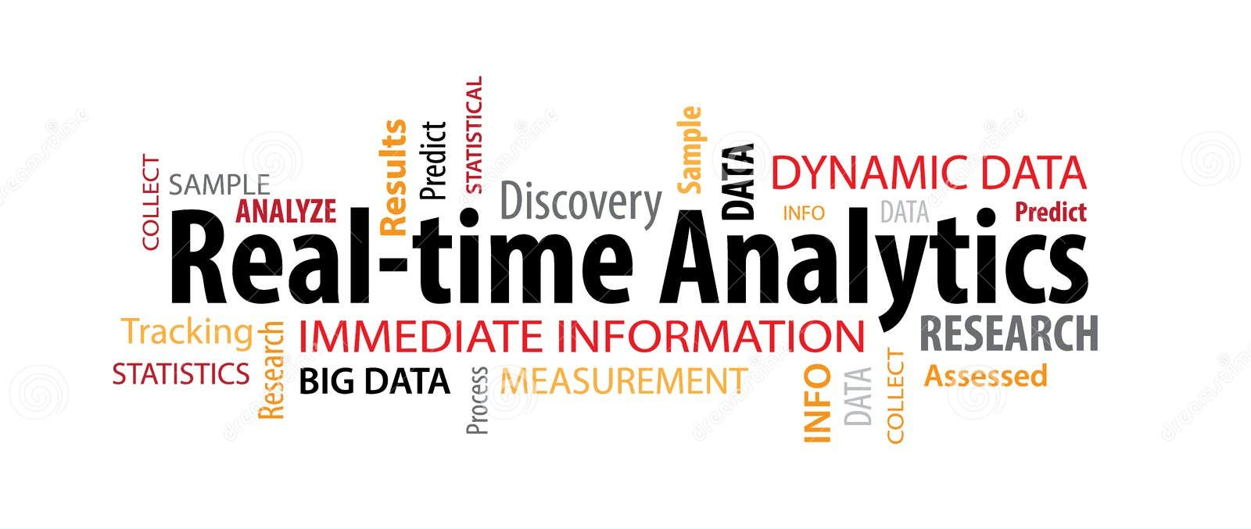

Slide 2

Member
สิรพงศ์ บุญพจน์ศิริ 6420412007
ก้องปภณ สังข์รุ่ง 6420412001
กฤติน ค้าไกล 6420412012
ภูมิ เจวประเสริฐพันธุ์ 6420412004
สพล สาหรับ 6420412009

Slide 3
Game integration with offline machine learning ML and online ML exhibits notable distinctions in various aspects.
1.Data Availability: Offline ML refers to training models on pre-collected data that is available before the game is deployed. In contrast, online ML involves training models in real-time using data generated during gameplay. The availability and nature of data differ significantly between the two approaches.
2.Training Process: Offline ML typically involves a batch training process, where the model is trained on a fixed dataset in one or more iterations. In contrast, online ML often utilizes online learning algorithms that can update the model incrementally as new data arrives, allowing for adaptive learning during gameplay.

Slide 4
Game integration with offline machine learning ML and online ML exhibits notable distinctions in various aspects.
3.Latency: Offline ML models can be trained and optimized in advance, resulting in lower latency during gameplay. On the other hand, online ML models require real-time inference, which can introduce latency due to data transmission, model updates, and computational requirements.
4.Scalability: Offline ML models can be trained on powerful hardware or distributed computing resources, allowing for complex and resource-intensive training algorithms. Online ML models, however, need to consider the computational constraints of the game environment and the capability to handle real-time updates efficiently.

Slide 5
conclusion
It's important to note that the specific implementation of offline and online ML integration can vary depending on the game, its requirements, and the available infrastructure. The decision to use offline or online ML, or a combination of both, depends on factors such as the nature of the game, data availability, real-time requirements, and the desired level of adaptability.

Slide 6
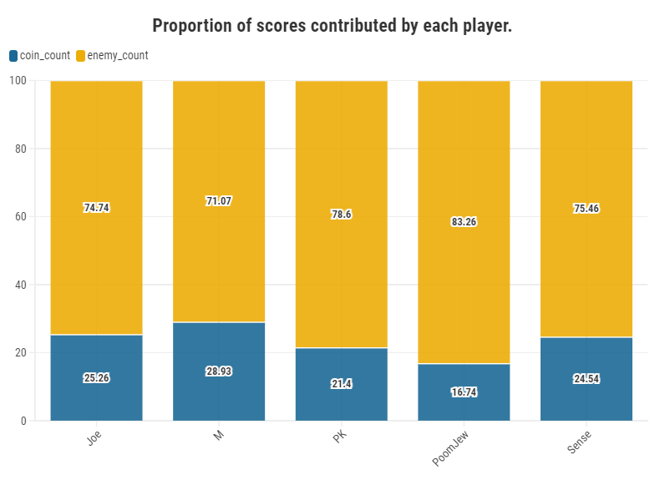

Slide 7
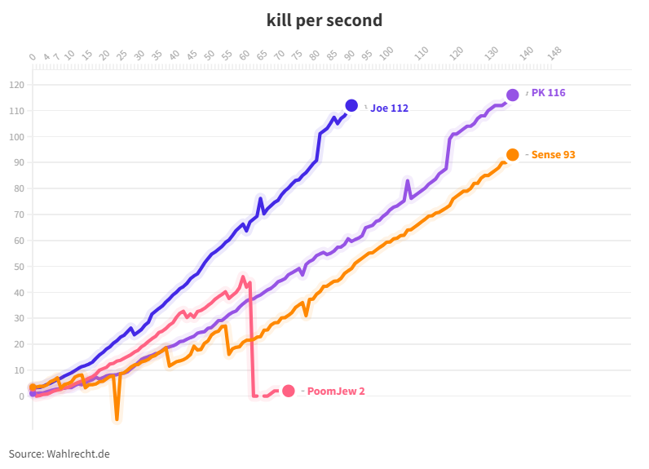

Slide 8
