Slide 1
PROJECT TITLE SECURE DATA HIDING IN IMAGES USING STEGANOGRAPHY
SECURE THE DATA TO PREVENT HACKERS
Presented By: Poonam Suthar
Student Name : Poonam Suthar
College Name & Department : Institute of Aeronautical Engineering,
Computer Science and Engineering

Slide 2
OUTLINE
Problem Statement
Technology used
Wow factor
End users
Result
Conclusion
Git-hub Link
Future scope

Slide 3
Problem Statement
In today's digital world, secure communication is a growing concern. Steganography offers a solution by hiding messages within images, making them indistinguishable from normal, non-modified images. This project demonstrates how to encode and decode secret messages inside an image file, with added password protection for extra security.

Slide 4
Technology used
Python: Chosen for its simplicity and powerful libraries.
OpenCV: Used to manipulate images by altering pixel values and encoding the message.
Steganography: The primary technique used to hide data in images by manipulating the least significant bits of pixel values.
Character Encoding: Converts characters into numerical representations and stores them in the image pixels.

Slide 5
Wow factors
Invisible Data: The secret message is stored within the image, invisible to the naked eye, making it a unique way of secure communication.
Security Through Password Protection: The message can only be decoded if the user knows the correct passcode, adding an extra layer of security.
User-Friendly: The implementation is easy to use, with simple inputs for encoding and decoding the message.

Slide 6
End users
Individuals: Anyone looking to securely send messages to friends, family, or colleagues.
Businesses: For sharing confidential information or documents through images.
Security Enthusiasts: Those interested in the fields of encryption, data security, and steganography.
Educational Use: Can be used to teach steganography and encryption techniques.

Slide 7
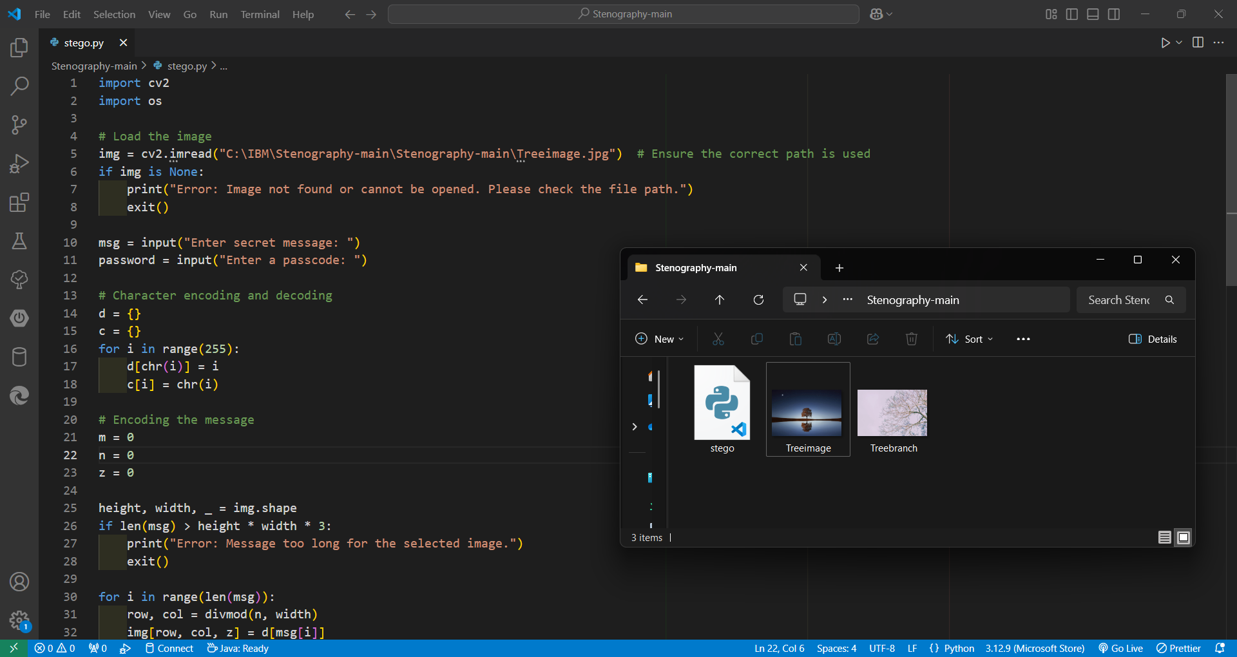
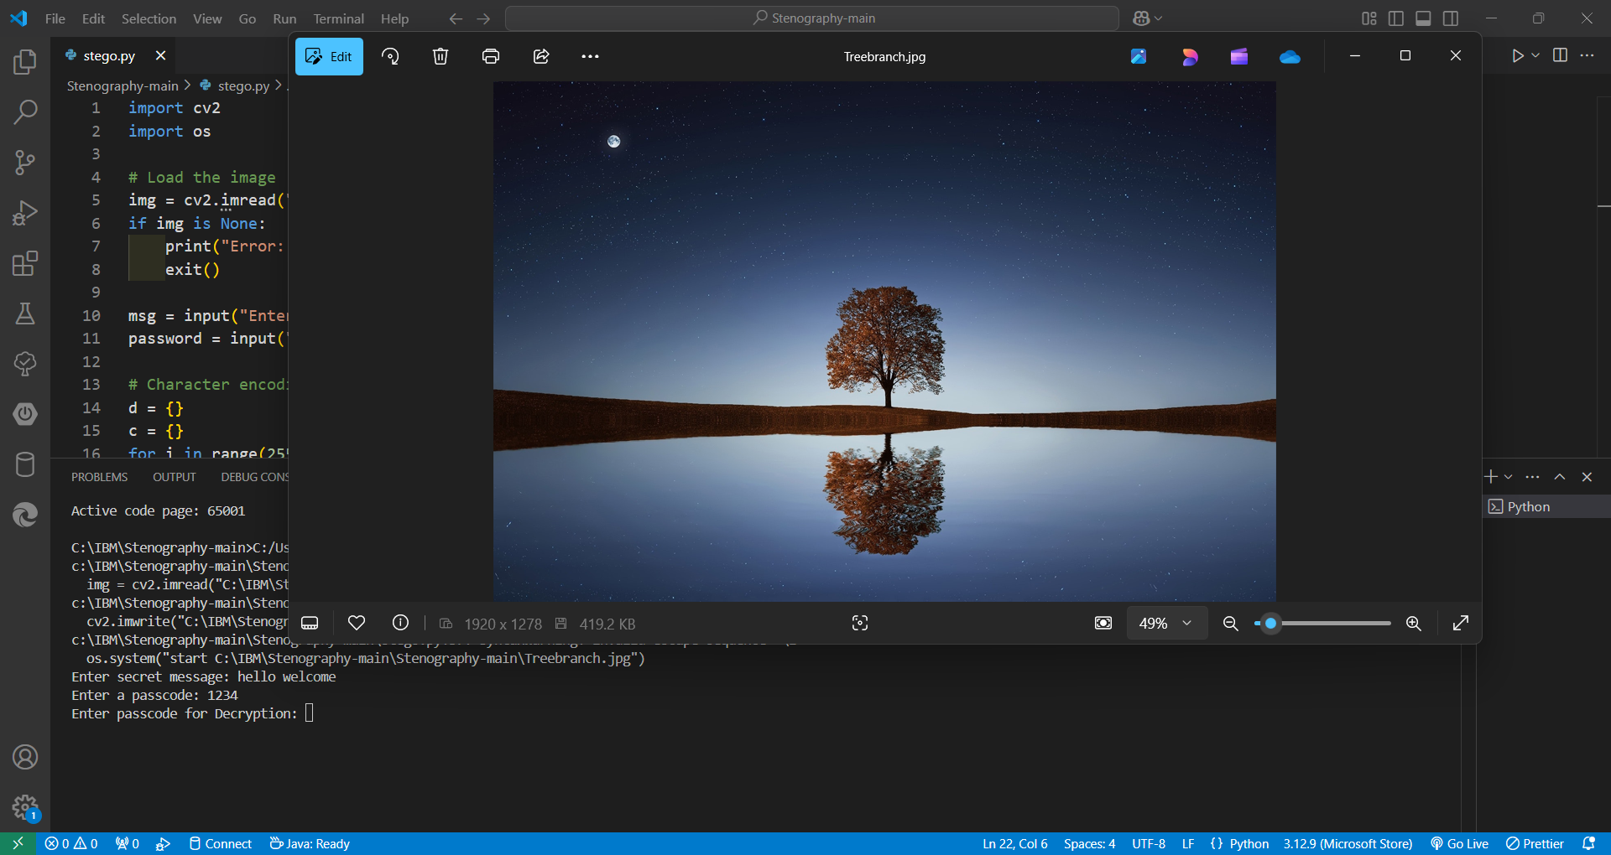
Results

Slide 8
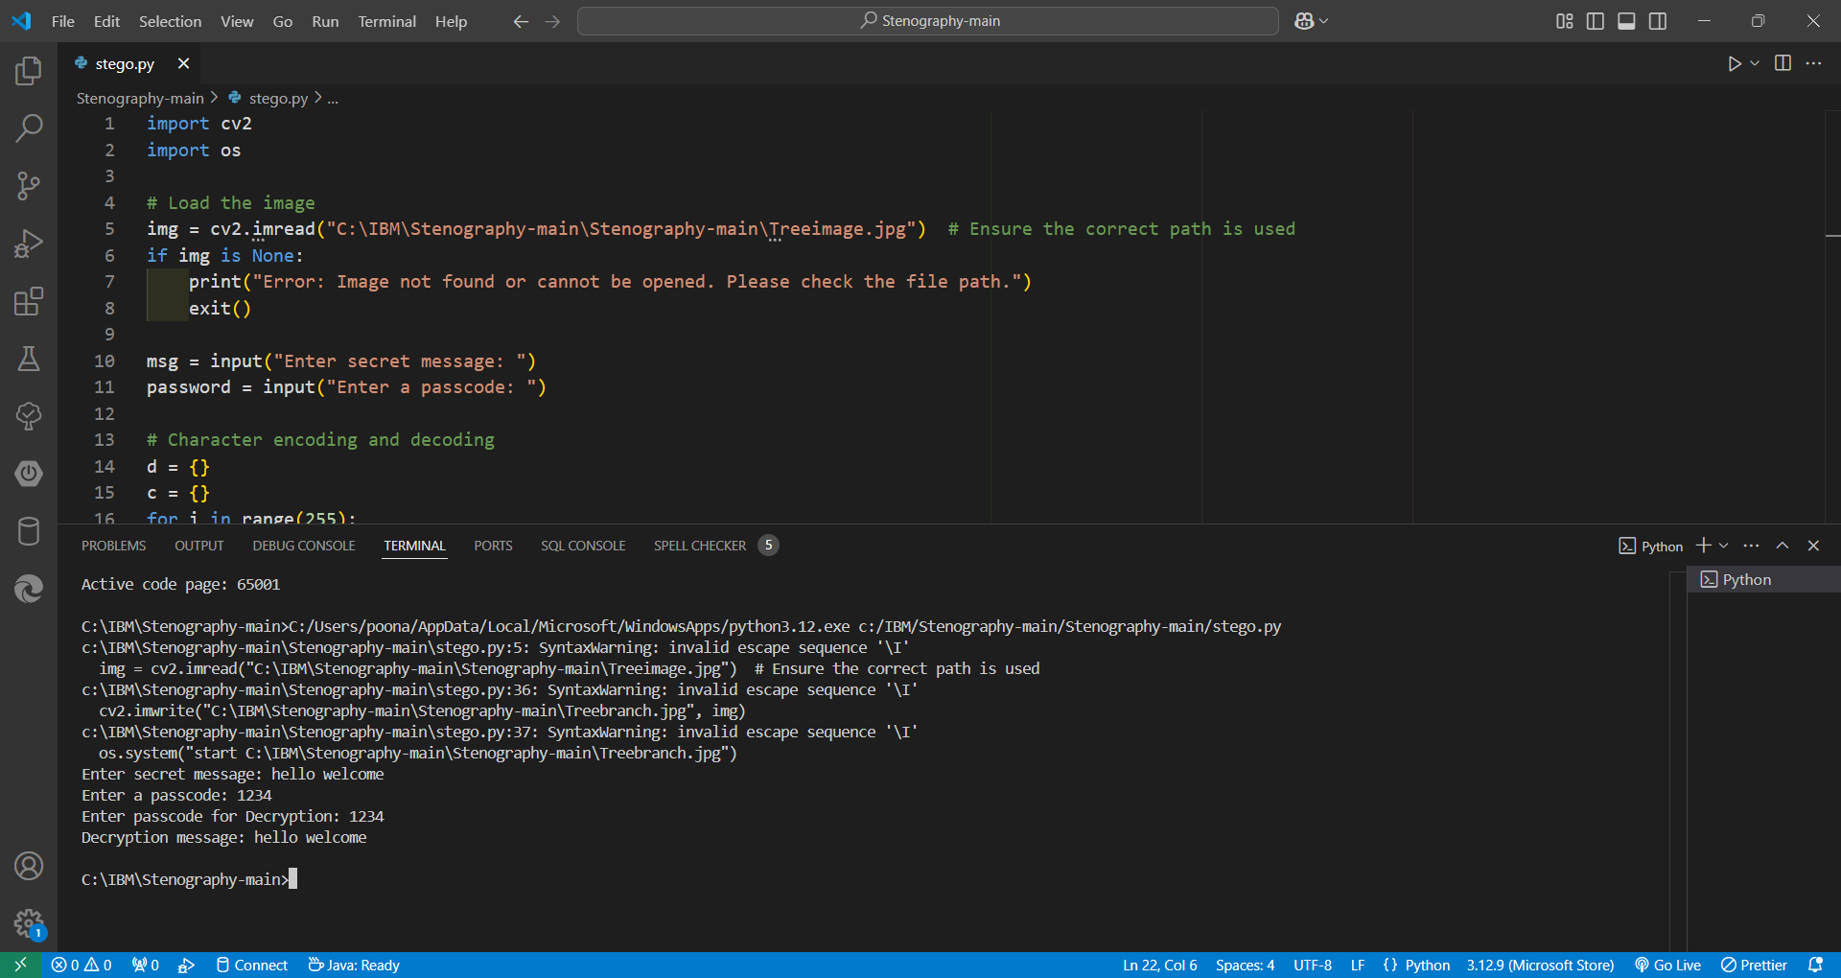
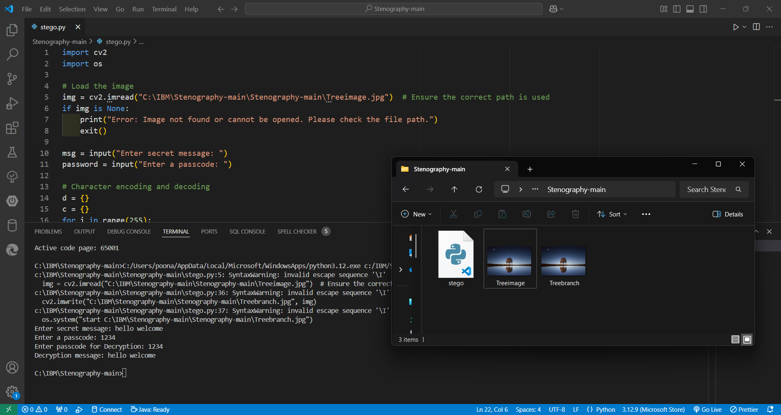

Slide 9
Conclusion
This project showcases the use of steganography to secure sensitive information by embedding it within an image. By using character encoding and password protection, it ensures that only the intended recipient can access the hidden message. The simplicity of the implementation makes it accessible for anyone interested in learning about digital security techniques.

Slide 10
GitHub Link
https://github.com/Poonam-2704/Steganography-With-Python-IBM-.git

Slide 11
Future scope(optional)
Encryption: The hidden message could be encrypted for an added layer of security before embedding in the image.
Compression: Implementing message compression techniques would allow larger messages to be hidden in images without significant changes to the image's appearance.
Multiple Layers of Data: The project could be expanded to hide multiple messages in a single image by using multiple layers or different color channels.
Cross-Platform Support: Extend the project to support images in different formats (e.g., PNG, BMP) and compatibility across different operating systems.

Slide 12
THANK YOU

